Slide 1
DO NOW
Be sure that you have a calculator today .
Turn in lab.
Pick up handout and look over it.

Slide 2
Density Block lab

Slide 3
DENSITY BLOCK LAB
PART A
Get your three blocks. Write the block number and color for each block in your data table IN INK.
Predict which of the three blocks will sink and which will float when placed in water. Record your predictions IN INK for each block in Data Table One. Remember that water has a density of 1.000 g/cm³.
Use the quart container already filled with water. Place each block in the container to test your predictions. Record your observations in the appropriate space in Data Table One.

Slide 4
DENSITY BLOCK LAB
PART B
Mass one of your blocks on the triple beam balance. Be sure it is DRY! Record the mass of the block in your data table.
Measure the length, width, and height of the block in centimeters. Measure to the hundredths place to have the correct number of significant digits. Record in your data table.
Repeat steps 3-4 for the other two blocks.

Slide 5
DENSITY BLOCK LAB
When you are done with your three blocks, put them back in your bin on the lab table for the next group.
Follow the directions on your lab sheet for the rest of the lab.

Slide 6
DENSITY BLOCK LAB
CALCULATIONS
Calculate the volume and density for the three blocks. Show your work in the space provided.

Slide 7
GOOD CALCULATIONS
Looking for:
Formulas
Work
Correct significant figures
No naked numbers
Correct answer

Slide 8
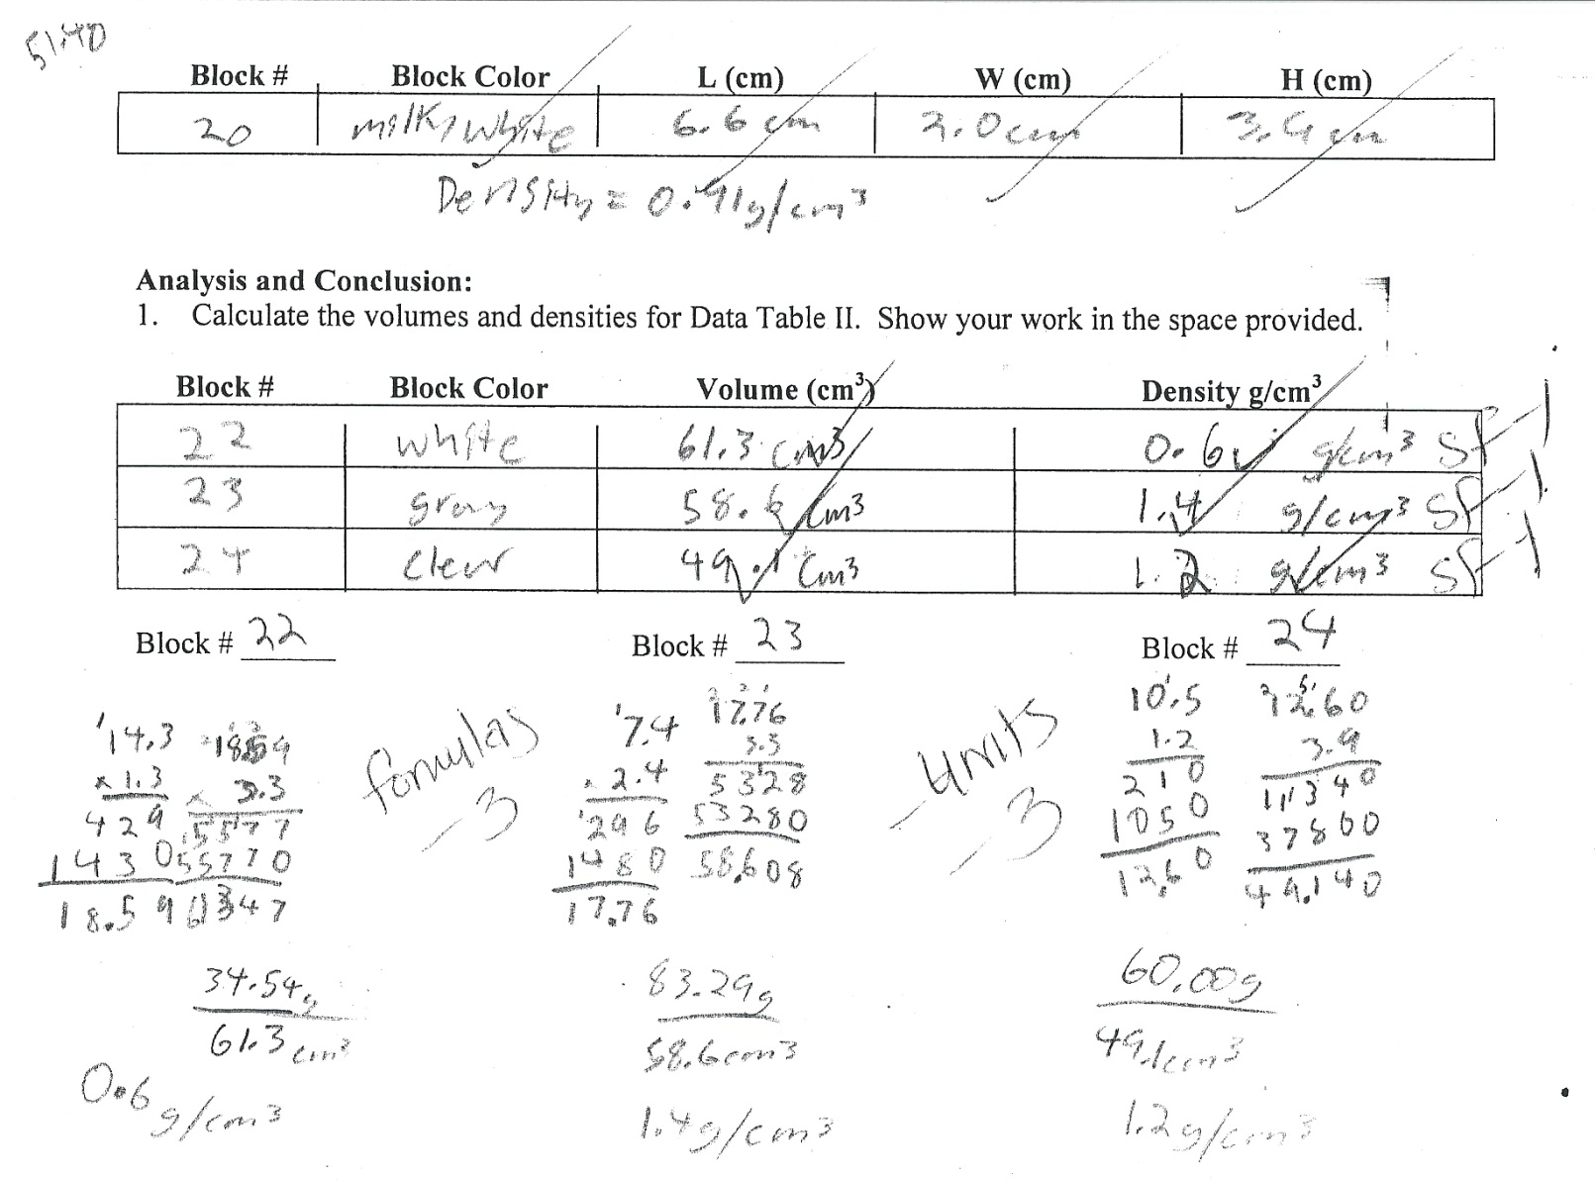
POOR CALCULATIONS

Slide 9
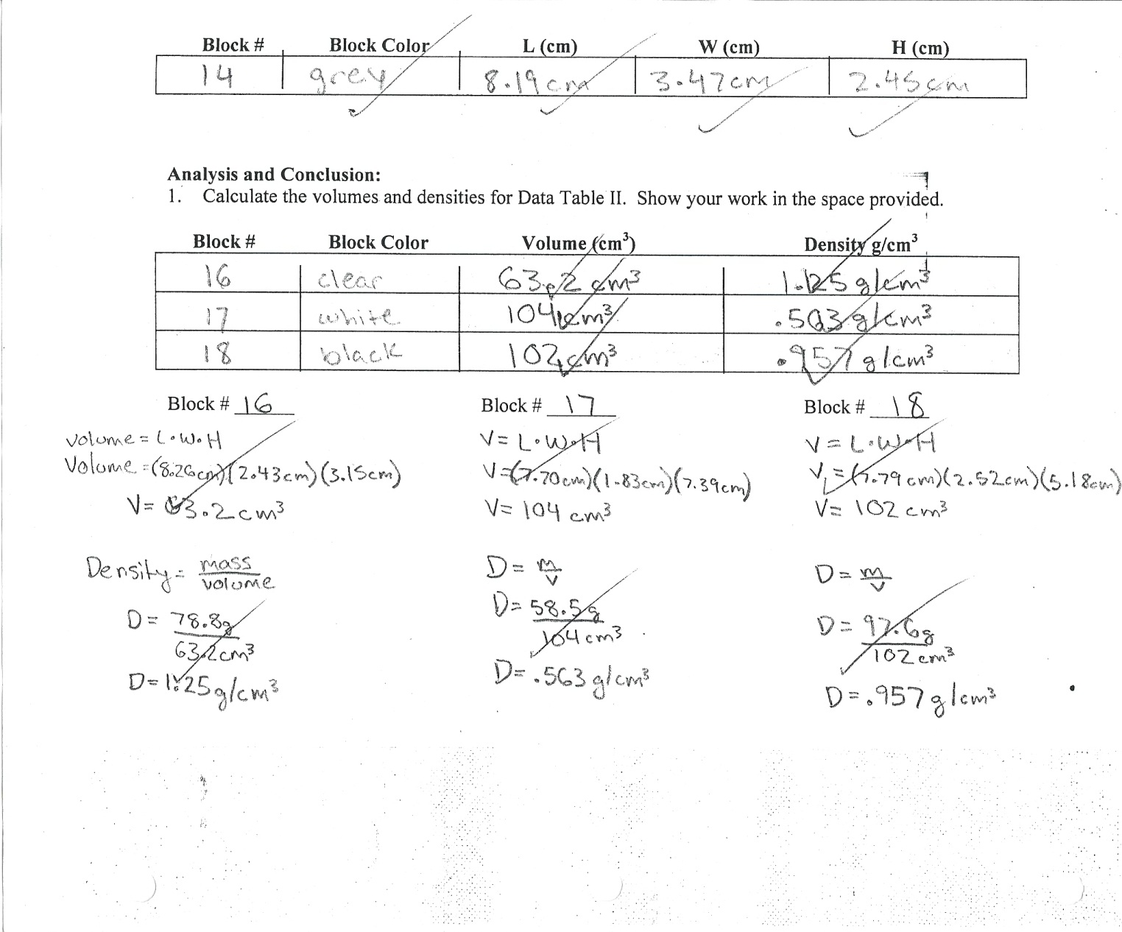
GOOD CALCULATIONS

Slide 10
DENSITY BLOCK LAB
From your teacher, get the density for one of your blocks. Have her write it in the table on your paper.
Determine the accuracy of your measurements by calculating the percent error for that block’s density.

Slide 11
DENSITY BLOCK LAB
If your percent error is over 5%, then you must re-measure your block for length, width, and height as well as mass. Recalculate density and then recalculate the percent error.
If you have less than 5% error, you are finished!

Slide 12
TRUE DENSITIES
Milky white - 0.91g/cm³
Black - 0.99 g/cm³
White - 0.54 g/cm³
Gray - 1.42 g/cm³
Colorless - 1.18 g/cm³

Slide 13
LAB DUE DATE
Density Block lab is due Wednesday
Each person turns in their own sheet for the lab.

Slide 14
QUESTIONS?

Slide 15
REMEMBER
Write the information for Data Table One on your lab sheet IN INK.
Write the information for Data Table Two in your logbook first or lose your lab sheet.

