Slide 1
DO NOW
Pick up notes sheet.
Turn in Density of the Earth Lab

Slide 2
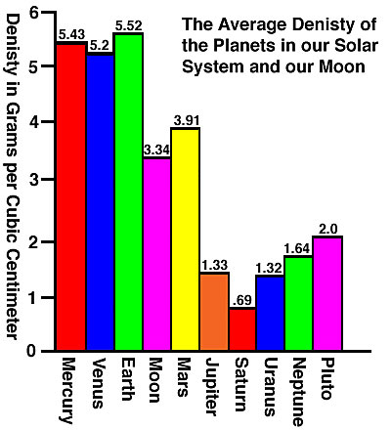
REVIEW
What conclusions can we make about each of the planets in our solar system based on it’s density?

Slide 3
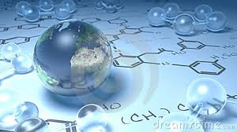
EARTH MATTER…
The Atom and Periodic Table

Slide 4
Atoms (elements)
Compounds
Minerals and Organic Compounds
Rocks Living Things
Earth Biosphere

Slide 5
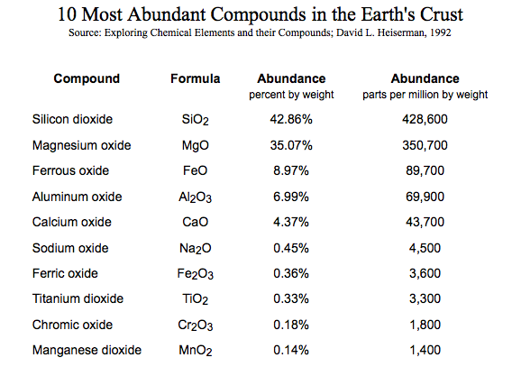
THE EARTH’S MAKE-UP
Most common compounds in the Earth are:
Silicon dioxide, 43%
Magnesium oxide, 35%

Slide 6
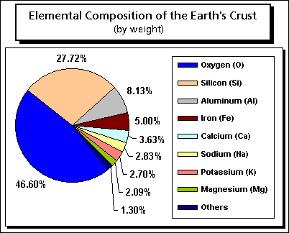
THE EARTH’S MAKE-UP
Most common elements in the Earth are:
Oxygen 47%
Silicon, 28%
Aluminum, 8%

Slide 7
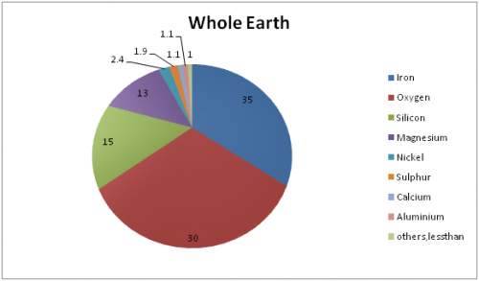
EARTH’S ELEMENTS

Slide 8
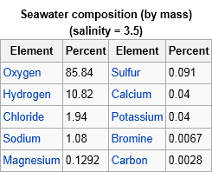
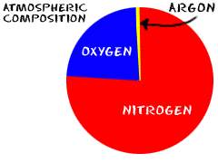
EARTH’S ELEMENTS

Slide 9
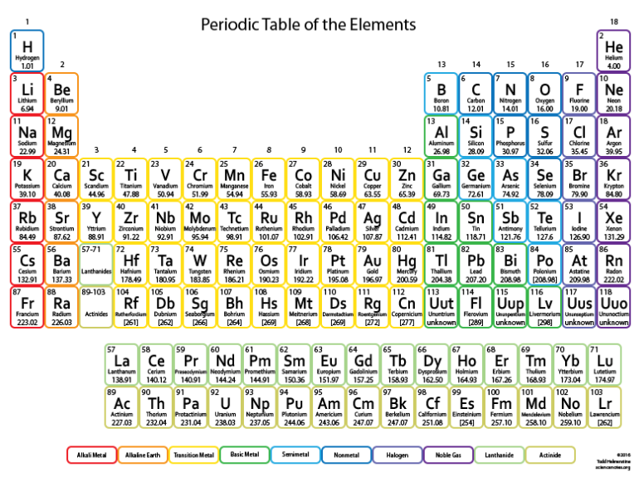
THE PERIODIC TABLE

Slide 10
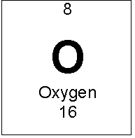
ATOMS
Proton: positive charge (+)
Neutron: neutral charge (o)
Electron: negative charge (-)
Nucleus: protons + neutrons

Slide 11
ATOMS
Atomic Number – number of protons in an atom’s nucleus.
Atomic Mass – average of the masses of the isotopes of the element.

Slide 12
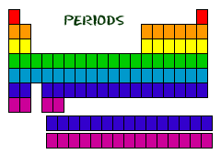
THE PERIODIC TABLE
DEFINITION: Periods are the horizontal rows of elements.
ADDITIONAL INFORMATION: Elements in each period have the same number of electron energy levels.

Slide 13
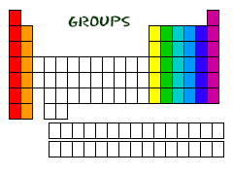
THE PERIODIC TABLE
DEFINITION: The vertical columns of elements.
ADDITIONAL INFORMATION: Elements in each group have the same number of electrons in the outer energy level and they have similar characteristics.

Slide 14
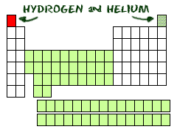
SPECIAL ELEMENTS
Hydrogen (H) and helium (He) are special elements.
Hydrogen has unique characteristics and is a gas.
Helium outer energy level is full, but only has two electrons; it is also a gas.

Slide 15
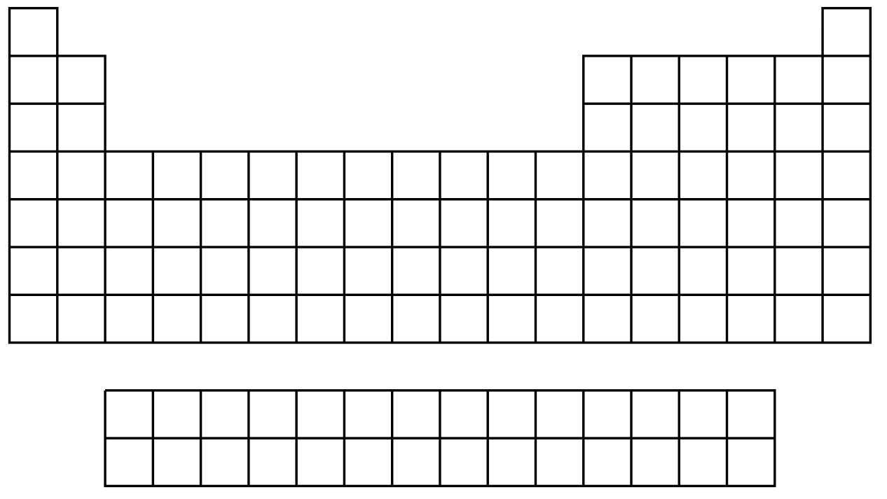
SPECIAL ELEMENTS
Write in H for hydrogen and He for helium on your blank table.

Slide 16
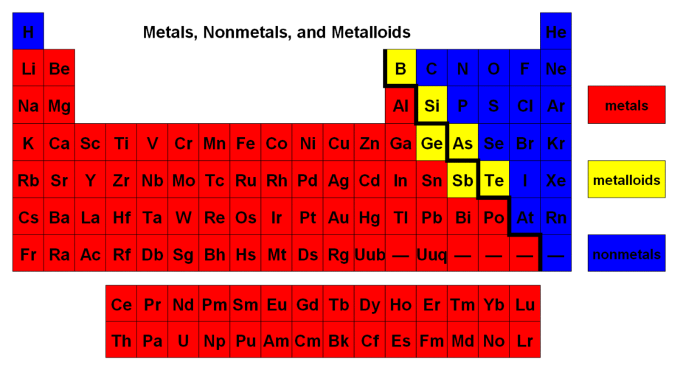
SPECIAL ELEMENTS

Slide 17
SPECIAL ELEMENTS
Draw in the staircase.
Indicate which side metals are on.
Most of the elements on the periodic table are metals.

Slide 18
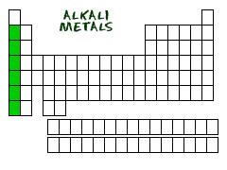
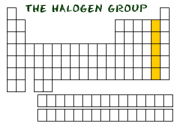
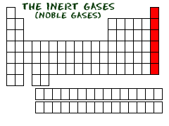
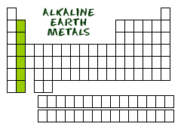
SOME FAMILY GROUPS
All groups have:
The same number of valence (outer level) electrons.
They share similar characteristics.
They form similar charged atoms.

Slide 19
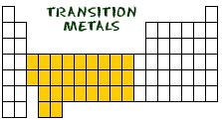
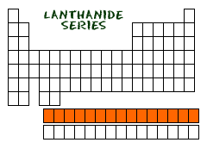
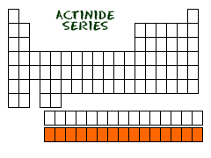
SOME FAMILY GROUPS
Transition metals can have more than eight electrons in their outer energy level.
The Lanthanide series can be found naturally on Earth.
The Actinide series are all radioactive and some are not found in nature.

Slide 20
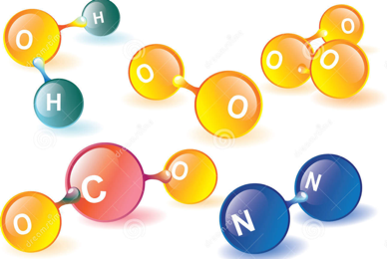
COMBINING ELEMENTS
1. Elements combine to form compounds.
2. The single unit of a compound is a molecule.

Slide 21
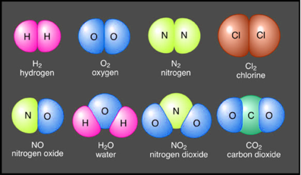
COMBINING THE ELEMENTS
3. Atoms will combine in ways that make them more stable.
4. Atoms will combine with elements that will give them the electrons they need.

Slide 22
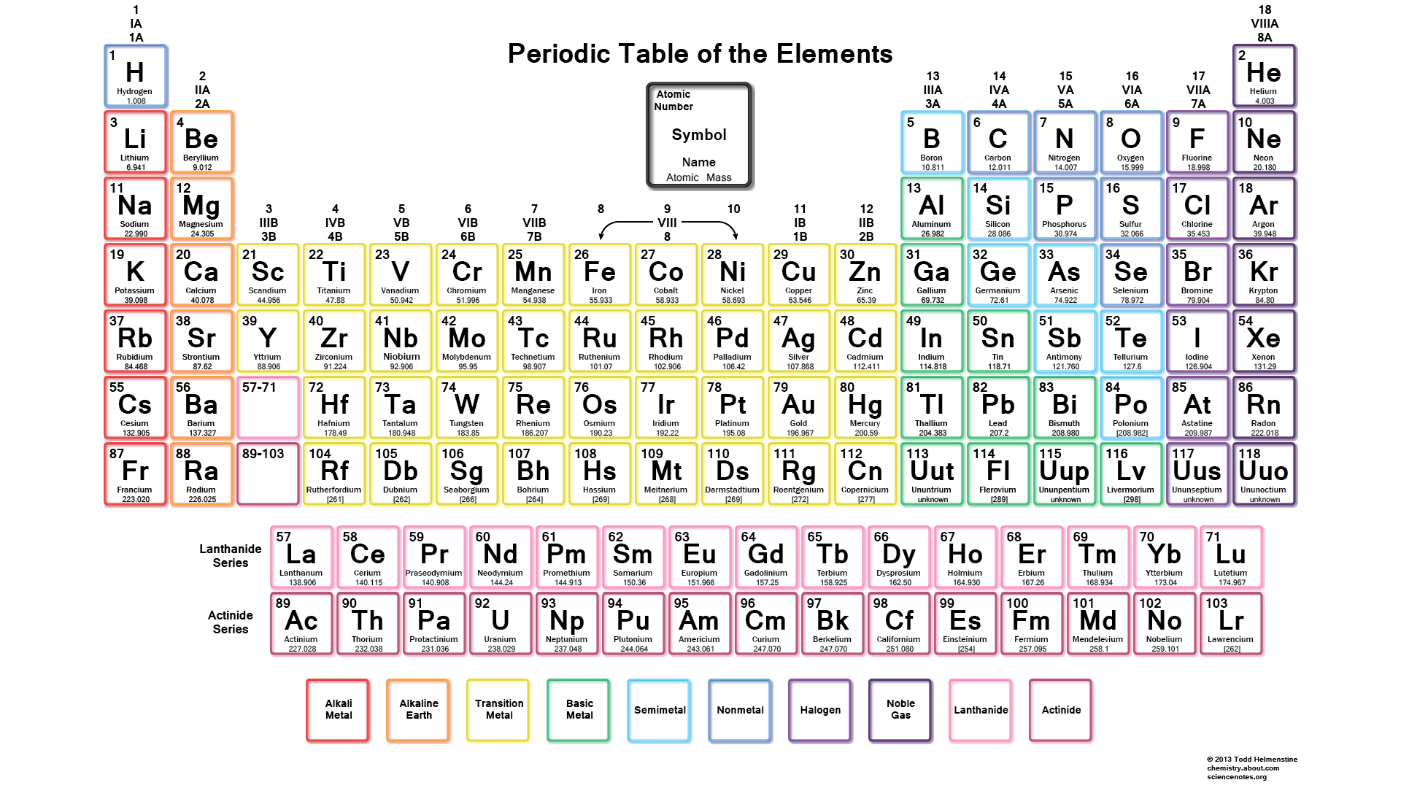
PERIODIC TABLE: CLUES
TO COMBINING ELEMENTS

Slide 23
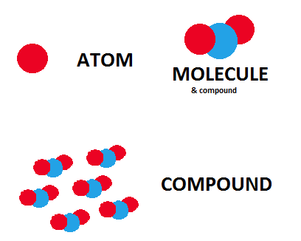
REVIEW
What is the difference between an atom, molecule and compound?

Slide 24
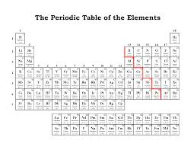
ACTIVITY:
Color the Periodic Table according to the directions
The Earth Science book or the Physical Science book under your desk has a periodic table on the inside back cover to help you.

