Slide 1
DO NOW

Slide 2
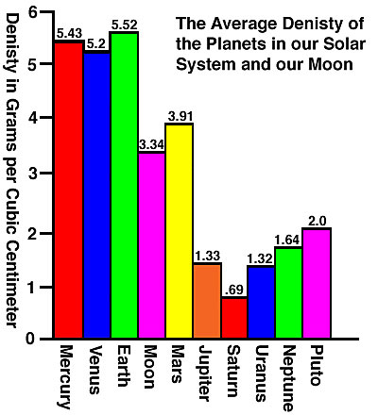
LOOKING BACK…
How close were you in calculating the density of Earth? Which group was the closest? (Least percent error?)
What conclusions can we make about each of the planets in our solar system based on it’s density?

Slide 3
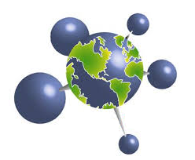
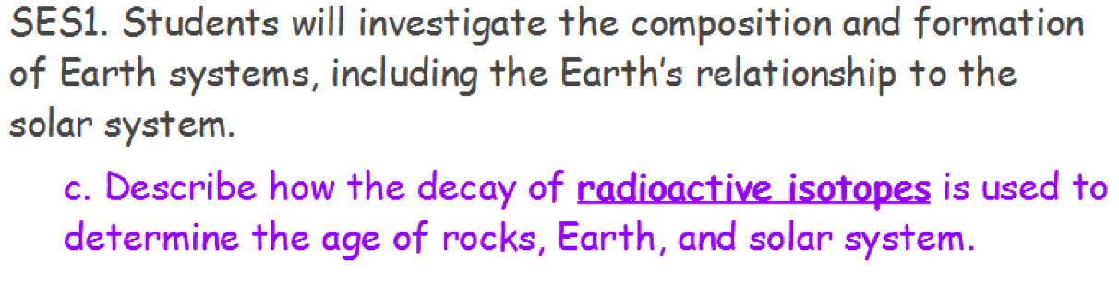
CHEMISTRY and EARTH SCIENCE

Slide 4
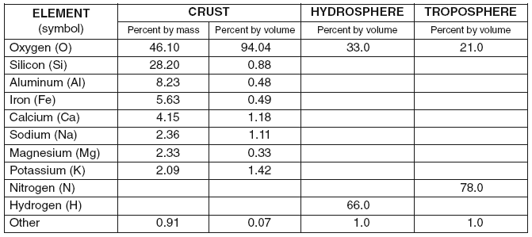
COMMON ELEMENTS IN EARTH’S SYSTEMS
Atoms!

Slide 5

A REVIEW
INSIDE THE ATOM
WHAT DO WE KNOW?

Slide 6
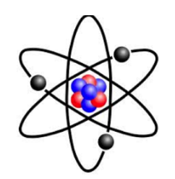
PARTS OF THE ATOM
Name | Charge | Mass | Location
Proton | + 1 | 1 amu | Nucleus
Neutron | 0 | 1 amu | Nucleus
Electron | -1 | 0.00054 amu | Electron Cloud

Slide 7

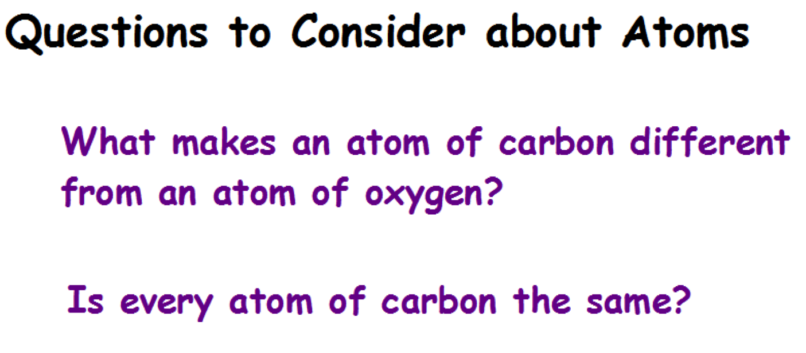

Slide 8
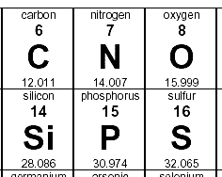
REVIEW
Atomic number
  Smaller number on periodic table.
  Periodic table is set up in increasing atomic number order.
  Number of protons.
Atomic mass
  Larger number on the periodic table.
  Is an average of the element’s isotopes.
  Unit – amu (atomic mass unit).
Mass number
  Take the atomic mass (bigger number on table) and round to a whole number.
  Equals protons + neutrons.

Slide 9
COUNTING PROTONS AND NEUTRONS
Look up the element on the periodic table.
  Number of Protons = Atomic number
  Number of Neutrons = Mass number minus the number of protons.
  Number of Electrons = number of protons

Slide 10

RADIOACTIVITY
Radioactivity starts in the nucleus.
Positive charges (protons) are attracted to negative charges (electrons)
Positive charges are NOT attracted to other positive charges.
Negative charges are NOT attracted to other negative charges.
Certain combinations of protons and neutrons are stable – they want to stay together.
Radioactive isotopes are NOT stable – they want to break apart.

Slide 11
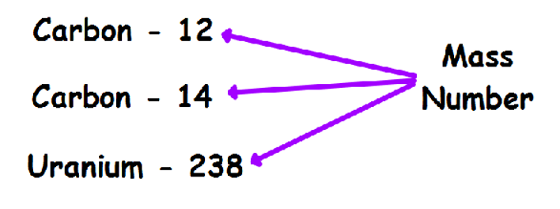
ISOTOPES
Same element, different mass
  Same number of protons, different number of neutrons.
  Use the mass number to distinguish the mass.

Slide 12
PRACTICE
How many protons and neutrons?
  Carbon-12?
  Carbon-14
  Phosphorus-31
  Remember # protons = atomic number
  # neutrons – mass number – atomic number

Slide 13
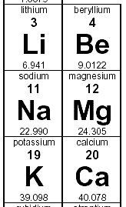
PRACTICE
How many protons and neutrons?
  Beryllium-9
  Sodium-21
  Remember # protons = atomic number
  # neutrons – mass number – atomic number

Slide 14

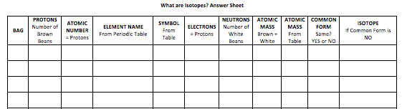
WHAT ARE ISOTOPES? LAB

Slide 15
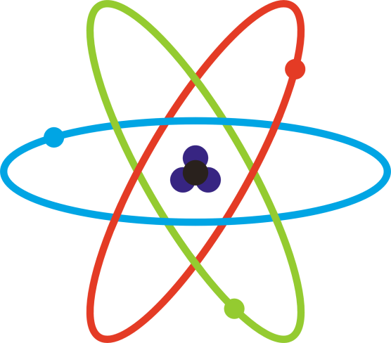
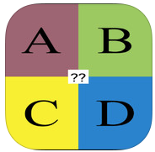
WHAT PART OF THE ATOM…
Has a positive charge?
Has a negative charge?
Has no charge?
Determines what element it is?
Electron
Proton
Neutron
Deutron

