Slide 1
DO NOW
Pick up notes sheets.

Slide 2
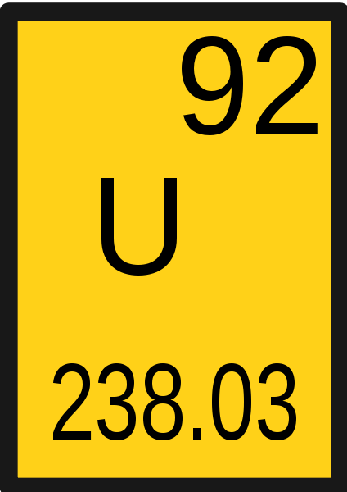
LOOKING BACK…
How many protons, neutrons, and electrons are in the nucleus of a Uranium 235 atom?
p⁺
nº
e⁻

Slide 3
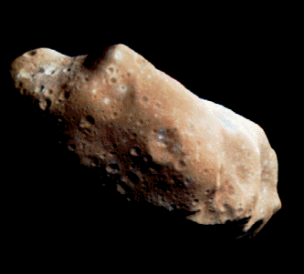
RADIOMETRIC DATING
SES1c: Describe how the decay of radioactive isotopes is used to determine the age of rocks, Earth, and solar system.

Slide 4
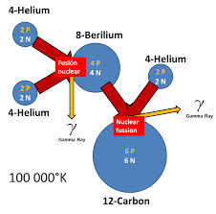
FUSION: ELEMENTS FORMED IN STARS
Universe is 13.7 billion years old.
Original composition was Hydrogen and Helium only.
Heavier elements were formed by nuclear fusion in stars.
  Smashes smaller atoms together to make larger atoms.

Slide 5
FUSION: ELEMENTS FORMED IN STARS
Fusion in stars makes elements up to Iron (#26).
Temperature greater than 50 million degrees Celsius required for fusion to start.
Supernova explosions create heavier elements over #26.

Slide 6
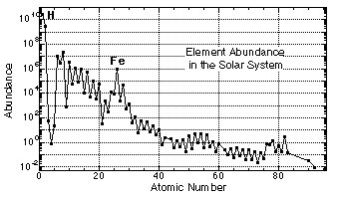
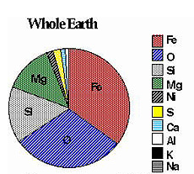
ABUNDANCE OF THE ELEMENTS

Slide 7
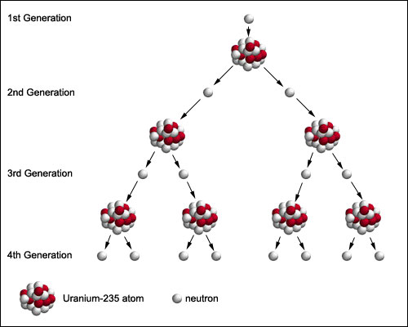
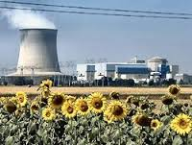
FISSION: BREAKING UP ATOMS
Splitting larger atoms to make smaller ones.
Created by a neutron being absorbed by a nucleus.
Happens in nuclear power plants.

Slide 8
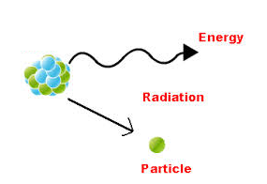
RADIOACTIVE DECAY
When the nucleus of atom is unstable and breaks apart releasing energy.
Smaller atoms form from bigger ones.
A natural process that releases energy.
Radioactive decay occurs at a constant rate and is random.
So what?

Slide 9

RADIOACTIVE DECAY
We can measure time with radioactivity. A half-life is the time it takes for half of a radioactive sample to change into a more stable atom.
Nothing can change the half-life time.
Different isotopes have different half-lives.
Radiometric Dating of Rocks reveals Earth is
4.6 BILLION years old!

Slide 10
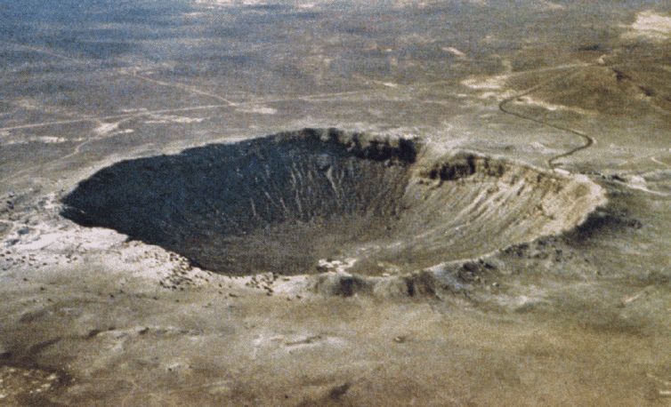
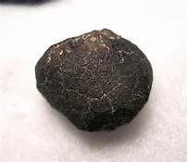
METEORITES TELL STORIES
Rocks fall to Earth and some are from asteroids.
Asteroids are original rock from the formation of the Solar System – they never became part of a planet.
Once they fall to Earth, they are called meteorites. They are the oldest rocks found.
Allende meteorite is 4.563 billion years old

Slide 11
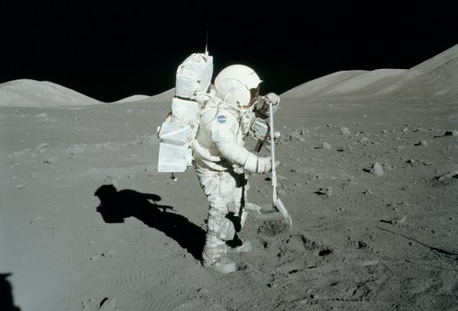
METEORITES TELL STORIES
These provide clues to the early Solar System and its formation.
Radiometric dating is used to determine age.
Chemical composition tells us what material was in the original formation.
Moon rocks brought back from Apollo missions also are approximately 4.5 billion years old.

Slide 12
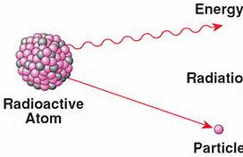
HOW DO WE DATE THEM?
Radiometric Dating using Radioactive Decay
Unstable atoms that eject particles and the atom loses energy.
New atoms are more stable.

Slide 13
HOW DO WE DATE THEM?
Process of dating involves comparing ratios of unstable atoms to stable atoms in a sample.
Only works for certain types of rocks
The rocks must contain radioactive isotopes that have half-lives that can be measured.

Slide 14
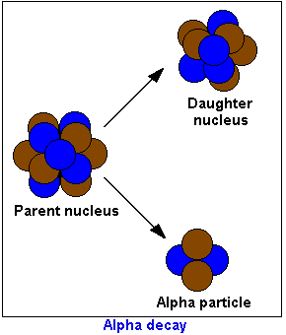
ALPHA PARTICLE RADIATION
Made of two neutrons and two protons.
Ejected from the nucleus of an atom.
The daughter nucleus becomes a different element.

Slide 15
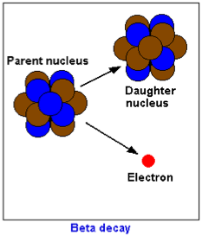
BETA PARTICLE RADIATION
an electron is emitted from the nucleus of a radioactive atom.
It is the result of a neutron splitting into positive and negative particles and ejecting an electron at high speeds.
Because the neutron has become a proton, the atom is now a different element.

Slide 16
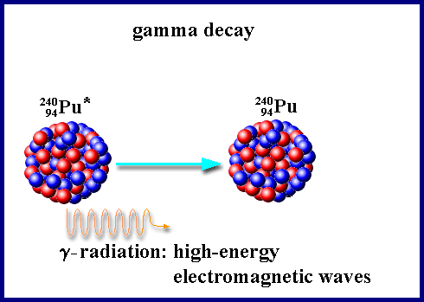
GAMMA RADIATION
No change in mass.
When an atom ejects an alpha or beta particle, the nucleus is often left in an over-energized state.
Excess energy is released as a gamma photon - a form of electromagnetic radiation.
Extremely high energy radiation and dangerous.

Slide 17
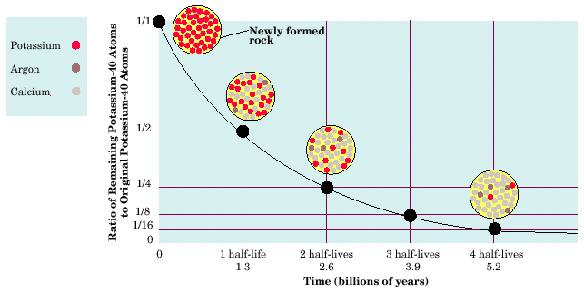
HALF-LIFE
Half-life describes the time it takes for half of the atoms in a sample to change, and half to remain the same. Can accurately measure ABSOLUTE AGE of a rock.

Slide 18
HALF-LIFE
When a radioactive nucleus changes, the remaining nucleus (and atom) is not the same as it was - it changed its identity.
  Shorter half-life = less stable
  As a radioactive isotope decays, the amount of radiation decreases but the half-life of the sample remains the same.

Slide 19
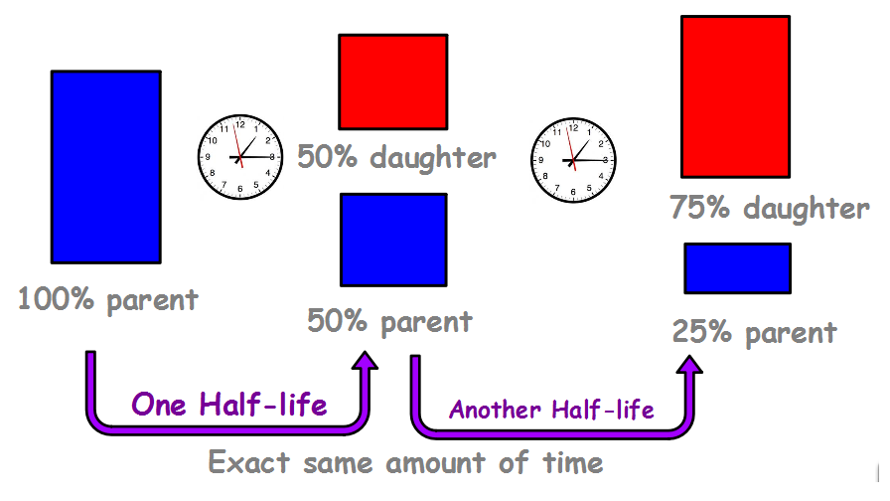
HALF-LIFE
What Happens Next?

Slide 20
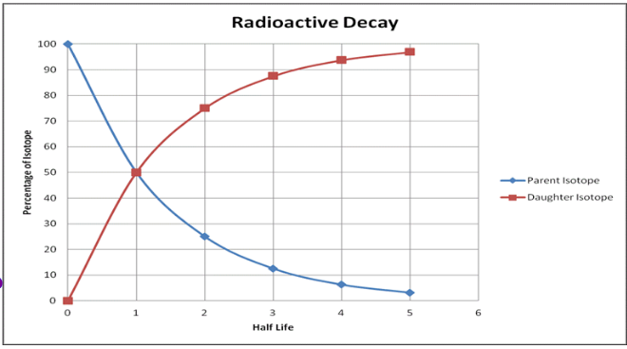
GRAPHING DECAY
What is on the X axis?
What is on the Y axis?
What is the blue line?
What is the red line?

Slide 21
TELLING TIME WITH THE GRAPH
Sample A is found to have 25% parent and 75% daughter. How many half-lives have gone by?

Slide 22
TELLING TIME WITH THE GRAPH
Sample B has about 6% of the original radioactive parent left. How many half-lives have gone by?

Slide 23
TELLING TIME WITH THE GRAPH
Challenge: How many half-lives will it take to reduce the amount of radioactive parent to 10%?

Slide 24
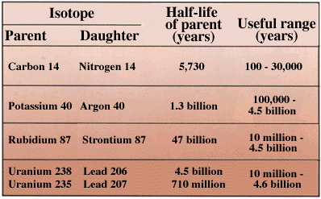
RADIOMETRIC DATING
A sample containing carbon -14 has been through 2 half lives. How old is the sample?

Slide 25
RADIOMETRIC DATING
A mineral sample was found to contain uranium - 238. Analysis shows it has been through 1 half life. How old is the sample?

Slide 26
RADIOMETRIC DATING
Challenge: A rock sample was analyzed for potassium - 40. In the sample, there was 10 micrograms of potassium - 40 and 30 micrograms of argon - 40. How old is the rock sample?

Slide 27
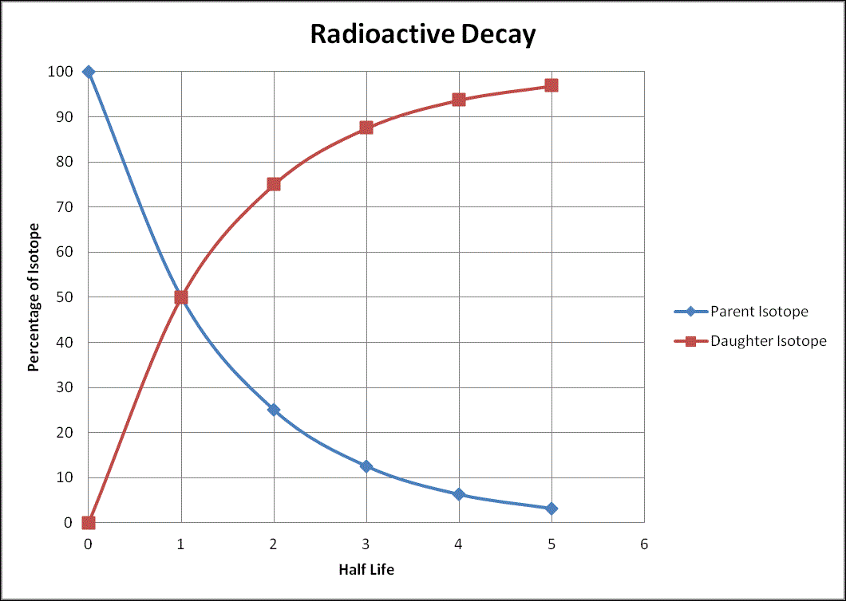

REVIEW…
A rock sample was aged using radiometric dating. Scientists found the rock to have approximately 88% of the stable daughter isotope and 12% of the radioactive parent isotope.
How many half-lives have gone by for this rock sample?
      A. 1
      B. 2
      C. 3
      D. 4

Slide 28
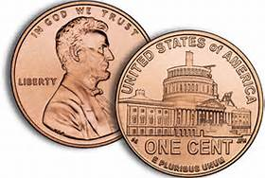
ACTIVITIES
Pennium Lab – discover the half-life of Pennium
Radioactive members of this isotope family are easily distinguished via a head on the front surface.
1. Collect a cup with 100 Pennium Isotopes.
2. Cover and shake/rattle the cup.
3. Pour your atoms onto your white paper. You will see that several of the previously radioactive atoms in the group have decayed, and the head is no longer visible. This means that they are now considered "safe" since they are no longer radioactive! Count them and put them to the side in the cup marked “safe” so you may determine the number of atoms that have decayed in that particular shake. Record the number of safe Pennium atoms that you have on the data table below.
4. Now you need to continue this pattern until no more radioactive members remain. Remember to record the number of decayed atoms after each round.

