Slide 1
DO NOW
Do I have your signed syllabus?
Do I have your Student Information Sheet?

Slide 2
HOUSEKEEPING
Pencil sharpeners, stapler, tape, hole punch
Recycling
Kleenex, hand sanitizer, anti-bacterial soap
Lab partners. Set for the semester

Slide 3
LAB SAFETY AND EQUIPMENT
The How-to’s and What-for’s of the chemistry laboratory

Slide 4

LAB SAFETY EQUIPMENT
Goggles
Eye wash
Emergency shower
First aid kit
Fire extinguisher
Fire blanket
Broken Glass box
Apron

Slide 5
LAB SAFETY EQUIPMENT
Know the location and purpose of each.

Slide 6
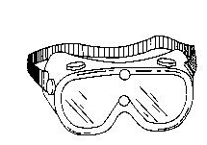
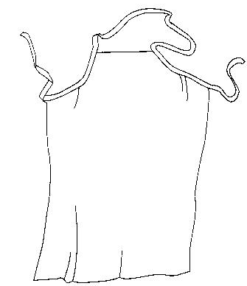
SAFETY EQUIPMENT
These should be worn to protect yourself from potential injuries.
Wear this if you want to.
ALWAYS WEAR THESE!

Slide 7
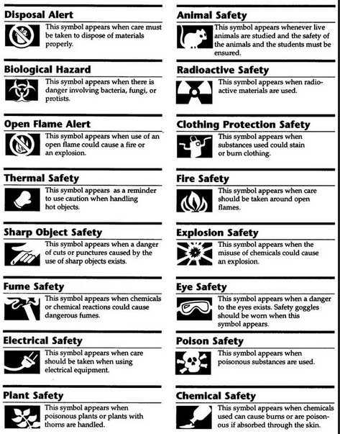
CHEMICAL SYMBOLS

Slide 8
LAB SAFETY RULES
There are many rules you should be familiar with. Every lab reminds you of the safety precautions before you start.
#1 Rule
FOLLOW DIRECTIONS AND
TEACHER INSTRUCTIONS!

Slide 9
LAB SAFETY RULES
2. Keep goggles on at all times. No exceptions. (if you are caught with them off, 10 points off your lab performance grade – added to the person who caught you.)
3. Perform only the activities that are authorized by the teacher.
4. Handle laboratory equipment only when instructed to do so.
5. Report all accidents to the teacher immediately.
6. Do not mix or taste chemicals for the fun of it.
7. Always clean up your workspace when you are finished.

Slide 10
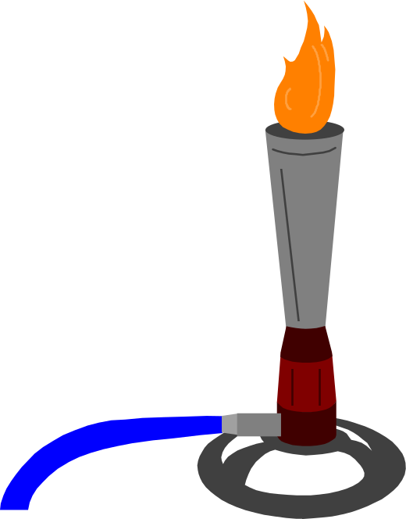
LAB SAFETY CONTRACT
Read through the laboratory safety contract.
Take home with signature sheet.
Add medical information and indicate if you wear contacts.
Have your parents sign it and give an emergency number.
Due back signed on Friday.

Slide 11
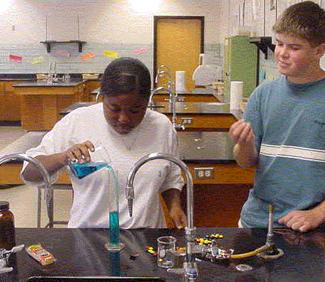
LAB SAFETY
Look at this photo:
1. Find two good lab techniques
2. Find two poor techniques.
Notes:
Two students are at lab desk. Bunsen burner is on at one side, not being used. The students do not have goggles on. There is food on the lab desk and one of the students is currently eating while pouring a chemical. The desk is relatively clean and the chemical are labeled.

Slide 12
No goggles
Food in lab
Top on bottle
Uncluttered desk

Slide 13
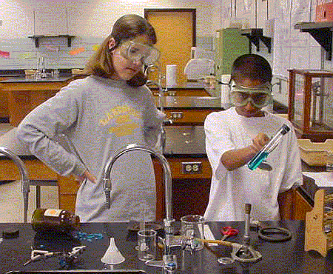
LAB SAFETY
Look at this photo:
1. Find three good lab techniques
2. Find three poor techniques.
Notes:
Two students, goggles on, heating water in a capped test tube over a Bunsen burner. Hair on one lab partner is down and dangling. Test tube is pointed away from others. Desk is cluttered and one of the chemical bottles has spilled on the counter.

Slide 14
Goggles on
Hair down
Cap on test tube
Pointed away
Spilled chemicals
Cluttered desk

Slide 15
PERFORMING A LAB
Plan ahead - read the lab twice.
Gather and organize equipment.
Follow the procedure step by step.
Record ALL observations and use the proper units of measurement.
Clean up, wash hands, put equipment back where it came from.
Answer the questions that go with the lab in complete sentences with no misspellings.

Slide 16


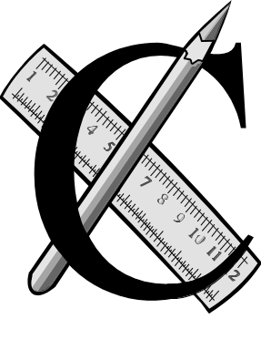
PERFORMING A LAB
Answer Analysis and Conclusion questions. Use complete sentences.
Do not use white-out ever.
There should be no misspellings on the lab sheet.

Slide 17
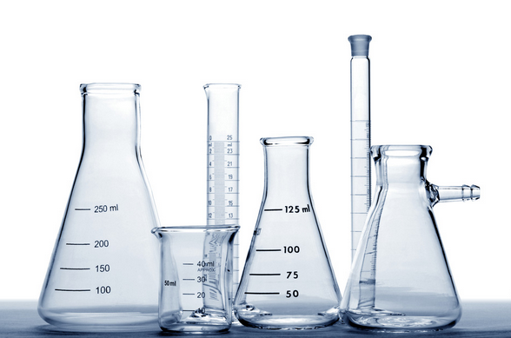
LAB EQUIPMENT

Slide 18
LAB EQUIPMENT
Sitting at your desk, write down the names of as many pieces of lab equipment as you can on the handout, front and back.
Then get up and walk around to the lab desks and write down the names of the ones you did not know.

Slide 19

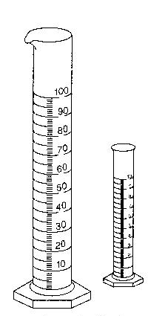
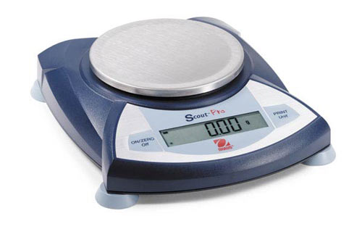
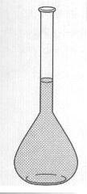
Accurate Measurements
These pieces of equipment provide accurate measurements when read properly.

Slide 20
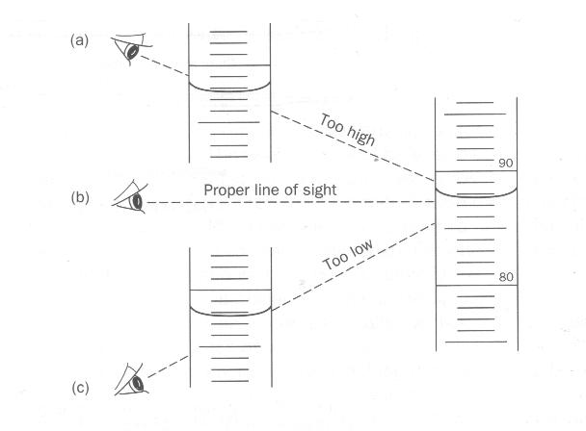
How to read a graduated cylinder
Your eye line should be even with the BOTTOM of the meniscus (curved surface of a liquid).

Slide 21
How to use an electronic balance
Always carry the balance with two hands.
Turn the balance on.
Wait for it to show 0.00.
Make sure the units is grams.
It is does not say 0.00, hit the “zero” or “tare” button to get it to go back to zero.
Please DO NOT push down on the pan ever. Maximum mass is 200 or 250 grams.

Slide 22
How to use a triple beam balance
Zero the balance - slide back all the mass poises so that the pointer is right at the zero line. You might need to turn the zero adjustment knob to get it right at the line.
Set object to be massed on pan.
Slide the mass poises until the pointer is at zero again. Start with the two heavier poises and then use the lightest one to do the fine tuning. Be sure the poises are in a groove.
To read the mass of an object in grams, add up the number that each poise is at when the pointer zeroes.

Slide 23
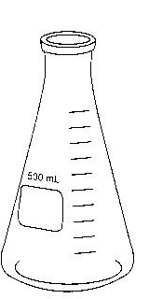
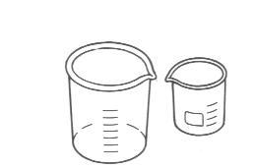
Approximate Measurements
These pieces of equipment do not provide accurate measurements but can be used for approximate measurements.

Slide 24
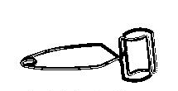



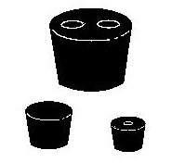


Other Equipment

Slide 25
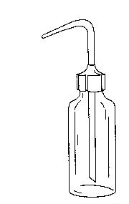
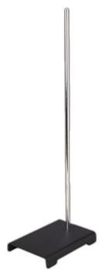

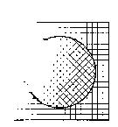
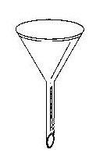
Other Equipment

Slide 26
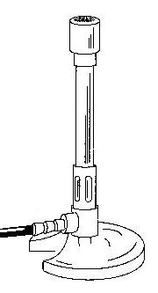
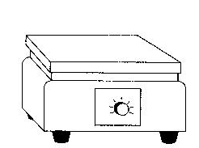
Equipment used for heating

Slide 27
TO DO
Put Lab Equipment sheet in your notebook for reference.
First Day Stations due tomorrow
Signed safety contract due Friday.

