Slide 1
DO NOW
Pick up three handouts – one is your notes.
Turn in your homework handout.

Slide 2
CLASSES OF MATTER
Matter can be classified as heterogeneous or homogenous.
HOMOGENEOUS
All parts of the substance are identical.
This includes elements, compounds, and solutions.
HETEROGENEOUS
All parts of the substance are NOT identical.
This includes mixtures.

Slide 3
MATTER
Homogeneous
Pure Substances
Solutions
Heterogeneous
Mixtures
Elements
Compounds

Slide 4
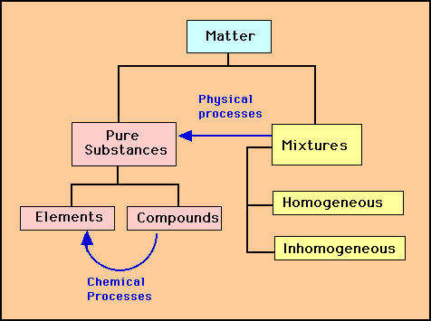
Heterogeneous

Slide 5
ELEMENT
the simplest pure substance.
cannot be changed into anything simpler through heat or a chemical reaction.
consist of all the same atoms (the building blocks of matter).
all parts are identical.
Examples: iron (Fe), copper (Cu), mercury (Hg)

Slide 6
COMPOUND
made up of more than one element; any combination of two or more different kinds of elements.
The elements are chemically combined.
Can be broken down by heating or chemical reaction.
The properties of compounds are different from those of the elements that make them up.
All parts are identical.
There are a fixed number of components in compounds.
Examples: water, salt, sugar, and DNA.

Slide 7
SOLUTIONS AND MIXTURES
There are three important properties of mixtures and solutions:
May change physical appearance
The parts that make it up can be present in any amount - the parts are not in fixed amounts.
Can be separated by simple physical means using methods based on physical properties. Separation can occur by filtration, distillation, crystallization, or chromatography.

Slide 8
SEPARATION TECHNIQUES
Filtration - Using a porous barrier to separate a solid from a liquid in a heterogeneous mixture.
Distillation - A way to separate homogeneous mixtures. Based on differences in boiling points of the substances involved. Boil off the lowest BP liquid first, etc.
Crystallization - The formation of pure solid particles of a substance from a solution containing the dissolved substance.
Chromatography - Separates the components of a mixture on the basis of the tendency of each to travel across the surface of another material.

Slide 9
PRACTICE
Describe a method that could be used to separate each of the following mixtures:
a. iron filings and sand c. the components of ink
b. sand and salt d. helium and oxygen gases

Slide 10
SOLUTIONS AND MIXTURES
SOLUTION
two or more substances mixed together.
is physically combined, but not chemically combined.
Each substance in a solution keeps its own separate identity and most of its own properties.
All parts are identical.
Parts cannot be separated by filtration.
Examples: sea water, air, coffee, brass
MIXTURE
two or more substances mixed together.
is physically combined, but not chemically combined.
Each substance in a mixture keeps its own separate identity and most of its own properties.
All parts are NOT identical.
Can be separated by filtration.
Examples: soil, raisin bran cereal, pizza

Slide 11
HOMEWORK
The Visual Organizer and A Classification Scheme are due Wednesday.

