Slide 1
DO NOW
Get out Factor Label notes and work on the back.
Turn in your signed Safety Contract.
Prepare for Metric Quiz – you need a calculator and something to write with.

Slide 2
FACTOR LABEL
1. kilo-, hecto-, deka-, deci-, centi-, milli-
2. 5mm 1 dam = 0.0005dam 35cm 1 km = 0.00035km
10000mm 100000cm
0.12m 100cm = 12cm
1m
19km 10000dm = 190000dm
1km
0.4m 10hm = 4hm
1m

Slide 3
METRIC QUIZ
Write on the quiz.
Be sure to show work for the two Factor Label problems (#5 and #6)
Turn it in when completed and sit SILENTLY until all are finished.

Slide 4
PERCENT ERROR,
ACCURACY, AND
PRECISION
Or how to tell if you are any good at data collection…

Slide 5
PERCENT ERROR
Calculation of percent error is one way to make a distinction between an observed value and a true or literature value.
Percent error can be used to describe the accuracy of results of laboratory investigations if a generally accepted (true or literature value) is known.
Percent error is always positive. Take the absolute value.
% error = [observed value - true/literature value] x 100
true/literature value

Slide 6
PRACTICE
1. The density of mercury is known to be 13.8 g/cm³. Results of an experiment give that density to be 14.2 g/cm³. Calculate the percent error.

Slide 7
PRACTICE
2. The volume of a rectangular solid is known to be 556 cm³. A student takes the following measurements for the dimensions of the rectangular solid:
8.34 cm 6.19 cm 10.42 cm
a. What volume is calculated for the rectangular solid from these measurements?
b. What is the percent error of these results?

Slide 8
QUESTIONS?

Slide 9
ACCURACY AND PRECISION
When taking measurements during a lab, you may need to know if your data is reliable. There are two ways to check reliability.
Precision: One way is to repeat the measurement several times. A reliable result will give the same measurement time after time. This is how close a set of measurements for a quantity are to each other, but still can be regardless of correctness.
Accuracy: This is how close a measurement is to the correct (standard, literature) value for the quantity.

Slide 10
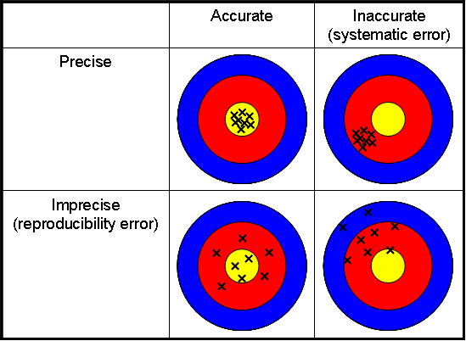

Slide 11
PRACTICE
Two students massed the same sample on two different laboratory balances. The results were as follows:
Balance A 12.11 g 12.09 g Balance B 12.1324 g 12.1322 g
Which balance is more precise?
If the mass of the sample is actually 12.1 g, which is more accurate?

Slide 12
ACTIVITY
Estimate the length of the coffee stirrer. Write it down.
FIRST RULER: measure the length of the coffee stirrer. Record the length
SECOND RULER: measure the length of the coffee stirrer. Record the length
THIRD RULER: measure the length of the coffee stirrer. Record the length
Explain why RULER #3 is more accurate than RULER #1.

Slide 13
SIGNIFICANT FIGURES
Helps to determine the exactness of measurements.
The last place in a number is the inexact number – all others have been measured with certainty.
There are several levels:
  Determining the # of significant figures in a number.
  Determining the # of significant figures in a calculation.

Slide 14
MEASURING SIGNIFICANTLY
Michael Phelps
Justin Gatlin

Slide 15
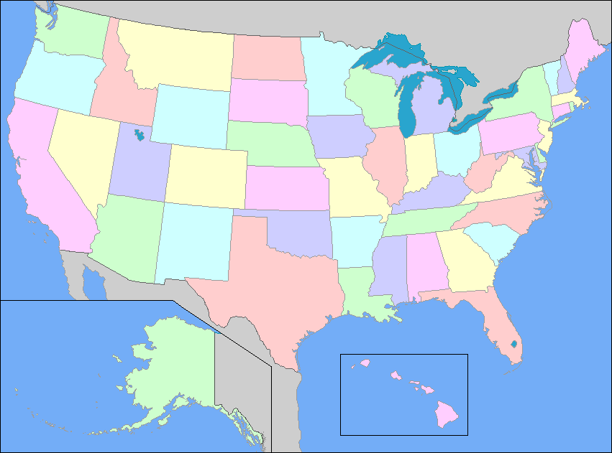
SIGNIFICANT FIGURES
ATLANTIC-PACIFIC RULE
This rule divides measurements into two kinds – those with a decimal point and those without.
If a decimal point is present in the number, count significant digits from the Pacific side. (If decimal point is present, count from the Pacific side.)
If a decimal point is absent, count from the Atlantic side.
You should start counting with the first nonzero digit you find. Thereafter, all digits, including zero, are significant.

Slide 16
SIGNIFICANT FIGURES
ANOTHER WAY
Digits other than zero are always significant.
One or more final zeros used after the decimal point are always significant.
Zeros between two other significant digits are always significant.
Zeros used solely for spacing the decimal point are not significant. The zeros are place holders only.

Slide 17
SIGNIFICANT FIGURES
Infinite amount of significant figures:
Counting numbers (23 cockroaches, 3 cars, 5 ice cream cones)
Defined constants or conversions (like 1km = 1000m)

Slide 18
PRACTICE
Calculate the number of significant figures in the following measurements.
45.601 g _______
0.00701 m _______
75,000 km _______
0.2460 mg _______
78,621.0 mL _______
4.567 m _______
23 desks _______
2.010L _______
0.002m _______

Slide 19
DO NOW
Do Percent Error, Accuracy, and Precision Practice for tomorrow.

