Slide 1
DO NOW
Turn in lab safety contract, syllabus, and student information sheet if you have not already.
Pick up notes sheet and project rubric.
Do not run in your project yet.
You need a calculator today – get out your own or get one from the front. Be sure to return it when finished.

Slide 2
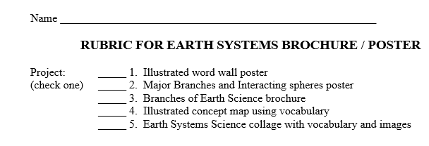
RUBRIC FOR PROJECT
Put your name at the top
Check off which project you did.

Slide 3
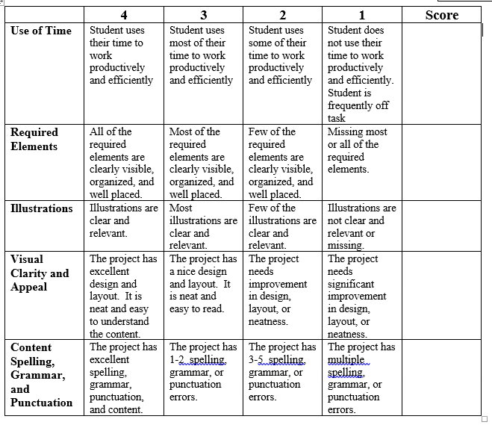
RUBRIC FOR PROJECT
Rate yourself.

Slide 4
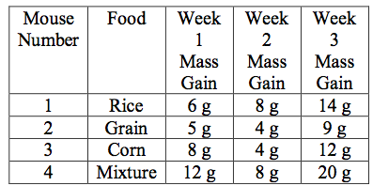
REVIEW
Identify the Variables:
Independent?
  What changes?
Dependent?
  What is measured?

Slide 5
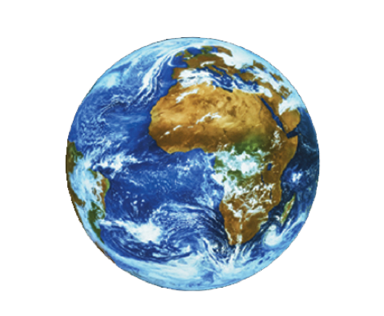
UNDERSTANDING DENSITY
SES1b. Explain how the composition of the Earth’s crust, mantle and core is determined and compare it to that of other solar system objects.

Slide 6
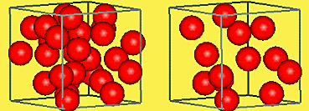
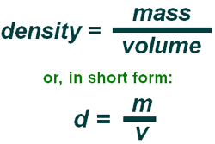
WHAT IS DENSITY?
FORMULA
A material's density is defined as its mass per unit volume.
It is a measurement of how tightly matter is packed together in something.

Slide 7
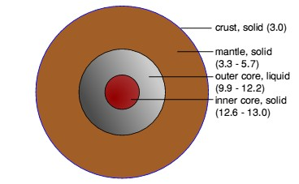
DENSITY DIFFERENCES DRIVE EARTH’S SYSTEMS
Density is most important because density differences cause things to move.
Geosphere – drives plate tectonics.
  Continental plates that are less dense are pushed up and denser plates subduct (go under) when they collide.

Slide 8
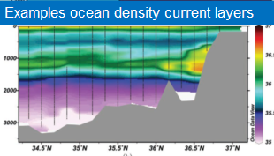
DENSITY DIFFERENCES DRIVE EARTH’S SYSTEMS
Hydrosphere – drives ocean currents.
  Cold water sinks and moves along ocean bottom.

Slide 9
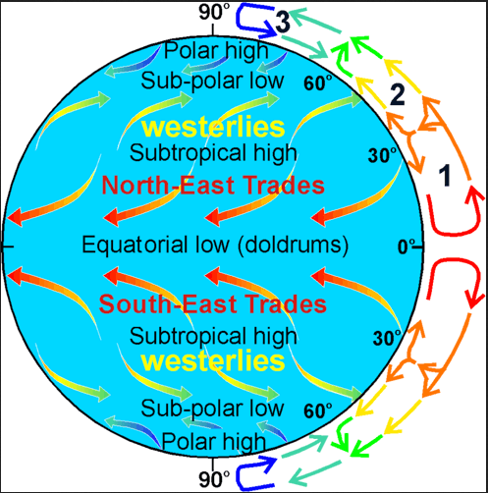
DENSITY DIFFERENCES DRIVE EARTH’S SYSTEMS
Atmosphere – drives global wind belts.
  Air pressure variations create differences in density, putting the atmosphere in motion.

Slide 10
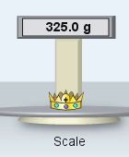
FINDING DENSITY: FIRST STEP
1. Find an object’s MASS
Science uses metric units
Mass in grams on a balance.
Balance

Slide 11
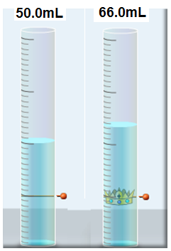
FINDING DENSITY: SECOND STEP
2. Find the object’s VOLUME
Liquid Displacement with a graduated cylinder
  Fill measuring device with water and note volume
  Drop in object
  Note new volume.
  Subtract old from new
  66.0mL – 50.0mL = 16.0mL
graduated cylinder

Slide 12
FINDING DENSITY: THIRD STEP
3. DIVIDE
M = 325 g
V = 16.0mL
325g / 16.0mL = 20.3g/mL

Slide 13
COMMON MISTAKES
Inverting mass and volume
biggest number doesn’t always go on the bottom of the equation.

Slide 14
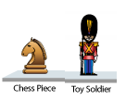
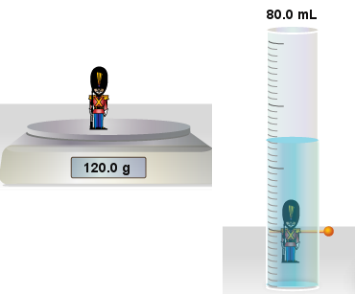
PRACTICE PROBLEMS
Calculate Density:
A. Toy Soldier
M = 120 g
V = 80 mL

Slide 15
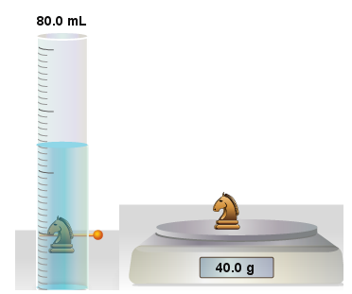
PRACTICE PROBLEMS
Calculate Density:
B. Chess Piece:
M = 40 g
V = 80 mL

Slide 16
PRACTICE PROBLEMS
Important Points:
1 mL = 1 cm³
Density of H₂O = 1.00 g/mL

Slide 17
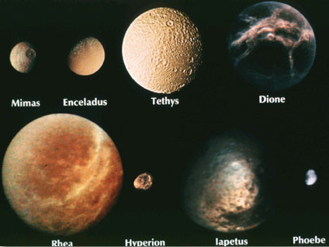
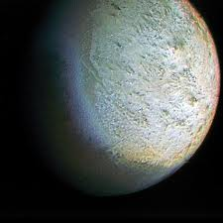
USING DENSITY TO DISCOVER COMPOSITION OF ICY WORLDS
Moons of the Gas Giants are usually composed of rock and ice.
The composition of these worlds is determined using their known densities.

Slide 18
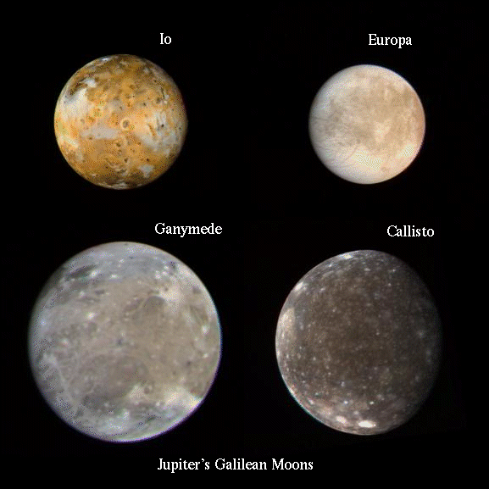
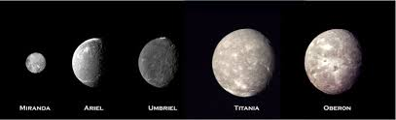
USING DENSITY TO DISCOVER COMPOSITION OF ICY WORLDS
It is a known fact that there is very little metal found in the Solar System beyond the frost line (line between rock and gas planets)
Water density = 1.0 g/cm³
Water Ice density = 0.9 g/cm³

Slide 19
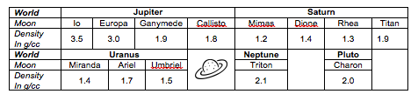
DENSITY OF ICY WORLDS
If rock has an average density of 3.5 g/cc, are there any moons composed mostly of rock? If so, which ones?
If water ice has a density of 0.9 g/cc, are there any moons composed entirely of ice? If so, which ones?

Slide 20
USING KNOWN DENSITIES
Percent Rock | Percent Ice | Density g/cc
100 | 0 | 3.5
80 | 20 | 3.0
60 | 40
50 | 50 | 2.2
40 | 60 | 1.9
20 | 80
0 | 100 | 0.9
Determine the composition of each satellite by using the known densities of rock and water ice to find the relative percentage of rock and ice in each world.
First, calculate the density of various rock and ice combinations using the following formula:
- Density = (% Rock X Density Rock) +
(% Ice X Density Ice) / 100

Slide 21
USING KNOWN DENSITIES
Percent Rock | Percent Ice | Density g/cc
100 | 0 | 3.5
80 | 20 | 3.0
60 | 40
50 | 50 | 2.2
40 | 60 | 1.9
20 | 80
0 | 100 | 0.9
To determine the density of a world that is 50% rock and 50% ice:
Density = (50% x 3.5) + (50% x 0.9) /100
Density = 175 + 45 / 100
Density = 220 / 100
Density = 2.2
Using the same formula, calculate the density for the TWO missing rock/ice combinations. Write your calculations in the box.

Slide 22
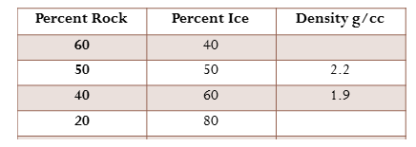
USING KNOWN DENSITIES
Density = (% Rock x Density Rock) + (% Ice x Density Ice) / 100

Slide 23
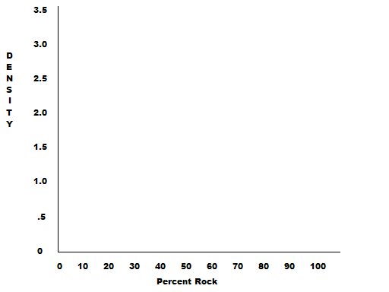
PLOT THE DENSITY VALUES
ON THE GRAPH

Slide 24
THE DENSITY VALUES

Slide 25
THE DENSITY VALUES

Slide 26
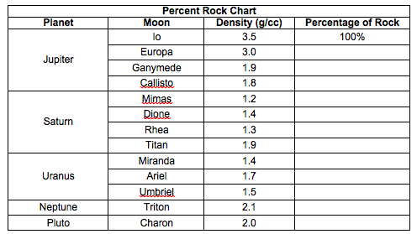
Finding the Composition Using Density
Read the graph to find the composition of each World.

