Slide 1
DO NOW
Turn in lab safety contract, syllabus, and student information sheet if you have not already.
Pick up lab handouts and READ.
Get out a calculator.

Slide 2
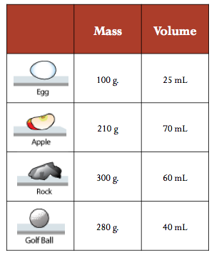
REVIEW
Which item has the GREATEST density?
A. Egg
B. Apple
C. Rock
D. Golf Ball

Slide 3
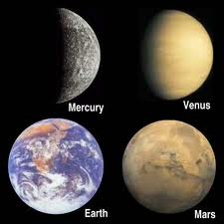
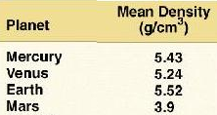
THINKING BACK…
Yesterday, we looked at the Density of Icy Worlds using the average density of Rock (3.5 g/cm³) and Ice (0.9 g/cm³).
The terrestrial planets have greater densities because they include heavy metals such as Iron which has a greater density than rock.
What conclusions can you make about the composition of the terrestrial worlds based on their known densities?

Slide 4
Calculating the Average Density of Planet Earth
SES1b. Explain how the composition of the Earth’s crust, mantle and core is determined and compare it to that of other solar system objects.

Slide 5
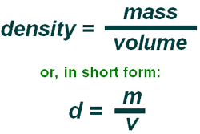
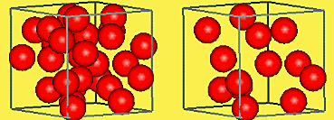
REVIEW: DENSITY
Mass per unit volume
Measurement of how tightly matter is packed together in something
D = M/V
Volume can be determined either by
linear measurement OR liquid displacement.

Slide 6
CALCULATING THE DENSITY OF THE EARTH
Introduction: Density differences in air, water and Earth’s lithosphere play a role in weather, ocean currents and plate tectonics. Different minerals have different known density ranges, which can be used to help identify them. Density of minerals is also referred to as “specific gravity.” For this lab you will be finding the density of six different minerals using a water displacement method to determine volume. You will then find the mass and calculate the density of each specimen. You will use what you find out to identify each sample. Remember that the formula for density is D = M / V.

Slide 7
CALCULATING THE DENSITY OF THE EARTH
Background Information: The Earth is approximately one-third iron, which has an average density of 7.87 g/cm³. Our planet’s core is made up of iron and nickel and extremely dense while the lithosphere (crust) is the least dense. The minerals you used in Part 1 are just a few of those found on Earth’s crust. Now you will use the data you gathered for the density of the rock samples, together with the known average density of Iron, to estimate the average density of the Earth and see how close you came to finding the Earth’s actual average density.

Slide 8
CALCULATING THE DENSITY OF THE EARTH
Materials:
100mL Graduated cylinder,
electronic balance,
water,
Five specimens
Colored pencils

Slide 9
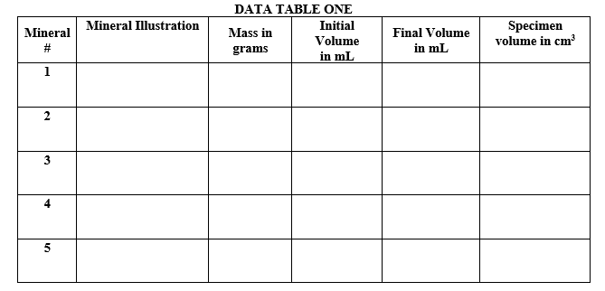
CALCULATING THE DENSITY OF THE EARTH
Procedure:
Match the number of the mineral in the first column in Data Table One with the one you are looking at.
Draw an illustration of each sample in the second column – use colored pencils.

Slide 10
CALCULATING THE DENSITY OF THE EARTH
  3. Determine the mass of each sample using the electronic balance and record in the third column, “Mass in grams”.
  4. To determine the volume of each sample in milliliters (mL), fill your graduated cylinder with approximately 50 mL of water. Record this volume in “Initial Volume” column.
  5. Carefully lower the mineral sample into the graduated cylinder until it is under water. Record the second volume in the next column, “Final Volume”.

Slide 11
CALCULATING THE DENSITY OF THE EARTH
Calculations
6. Calculate the amount of water displaced which the volume of the sample. Subtract the initial volume from the final volume. For example, if you start with 50.0 mL of water and after you lower the sample into the cylinder the new volume reads 65.0mL, then the volume of the sample is 15.0mL. Change the units to cm³ as 1mL = 1cm³. Put this information in the final column of Data Table One, “Specimen volume”.

Slide 12
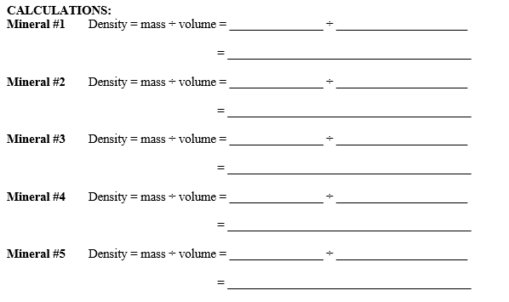
CALCULATING THE DENSITY OF THE EARTH
7. Calculate the density of each specimen in your table using the formula d = m/v. Record this value in Calculation Table One in the second column. Call a teacher over to check your work after you have done one or two.

Slide 13
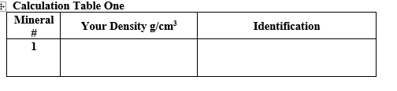
CALCULATING THE AVERAGE DENSITY EARTH
  8. The known (expected) densities of the minerals that these could be are:
Corundum – 4.02g/cm³ Quartz – 2.652g/cm³
Calcite – 2.71g/cm³ Fluorite– 3.13g/cm³
Iron Pyrite –5.022g/cm³ Hematite – 5.262g/cm³
Determine which type of mineral that each sample is according to its density and write its name in the third column of the Calculation Table, “Identification”.

Slide 14
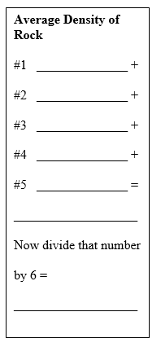
CALCULATING THE DENSITY OF THE EARTH
Calculations and Analysis
Calculate the average density of all your mineral samples combined by adding all densities and dividing by 6. Do this in the box to the right - “Average density of rock”

Slide 15
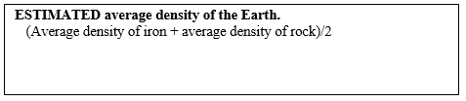
CALCULATING THE DENSITY OF THE EARTH
2. We learned in our “Icy Worlds” activity last week that the average density of rock is 3.5 g/cm³. How close did you come?
3. Add the average density of iron (7.87 g/cm³) to the average density of YOUR rock and divide by two (2) to find a combined average. Show your work in the box below:

Slide 16

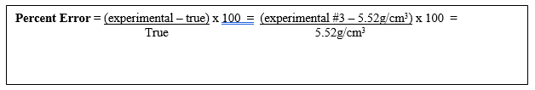
CALCULATING THE DENSITY OF THE EARTH
4. The actual average density of the Earth is 5.52 g/cm³ (its true value). To compare the actual density of Earth to your value, calculate the percent error. Calculate this in the box below, using the formula provided.
The actual average density of the Earth is 5.52 g/cm³
(its expected or “known” value).

Slide 17
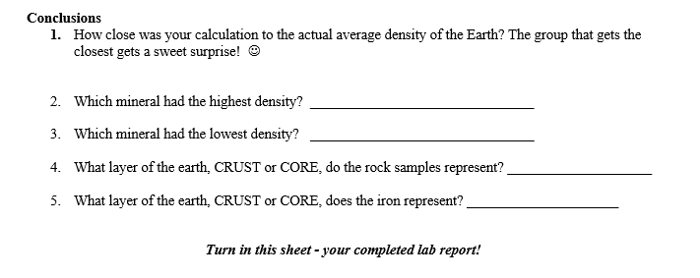
CALCULATING THE DENSITY OF THE EARTH

Slide 18
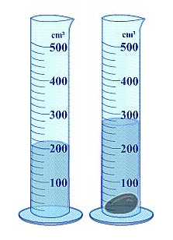
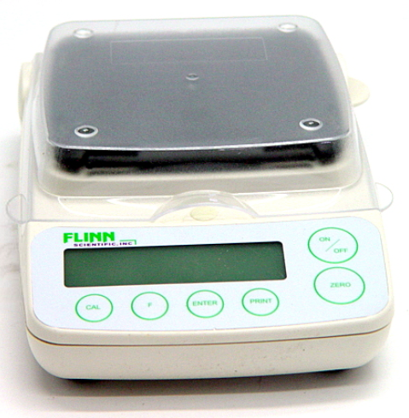
TO DO
Get with your lab partner.
Go to your lab desk.
Mass each specimen.
Determine the volume of each specimen

Slide 19
DO NOW
Get out your lab sheets
Get a calculator.

