Slide 1
GRAPHING PRACTICE

Slide 2
WHAT IS DATA?
Information
  Quantitative – numbers
  Qualitative – observations
  If you are graphing, then the data is quantitative.

Slide 3
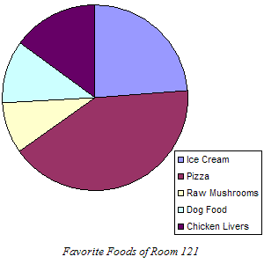
DETERMINING THE PROPER GRAPH
Circle Graph
  For data that together equals 100%.
  trying to compare parts of a whole.

Slide 4
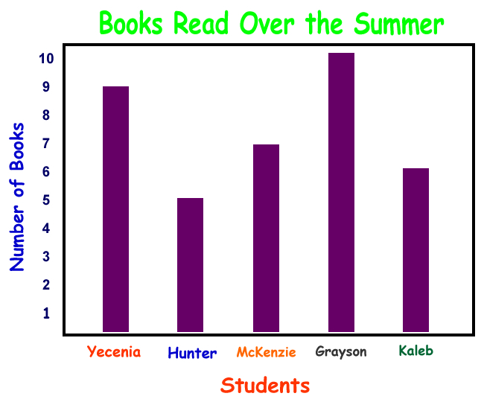
DETERMINING THE PROPER GRAPH
Bar Graph
  How a quantity varies with time, location, temperature, etc.

Slide 5
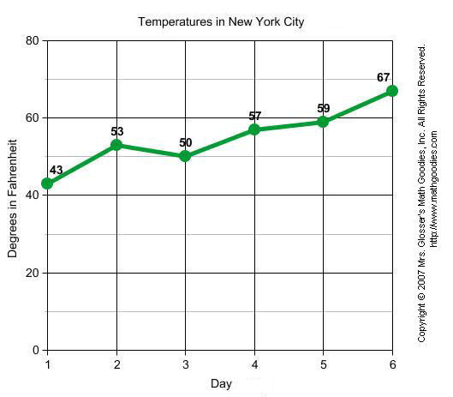
DETERMINING THE PROPER GRAPH
Line Graph
  Most of what we will use in chemistry.
  Independent variable – x axis
  Dependent variable – y axis
  These graphs track changes over long or short periods of time.

Slide 6
CAR DEPRECIATION
I bought a car in 2004 and it has slowly lost value as the years have gone by. Here is my information. In 2004, it was worth $24,000. In 2005, it was worth $22,500. In 2006, it had dropped to $19,700. In 2007, it was worth $17,500 and in 2008, it was worth $14,500. In 2009, it was worth $10,000 and when I sold it in 2010, I got $5800.

Slide 7
DATA TABLE
      How is data table set up?
Order
Title
Variables
Units
Data
Neat

Slide 8
CAR DEPRECIATION
I bought a car in 2004 and it has slowly lost value as the years have gone by. Here is my information. In 2004, it was worth $24,000. In 2005, it was worth $22,500. In 2006, it had dropped to $19, 700. In 2007, it was worth $17,500 and in 2008, it was worth $14,500. In 2009, it was worth $10,000 and when I sold it in 2010, I got $5800.
Make a data table with the car data from 2004 to 2010.

Slide 9

THE GRAPH
WHAT ARE WE GRAPHING?
  Years and money
What type of graph should we use?
  Circle Bar Line

Slide 10
DEVELOP A SCALE FOR THE GRAPH
Turn to graph sheet.
What gets graphed where?
The independent variable goes on the X axis and the dependent variable goes on the Y axis.
Count the number of lines going up.
  This will be for the money $5000 to $25000
Count the number of lines going across.
      This will be for the years 2004 to 2010

Slide 11
PLOT THE DATA
Year | Worth
2004 | $24,000
2005 | $22,500
2006 | $19,700
2007 | $17,500
2008 | $14,500
2009 | $10,000
2010 | $5,800

Slide 12
ADDITIONAL STUFF
Put a title on your graph
Label the X axis with what it is and units.
Label the Y axis with what it is and units.
Do you need to make a key? A legend for parts of the graph?

Slide 13
INTERPRETING THE DATA
Okay, so now we get to interpret what we see.
Answer the questions on the back side of the graph sheet.
Then do Brainstretcher #6 – finish for homework.

