Slide 1
DO NOW
Pick up notes handout
Turn in Cha-Cha-Cha-Changes lab. Is your partner’s name on it????

Slide 2
The Development of the Atomic Theory
Democritus to Rutherford

Slide 3
What do you know about the atom?

Slide 4
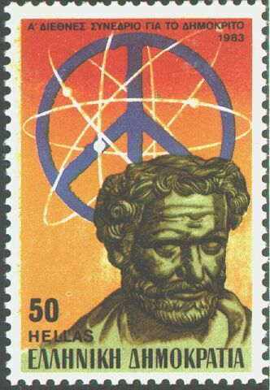
450 BC
Greek - Democritus
Atom was indivisible.
Theorized the existence of the atom.
Also, theorized that there were just four 'elements' - fire, water, air, earth.

Slide 5
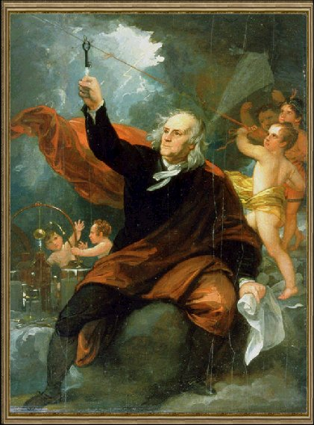
1760
Benjamin Franklin
discovers that an object can have an electrical charge.
Charge can be positive or negative.

Slide 6
1803
John Dalton
1. Atom was indivisible.
2. All elements are composed of atoms.
3. The same atoms for one element are exactly alike.
4. Atoms are neither created or destroyed in a chemical reaction.
5. In a chemical reaction, atoms are separated, combined, or rearranged.
6. Different atoms combine in simple whole number ratios to form compounds.

Slide 7
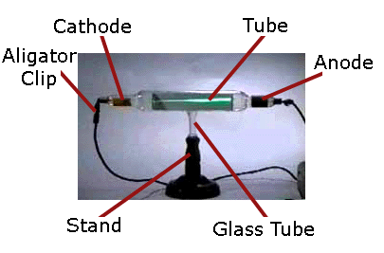
1880
Sir William Crookes
determined that rays were traveling from one end to another in the cathode ray tube

Slide 8
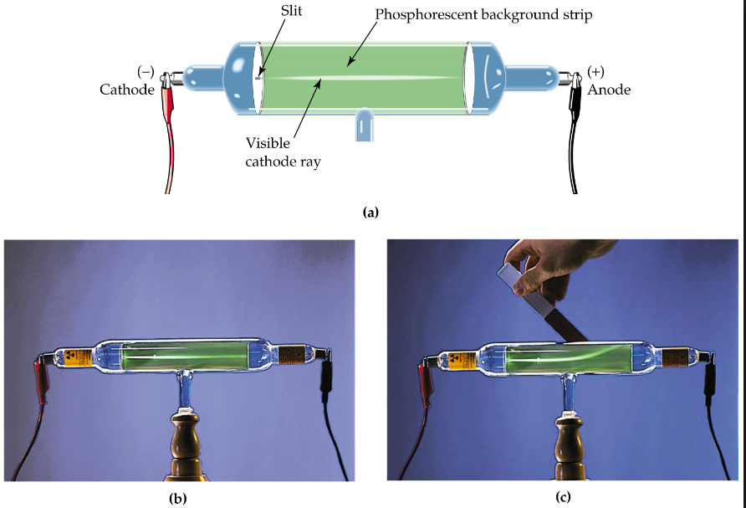
CATHODE RAY TUBE
Others experimented with the cathode ray tube and discovered that the type of gas had no effect so the ray must be a part of all matter.
A magnet deflected the ray, so it must be composed of charged particles, and it deflected toward the positive, so the charged particles must be negative.

Slide 9
Late 1890s
J. J. Thomson
discovered the electron using the cathode ray tube .
determined that the electron was smaller than a hydrogen atom.
Knew the atom was neutral and the electron was negative, so there must be positive material with a lot more mass.

Slide 10
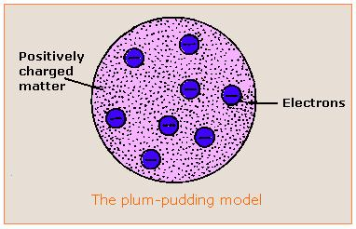
J. J. THOMSON
Said the atom was a positive pudding-like material throughout which negatively charged electrons were scattered - Plum Pudding or Chocolate Chip Cookie Model

Slide 11
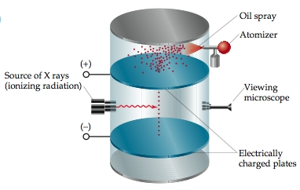
1909
Robert Millikan
Measured the mass of an electron. Knew the electron was negative, but determined the charge (as a measurement).
Was able to use this measurement to determine the mass of an electron. It was 1/1840 of a hydrogen atom.

Slide 12
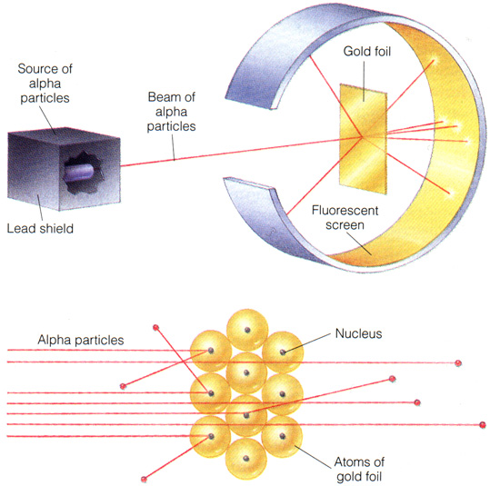
VIDEO

Slide 13
1909
Ernest Rutherford
Did famous gold foil experiment (the alpha scattering experiment).
Calculated that the atom was mostly empty space through which electrons move.
Concluded that the atom has a small, dense, positively charged, centrally-located nucleus surrounded by negatively charged electrons.

Slide 14
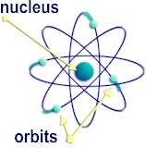
1919
Ernest Rutherford
He had refined the concept of the nucleus. Called the positive particles protons.

Slide 15
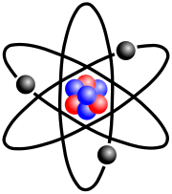
1932
Ernest Rutherford and James Chadwick
showed the nucleus also had neutrons.
The neutron was basically equal in mass to the proton but had no electrical charge – considered neutral.

Slide 16
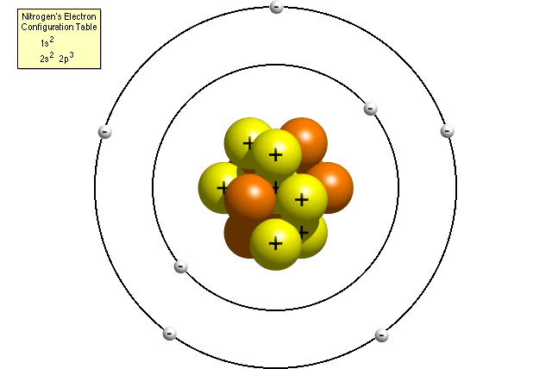
1914
Neils Bohr
Concluded that the electrons moved around the nucleus in definite orbits or energy levels.

Slide 17
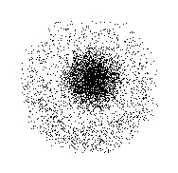
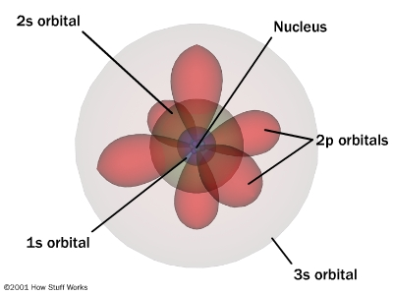
QUANTUMMECHANICAL MODEL - CURRENT
Electrons do not move in definite orbits.
The exact location of an electron in an atom is impossible to determine.
The electron location can only be spoken of in terms of a probability of being in a particular location.

Slide 18
THE DIVISIBLE ATOM
Is indivisible .
Composes all elements.
The same atoms for one element are exactly alike.
Atoms are neither created or destroyed in a chemical reaction.
Atoms are separated, combined, or rearranged in a chemical reaction in simple whole number ratios.
FALSE - divisible
TRUE
FALSE – not alike
TRUE
TRUE

Slide 19
ATOMIC THEORY to this point
is spherically shaped with a dense, centrally located, positive nucleus surrounded by one or more negatively charged electrons in an electron cloud.
Most of the atom consists of fast moving electrons traveling through empty space surrounding the nucleus.
Electrons are held within the atom by an attraction to the positive nucleus.
The nucleus has neutral neutrons and positive protons and 99.9% of the mass.
Since atoms are electrically neutral, the number of protons must equal the number of electrons.

Slide 20
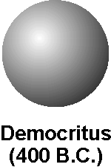

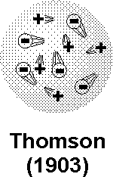
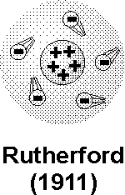

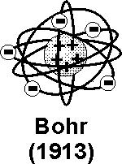
THE ATOMIC THEORIES THROUGH TIME

Slide 21
TO DO
Handout due Wednesday.

