Slide 1
DO NOW
Pick up notes.
Turn in Concentration and Reaction Rate lab.
23 days to get your late work in by the May 18 deadline and thus your grade up….

Slide 2
CHEMICAL EQUILIBRIUM
UNIT 14

Slide 3
REVERSIBLE REACTIONS
Most reactions do not go all the way to completion (meaning all the reactants are used up). Reactions can proceed in both directions.
This is usually indicated by: N₂O_{4 (g)} ↔ 2 NO_{2 (g)}
A chemical reaction in which the products regenerate the original reactants is called a REVERSIBLE REACTION.
double
arrow

Slide 4
REVERSIBLE REACTIONS
In theory, all reactions are reversible.
Some are reversible on their own and others are reversible only under restricted conditions.
Do not assume that all reactions proceed until one of the reactants is entirely consumed. GOOD TEST QUESTION!

Slide 5
DEMO
Heat is absorbed when N₂O₄ changes into
2 NO₂ molecules
N₂O_{4 (g)} ↔ 2 NO_{2 (g)}
colorless ↔ red-brown

Slide 6
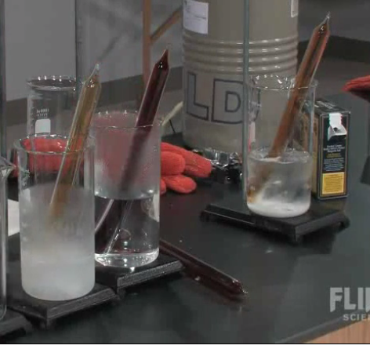
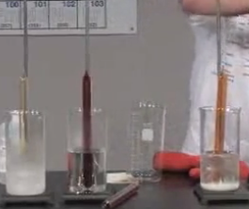
EQUILIBRIUM TUBES

Slide 7
CHEMICAL EQUILIBRIUM
In equilibrium, it is important to remember that reaction rate is proportional to concentration.
rate = Δ[Reactants or Products]
Δ Time
Reaction rate is the speed at which a reaction occurs. When the reaction goes faster, the reaction rate increases, but the actual time decreases.

Slide 8
CHEMIMCAL EQUILIBRIUM
How many times have we talked about equilibrium?
What are some examples?

Slide 9
CHEMICAL EQUILIBRIUM
Chemical equilibrium is the state in which the concentrations of reactants and products remain constant with time.
The rate at which they are formed in each reaction equals the rate at which they are consumed in the opposite direction.
The concentration remains constant.

Slide 10
CHEMICAL EQUILIBRIUM
Chemical equilibrium is a dynamic, or changing, process. But the net change in concentration is zero.
REMEMBER DYNAMIC EQUILIBRIUM? Here it is again!

Slide 11
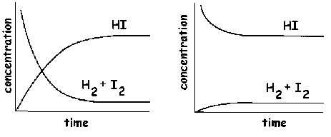
CHEMICAL EQUILIBRIUM
Rate_{forward} = Rate_{reverse}

Slide 12
CHEMICAL EQUILIBRIUM
H₂ + I₂ ↔ 2HI
When a reaction is at equilibrium, the following is true:
Rate_{forward} = Rate_{reverse}

Slide 13
CHEMICAL EQUILIBRIUM
H_{2(g)} + I_{2(g)} ↔ 2HI_{(g)}
Rate_{forward} = Rate_{reverse}
Rate_{forward} = K_{f}[H₂][I₂] Rate_{reverse} = K_{r}[HI]²

Slide 14
CHEMICAL EQUILIBRIUM
By moving the rates to the same side and calling them K_{eq}, we get:
K_{eq} = [HI]^{2 product}
Equilibrium Constant [H₂][I₂] ^{reactant}

Slide 15
CHEMICAL EQUILIBRIUM
TO SUM IT ALL UP
The mass action law states that if the system is at equilibrium at a given temperature, then the following ratio is a constant.
aA + bB ←→ cC + dD becomes
Keq = [C]^{c}[D]^{d}
[A]ª[B]^{b}

Slide 16
CHEMICAL EQUILIBRIUM
Keq = [C]^{c}[D]^{d}
[A]ª[B]^{b}
ALWAYS products divided by reactants;
The coefficient becomes the exponent;
Brackets mean concentration.

Slide 17
CHEMICAL EQUILIBRIUM
The Law of Chemical Equilibrium states that at a given temperature, a chemical system may reach a state in which a particular ratio of reactant and product concentrations has a constant value, K_{eq}.
K_{eq} is the numerical value of the ratio of product concentration to reactant concentration with each concentration raised to the power corresponding to its coefficient.
It is constant only at a specific temperature. If temperature changes, K_{eq} changes.

Slide 18
CHEMICAL EQUILIBRIUM
Write the equilibrium expressions for the following reactions. All are gases. Start out by writing “K_{eq} = “
3H_{2(g)} + N_{2(g)} ↔ 2NH_{3(g)}
SO_{2(g)} + NO_{2(g)} ↔ NO_{(g)} + SO_{3(g)}
FeCl_{3(aq)} + 3KSCN_{(aq)} ↔ 3KCl_{(aq)} + Fe(SCN)_{3(s)}

Slide 19
CHEMICAL EQUILIBRIUM
RULES:
Use GASES and AQUEOUS SOLUTIONS in the mass action expressions. Leave everything else out.
Do not include pure solids or pure liquids in your mass action expression. The concentration of pure solids and liquids is constant and can be determined by their densities so we leave them out of the expression.
If it is an aqueous solution, it is not pure, and must included

Slide 20
DETERMINING A NUMERICAL VALUE FOR K_{eq}
Experiments must be performed to determine the concentrations of reactants and products at equilibrium.
To determine the value of K_{eq}, we will use the equilibrium expression we just learned.
STEPS:
Balance the chemical equation.
Write the equilibrium (mass action) expression.
Plug in the equilibrium concentrations to solve the problem.

Slide 21
DETERMINING A NUMERICAL VALUE FOR K_{eq}
Table 1
Initial Initial EQ EQ K_{eq}
Trial [R]M [P]M [R]M [P]M
1 0.0200 0.0 0.0172 0.0014 4.73
2 0.0300 0.0 0.0243 0.0028 4.74
3 0.0 0.0200 0.0310 0.00452 ?
Calculate K_{eq} for the third trial. Use the equation: 2 R ←→ P
K_{eq} = [P] = (0.00452) =
[R] ² (0.0310)²
K_{eq} has no units

Slide 22
NUMERICAL VALUE FOR K_{eq}
EXAMPLE:
What is the equilibrium constant for the following reaction if the equilibrium or final concentrations are [I₂] = 0.302M, [H₂] = 0.428M, and [HI] = 0.655M ?
H₂ + I₂ ↔ 2HI
K_{eq} =

Slide 23
TO REMEMBER
SOME THINGS TO REMEMBER:
1. If K_{eq} is small (less than one), then the reactants are favored and equilibrium is established before the product is formed.
2. If K_{eq} is large (greater than one), then products are favored and equilibrium is established after lots of product is formed.
3. If K_{eq} = 1, then the concentrations of the reactants and products are equal.

Slide 24
TO REMEMBER
4. Each reaction has a unique K_{eq} for every temperature. If the temperature changes, the K_{eq} changes.
5. K_{eq} DOES NOT indicate the time it takes to reach equilibrium. It only provides information about the mixture of reactants and products at equilibrium.

Slide 25
TO DO
Do handout for tomorrow.

