Slide 1
DO NOW
Pick up notes
We All Scream for Ice Cream lab is due Wednesday.

Slide 2
KINETICS
UNIT #13

Slide 3
KINETICS
Kinetics: The area of chemistry concerned with the speed at which reactions occur.
Some reactions are fast and some are slow.
Make sure you can make a distinction between rate and time. If the rate of a reaction is high, the time of the reaction is low.
We look for an average of the process. The average rate of an action or process is the change in a given quantity during a specific period of time.

Slide 4
KINETICS
The general rate equation for any chemical reaction:
change in concentration
average rxn rate = Δ[reactant or product]
Δtime
change in time
The reaction rate changes throughout a reaction, therefore the average is found.
This must be determined experimentally by measuring the concentration of the reactants and products in an actual reaction. The reaction rates cannot be calculated from equations like stoichiometric amounts can.

Slide 5
COLLISION THEORY
Collision Theory: This theory states that in order for molecules to react, they must collide.
The collision can involve a particle and a container wall or two particles.
Rarely does it involve more than two particles.

Slide 6
COLLISION THEORY
There are three parts:
The particles must collide.
The particles must collide with the correct orientation.
The particles must collide with sufficient energy to form an activated complex.

Slide 7
COLLISION THEORY
Collision theory helps explain why chemical reactions proceed through a series of steps called reaction mechanisms.
Most chemical equations show three or more particles on the reactant side.
Example:
2 NO + F₂ yields 2 NOF
  All three molecules do not meet to form the NOF molecule. There is an intermediate step first where one NO molecule collides first, and then the other one does.

Slide 8
COLLISION THEORY
If there are no collisions, there would be no reactions.
The collision must be effective - a product must be formed. Not many are.

Slide 9
FACTORS AFFECTING RXN RATE
DEMO: solid vs. liquids
A. Nature of the Reactants
The rate of a reaction depends on the particular reactants and the complexity of the bonds that have to be broken and formed in order for the reaction to proceed.
Slight rearrangement of atoms is usually rapid at room temperature. Ionic reactions occur very fast. Why is that?
Reactions involving covalent bonds take place more slowly at room temperature.
The phase of the reactants can have an effect on reaction rate. Homogeneous reactions occur more rapidly than heterogeneous reactions. Reaction rates should be highest among gases rather than liquids or solids.

Slide 10
FACTORS AFFECTING RXN RATE
DEMO: 30% vs. 3%
B. Concentration
Remember that the rate of reaction is defined as a change in the concentration over time.
WHY: Increase concentration and there are more particles in a given volume. So, the chances of the particles colliding increase.

Slide 11
FACTORS AFFECTING RXN RATE
DEMO: clump vs. powder
C. Surface Area
The larger the surface area of the reactant, the greater the number of particles that are exposed for the reaction.
WHY: Increasing the surface area increases the frequency of collisions.

Slide 12
FACTORS AFFECTING RXN RATE
DEMO: cold vs. room vs. hot
D. Temperature
Increased temperature usually increases the reaction rate. The temperature rises and the average kinetic energy increases. The faster the molecules move, the more frequently they will collide.
Increasing the temperature gives more particles the required activation energy and also increases the effectiveness of the collision.

Slide 13
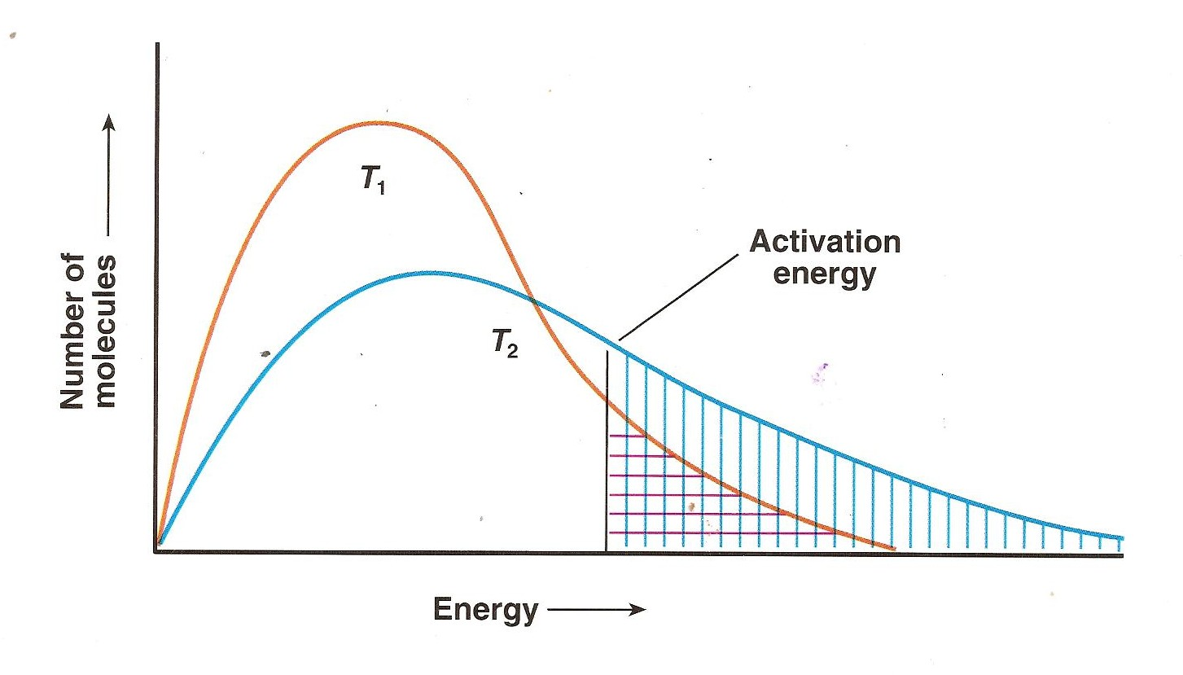
TEMPERATURE
As the temperature increases, there are more molecules with higher energies. The number of molecules which can react – those with kinetic energies greater than the activation energy – are represented by the BLUE area to the right of the black line.

Slide 14
FACTORS AFFECTING RXN RATE
DEMO: yellow → red → yellow
E. Catalysts
A catalyst is a substance that increases the rate of a reaction without itself being used up in the reaction.
Catalysts change the reaction mechanism for a reaction.
A catalyst does not appear in the overall chemical equation.
Catalysts work by lowering the amount of energy required to get the reactants to react.
Opposite from catalysts are inhibitors.
Inhibitors slow down the rate of a reaction by binding to the reactants to keep them from reacting.

Slide 15
FIZZ FIZZ
Purpose:
To compare the rates of two different reactions.
Materials:
two test tubes graduated cylinder two beakers
Alka seltzer tablet water vinegar
Safety:
Wear goggles and maintain a clean workspace

Slide 16
FIZZ FIZZ
Procedure:
Put on your goggles.
Measure 20.0 mL of tap water and place in one test tube and measure 20.0 mL of vinegar and place in the second test tube.
Place each test tube in a beaker.
Add ONE HALF of the Alka seltzer tablet to each test tube at the SAME TIME.
Compare the reactions in the two tubes.

Slide 17
TO DO
Handout – Study Guide due tomorrow
Bring your book tomorrow.

