Slide 1
DO NOW
Pick up notes and Review #20.

Slide 2
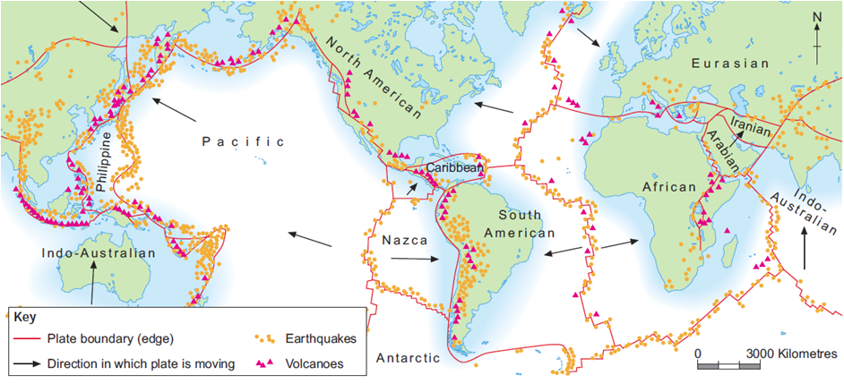
REVIEW: Why are earthquakes and volcanoes found in these places?
These are plate boundaries

Slide 3

UNDERSTANDING THE HYDROLOGIC CYCLE
GPS Standards SES1e:
Identify the transformations and major reservoirs that make up the hydrologic cycle.

Slide 4
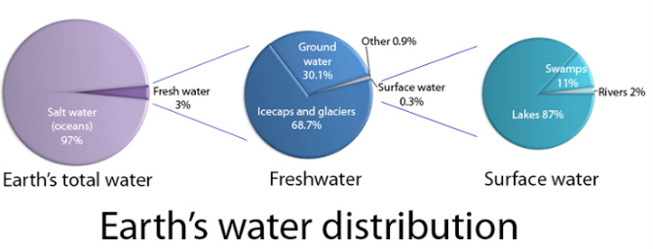
EARTH’S WATER SUPPLY
Earth’s Water Supply:
About 70 percent of the Earth's surface is water-covered
The oceans hold about 97% of the planet’s water.
Freshwater is 3%.

Slide 5
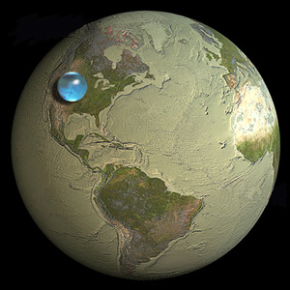
EARTH’S WATER SUPPLY
Freshwater includes water in:
  Glaciers and ice caps (2%)
  Rivers and lakes
  Groundwater and soil moisture
  Aquifers
  Water vapor in the air
  Plants and animals
Still, all that water would fit into that tiny ball that has a diameter of about 860 miles.

Slide 6
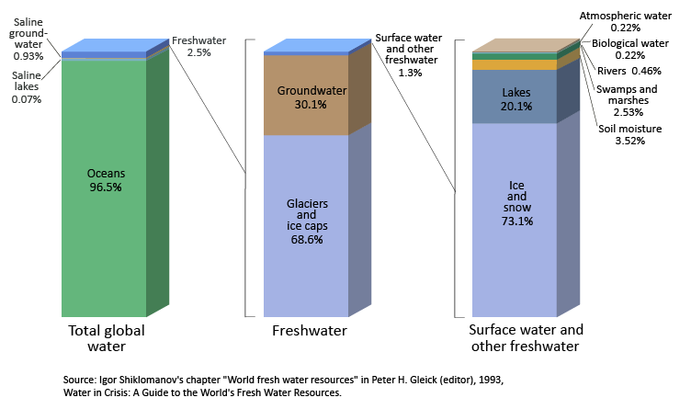
WHERE’S THE WATER?

Slide 7
SUPPLY OF WATER ON EARTH
Almost a closed system.
Little loss to space.
Some cycling with Earth’s interior in the subduction zones.
Some outgassing at volcanoes and mid-ocean ridges.

Slide 8
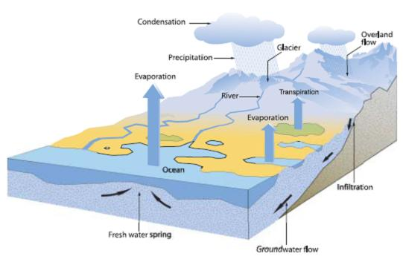
HYDROLOGIC (WATER) CYCLE
Biogeochemical cycle that transports water through Earth’s systems
The Sun: Source of energy
Gravity:
  Major force acting on water.
  Moves all transformations except evaporation.

Slide 9
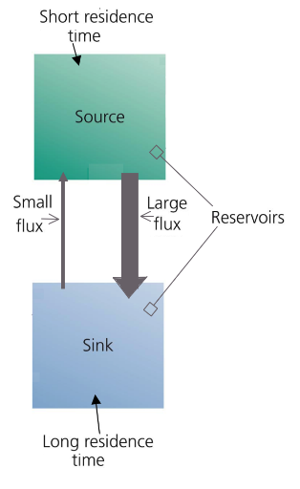
CYCLES HAVE
RESERVOIRS AND TRANSFORMATIONS
Reservoir = where water accumulates or are held for a long period of time.
Source = water stored here but moves through quickly
Sinks = water is held for long periods

Slide 10
CYCLES HAVE
RESERVOIRS AND TRANSFORMATIONS
Transformations = transport pathways that move materials between reservoirs.
  Flux = the rate at which materials move between pools

Slide 11
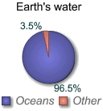
RESERVOIR
Ocean Water ≅ 97%
97% of all Earth’s Water is found in the Oceans.
It is salty and unsuitable for human consumption.
Oceans supply about 90% of the evaporated water that goes into the water cycle.

Slide 12
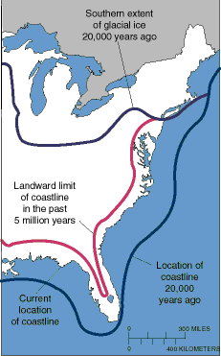
CHANGING OCEANS
Amount of water varies over time.
During ice ages water accumulates as ice and lessens in other parts of the water cycle.
  During the last ice age, the oceans were about 400 feet (122 meters) less than today.
Reverse is true during warming periods.
  125,000 years ago, the seas were about 18 feet (5.5. meters) higher.

Slide 13
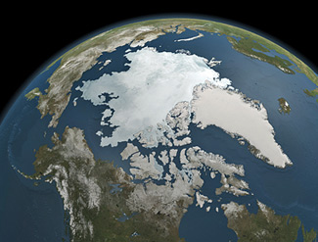
RESERVOIR
Glaciers and Ice Caps ≅ 2%
Almost 2% of all Earth’s total water supply is tied up in ice and glaciers.
2/3 of Earths’ freshwater is ice.

Slide 14
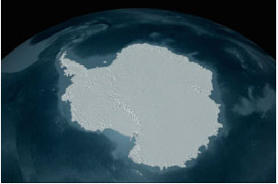
RESERVOIR:
Glaciers and Ice Caps ≅ 2%
Glacial ice covers 10%-11% of all land.
90% of ice mass in Antarctica.

Slide 15
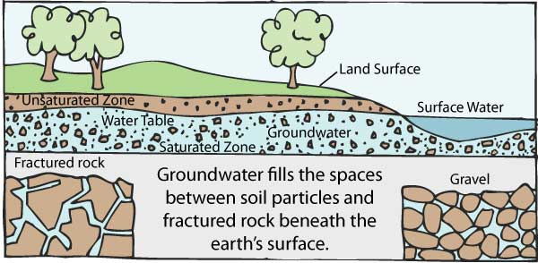
RESERVOIR
Groundwater ≅ 1%
Water that is stored beneath the surface - more like water in a sponge than a “river”.
Unsaturated zone: upper layer of soil – water is present but soil not “soggy”
Saturated zone: cracks and spaces between rock particles hold water
Aquifers: underground storage

Slide 16
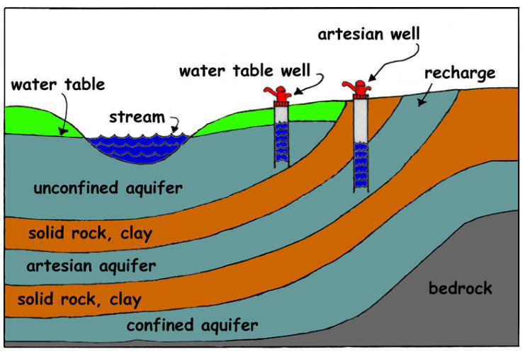
RESERVOIR
Groundwater ≅ 1%

Slide 17
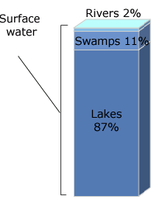
RESERVOIR
Surface Water ≅ 0.008%
Water on the surface - Lakes, Swamps and Rivers
Amount of water in rivers and lakes is always changing due to inflows and outflows.
20% of all unfrozen surface water is in Lake Baikal in Siberia (1,620 m deep) – deepest and oldest lake on Earth.
Another 20% is in the Great Lakes.

Slide 18
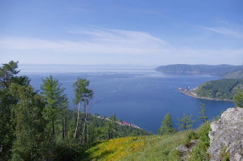
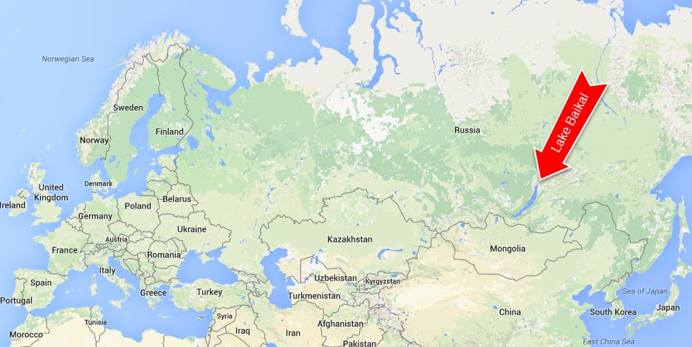
LAKE BAIKAL

Slide 19
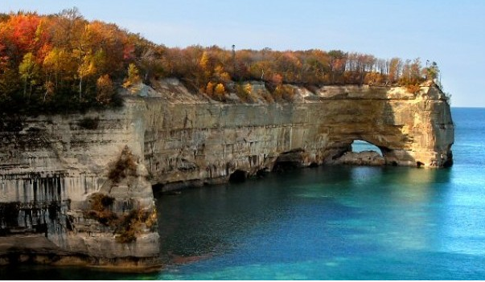
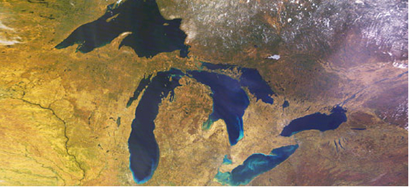
GREAT LAKES

Slide 20
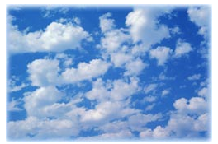
RESERVOIR
Water in the Atmosphere
≅ 0.001%
Form of water vapor or ice crystals in air
The “superhighway” that moves water around the globe.
Rising air cools and condenses into clouds.
Winds move the clouds until water falls as precipitation.

Slide 21
TRANSFORMATION
Evaporation
Process which changes water from a liquid to a gas (vapor).
  The primary pathway that gets water into the atmosphere.
  Energy comes from the Sun.
  Process works against gravity.
  Provides approximately 90% of the moisture in the atmosphere.

Slide 22
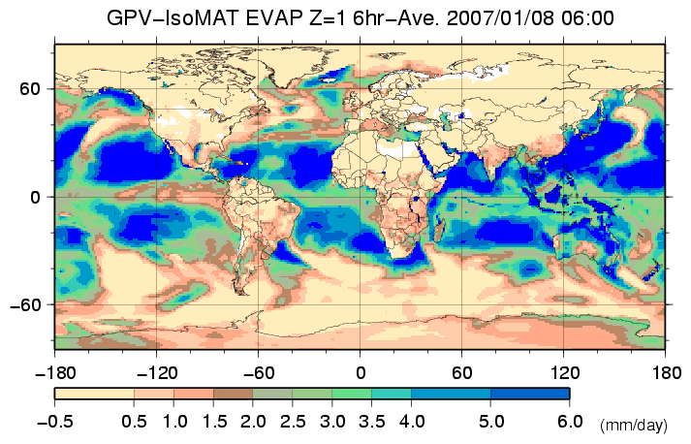
TRANSFORMATION
Evaporation
Evaporation depends on solar energy.

Slide 23
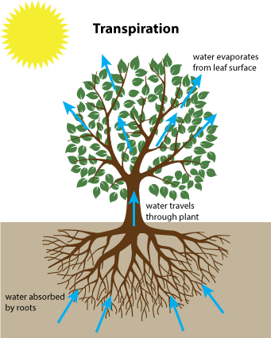
TRANSFORMATION
Transpiration
The loss of water vapor from parts of the plant, mainly the leaves.
Provides about 10% of the moisture in the atmosphere.

Slide 24
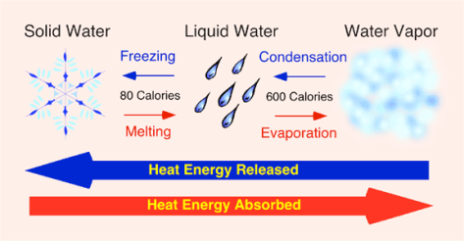
TRANSFORMATION
Condensation
The process by which water vapor in the air is changed into liquid water.
Forms as air containing water vapor rises and cools.
Energy absorbed during evaporation is released at condensation as latent heat .

Slide 25
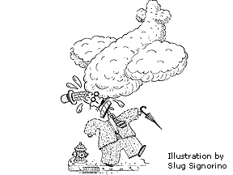
TRANSFORMATION
Condensation
An average cloud, 1 km in diameter and 100 meters thick, has a mass equivalent to one B-747 jumbo jet, but doesn’t sink because it is less dense than the air.

Slide 26
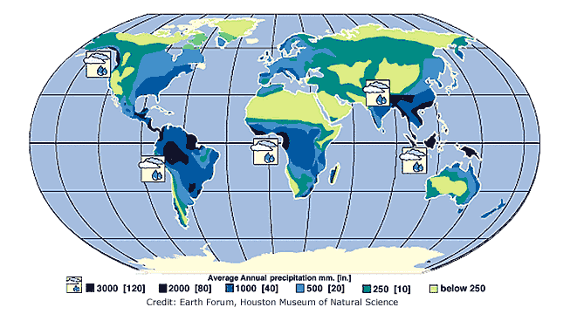
TRANSFORMATION
Precipitation
Water released in the form of rain, freezing rain, sleet, snow, or hail.
Most precipitation falls as rain.
Gravity is the force that moves water.

Slide 27
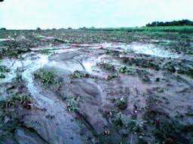
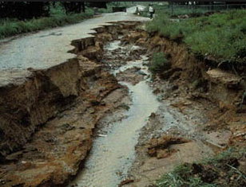
TRANSFORMATION
Surface Runoff
Precipitation runoff over the landscape.
Meteorological factors affecting runoff:
Type of precipitation (rain, snow, etc.).
Rainfall intensity, amount & duration.
Distribution of rainfall over the region.
Direction of storm movement.
Precipitation that occurred earlier and resulting soil moisture.

Slide 28
TRANSFORMATION
Surface Runoff
Physical characteristics affecting runoff:
Land use
Vegetation
Soil type
Drainage area, shape and elevation
Topography, especially land slope
Drainage network patterns

Slide 29
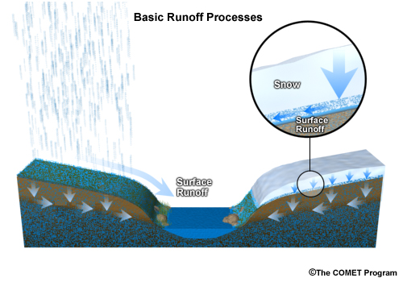
TRANSFORMATION
Surface Runoff

Slide 30
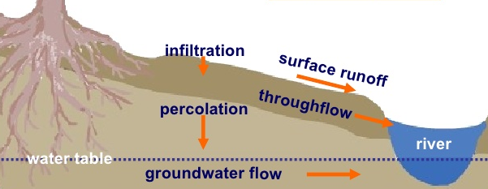
TRANSFORMATIONS
Groundwater
Groundwater Recharge: How aquifers are replenished
Infiltration: Water absorbed into ground
Affected by porosity and permeability of the surface

Slide 31
TRANSFORMATIONS
Groundwater
Percolation: Water movement though ground layers
Moved by gravity
Springs: Water rises to surface
Subsurface Runoff: Water that flows underground and discharges into stream or other water body

Slide 32
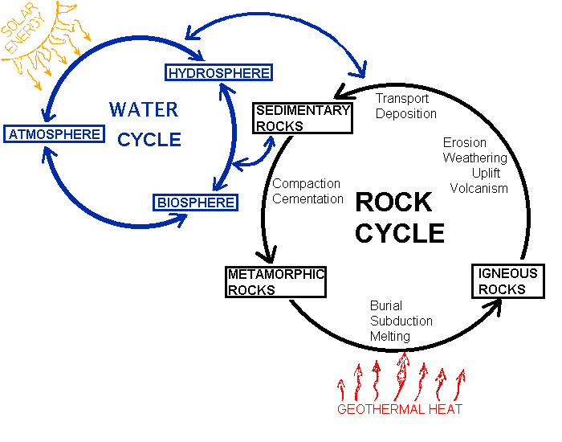
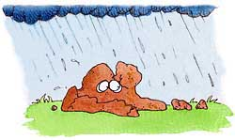
WATER AND ROCK CYCLES INTERACT

Slide 33
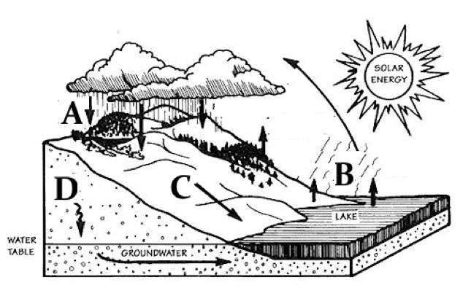
REVIEW
Which is:
Evaporation?
Run off?
Precipitation?
Infiltration?
B
C
A
D

Slide 34
TO DO
Do Review #20 - due Monday.

