Slide 1
DO NOW
Pick up notes.
HAPPY NATIONAL CHEMISTRY WEEK!
National Chemical Week Extra Credits are due starting tomorrow. See purple sheet for individual due dates.

Slide 2
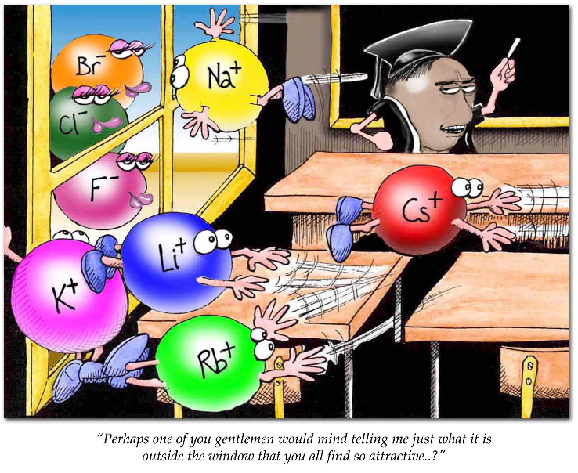
CHEMICAL BONDING

Slide 3
CHEMICAL BONDING
When atoms interact to form a chemical bond, only the outer energy level is in contact – the valence electrons.
Electron Dot Diagrams are used to keep track of the valence electrons.

Slide 4
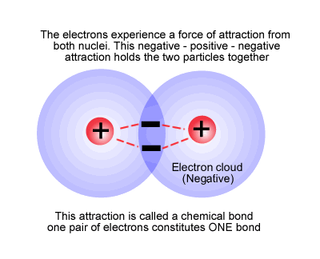
CHEMICAL BONDING
Chemical bonding is the combining of elements to form new substances.
They are formed in definite ways according to certain rules.

Slide 5
CHEMICAL BONDING
OCTET RULE:
It is the goal of every atom to have a full outermost energy level.
The atom gets this by losing or gaining electrons to form an octet (full set of eight valence electrons).
This is the most stable formation.

Slide 6
Video: Ionic Bonding
Why does adding water initiate the reaction?

Slide 7

IONIC BONDING
involves a TRANSFER of electrons from one atom to another.
is held together by electrostatic force (+/-)
happens when electronegativities between two atoms are very different.

Slide 8
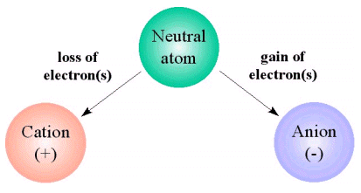
IONIC BONDING
Forms ions.
An ion is a charged particle that has lost or gained electrons.
The atom that gains electrons = ANION
The atom that loses electrons = CATION.

Slide 9
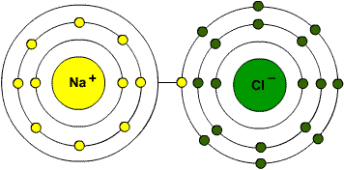
EXAMPLE
Sodium (0.93) loses an electron.
Chlorine (3.16) gains an electron.
3.16 - 0.93 = 2.23
Anything over 1.67 is ionic

Slide 10
IONIC BONDING
The basic rule is that opposites attract.
A strong attraction between oppositely charged ions (formed by the transfer of electrons) hold the ions together in an ionic bond – this is the electrostatic force.

Slide 11
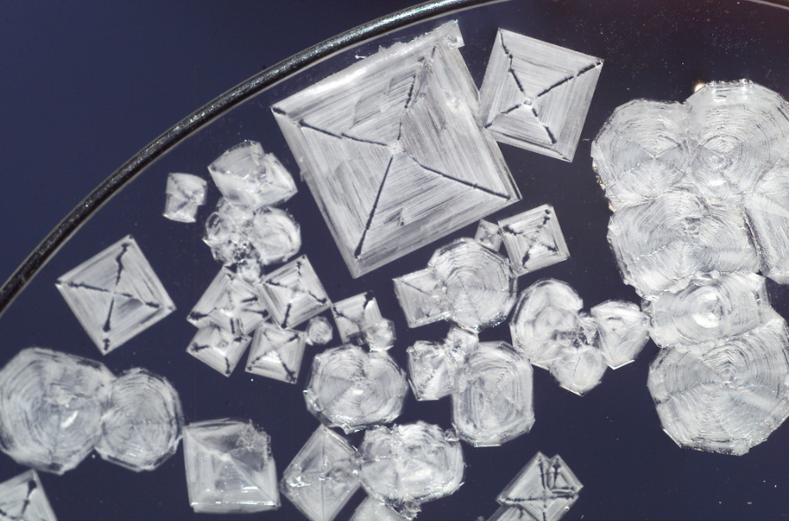
CHARACTERISTICS
high melting and boiling points.
tend to be soluble in water.
Solids are poor conductors of heat and electricity.

Slide 12
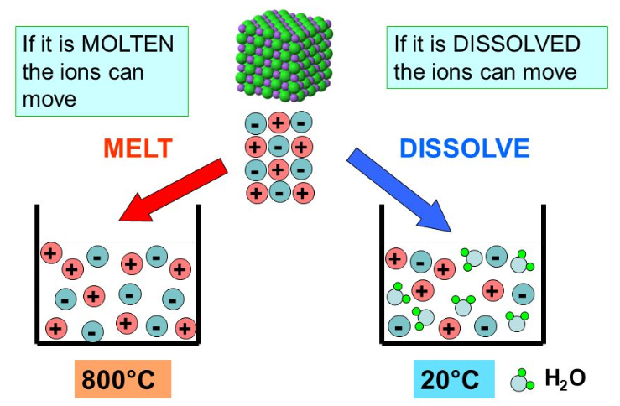
CHARACTERISTICS
When dissolved in a liquid or melted, they become good conductors.

Slide 13
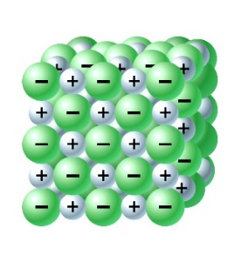
CHARACTERISTICS
Ions are arranged in a CRYSTAL.
The crystal is hard – you need a lot of force to break it. When it does break, it will shatter.
Generally forms between elements on opposite sides of the periodic table.

Slide 14
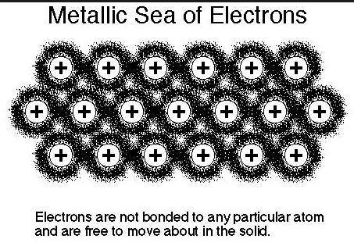
METALLIC BONDS
Metallic solids have only metals in them.
Metals give up electrons easily.
A metallic bond is where the electrons in the outermost energy level overlap and form a common electron cloud (a sea of electrons).

Slide 15
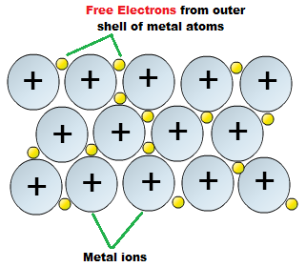
METALLIC BONDS
The many electrons easily dislodged from a large group of metal ions flow freely through the assembly of metal ions.
These electrons are called DELOCALIZED.
This ‘fluid’ of electrons holds the positively charged metal ions together.

Slide 16
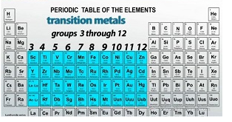
METALLIC BONDS
Transition metals are the hardest and strongest metals because they have more electrons in this sea.

Slide 17
METALLIC BONDS
It is the mobility of the electrons in metals that makes metals both malleable and ductile.
This also accounts for the metal’s high thermal and electrical conductivities.
Metals are opaque and shiny because the electrons vibrate when light falls upon them, reflecting most of the light.

Slide 18
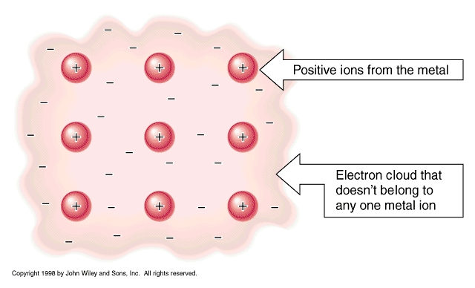
METALLIC BOND

Slide 19
CHARACTERISTICS
Flexibility – the metal ions slide past each other, yet hold together.
Conductivity – free flowing electrons conduct heat and electricity well
High melting point – it takes a lot of energy to overcome this bond

Slide 20
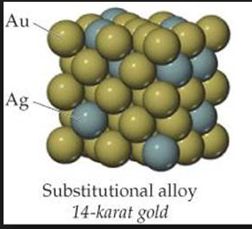
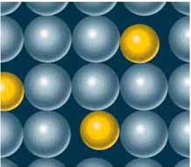
ALLOYS
Alloys – solid solutions of metals; two metals bonded to each other.
Substitutional alloys – alloys where atoms of the original metal are replaced by metal atoms of a similar size. Examples: Sterling silver (silver/copper) and 10-karat gold (gold/copper or silver)

Slide 21
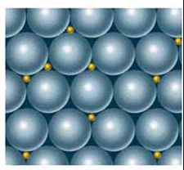
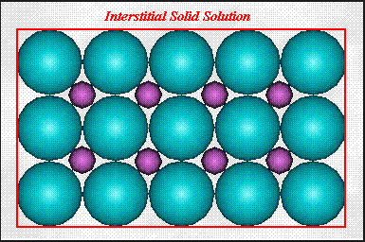
ALLOYS
Interstitial alloys – small holes in the metal crystal are filled with atoms of a smaller size. Example: carbon steel (iron/carbon)

Slide 22
TO DO
Ionic Compounds – due tomorrow.

