Slide 1
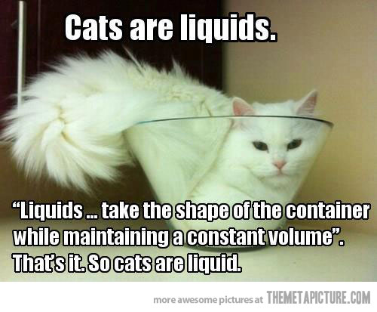
DO NOW
Pick up notes.

Slide 2
BIG CHILL PROJECT
Goal: Build a container that keeps an ice cube from melting for the longest period of time.
Must be 15.0cm x 15.0cm x 15.0cm or smaller.
Must operate at room temperature with no electricity.
Must be an original creation.

Slide 3
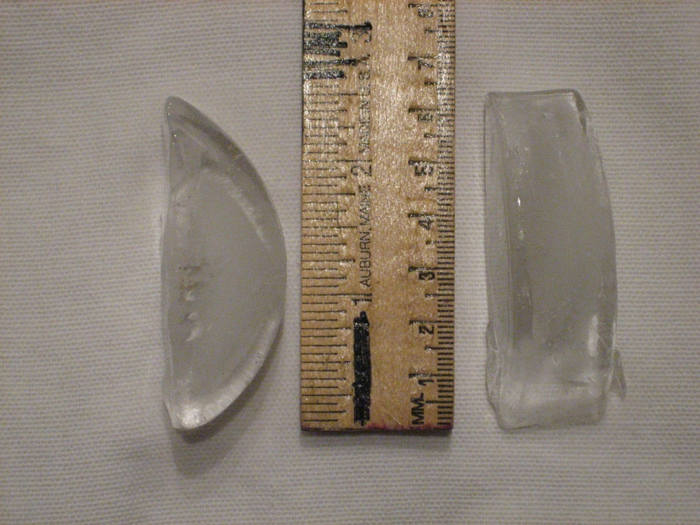
BIG CHILL PROJECT
Must have a opening and chamber big enough to accommodate an ice cube.

Slide 4
BIG CHILL PROJECT
Grade is two parts:
1. Construction - 50 pts
2. Efficiency - 50 pts
Bonus points for being a top three finisher in your class, the best design in your class, ice cube lasting longer than 8 hours, and a parent signature on the blue form.
DUE FRIDAY MARCH 3

Slide 5
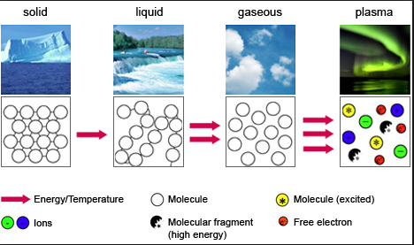
Phases of Matter and Energy

Slide 6
Kinetic-molecular theory
Explains the effects of temperature and pressure on matter.
All matter is composed of small particles.
The small particles are in constant, random motion.
All particles have perfectly elastic collisions – there is no change in total kinetic energy (KE).

Slide 7
AVERAGE KINETIC ENERGY
Definition: The average of the kinetic energies of all the particles of matter in a given sample.
An impossible task to measure directly, so the temperature is used.
The temperature of a substance is a measure of the average kinetic energy of the particles in a sample of matter.

Slide 8
AVERAGE KINETIC ENERGY
Since kinetic energy is conserved, the average kinetic energy of the particles remains the same and can be measured.
Therefore, a increase in temperature means that the particles, on the average, are moving faster.

Slide 9
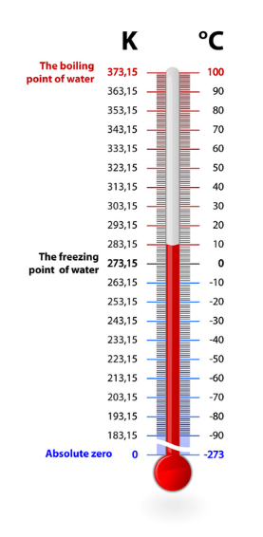
KELVIN
Temperature scale based on absolute zero.
The SI unit of temperature.
Absolute zero is the temperature where all molecular motions stops.
0 Kelvin (K) = -273.16 ºC
Formula: K = ºC + 273

Slide 10
HEAT
Temperature can also be used to determine the flow of energy.
Warmer objects will have a higher kinetic energy than cooler objects.
Energy is ALWAYS transferred from warmer to cooler objects.
The amount of energy transferred is called HEAT.

Slide 11
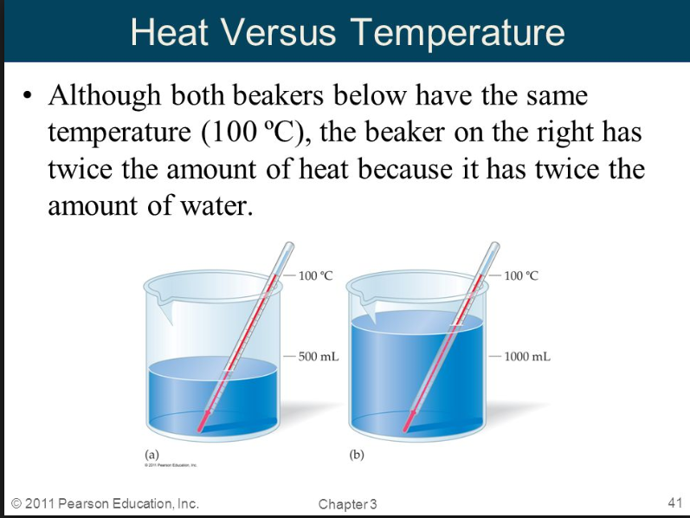
Temperature VERSUS HEAT
REMINDER
Temperature is a measure of the average kinetic energy of a substance.
Heat is the energy transferred from one substance to another.

Slide 12
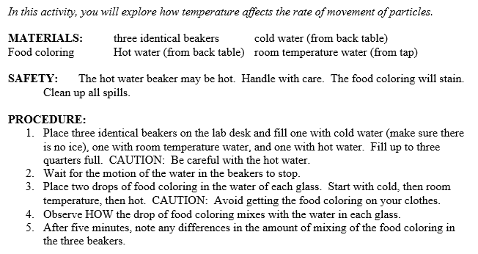
TURN UP THE HEAT, I’M SLOWING DOWN

Slide 13
TO DO
Turn in lab once you complete the three questions.
Work on the review on the back of the notes – due tomorrow.

