Slide 1
DO NOW
Pick up notes and Review #28.
Have you turned in article summary #9?
Did you check your email for a confirmation from me?
If you were NOT here Friday, get your Unit 9 notes out.

Slide 2
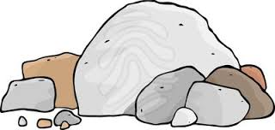
REVIEW
What do you remember about minerals?
  What are they?
  Where are they found?
  What is the difference between a rock and a mineral?
Minerals are naturally occurring, inorganic, homogeneous, solid with a crystalline structure.
They are the building blocks of rocks.

Slide 3
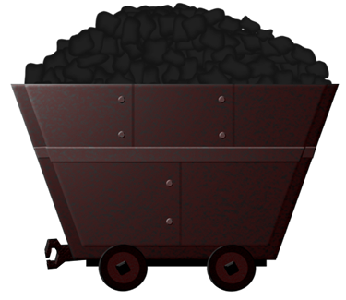
MINERAL RESOURCES AND MINING
SES6. Students will explain how life on Earth responds to and shapes Earth systems.
b. Geological and ecological processes cycle matter and energy; human activity alters rates

Slide 4
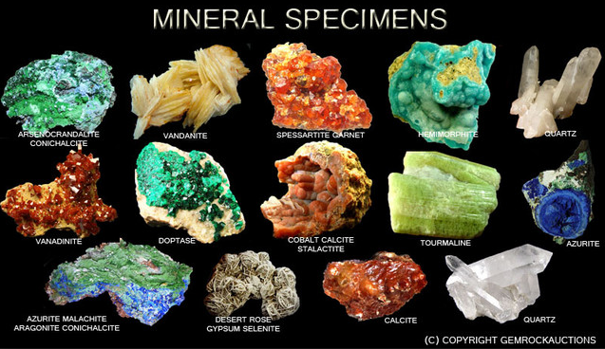
MINERAL RESOURCES
Minerals are a naturally occurring solid with a definite chemical composition and crystalline structure that is formed through inorganic processes.
Unevenly distributed throughout world – some places have more of one kind or another.

Slide 5
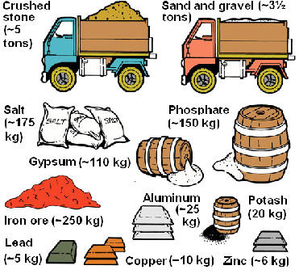
MINERAL RESOURCES
Three groups:
  Metallic mineral – like iron and copper
  Nonmetallic mineral – like salt and clay
  Energy resources – like coal and oil

Slide 6
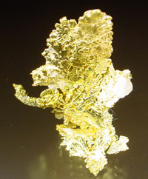
METALLIC RESOURCES
Resources from which ductile, malleable, opaque and reflective metals are found that are also good heat and electricity conductors.
Yield new products when melted.

Slide 7
METALLIC RESOURCES
Considered abundant when more than 0.1 % (Fe, Al, Mg).
Considered scarce at less than 0.1% (Ni, Cu, Zn)
Most metallic ore deposits are a result of plate tectonic activity.

Slide 8
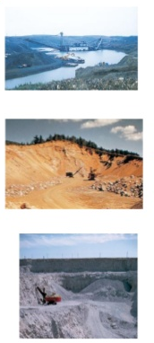
NON-METALLIC RESOURCES
They don’t yield new products when melted.
They are usually glassy, dull, or waxy.
They are used as insulators and can be transparent.
They are used for:
Construction materials:
  Sand, gravel, limestone, gypsum

Slide 9
NON-METALLIC RESOURCES
Agriculture:
  Phosphate, nitrate, potassium
Industrial:
  Rock salt, sulfur, clay, gypsum
Household and Business products:
  Glass sand, diatomite

Slide 10
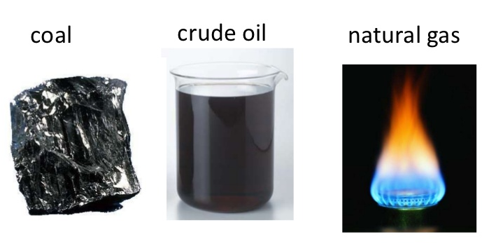
ENERGY RESOURCES
Organic!
  Form from remains of living things .
  Consist of hydrocarbons.
  Are basically stored energy.

Slide 11
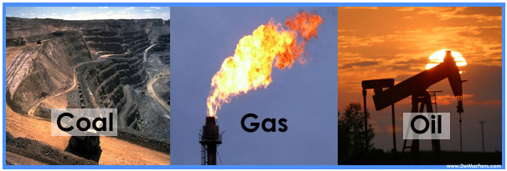
ENERGY RESOURCES
Includes:
  Coal - formed in process of carbonization – plants debris buried in swamps or mud become peat then coal.
  Petroleum and Natural Gas - formed from remains of marine organisms and plants under heat and pressure.

Slide 12
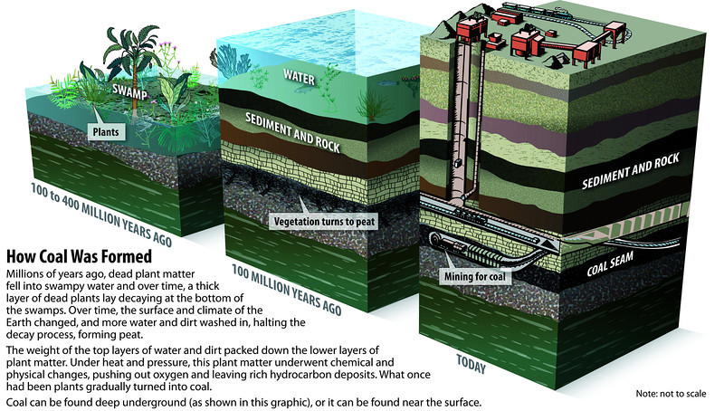
ENERGY RESOURCES

Slide 13
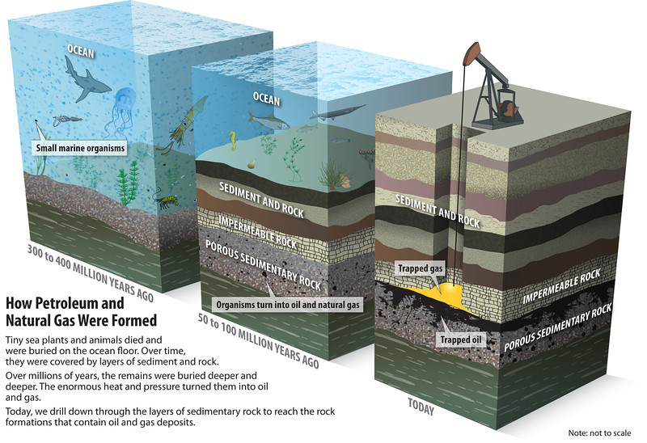
ENERGY RESOURCES

Slide 14

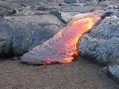
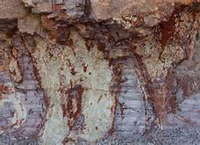
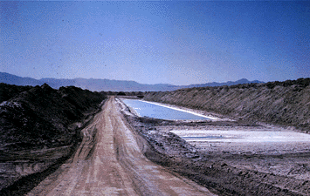
HOW MINERALS FORM
Minerals form in MANY ways
Four main processes:
Cooling magma
Evaporation
Precipitation
Heat and Pressure
Sometimes evaporation and precipitation are grouped together
Sometimes other variations referenced

Slide 15
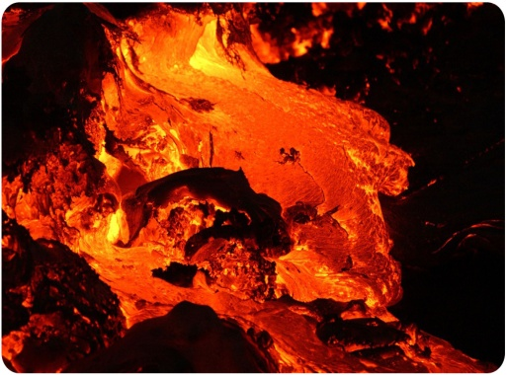
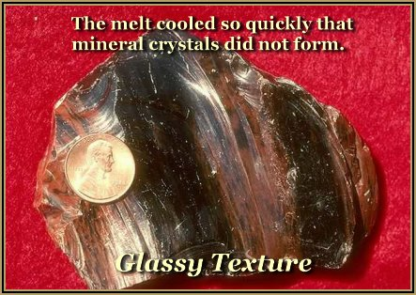
MINERALS FROM MAGMA
Crystallization depends on:
Cooling rate
  faster = smaller crystals
  Slower = larger crystals
Gas in magma
Chemical composition of magma

Slide 16
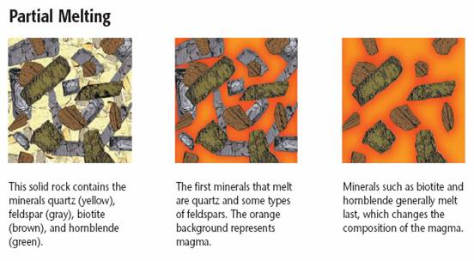
MINERALS FROM MAGMA
Melting can cause differentiation based on specific heat of different minerals.
Examples: orthoclase and quartz

Slide 17
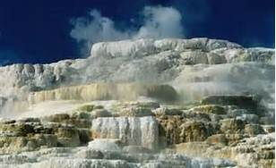
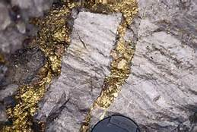
MINERALS FROM SOLUTIONS
Supersaturated solutions of dissolved minerals
Excess mineral solute is deposited on a surface or water evaporates.
Veins can form when solutions flow through cracks.
Lode: Hot mineral solutions in cracks in rocks.
Examples: Halite and calcite.

Slide 18
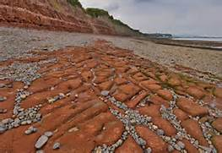
MINERALS FROM THE WATER CYCLE
Dissolved minerals can settle at bottom of ocean or lake.
Water evaporates and leaves behind mineral deposits.

Slide 19
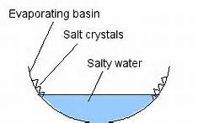
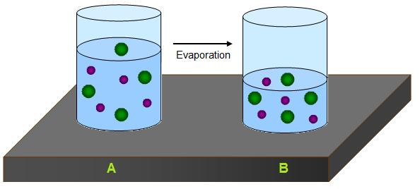
MINERALS FROM THE WATER CYCLE
Salt water is the major source of minerals formed by evaporation (90%)
Examples: gypsum and salts

Slide 20
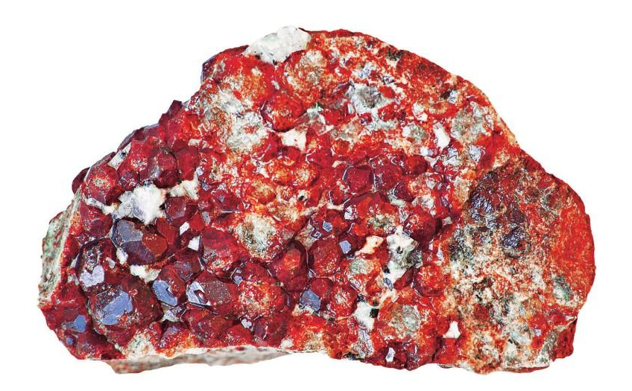
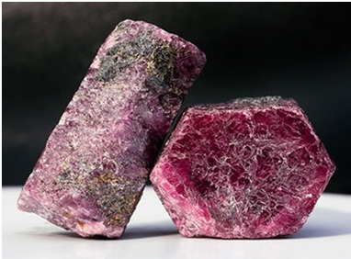
MINERALS FROM HEAT AND PRESSURE
Heat and pressure can cause:
Recrystallization
Chemical reactions
Examples: garnet and corundum

Slide 21
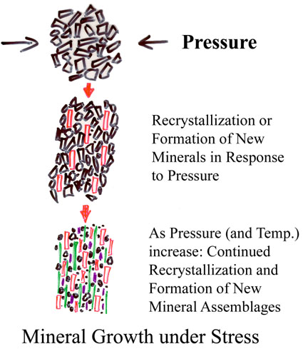
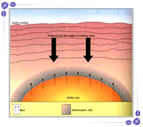
MINERALS FROM HEAT AND PRESSURE

Slide 22
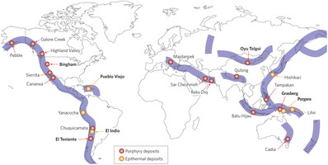
MINERALS AND PLATE TECTONICS
Some minerals produced by convergent plates.

Slide 23
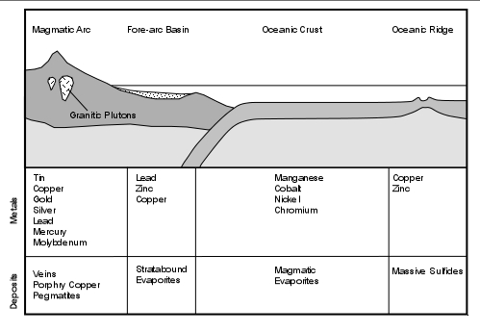

Slide 24
MINERALS AND PLATE TECTONICS
Heat near subduction zones can produce:
Iron Ores Lead
Copper metal Silver metal
Gold metal Zinc Tin
Not just where plates meet now, but in the past!

Slide 25
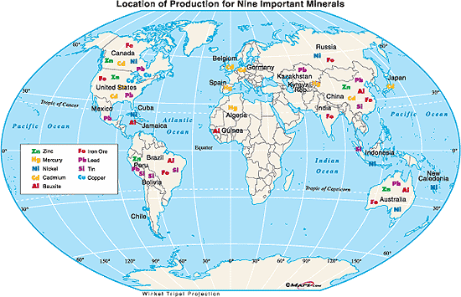
Link to Mineral Distribution Maps @ USGS

Slide 26


PEOPLE USE MINERALS
The average person consumes or uses 40,000 pounds of minerals every year.
Basic and raw materials in our daily lives are essential, and are vital for economic, social and technological development.

Slide 27
PEOPLE USE MINERALS
Over the course of a lifetime, one individual will use more than:
  1,050 pounds of lead
  1,050 pounds of zinc
  1,750 pounds of copper
  4,550 pounds of aluminum
  91,000 pounds of iron and steel
  360,500 pounds of coal
  one million pounds of industrial minerals such as limestone, clay, and gravel.

Slide 28
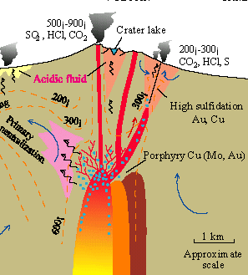
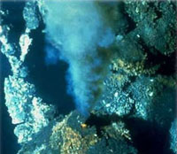
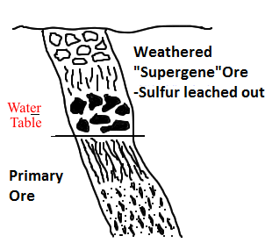
ORES
Mineral resources mined for profit.
A deposit in the Earth’s crust of one or more valuable minerals.
Primary Ores: deep veins and deposits – often rich in sulfur.
Weathered (supergene) ores – weathered near surface, sulfur leached out – cleaner and cheaper to mine and process – in a contaminated layer.

Slide 29
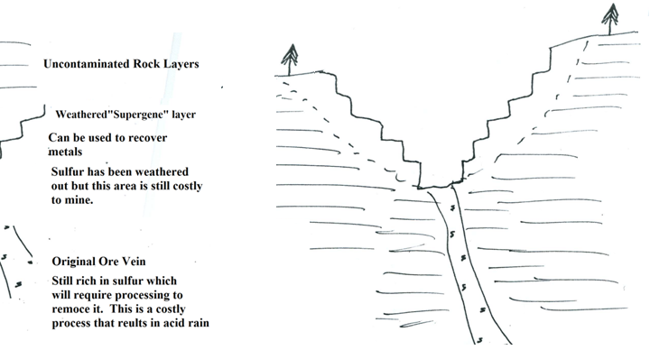
MINING OF ORES
Sulfur is a problem especially in coal because it contributes to acid rain!
PRIMARY ORES:
Deep veins and deposits
Rich in sulfur (impurities)
Deeper ores are expensive to mine and process
WEATHERED ORES:
Contaminated layer near surface
Sulfur leached out
Cheap to mine and process

Slide 30
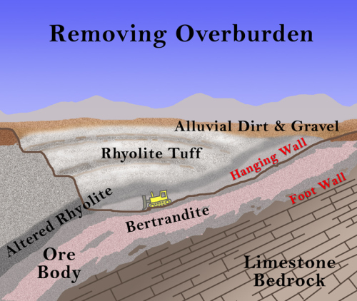
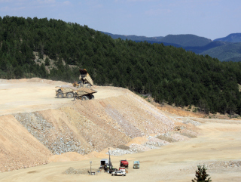
MINING PROCESS
Start by removing the Overburden.
Overburden is material that lies above an ore area.
Must be removed prior to surface mining.
May be replaced after mining.

Slide 31
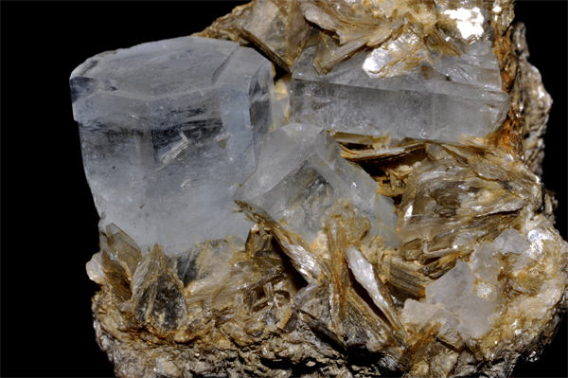
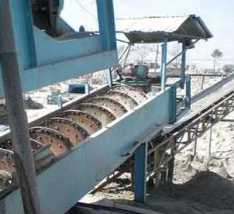
WASTE MATERIAL
Gangue:
  Worthless leftovers.
  Surrounds or is mixed with mineral or ore.
  Has other minerals mixed with it.
Tailings:
  Piles of waste left behind after extraction.
  Contains gangue.

Slide 32
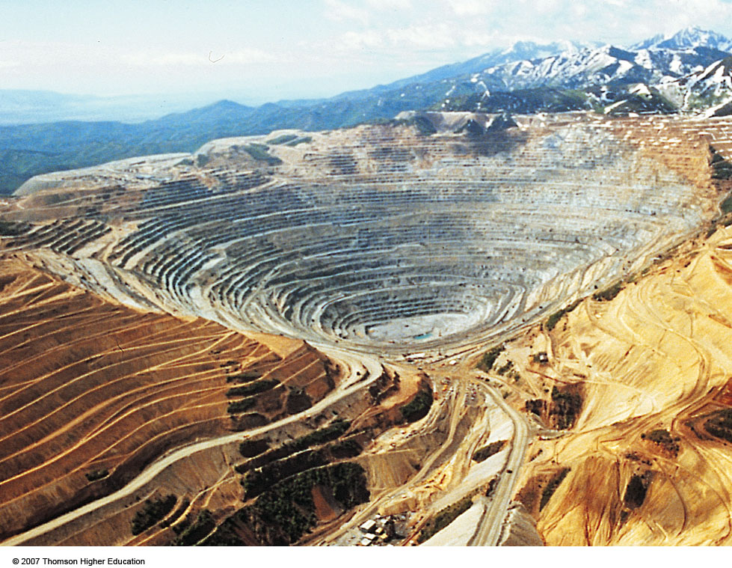
METHOD:
OPEN-PIT MINING
Machines dig holes and remove ores, sand, gravel, and stone.
Toxic groundwater can accumulate at the bottom.

Slide 33
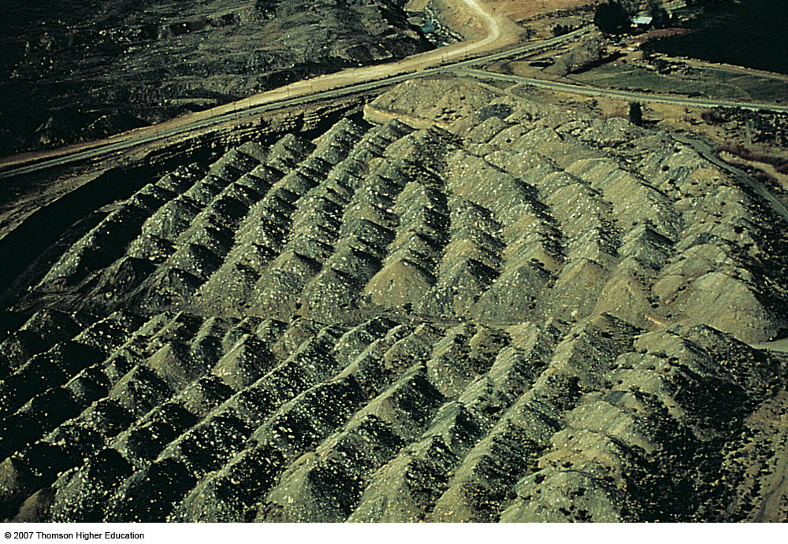
METHOD:
AREA STRIP MINING
Earth movers strip away overburden and giant shovels remove mineral deposit.
Often leaves highly erodible hills of rubble called spoil banks.

Slide 34
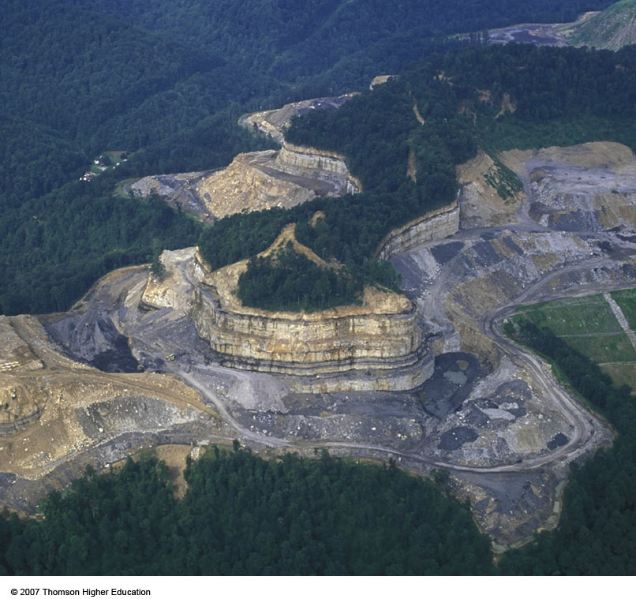
METHOD: MOUNTAINTOP REMOVAL
Machinery removes the tops of mountains to expose minerals – often used for coal.
Heavy equipment used to move overburden downhill during the mining of coal.
The resulting waste rock and dirt are dumped into the streams and valleys below.

Slide 35
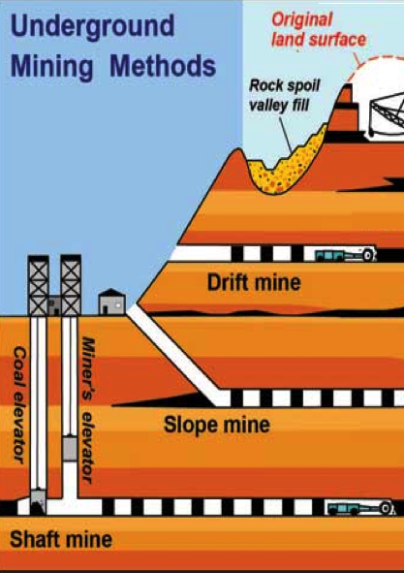
METHOD:
SUBSURFACE MINING
Include:
Drift
Slope
Shaft
Hard Rock
Borehole
Fracking

Slide 36
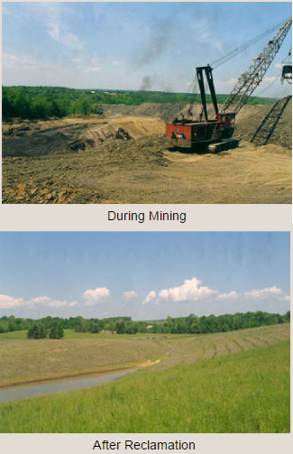
MINING RECLAMATION
The word reclamation comes from “reclaim” - meaning to take something back.
The process of returning land to its original or better condition before mining.
Without reclamation, habitats are permanently destroyed and erosion increases.

Slide 37

REVIEW
Hot mineral solutions in cracks in rock are called:
Supergene ores
Crystal
Lode
Gangue

Slide 38

LAB: CORE SAMPLING
Objective: To demonstrate how geologists can discover mineral deposits that are buried in the Earth’s crust and determine what their distribution is by collecting and analyzing cores.

Slide 39
LAB: CORE SAMPLING
Materials:
Paper plate
Cupcake
Plastic knife
toothpick
plastic transparent straw

Slide 40
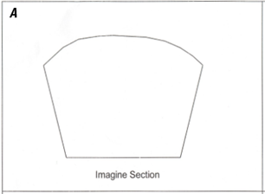
LAB: CORE SAMPLING
1. In Section A in your lab sheet data table, draw what you think the inside of the cupcake looks like if there were three different layers present. The layers are white, red, blue, and yellow
2. Once you have done it, have your teacher initial your drawing – do not make ANY changes to this drawing after your teacher initials it.

Slide 41
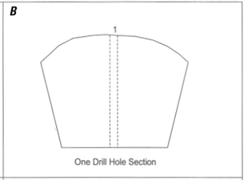
LAB: CORE SAMPLING
3. Use your straw to take a core sample in the dead center of the cupcake. Rotate and push the straw at the same time to “drill” into your cupcake. Pull out the sample core.
4. In Section B of your data table, draw what you think the inside of your cupcake looks like now based on the information from the core sample. This represents the first exploration drill hole.

Slide 42
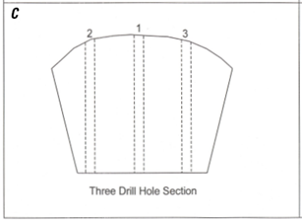
LAB: CORE SAMPLING
5. Take two additional core samples on either side of the center hole (line up the drill holes across the cupcake like this: O O O.)
6. In Section C of your data table, draw what you think the inside of your cupcake looks like now based on the information from additional core samples.

Slide 43
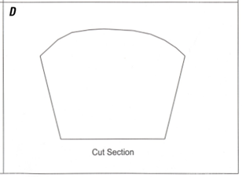
LAB: CORE SAMPLING
7. Using the plastic knife, cut open your cupcake, bisecting the drill holes.
8. In Section D of your data table, draw what the cross section inside your cupcake looks like. Compare it to your previous drawings.

Slide 44
LAB: CORE SAMPLING
Once you are finished with the core sampling and drawing your cross sections, bring your paper to a teacher for verification that the lab is complete.
ONLY THEN can you eat the cupcake.

Slide 45
TO DO
Review #28 due tomorrow.
Answer the Evaluation and Discussion questions.

