Slide 1
DO NOW
Pick up the notes and the lab.
Big Chill Project is due Friday along with your blue sheet.

Slide 2
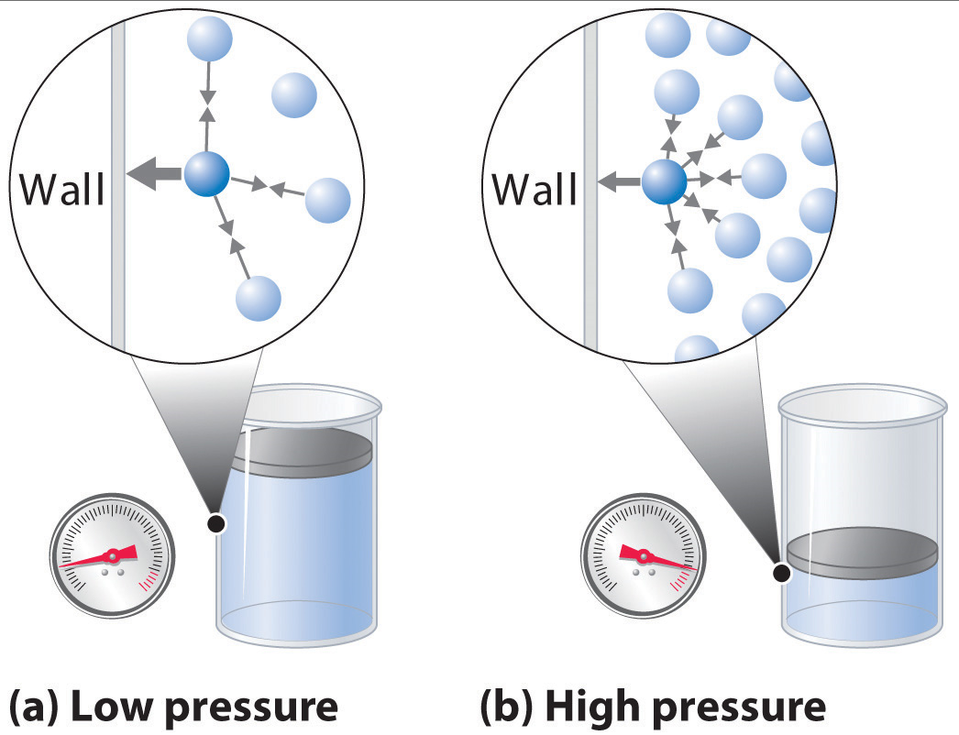
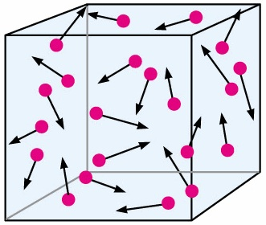
PRESSURE
Pressure is the force per unit area.
Gases exert pressure when they hit the walls of their container.
Even though a gas molecule has little mass, million of millions of millions of gas molecule’s pressure can add up.

Slide 3
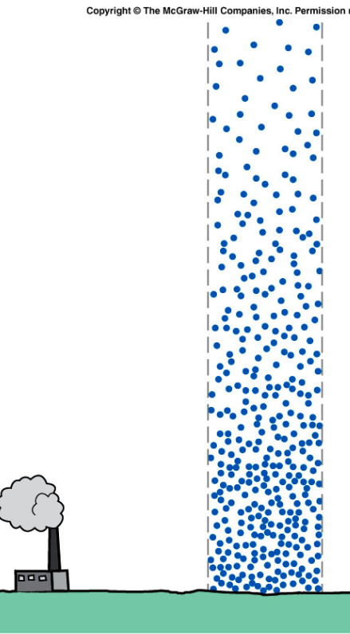
PRESSURE
There is pressure exerted by the atmosphere.
At sea level this pressure is equal to one atmosphere.
Move up in altitude and the pressure decreases. There is less atmosphere pushing down.

Slide 4
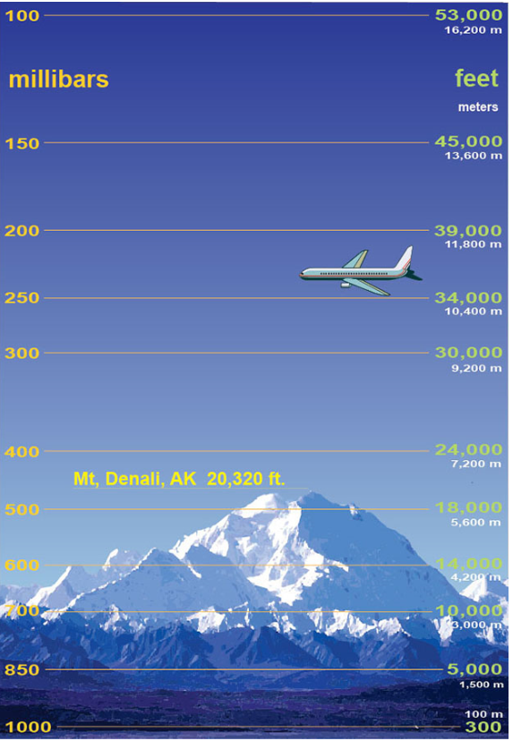
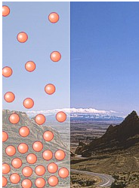
PRESSURE

Slide 5
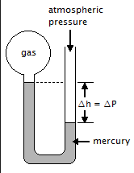
PRESSURE
To measure air pressure, you might use a barometer or a manometer.
A barometer measures atmospheric pressure.
A manometer measures the internal pressure of an enclosed gas.

Slide 6
PRESSURE
Pressure is measured in a variety of units.
UNIT | ABBREVIATION | COMPARE TO 1 ATM
Kilopascal | kPa | 101.3 kPa
Millimeters of mercury | mmHg | 760.0 mmHg
Torr | torr | 760.0 torr
Atmosphere | atm | 1.0 atm
Pounds per square inch* | psi | 14.7 psi
*We will use all of these but psi.

Slide 7
PRESSURE
DEMO
Six Fig Newtons = One Newton
1 N/m²
1 kPa = 6000 Fig Newtons/m²
101.3 kPa = 608000 Fig Newtons
600,000 Fig Newtons laid on top of each other would be 29 feet high!

Slide 8
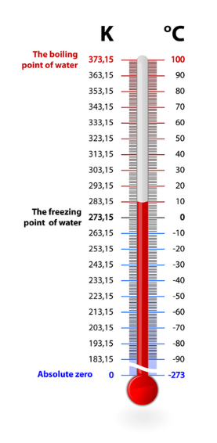
TEMPERATURE
Temperature scale based on absolute zero.
The SI unit of temperature.
We do not use it in class because we do not have Kelvin thermometers.
Absolute zero is the temperature where all molecular motions ceases.

Slide 9
TEMPERATURE
Absolute zero is the temperature where all molecular motion ceases – the particles of matter are not moving at all so the average kinetic energy would be zero.

Slide 10
TEMPERATURE
Kelvin can be easily converted to Celsius:
0 Kelvins, K = -273°C = absolute zero
K = ºC + 273
Convert the following into Kelvin
450° C = ___________
-120° C = ___________
Convert the following into ° C
330 K = _____________
126 K = _____________

Slide 11
LAB: GAS PRESSURE
Purpose:
Observe the effect of increase pressure on the volume of a confined gas.
Graph the pressure to volume relationship
Describe the pressure to volume relationship in mathematical terms.

Slide 12
LAB: GAS PRESSURE
Background:
The volume of a gas depends on three factors: 1.) The number of moles of the gas; 2.) the temperature at which the volume is measured and; 3.) the pressure. For measurements at constant temperature, there is a simple mathematical relationship between the volume of a gas and the pressure. This relationship is known as Boyle’s Law in honor of Sir Robert Boyle, the British chemist who first recognized it about 300 years ago. This activity's purpose is to discover the relationship between pressure and volume of a gas.

Slide 13
LAB: GAS PRESSURE
Materials:
metric ruler
pipet (filled with a blue liquid and sealed)
8 same size books

Slide 14
LAB: GAS PRESSURE
First, form a hypothesis to explain what will happen to the volume of the gas as the pressure (more books) is increased. Do this in INK!
“If the pressure of the gas increases, the volume of the gas will -------”

Slide 15
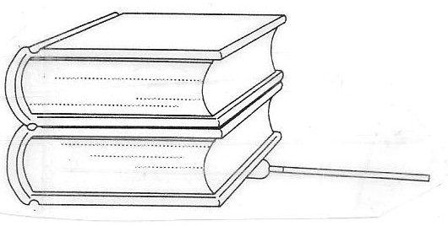
LAB: GAS PRESSURE
The Experiment:
2. Place two equal-sized books on the bulb of the pipet. The stem of the pipet should be visible as shown in the diagram.

Slide 16
LAB: GAS PRESSURE
3. Measure the column length of the trapped air in the stem of the pipet in millimeters (watch significant figures when measuring) and enter this measurement in your logbook.
4. Place another book on top of the first two, and measure and record the length of the air column again.
5. Continue to add the remaining books to the stack one-by-one until you have a total of eight. Measure and record each new air column length in data table.

Slide 17
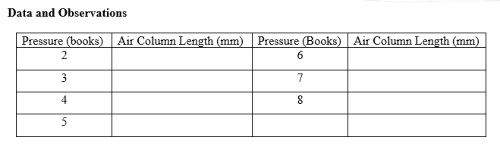
LAB: GAS PRESSURE

Slide 18
LAB: GAS PRESSURE
When you finish:
Put the pipet back in the box on the back desk
Return the ruler to the box on the back desk.
Stack the textbooks and leave on the counter.

Slide 19
LAB: GAS PRESSURE
1. Plot your data on the first graph grid on the other side. Use the pressure in books as the X variable and the length of the column of air in millimeters as the Y variable. Be sure to put a title on your graph, start at zero, and use the WHOLE graph! Is the relationship between gas pressure and volume linear? (circle one) YES NO

Slide 20
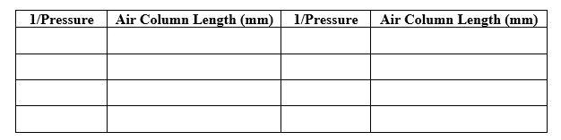
LAB: GAS PRESSURE
3. Calculate the inverse of the pressure, 1/pressure in books (i.e. ½, ¹/3, ¼). NO FRACTIONS – convert the numbers!!! Use the length of air column from your data table. Enter in table below.

Slide 21
LAB: GAS PRESSURE
4. Plot the second graph on the other side. Use the inverse, 1/pressure, as the X variable and the length of the air column as the Y variable. Be sure to put a title on your graph, start at zero, and use the WHOLE graph
When you do the graph for #4, do not use fractions – graph the decimals of the fractions (0.5, 0.33, 0.25, etc.) Be sure your number line is consistent.

Slide 22
LAB: GAS PRESSURE
If there is any liquid in the non-bulb end of the pipet, used centripetal force (spin in a circle) to get the liquid back into the bulb.
You are going to have to share books. Please use only chemistry or only Earth science books to make it consistent.
Measure in millimeters.
Lab is due Thursday.

