Slide 1
DO NOW
Pick up notes.
Handout is due tomorrow

Slide 2
HANDOUT – due Wednesday
For the CONCEPT REVIEW: Solutions handout you need to know something about a few of the solutions listed in Table 1:
hexane/cyclohexane – nonpolar
benzene – nonpolar
methanol (alcohol) - polar

Slide 3
SOLUTIONS
If you are not part of the SOLUTION, you’re part of the PRECIPITATE!

Slide 4
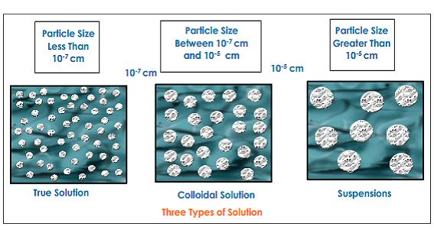
THREE TYPES OF MIXTURES
SOLUTION COLLOID SUSPENSION
There are three basic types of mixtures: solutions, colloids, and suspensions.
The particle size determines the type of mixture.

Slide 5
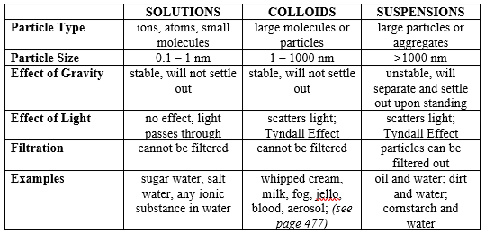
MIXTURES

Slide 6
DEMO
SOLUTION: Salt and water
COLLOID: Shaving gel
SUSPENSION: Cornstarch in water
TYNDALL EFFECT: particles dispersed in mixture are big enough to scatter light.

Slide 7
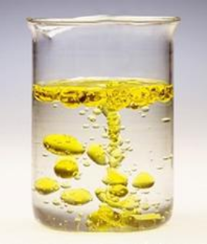
SOLUTIONS
A solution is a homogeneous mixture of two or more substances in a single physical state.
Solutions form when particles of solute are interspersed evenly through the solvent.

Slide 8
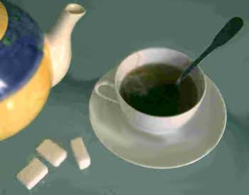
SOLUTIONS
SOLVENT: the substance doing the dissolving and in the greater amount. The most common is water. Called Aqueous.
SOLUTE: the substance being dissolved and in less abundant.

Slide 9
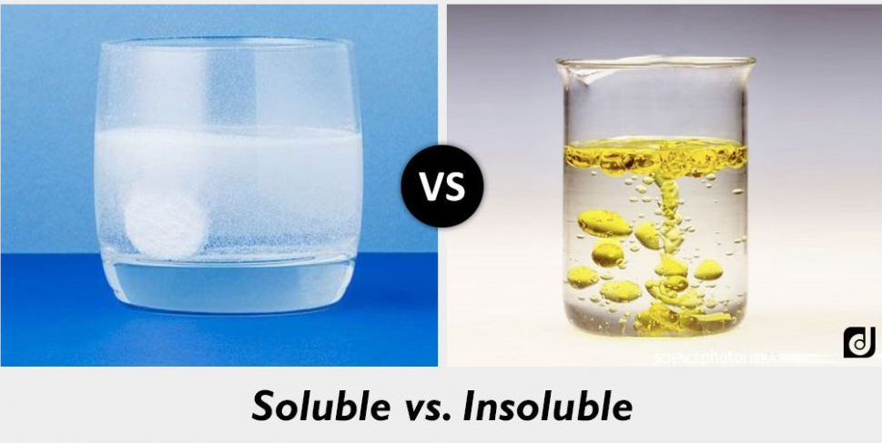
SOLUTIONS
SOLUBLE: when a substance dissolves into another substance.
INSOLUBLE: when a substance does not dissolve into another substance.

Slide 10
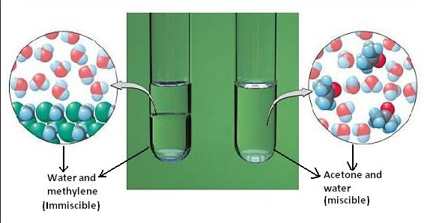
SOLUTIONS
MISCIBLE: two liquids that are soluble in each other.
IMMISCIBLE: two liquids that are insoluble in each other.

Slide 11
QUESTION?
If I combine 50mL beads and 50.0mL sand, what will the final volume be?
If I combine 50.0mL water (green) and 50.0mL alcohol, what will the final volume be?

Slide 12
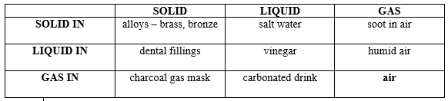
NINE BASIC TYPES OF SOLUTIONS
There are three basic phases of matter and they can combine in nine different ways to form solutions.
Homogeneous mixtures of solids are usually made from liquid solutions that have been mixed and then solidified (frozen).

Slide 13
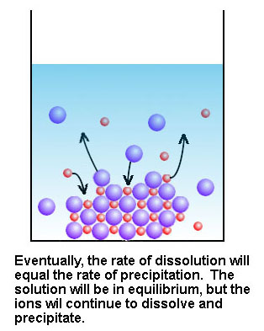
SOLUTION EQUILIBRIUM
A solution is in dynamic equilibrium when the number of solute particles returning to the crystal surface is equal to the number of solute particles leaving the crystal surface.
Saturated is dependent upon temperature and pressure.

Slide 14
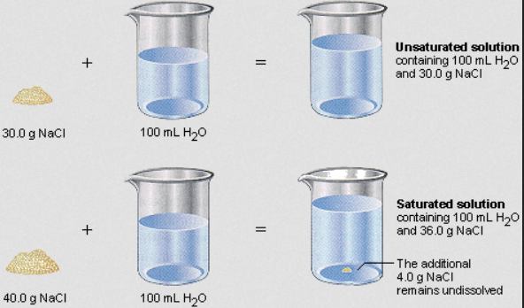
SOLUTION EQUILIBRIUM
A SATURATED solution is a solution with the maximum amount of solute dissolved at a given temperature (Any more added goes to the bottom). It has reached dynamic equilibrium.
An UNSATURATED solution has the ability to dissolve more solute at a given temperature

Slide 15
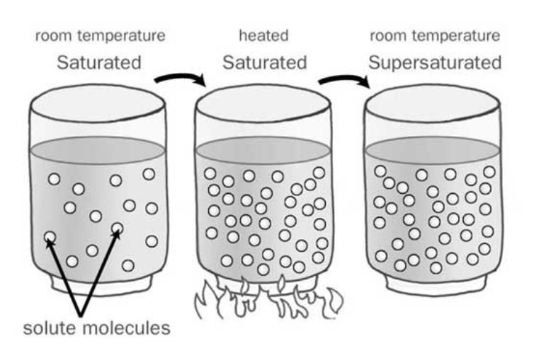
SOLUTION EQUILIBRIUM
If a solution is SUPERSATURATED, then a hot solution is saturated and cooled. An unstable condition results because the solution holds more solute that it normally does at a given temperature.

Slide 16
SOLUTION EQUILIBRIUM
Give and example of each type of solution:
Unsaturated
Saturated
Supersaturated

Slide 17
VIDEOS
Supersaturation
A large supersaturation:
Rapid Crystallization

Slide 18
SOLUTIONS
VIDEO: Solutions
What are ion-dipole attractions?
During the process of solvation, how do ion-dipole attractions compare to the ionic bonds inside an ionic crystal?
Describe the processes that are balanced when solubility equilibrium has been reached.

Slide 19
SOLUTIONS
VIDEO: Solutions
4. If more solute is added to a solution in equilibrium, will this always result in more dissolved solute particles in the solution? Explain.
5. How does a solution become supersaturated?
6. After crystals precipitate out of a supersaturated solution, would you still call it supersaturated? Explain.

Slide 20
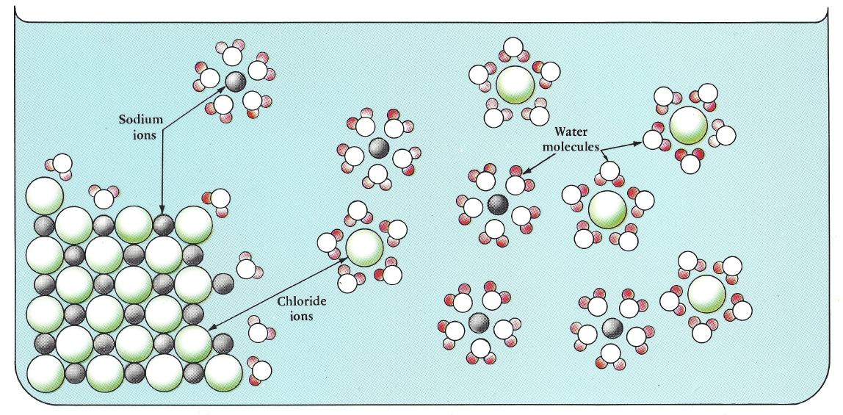
THE DISSOLVING PRACTICE
Dissolving occurs when the solute is pulled apart by the solvent.

Slide 21
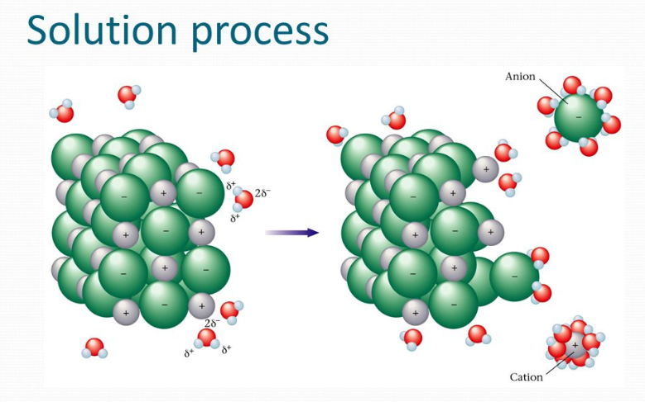
THE DISSOLVING PRACTICE
This takes place at the surface of the solute.
The solvent surrounds the solute.
This process of surrounding the solute is called SOLVATION.

Slide 22
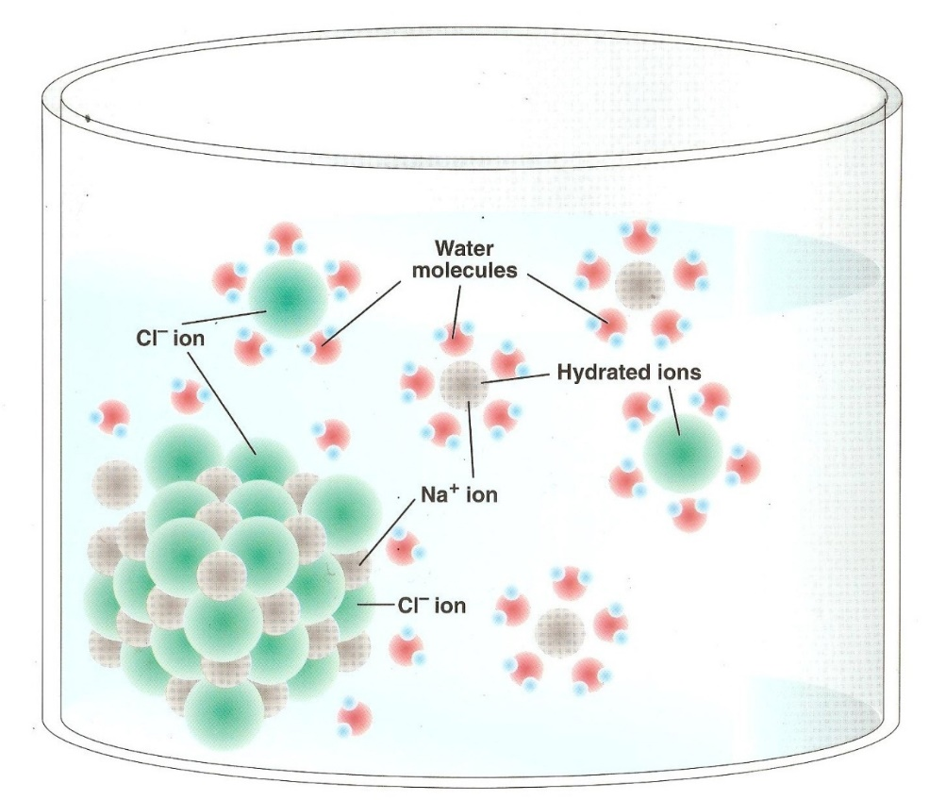
THE DISSOLVING PRACTICE
When the surrounding is done by water, this is called HYDRATION, a particular type of solvation.
When ionic compounds separate into their ions in a solvent, DISSOCIATION occurs.

Slide 23
SOLUTE-SOLVENT COMBINATIONS
1. Polar Solvent – Polar Solute:
The polar solvent is attracted to the polar solute. The solvent gradually surrounds the solute. The particles attach themselves due to polar attraction. Solvation occurs. Like dissolves like. Ex. Salt and water

Slide 24
SOLUTE-SOLVENT COMBINATIONS
2. Polar Solvent – Nonpolar Solute:
Polar solvent particles are attracted to each other and not the solute. Solvation does not occur and a solution is unlikely. Ex. oil and water

Slide 25
SOLUTE-SOLVENT COMBINATIONS
3. Nonpolar Solvent – Polar Solute:
Nonpolar solvent particles have little attraction to the polar solute. Solvation does not occur and a solution is unlikely. Ex. Salt and oil

Slide 26
SOLUTE-SOLVENT COMBINATIONS
4. Nonpolar solvent – nonpolar solute:
Random motion of solute particles causes them to leave the surface of the solute and become evenly dispersed in the nonpolar solvent. Solvation occurs. Like dissolves like.

Slide 27
LASERDISC
Polar and Nonpolar Solvents – Chapter 30
How would you predict whether carbon tetrachloride is a polar or nonpolar solvent? What evidence have you observed that supports your prediction?
Based on chemical formula alone, can you tell whether iodine, I₂, is a polar or nonpolar solute? What evidence have you observed that supports your prediction?
Based on the chemical formula alone, can you tell whether copper (II) chloride, CuCl₂, is a polar or nonpolar solute? What evidence have you observed that supports your prediction?

Slide 28
HOMEWORK
Handout is due tomorrow.

