Slide 1
DO NOW
Pick up notes.

Slide 2
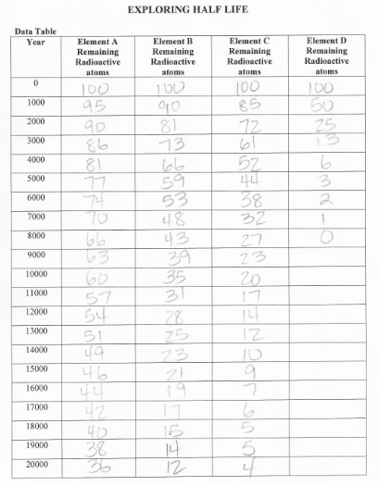
HALF-LIFE SIMULATION LAB

Slide 3
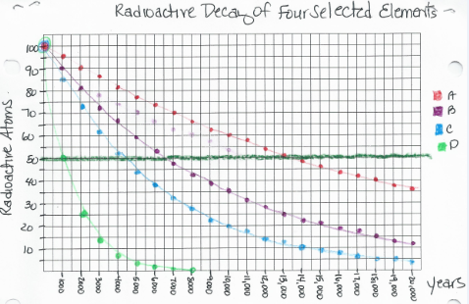
HALF-LIFE SIMULATION LAB

Slide 4
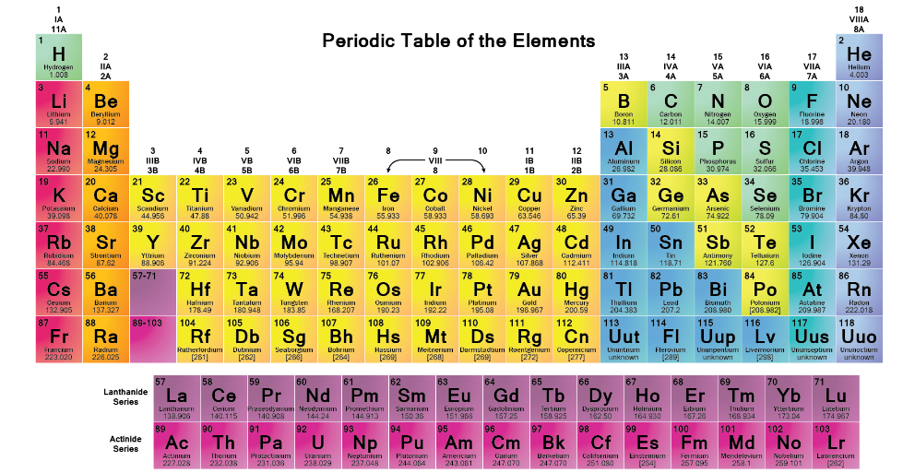
THE PERIODIC TABLE

Slide 5
A BRIEF HISTORY
We have not always had the periodic table.
The modern table as we know it is only about 100 years old.

Slide 6
A BRIEF HISTORY
First Attempts at a Periodic table
Credit for the first periodic table (published in 1862) probably should be given to a French geologist, A.E.Beguyer de Chancourtois.
De Chancourtois was first to recognize that elemental properties reoccur every seven elements, and using this chart, he was able to predict the stoichiometry of several metallic oxides. Unfortunately, his chart included some ions and compounds in addition to elements.

Slide 7
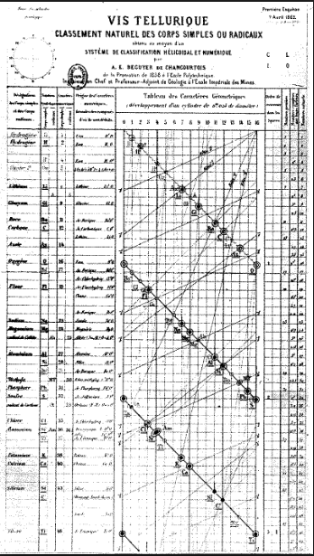
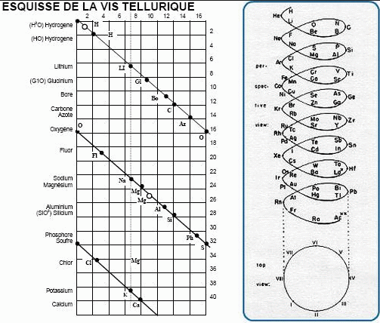
De Chancourtois’
Periodic Table

Slide 8
A BRIEF HISTORY
Law of Octaves
John Newlands, an English chemist, wrote a paper in 1863 which classified the 56 established elements into 11 groups based on similar physical properties, noting that many pairs of similar elements existed which differed by some multiple of eight in atomic weight.
In 1864 Newlands published his version of the periodic table and proposed the Law of Octaves (by analogy with the seven intervals of the musical scale). This law stated that any given element will exhibit analogous behavior to the eighth element following it in the table.

Slide 9
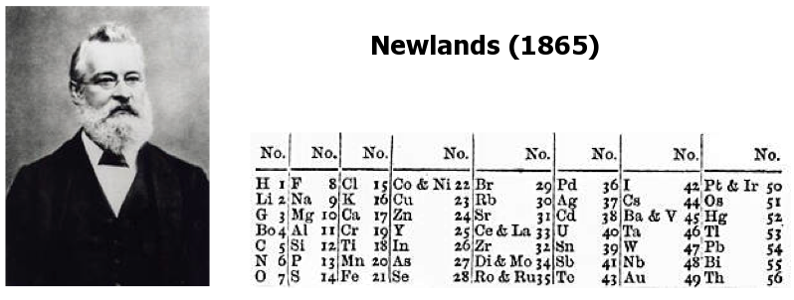
NEWLAND’S PERIODIC TABLE

Slide 10
A BRIEF HISTORY
Father of the Periodic Table
DMITRI MENDELEEV 1869
- discovered a basic chemistry principle.
- felt there was a certain pattern with the elements.
- tested his hypothesis that there was a periodic relationship among the elements.
- set up the periodic table by atomic mass.
- left blanks for undiscovered elements (three were later discovered).

Slide 11
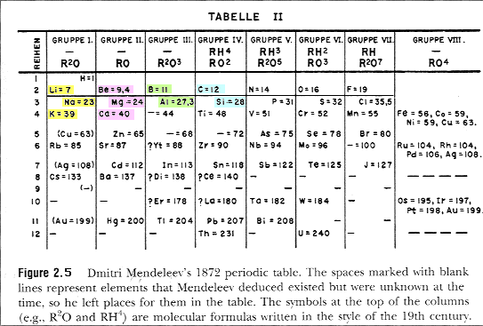
MENDELEEV’S TABLE
Notice that he left some gaps
Notice there are NO Noble Gases

Slide 12
A BRIEF HISTORY
PROBLEMS WITH HIS TABLE
Problems arose as new elements were discovered and didn’t always fit nicely when ordered by mass.

Slide 13
A BRIEF HISTORY
Discovery of the Noble Gases
In 1895 Lord Rayleigh reported the discovery of a new gaseous element named argon which proved to be chemically inert. This element did not fit any of the known periodic groups.
In 1898, William Ramsey suggested that argon be placed into the periodic table between chlorine and potassium in a family with helium, despite the fact that argon's atomic weight was greater than that of potassium. This group was termed the "zero" group due to the zero valency of the elements. Ramsey accurately predicted the future discovery and properties neon.

Slide 14
A BRIEF HISTORY
Father of the Modern Periodic Table
HENRY MOSELEY 1913
- some elements were out of place in Mendeleev’s table.
published results of his measurements of x-ray spectral lines.
He was able to derive the relationship between the square root of the x-ray frequency and number of protons – the atomic number.
elements were then placed according to atomic number in the periodic table. This was an important change.
- This is the modern periodic table.

Slide 15
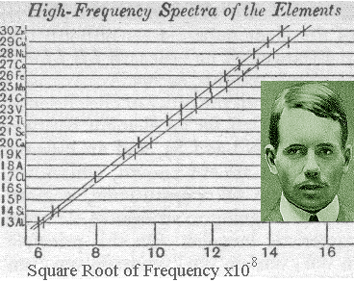
MOSLEY’S DATA

Slide 16
A BRIEF HISTORY
The Final Changes to the Table
GLENN SEABORG 1945
The last major change to the periodic table resulted from his work in the middle of the 20th century.
Starting with plutonium in 1940, Seaborg discovered transuranium elements 94 to 102 and reconfigured the periodic table by placing the lanthanide/actinide series at the bottom of the table.
In 1951 Seaborg was awarded the Nobel Prize in chemistry and element 106 was later named seaborgium (Sg) in his honor.

Slide 17
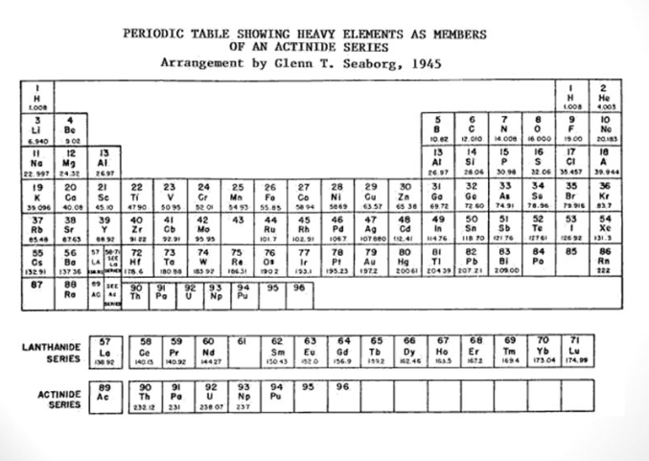
SEABORG’S PERIODIC TABLE

Slide 18
THE PERIODIC LAW
The physical and chemical properties of the elements are periodic functions of their atomic numbers.
Memorize this!

Slide 19
HOW THE PERIODIC TABLE IS SET UP…
COLUMNS
vertical,
called groups (numbers) or families (names)
- 18 total (8 main ones)
- elements in a column are not identical, but similar in properties.

Slide 20
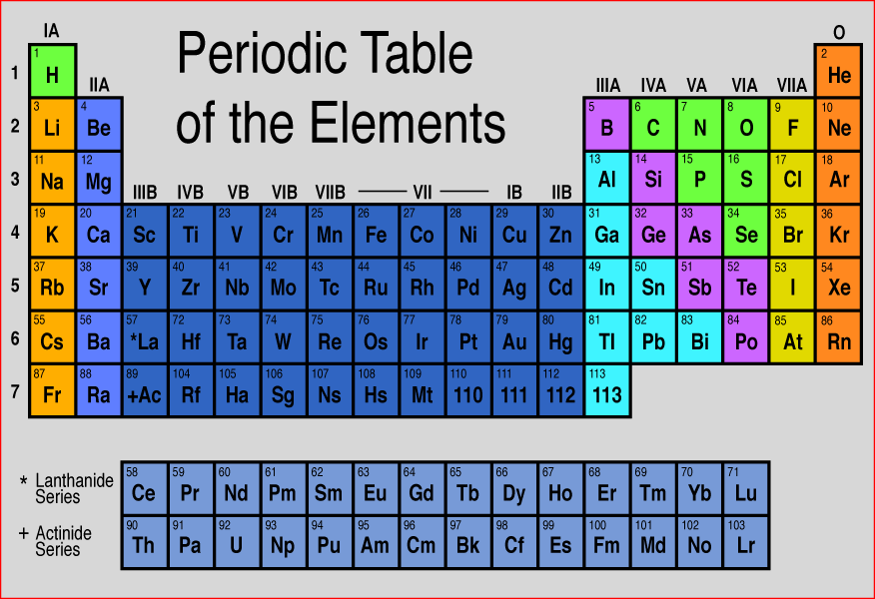

Slide 21
HOW THE PERIODIC TABLE IS SET UP…
Rows
horizontal, called periods,
7 total (right now)
elements are not alike in any way
PATTERN:
  left side elements are active solids,
  far right side elements are inert gases.
  Last two rows are rare earth(inner transition) elements.
  Atomic number increases from left to right.

Slide 23
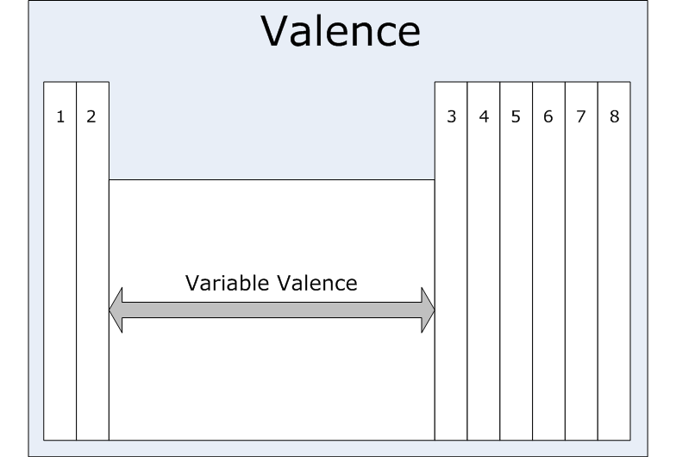
VALENCE
ELECTRONS
Remember: you can determine the number of valence electrons by the element’s position on the table.
Remember that HELIUM has 2 not 8 electrons.

Slide 24
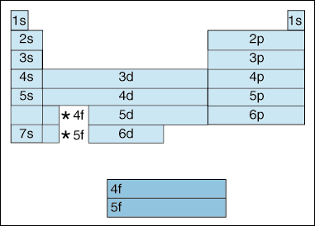
ELECTRON CONFIGURATION
Remember the blocks – s, p, d, f

Slide 25
ELECTRON CONFIGURATION
The most stable electron configuration is one where all the orbitals on the highest energy level are full – like the Noble Gases.
Anything ending in p⁶ is stable.
If you draw an electron dot diagram with 8 electrons, that is a very stable element – OCTET RULE.

Slide 26
ELECTRON CONFIGURATION SHORTHAND
  When using the shortcut, you find the element on the periodic table.
  Then you find the noble gas that precedes it.
  Then you write the noble gas symbol inside brackets [X].
  Finish the electron configuration with what comes after the noble gas.

Slide 28
ELECTRON CONFIGURATION SHORTHAND
  Example: Chlorine, Cl is 1s²2s²2p⁶3s²3p⁵ becomes [Ne] 3s²3p⁵
  Calcium
  Iodine
  Uranium

Slide 29
EXCEPTION
When doing the shortcut for a Noble Gas, you must use the Noble Gas before it.
Yes: for Neon [He]2s²2p⁶
No: for Neon [Ne]

Slide 30
PRACTICE
Calcium
Iodine
Uranium

Slide 32
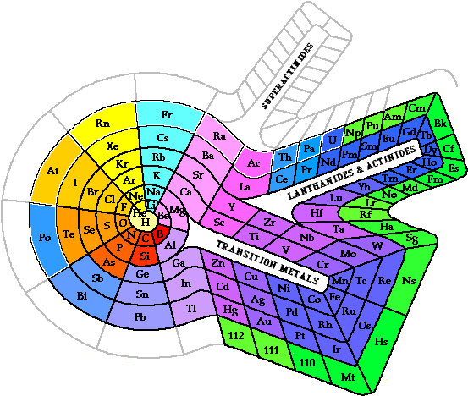
Alternative Periodic Tables:
Spiral

Slide 33
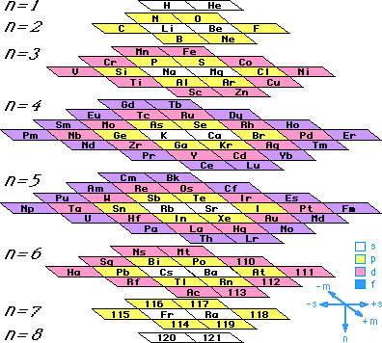
Alternative Periodic Tables:
Stowe

Slide 34
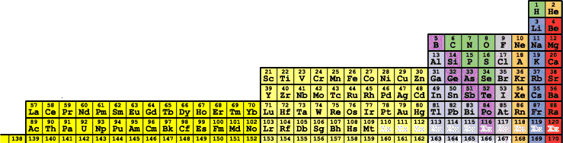
Alternative Periodic Tables:
Tarantola

Slide 35
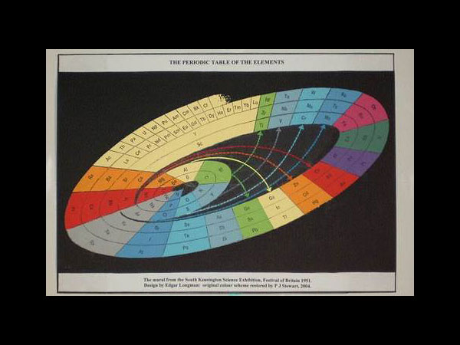
Alternative Periodic Tables:
Edgar Longman

Slide 36
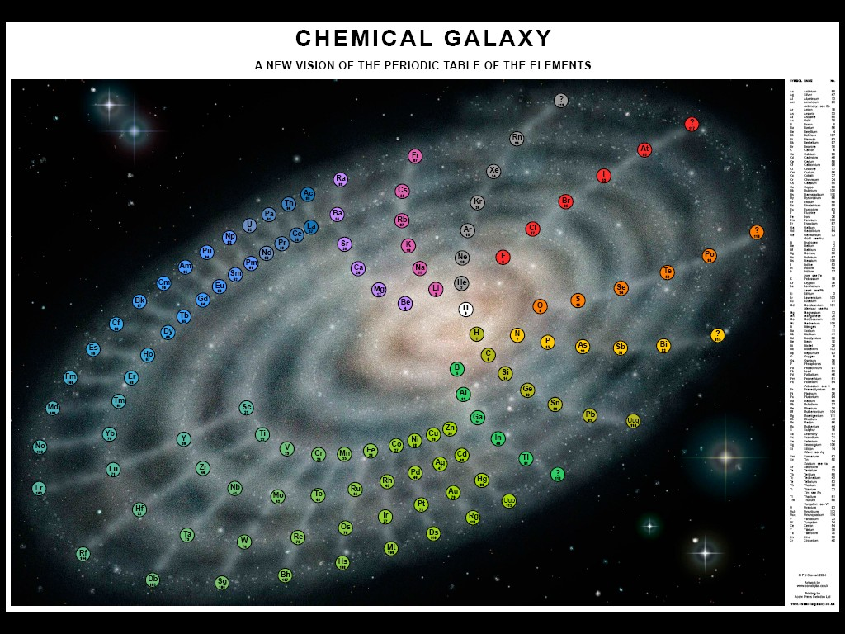
Alternative Periodic Tables:
Chemical Galaxy

Slide 37
Alternative Periodic Tables
More periodic tables:
http://en.wikipedia.org/wiki/Alternative_periodic_tables

Slide 38
TO DO
Mendeleev’s Periodic Table – due tomorrow.

