Slide 1
DO NOW
Pick up notes and Review #28

Slide 2
REVIEW
Wind
Water
Ice
Gravity
Erosion is the process by which products of weathering are transported . What are the major agents of weathering?

Slide 3
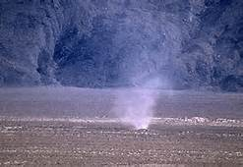
Wind Erosion
SES3. Students will explore the actions of water, wind, ice, and gravity that create landforms and systems of landforms (landscapes).
e. Explain the processes that transport and deposit material in terrestrial and marine sedimentary basins, which result, over time, in sedimentary rock.

Slide 4
WEATHERING: BREAKING DOWN EARTH’S CRUST
Weathering is
Change in the physical form and chemical composition of rock.
Interaction between the tectonic and the hydrologic cycle causes recycling of the materials of the Earth's crust.
Part of the rock cycle – old rocks destroyed and can be recycled into new sedimentary rocks.

Slide 5
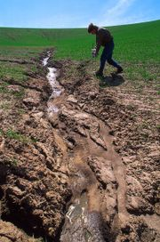
EROSION
Erosion is the process that transports Earth’s weathered materials from one place to another by wind, water or ice.

Slide 6
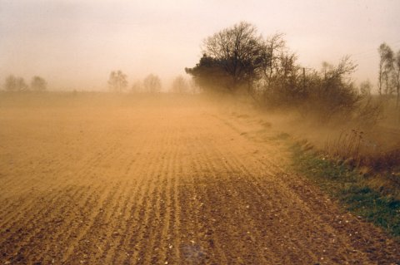

WIND EROSION
Wind contains energy. This energy can erode the landscape.
Moving air can pick up and transport sediments. This is called wind erosion.
Wind erosion is more likely to occur in areas of little vegetative cover and rain.
Video Link: Soil Erosion

Slide 7
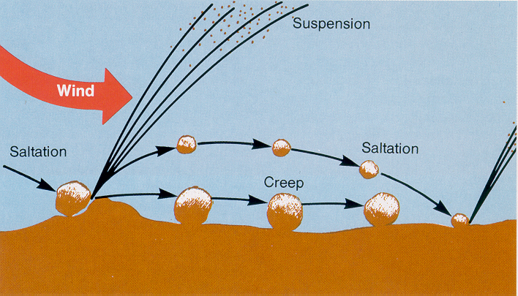
TYPES OF WIND EROSION
  Creep- The largest particles which are too heavy to be lifted into the air are rolled along the surface.

Slide 8
TYPES OF WIND EROSION
  Saltation - larger particles are pushed and bounced along the ground. This accounts for the most wind transport of sand.

Slide 9
TYPES OF WIND EROSION
  Suspension- small particles become airborne for long distances.

Slide 10
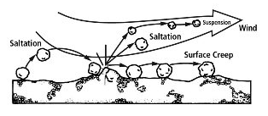
TYPES OF WIND EROSION

Slide 11
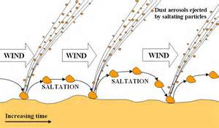
SALTATION
Saltation: Movement of sand grains by series of jumps and bounces

Slide 12
SALTATION
  When wind speed is high enough to lift sand particles.
  Sand grains collide, some bounce.
  Move in direction of wind.
  Usually less than one meter above ground.
  Moisture makes soil heavy – harder to move.
  Dust suspended in air longer by air currents .

Slide 13
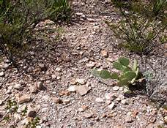
DEFLATION
A form of wind erosion which removes the top layer of fine, very dry soil or rock particles and leaves behind large rock particles

Slide 14
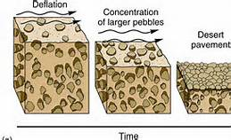
DEFLATION
  Wind removes fine-grained particles.
  Coarser materials remain and concentrate at surface.
  Eventually remaining surface composed only of coarse materials that cannot be transported by wind.
  Desert or stone pavement – remaining rock particles that form a surface of closely packed small rocks.

Slide 15
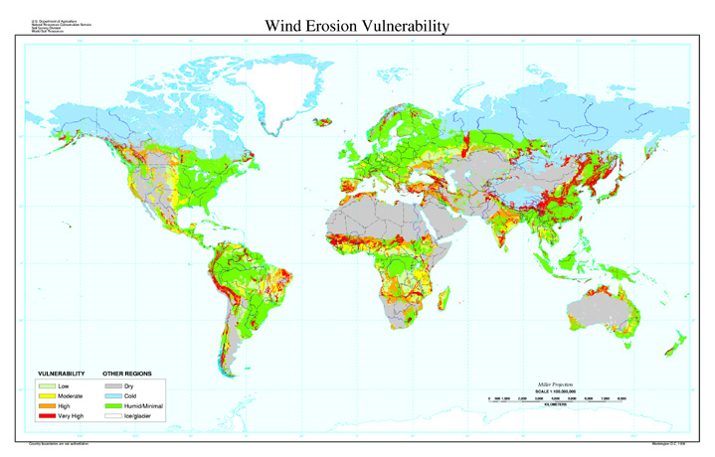

Slide 16
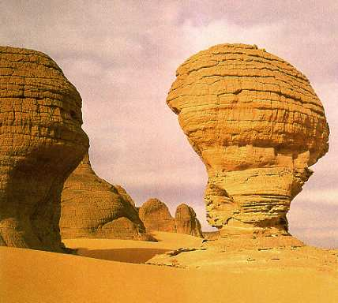
EFFECTS OF WIND EROSION
Abrasion is when particles rub against the surface of rocks or other materials (not limited to wind).

Slide 17
EFFECTS OF WIND EROSION
Pitted and grooved areas on a rock are known as ventifacts.
The direction of the wind in an area can be determined by the appearance of the ventifacts.

Slide 18
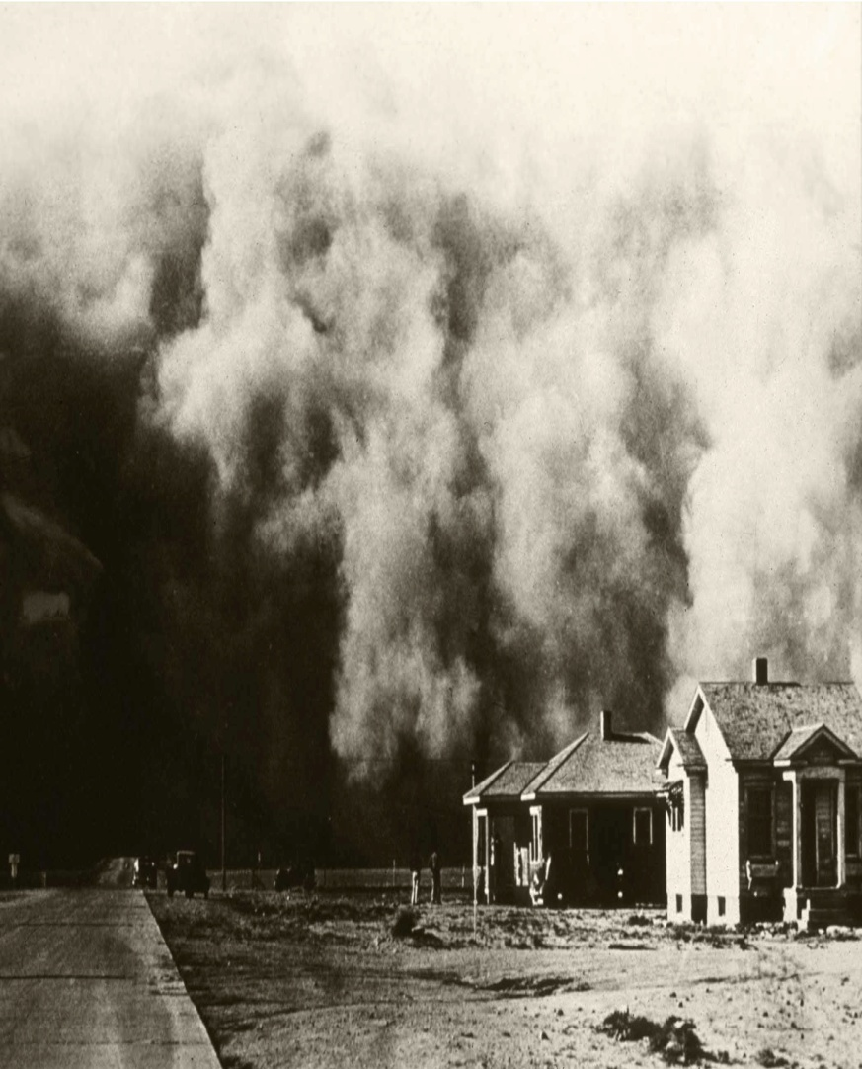
EFFECTS OF WIND EROSION
Dust Bowl: period that occurred during the drought years of the 1930s.
Drought and wind in the region resulted in an increased susceptibility of the topsoil to wind erosion.
Video Link:
Dust Bowl

Slide 19
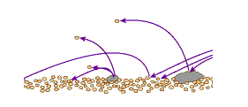
REVIEW
What type of wind erosion is illustrated in the image shown?
Abrasion
Creep
Deflation
Saltation

Slide 20
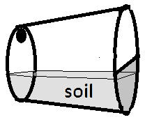

LAB: WIND EROSION
Purpose: Wind erosion can be reduced by putting a protective vegetative cover on the surface of soil.
In this experiment you will simulate wind erosion on a bare surface and one that has vegetative cover.

Slide 21
LAB: WIND EROSION
During the Dust Bowl, wind acted as an agent for erosion. The soil loss is greater for soil that is bare, called fallow, than for soil that has crop residue covering the surface. In this experiment you will simulate wind erosion on a bare surface and one that has vegetative cover.
Purpose: Wind erosion can be reduced by putting a protective vegetative cover on the surface of soil.
In this experiment you will simulate wind erosion on a bare surface and one that has vegetative cover.

Slide 22
LAB: WIND EROSION
Materials:
2 Styrofoam cups
Index card
2 Drinking straws
Soil sample
Craft moss
Digital balance
Scissors
Newspaper
Tape

Slide 23
LAB: WIND EROSION
PROCEDURE
Trace the open end of the cup on your index card. Cut it out.
Cut the circle you created in half on the card stock.
Securely tape one half circle over the open end of each cup.
Make a small hole in the bottom of each cup NEAR THE EDGE. It needs to be big enough for the straw but no bigger. The hold should be on the opposite end of where you taped the card.

Slide 24
LAB: WIND EROSION
5. Hold the cup on the side with the hole at the top and the side with the covered with the on the bottom. Fill each cup about one third full of soil.
6. On top of the soil in one cup, apply a layer of craft moss.
7. Mass each cup individually and record the initial mass in the data table.
8. Insert the tip of the drinking straw into the hole in the bottom end of each cup.
9. Lay newspapers over your lab table and place the cup on its side in the middle of the table.

Slide 25
LAB: WIND EROSION
10. READ THIS ENTIRE STEP BEFORE PROCEEDING! While holding the cup horizontally with the hole to the top and the drinking straw directed toward the soil, you will exhale a moderate amount to blow across the top of the soil in the cup. Do NOT inhale. You will exhale and blow through the straw across the top of the soil for a total of TEN breaths into each cup. The amount of exhale needs to consistent for each trial. Have a partner hold a piece of paper in front of the open end of the cup so that any dirt blown out of the cup is deflected, falls and ends up on the newspaper.

Slide 26
LAB: WIND EROSION
11. Remove the straw and mass each cup again. Record the mass in the data table.
12. Repeat the experiment; this time blowing harder. Record the data in the second data table.
13. Clean up your mess. Carefully throw away the newspaper with the trapped soil. Return the left over soil in the cup and bring your cups to your teacher. Trash your straws.

Slide 27
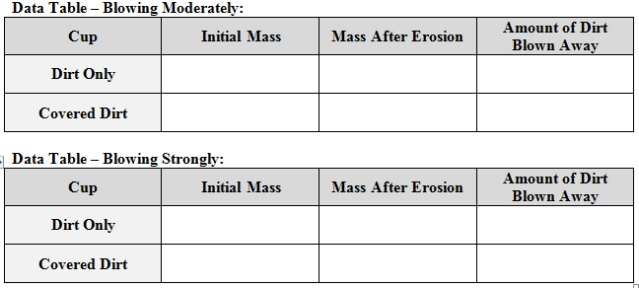
LAB: WIND EROSION

Slide 28
LAB: WIND EROSION
Analysis:
1. In the experiment, how much soil was lost to wind erosion blowing moderately?
Cup one: Field that has soil without cover: ____________
Cup two: Field that has soil with cover: ______________
2. In the experiment, how much soil was lost to wind erosion blowing strongly?
Cup one: Field that has soil without cover: ____________
Cup two: Field that has soil with cover: ______________
3. What was the agent of erosion in the experiment?
4. How did the moss affect the rate of erosion? Why?
5. How did the strength of the wind affect the rate of erosion?

Slide 29
TO DO
Do Wind Erosion lab now.
Review #28 is due Monday.

