Slide 1
DO NOW
Pick up notes and Review #27.

Slide 2
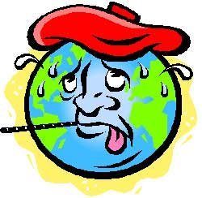
REVIEW
Which greenhouse gases are natural?
Which are anthropogenic?
Water vapor?
Chlorofluorocarbons (CFC’s)?
Nitrous oxides?
Sulfur hexafluoride?
Carbon dioxide?
Methane?

Slide 3
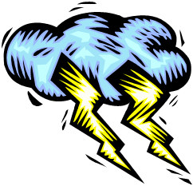
CLIMATE CHANGE AND EXTREME WEATHER
SES5. Students will investigate the interaction of insolation and Earth systems to produce weather and climate.
e. Describe the hazards associated with extreme weather events and climate change.

Slide 4
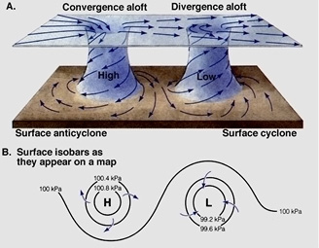
Weather Review
Molecules in the atmosphere are warmed by radiation from earth and retain that heat.
Uneven heating and cooling of earth’s surface causes high and low pressure differences.
Air flows from high to low pressure at surface.

Slide 5
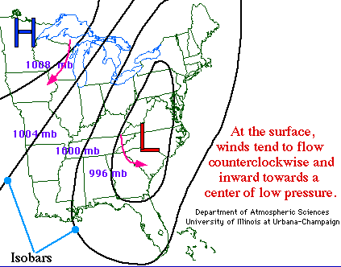
Weather Review
When air masses of different characteristics meet, FRONTS form.
Rising air in low pressure condenses and forms clouds.
Condensation releases energy in form of LATENT HEAT.
Latent heat provides energy for severe weather.

Slide 6
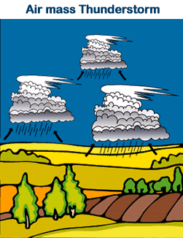
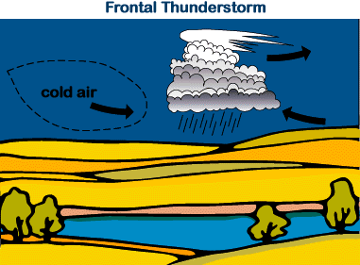
Thunderstorm Formation
Formed by uplifting of warm and humid air.
Air condenses and clouds form.
Latent heat is released.
Thunderstorms need three conditions to form:
1. Moisture
2. Lifting mechanism (rising air)
3. Instability

Slide 7
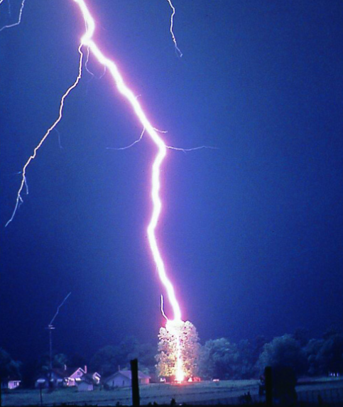
Lightning AND Thunder
Electric current caused by build up of negative electric charges in clouds.
A positive charge also builds up on the ground beneath the cloud.
The charge coming up from these points eventually connects with a charge reaching down from the clouds and - zap - lightning strikes!
Lightning is about 54,000° F!
When a lightning bolt travels from the cloud to the ground, it actually opens up a little hole in the air, called a channel.
Once the light is gone, the air collapses back in and creates a sound wave that we hear as thunder.

Slide 8

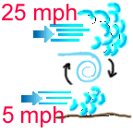
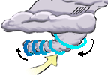
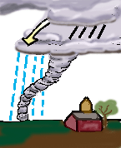
Tornadoes
A TORNADO is a violent rotating column of air extending from a thunderstorm to the ground.
Air rotates because of wind shear.
Faster spin makes a funnel cloud.
The funnel rotates and touches down.
More common in USA because warm, moist air from the Gulf of Mexico meets cool, dry air from Canada.
Most tornadoes form in thunderstorms.
Intensity determined using Fujita scale – based on damage.
TORNADO!

Slide 9
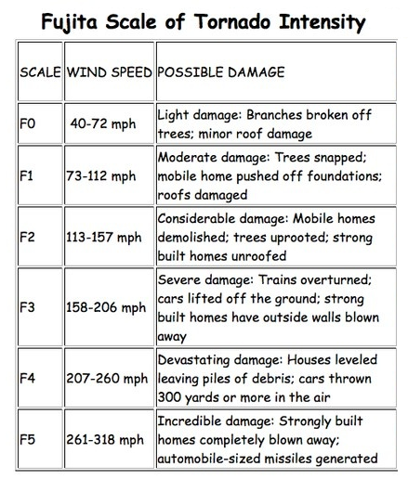
Fujita Scale: Tornado Damage

Slide 10
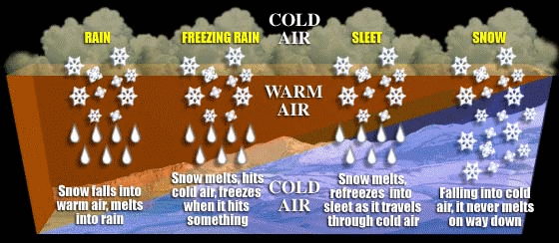
Winter Storms
Energy from the clash of two air masses of different temperatures and moisture levels.
Form when an air mass of cold, dry, Canadian air moves south and interacts with a warm, moist air mass moving north from the Gulf of Mexico.
Low pressure system – the lower the pressure, the worse the storm.

Slide 11
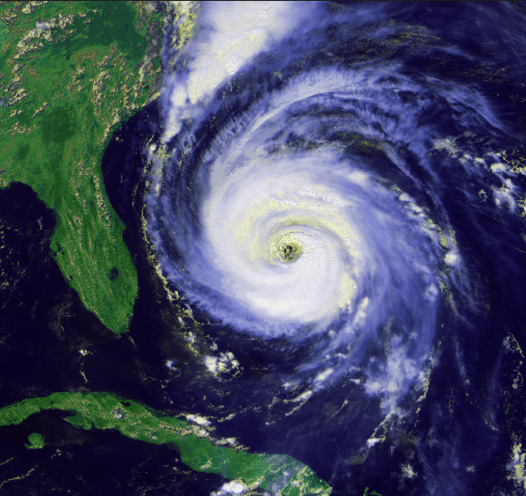
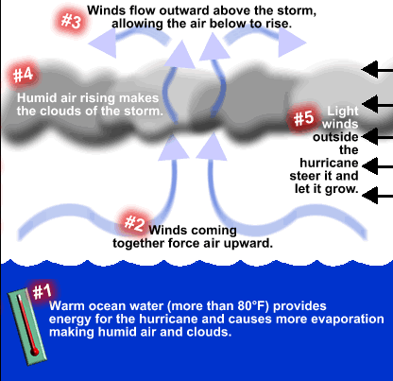
Hurricanes
Form over really warm ocean water- 80°F or warmer.
Energy from warm ocean waters forms a center of low pressure.
Latent heat from evaporation and condensation feeds storms.
  Higher temperatures, more evaporation, more energy!

Slide 12
Hurricanes
Form in tropical regions, north and south of the equator.
Coriolis force creates the spin in the hurricane.
Hurricanes rotate in a counter-clockwse direction (Northern hemisphere) around the low pressure center called the "eye."

Slide 13
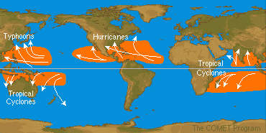
Hurricane Formation AND Movement
Move in generally predictable patterns.
Generally form in the trade wind belts and move eastward.
As they come close to land, they tend to turn toward the poles and then are caught in the prevailing Westerly winds.

Slide 14
Hurricane Formation AND Movement
Many form from hot air that blows westward from the Sahara desert over the Atlantic ocean. Air rises over the ocean and a low pressure system forms.
Hurricanes from in Pacific and Indian oceans called Typhoons and Cyclones.

Slide 15
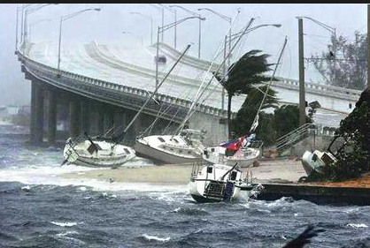
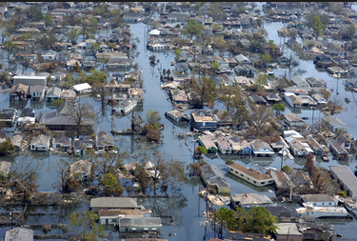
Hurricane Damage
Wind damage:
  Can destroy buildings and homes
  Debris (signs, roofing material, siding, etc.) become flying missiles in hurricanes.
Flood damage:
  Torrential rains often in excess of six inches can produce deadly and destructive floods.

Slide 16
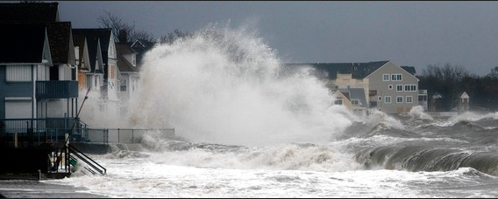
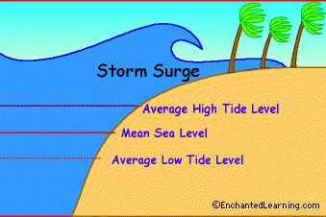
Hurricane Damage
Storm surge damage:
  Accounts for 90% of all hurricane deaths
  Large dome of water often 50 to 100 miles wide that sweeps across the coastline near where a hurricane makes landfall.
  The stronger the hurricane and the shallower the offshore water, the higher the surge is.

Slide 17
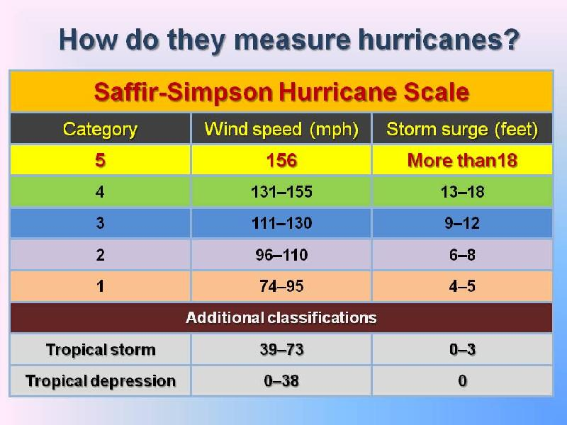
Classifying Hurricanes

Slide 18
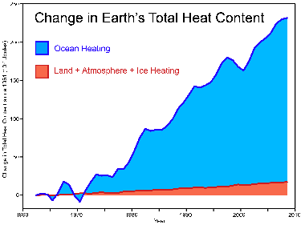
Energy in the Atmosphere
Global average surface temperature rose about 1.6°F between 1906 and 2005 .
Sources of heat:
  Greenhouse effect- anthropogenic or naturally occurring
  Latent heat – increased evaporation/condensation due to increased temperature
Increase in energy provides more energy for storms.
Global warming leads to more extreme weather because there is more energy in the atmosphere.

Slide 19
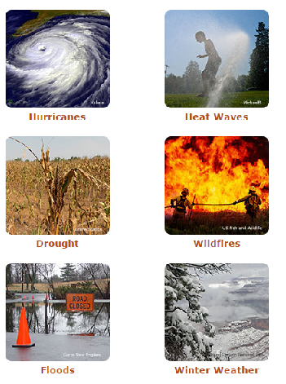
Global Warming and Extreme Weather
Global warming is making hot days hotter, rainfall and flooding heavier, hurricanes stronger, and droughts more severe.
This intensification of weather and climate extremes is a result of more energy in the atmosphere.
It is also causing dangerous changes to the landscape of our world, adding stress to wildlife species and their habitat.

Slide 20

Global Warming AND Water Vapor
Warmer atmosphere holds more water vapor.
Water vapor is a powerful greenhouse gas.
More water vapor increases energy and increases temperature (positive feedback loop).

Slide 21
Global Warming AND Water Vapor
More water vapor provides more moisture for weather events
  More moisture for rain and snow.
  Greater number and intensity of hurricanes.
  Precipitation shifts, patterns change.

Slide 22
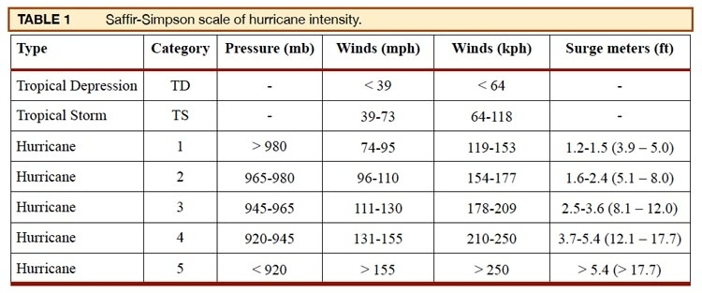
Review
Why does global warming lead to more frequent and intense hurricanes?

Slide 23

LAB:
Explore the RED CROSS website to learn more about hurricanes.

