Slide 1
DO NOW
Turn in Molar Quantities lab.
Pick up Notes
Get out your green periodic table, calculator, and Empirical and Molecular Formulas handout

Slide 2
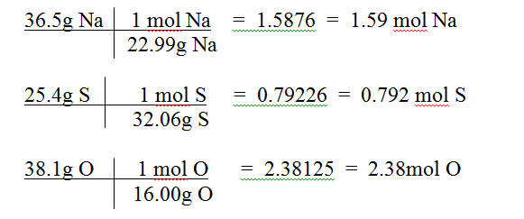


HOMEWORK
1. Find the empirical formula for a substance that has 36.5g Na, 25.4g S, and 38.1g O.

Slide 3
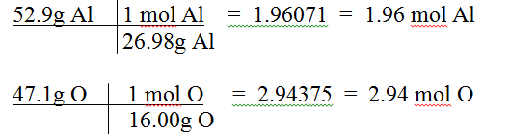
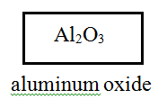

HOMEWORK
2. While trace impurities of iron and chromium in natural corundum form the gemstones ruby and sapphire, they are basically a binary compound of aluminum and oxygen, with 52.9% Al and 47.1% O. Find the empirical formula and give the chemical name for corundum.

Slide 4
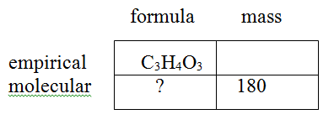
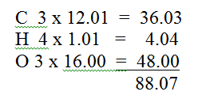


HOMEWORK
3. The simplest formula for vitamin C is C₃H₄O₃. Experimental data indicates that the molecular mass of vitamin C is 180 amu.

Slide 5
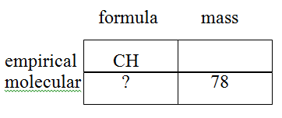
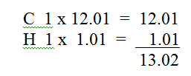


HOMEWORK
4. An organic compound has an empirical formula of CH. If the molecular mass is 78, what is the molecular formula?

Slide 6
HYDRATES
A crystalline compound in which its ions are attached to one or more water molecules.
Hydrates are solids with water molecules trapped in them.
Used in the desiccation of substances and to store energy in solar cells.
Usually have a specific ratio of water to the compound and are considered one single molecule.
The “•” does NOT mean to multiply. It means that waters are attached.
When calculating the mass, you must also calculate the amount of water.

Slide 7
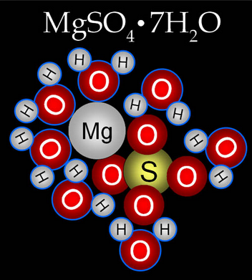
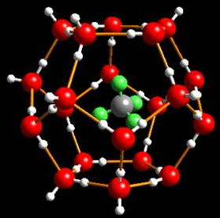
HYDRATES
Methane Hydrate

Slide 8
HYDRATES
The formula is written as:
(ionic formula) (number of waters)
XY • XH₂O
CuSO₄ • 5H₂O
copper (II) sulfate pentahydrate

Slide 9
HYDRATES
Use the same prefixes as with covalent compounds:
mono – 1 tetra - 4 hepta -7 deca - 10
di - 2 penta – 5 octa - 8
tri - 3 hexa – 6 nona -9
Practice Naming
Na₃PO₄ • 2H₂O
Ba(OH)₂ • 8H₂O
SrCl₂ • 6H₂O

Slide 10
ANALYZING A HYDRATE
In order to analyze, you must drive off the water. This is usually done by heating the compound.
The compound that is left is “anhydrous” – without water.
The compound usually changes color.
g ANHYDROUS SOLID + g WATER = g HYDRATE

Slide 11
DETERMINING THE FORMULA
It is a lot like calculating the empirical formula only you are not using single elements.
You are using water and the compound.
Follow these steps:
You have a 5.00g sample of a barium chloride hydrate. Determine the correct formula is you are given 5.00g of the hydrate and once you heat it and drive the water off, the new mass of the anhydrate is 4.26g

Slide 12
STEP ONE
1. Find the individual masses if they are not given to you
Hydrate mass – anhydrous mass = water mass
Example:
5.00g – 4.26g = 0.74g

Slide 13
STEP TWO
2. Find the empirical formula.
4.26g BaCl₂ 1 mol BaCl₂ = 0.0205mol BaCl₂
208.23g BaCl₂
0.74g H₂O 1 mol H₂O = 0.041mol H₂O
18.02g H₂O

Slide 14
STEP THREE
3. Divide the smallest mole amount into both.
BaCl₂ 0.0205mol = 1.00
0.0250mol
H₂O 0.041mol = 2.0 0.0205mol
BaCl₂ • 2H₂O

Slide 15
ALL THE STEPS
This is just like empirical formula calculations.
Convert mass to moles for the water and the ionic formula.
Divide the lowest mole into itself and the other.
Determine the formula.

Slide 16
PRACTICE
Determine the formula of a hydrate with 48.8% MgSO₄ and 51.2% H₂O.

Slide 17
HYDRATE ANSWER
48.8% MgSO₄ → 48.8g MgSO₄
48.8g MgSO₄ 1 mol MgSO₄ = 0.405mol MgSO₄
120.37g MgSO₄
51.2% H₂O → 51.2g H₂O
51.2g H₂O 1 mol H₂O = 2.84mol H₂O
18.02g H₂O
0.405mol MgSO₄ = 1 2.84mol H₂O = 7
0.405mol MgSO₄ 0.405mol MgSO₄
MgSO₄ • 7H₂O magnesium sulfate heptahydrate

Slide 18
TO DO
Molecular and Hydrate Formulas handout due tomorrow.
Lab tomorrow.

