Slide 1
DO NOW
Pick up the notes and Review #19.
Turn in review #18.

Slide 2
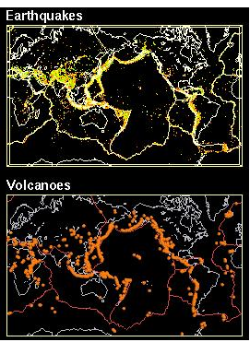
REVIEW
Why do earthquakes and volcanoes generally occur in the same geographic regions?
They both occur at plate tectonic boundaries!

Slide 3
PLATE TECTONIC HAZARDS
SES2C: Relate certain geologic hazards to specific plate tectonic settings.

Slide 4
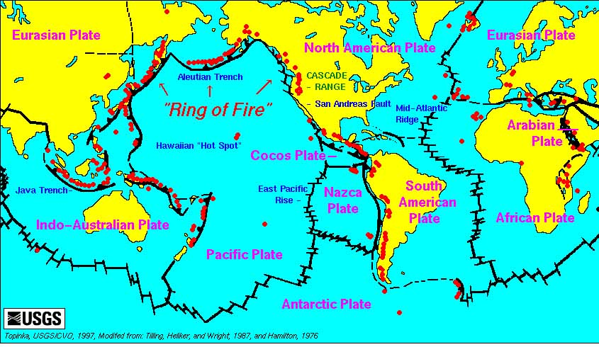
HAZARDS: VOLCANOES, EARTHQUAKE AND TSUNAMIS

Slide 5
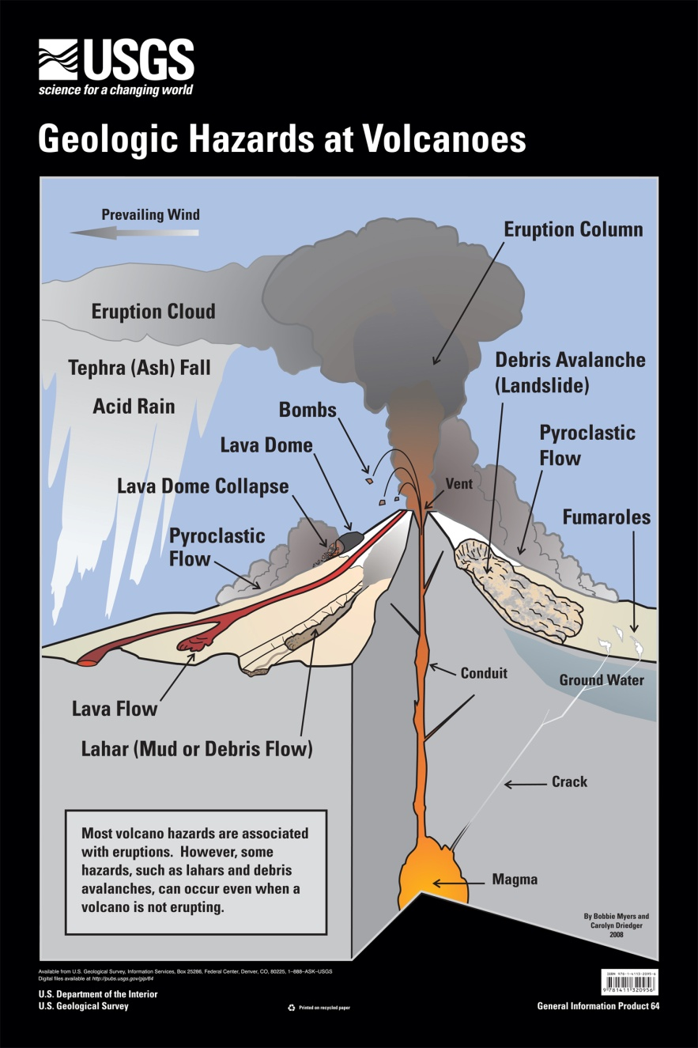
VOLCANOES
11% of active volcanoes are in the USA (169).
Mt. Rainier in Washington one of nation’s most dangerous.
United States Geological Survey (USGS) monitors the threat.

Slide 6
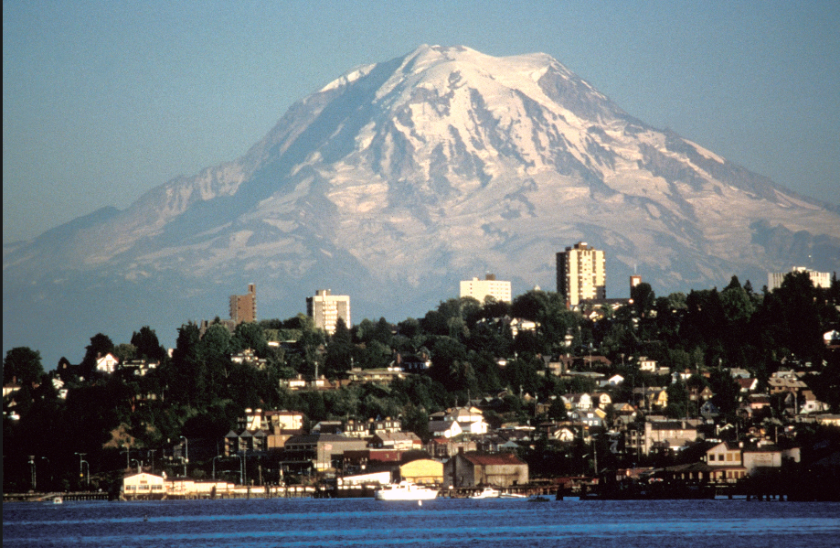
MOUNT RAINIER

Slide 7
VOLCANOES
Dangers include:
  Lava flows
  Debris
  Avalanches
  Explosive blasts
  Gas emissions
  Ash clouds

Slide 8
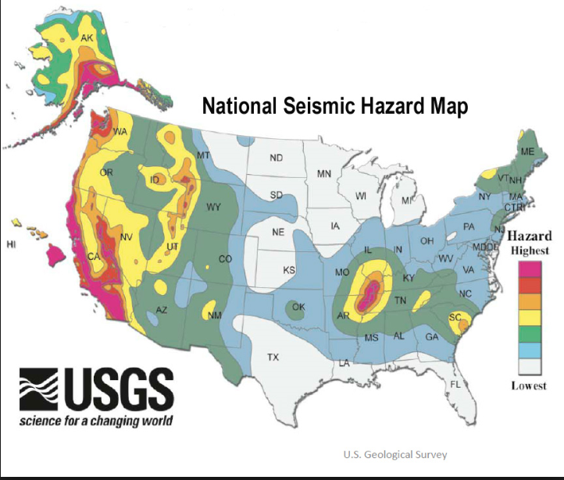
EARTHQUAKES
Risks along fault lines - 39 US States have risk.
Federal Emergency Management Agency (FEMA) estimates $5.6 billion losses per year.

Slide 9
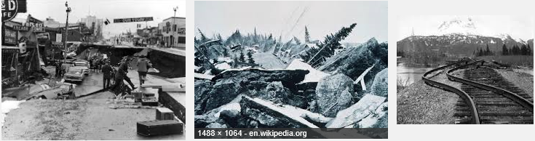
EARTHQUAKES
USGS monitors earthquakes.
Largest earthquake in USA: 9.2 in Alaska 1964.

Slide 10
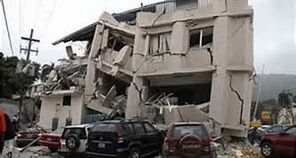
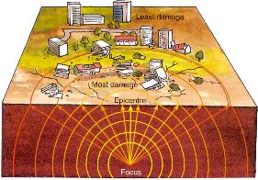
EARTHQUAKES
Most severe likely to have shallow focus.
The type of ground impacts damage
  Solid rock has less damage than less resistant rocks.
  Sand and mud vibrate like jelly in an earthquake.

Slide 11
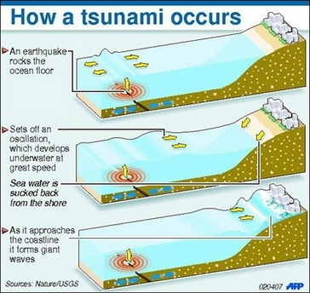
TSUNAMI
Gigantic ocean waves
Severe ground shaking may cause tsunamis.
When the waves enter shallow water, they may rise to several feet or, in rare cases, tens of feet, striking the coast with devastating force.
Formed after:
  volcanic eruption
  submarine earthquake
  landslide

Slide 12
TSUNAMI
Warning Signs
As a tsunami approaches shorelines, water may recede from the coast, exposing the ocean floor, reefs and fish.
Abnormal ocean activity, a wall of water, and an approaching tsunami create a loud roaring sound similar to that of a train or jet aircraft.

Slide 13
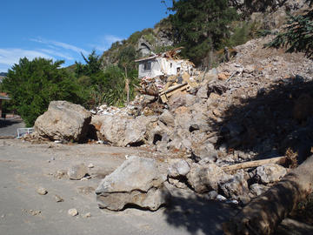
LANDSLIDES
Seismic waves destabilize cliffs and steep slopes.
Can cause landslides and rockfalls.

Slide 14
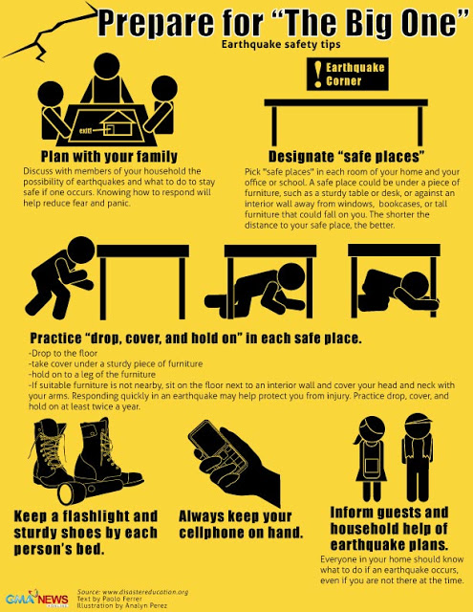
EARTHQUAKE SAFETY
Destructive earthquakes can happen anywhere.
Most injuries during earthquakes are caused by the collapse of buildings.
Safety measures in an earthquake include:
  stand in a doorway,
  crouch under a table or desk.
  stay calm.

Slide 15
TO DO
Work on the Igneous Rocks lab and the Viscosity lab.
Review #19 due tomorrow.

