Slide 1
DO NOW
Pick up notes, small white paper, and Review #33.
Turn in Review #32.

Slide 2
SMALL WHITE PAPER
Write your name (LEGIBLY!)
Write your math class (Foundations, Algebra I, Geometry, etc.)
Pass it to the front.

Slide 3
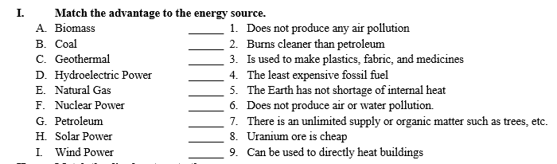
REVIEW #30

Slide 4
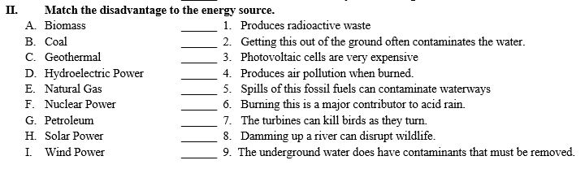
REVIEW #30

Slide 5
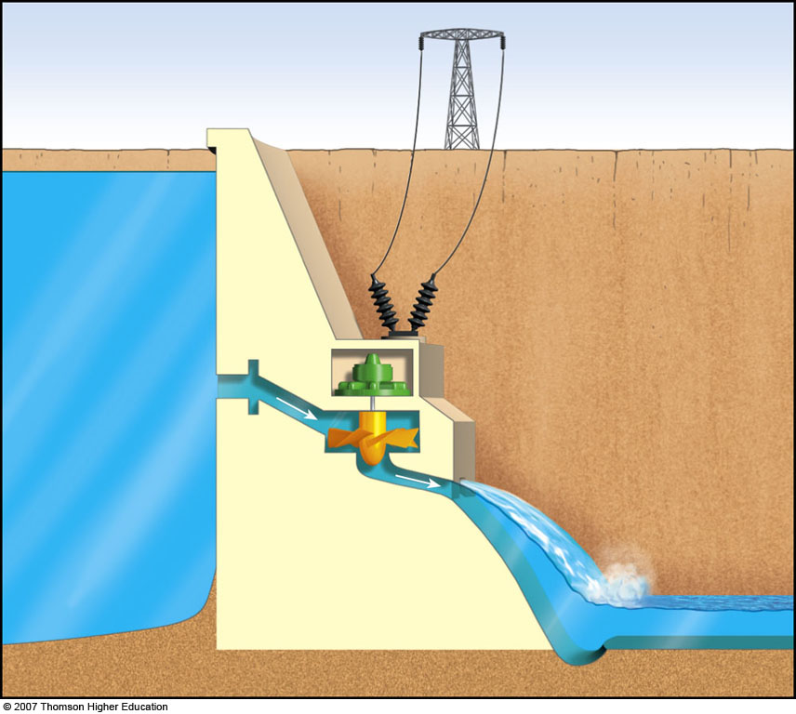
REVIEW
What are some of the advantages of building dams?
What are some of the disadvantages?

Slide 6
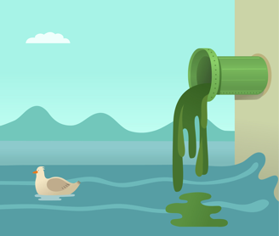
WATER POLLUTION
AND TREATMENT
SES6. Students will explain how life on Earth responds to and shapes Earth systems.
a. Relate the nature and distribution of life on Earth, including humans, to the chemistry and availability of water.

Slide 7
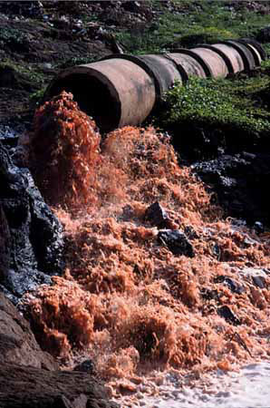
Water Pollution
Water pollution is the contamination of bodies of water.
It can come from discharges of untreated sewage and industrial wastes.
It is a major problem in developing countries – few regulations.
Polluted groundwater is difficult to clean because the recycling process of groundwater can take hundreds or thousands of years.
Remember that groundwater is BELOW the surface.

Slide 8
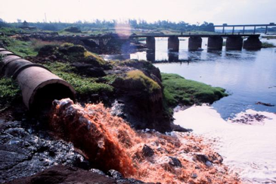
SOURCES OF WATER POLLUTION
Most water pollution comes from human activities on land.
Point sources: specific locations
  Factory waste, sewage treatment plants, mines, etc.
Nonpoint sources: cannot be traced to a single site of discharge
  acid rain, runoff, seepage into groundwater
Farming is largest source of water pollution in the U.S.

Slide 9
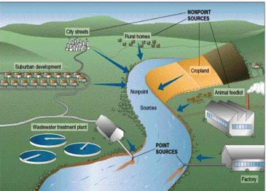
SOURCES OF POLLUTION

Slide 10
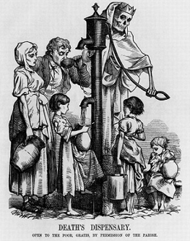
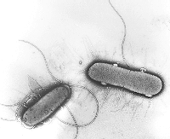
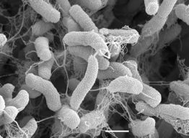
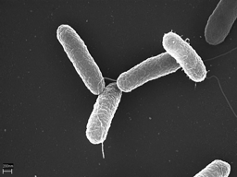
WATER POLLUTION AND DISEASE
Pathogens: organisms that produces a disease - an organic pollutant.
Can be bacteria, viruses or parasites
Includes: E. coli, Cholera, Typhoid fever, dysentery, giardiasis, hemolytic uremic syndrome .
Symptoms often include explosive emissions from either end of the digestive tract.
Escherichia coli
Vibrio cholerae
Salmonella Typhi

Slide 11
WATER POLLUTION
Affecting Health
Infectious agents like bacteria and viruses – comes from sewage, human and animal excrement.
Organic Chemicals like pesticides, plastics, detergents, and oil – comes from agricultural, industrial, and domestic wastes.
Inorganic Chemicals like acids, salts, and metals – comes from industrial and domestic effluents.
Radioactive Materials like uranium, thorium, radon, etc. – comes from mining, power plants, and other natural sources.

Slide 12
WATER POLLUTION
Affecting Ecosystem
Plant nutrients like nitrates, phosphates, etc. – comes from chemical fertilizers, sewage, and manure.
Sediments like silt and soil – comes from soil erosion.
Thermal (heat) – comes from industries and power plants.
Oxygen Demanding like agricultural wastes and manure – comes from sewage, and agricultural runoff.

Slide 13
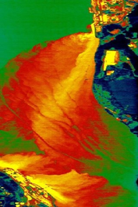
Thermal Pollution
Thermal pollution is the harmful release of heated liquid into a body of water or heat released into the air as a waste product of a business.
Happens when industries and power plants release hot water into the environment.

Slide 14
Thermal Pollution
Effects:
  Sudden increases in temperature
  Decreased dissolved oxygen
  Changes to reproductive cycles of plants and animals
  Increased susceptibility to disease
  Economic and environmental damage

Slide 15
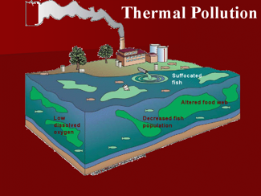
THERMAL POLLUTION

Slide 16
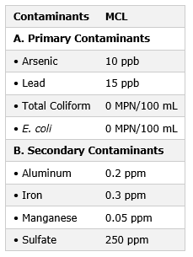
DRINKING WATER QUALITY
Much of the world's drinking water is contaminated and poses serious health threats.
Most drinking water is purified by storage in reservoir (suspended matter settles), and treated by sand filters, activated charcoal, and addition of chlorine.
Many use bottled water and home filters; bottled water is often more contaminated than tap water.
MCL – maximum contaminant level

Slide 17
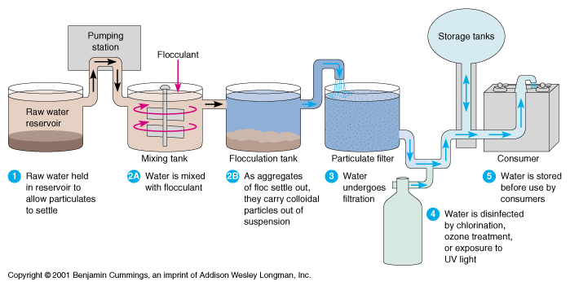
Municipal Water Comes from Water Purification Plants

Slide 18
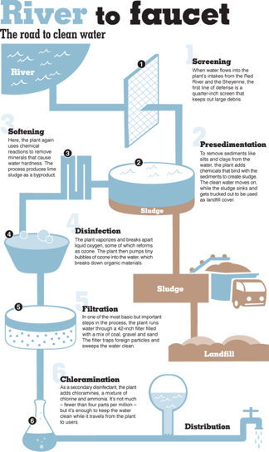
Initial Treatment
Screening - the removal of any coarse floating objects, weeds, etc. from the water.
Aeration - dissolving oxygen into the water to remove smell and taste, promote helpful bacteria to grow, and precipitate nuisance metals like iron and manganese.
pH correction - preparing for coagulation and to help precipitate metals.

Slide 19
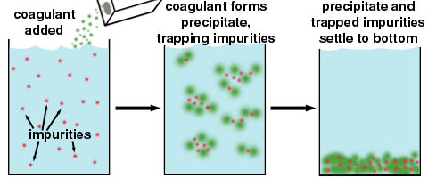
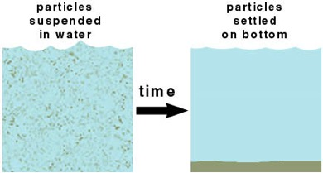
Major Clean Up
Coagulation and flocculation – Settles out suspended particles by adding a coagulating agent (usually alum) to help form a floc.
Sedimentation - Floc settles out and is scraped and vacuumed off the bed of large sedimentation tanks. process.
Chlorination – chlorine added to kill algae and bacteria

Slide 20
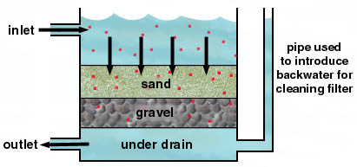
Sand filters the water
isis.csuhayward.edu/alss/Geography/ mlee/geog4350/4350c4f01.ppt

Slide 21
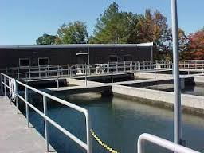
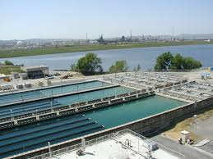
Final Touches
Disinfection - water completely free of suspended sediment is treated with chlorine then ammonia (chloramine), or ozone.
pH adjusted – to meet desired range of 6.5 to 8.5 pH units
Video:
Water Treatment Process

Slide 22
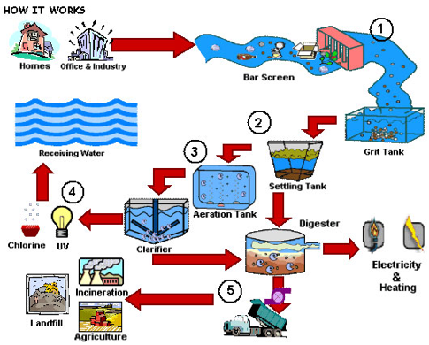
Where does wastewater go?
Wastewater (Sewage) Treatment Systems take human and industrial liquid wastes and make them safe enough to return to the environment.
Wastewater treatment systems use the same processes of purification that would occur in a natural aquatic system only they do it faster and in a controlled situation.

Slide 23
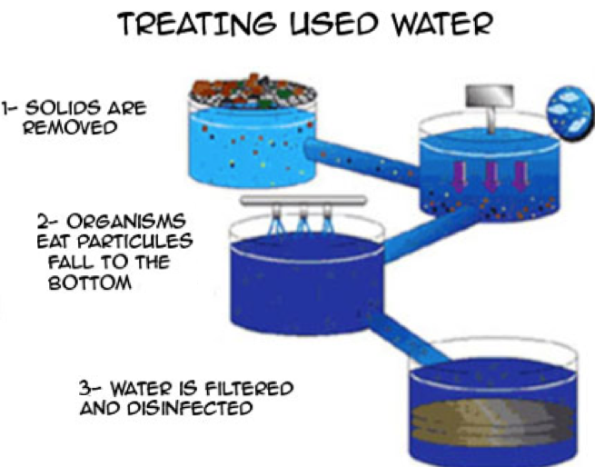
Water Treatment Stages
Depending on the type of treatment plant and the quality of raw water, treatment generally proceeds in the following sequence of stages:
Solid separation
Breakdown of organics by bacteria
Disinfection
As required, adsorption or other advanced process will be added, depending on the chemistry of the treated water.
isis.csuhayward.edu/alss/Geography/ mlee/geog4350/4350c4f01.ppt

Slide 24
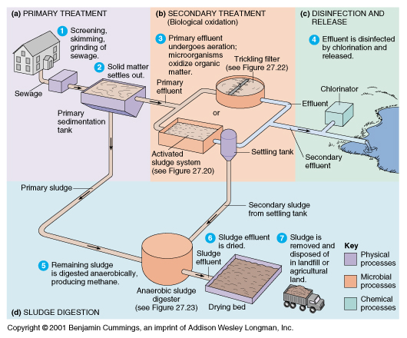

Slide 25
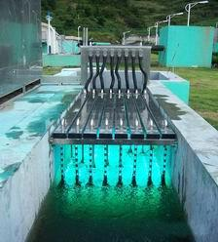
Disinfection AND Release
Methods of Disinfection:
chlorine or ozone (or other oxidizing chemicals such as bromine, iodine or hydrogen peroxide, bleach/sodium hypochlorite, chloramines)
ultraviolet radiation (UV)
microfiltration (using ceramic filters)
lime treatment
electron beam radiation

Slide 26
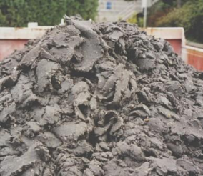
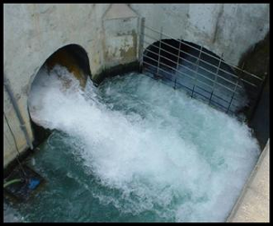
Where Does it Go?
Solid waste (sludge) separated during primary and secondary treatment is disposed of elsewhere.
Effluent is wastewater that is cleaned and released into the environment (rivers/streams).

Slide 27
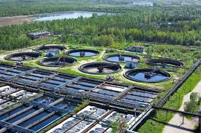
Water Treatment Virtual Tour
Water Resource Recovery Facility 3D Virtual Tour Video

Slide 28
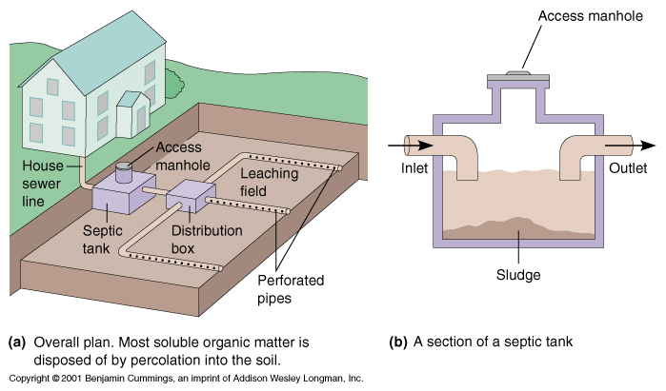
SEPTIC TANKS
SEPTIC TANK: a tank, typically underground, in which sewage is collected and allowed to decompose through bacterial activity before draining by means of a leaching field (field lines).
Alternative when no wastewater treatment facility available.

Slide 29
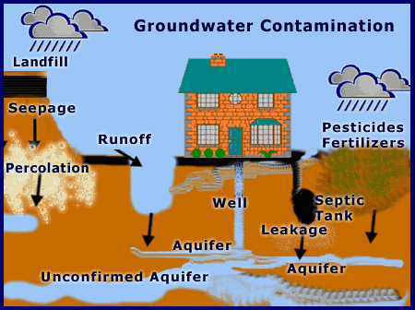
Review:
How long can it take for polluted groundwater difficult to naturally recycle?
Months
Decades
Centuries
Hundreds or thousands of years

Slide 30
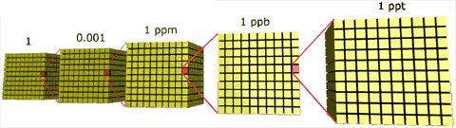
LAB: UNDERSTANDING PPM
Purpose:
To Create a model to illustrate ppm and ppb concentration levels, used to measure air pollutants and correlate those concentrations to the concentration of greenhouse gases and the standards for pollutants in the environment.
Materials:
Well plate
Cups
Water
Two pipettes
Food coloring
Toothpick
White paper

Slide 31
LAB: UNDERSTANDING PPM
Procedures:
Use the “FC” pipette when moving food coloring and the “water pipette when adding water.
Place well plate on the white paper for better viewing.
In cell A1, place 10 drops of food coloring with no water.
Transfer 1 drop of food coloring from cell A1 to cell A2 with the FC pipette.
Add 9 drops of water to cell A2 with the water pipette and mix well.
Take one drop of colored water from cell A2 and transfer to cell A3.
Add 9 drops of water to cell A3 and mix well with the toothpick.
Repeat the process for cells A4 through A6 then B6, C6, D6, and then D5. Remember to use the correct pipette.

Slide 32
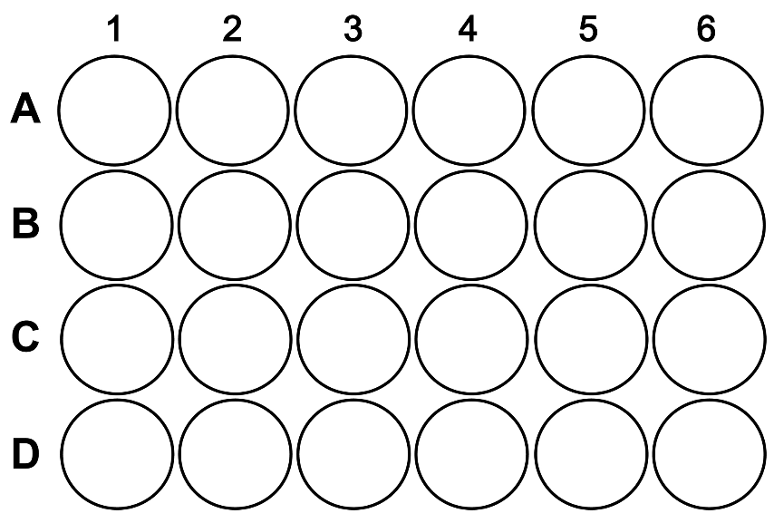
LAB: UNDERSTANDING PPM

Slide 33
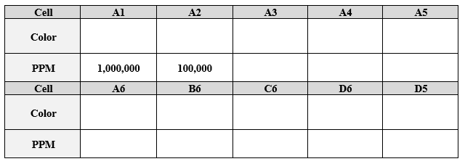
LAB: UNDERSTANDING PPM
1. Make observations about the color of each cell. Record your observations in the data table provided under “COLOR”.

Slide 34
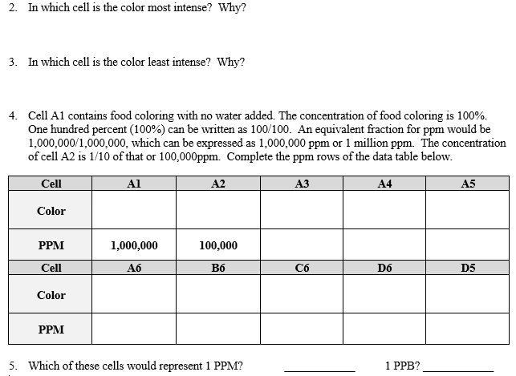
LAB: UNDERSTANDING PPM

Slide 35
TO DO
Review #33 due tomorrow.
Do lab.

