Slide 1
DO NOW
Turn in Review #19.
Pick up notes and practice sheet.

Slide 2
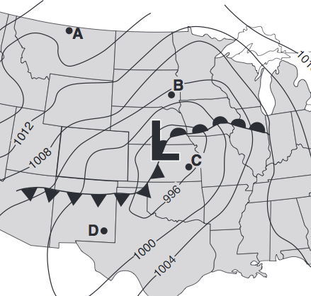
REVIEW
What direction are the winds coming from in each city?
What is the weather currently like in:
  City B?
  City C?

Slide 3
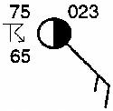
WEATHER STATION MODELS:
REPORTING WEATHER DATA
SES5. Students will investigate the interaction of insolation and Earth systems to produce weather and climate.

Slide 4
MEASURING LOWER-ATMOSPHERE WEATHER
Temperature:
Thermometer
Dew Point:
Psychrometer
Air Pressure:
Barometer

Slide 5
MEASURING LOWER-ATMOSPHERE WEATHER
Wind Direction:
Wind Vane
Precipitation: Rain Gauge
Wind Speed:
Anemometer

Slide 6
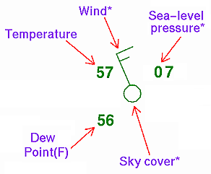
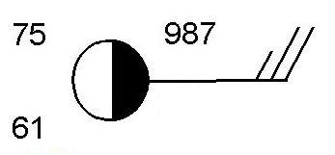
STATION MODELS
A station model is a cluster of symbols that show weather conditions.

Slide 7
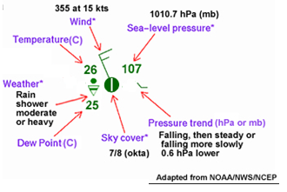
STATION MODELS
Weather conditions:
Cloud cover
Wind direction and speed
Temperature
Dew Point (temperature at which air is saturated or would be at 100% humidity)
Air Pressure
Current Data: NOT predictions

Slide 8
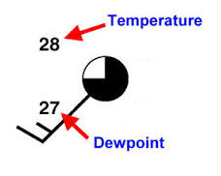
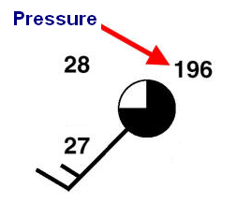
TEMPERATURE, DEW POINT AND PRESSURE
Pressure – top right
Drop the “9” or “10” at the beginning.
Two digits – whole number
Three digits – 1 decimal place
Temperature – top left
Dew Point – bottom left
Pressure is 1019.6
The more moisture in the air, the closer the dew point and temperature are – the more likely there is precipitation.
Normal range is 980 to 1050

Slide 9
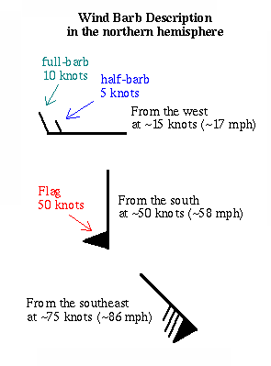
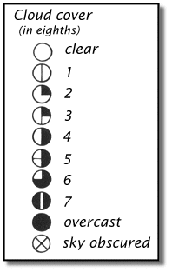
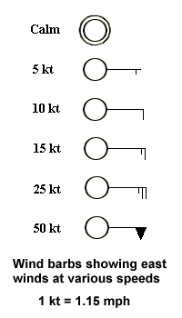
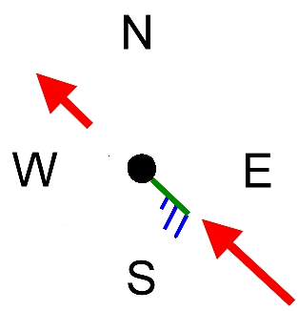
WEATHER STATION DATA: CLOUDS AND WINDS
Flags tell Wind Speed
Barbs tell wind direction

Slide 10
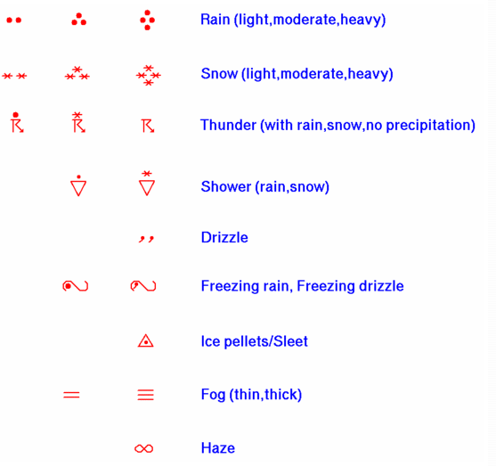
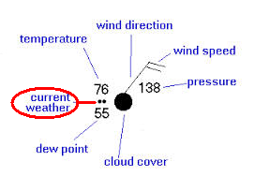
CURRENT CONDITIONS
Shown between Temperature and Dew Point.
Shows precipitation.
Not always indicated.

Slide 11
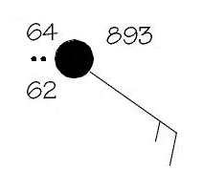
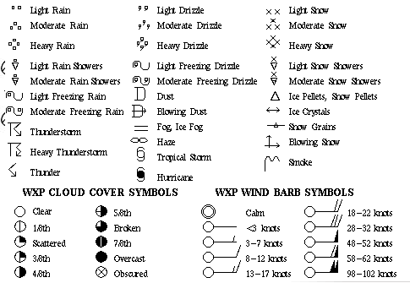
PRACTICE
What is the:
Cloud Cover?
Wind Speed?
Wind Direction?
Temperature?
Dew Point?
Current Weather?

Slide 12
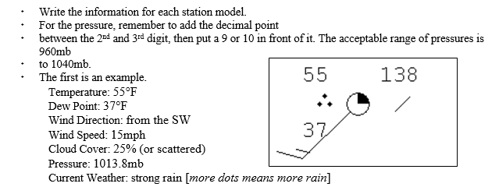
PRACTICE

Slide 13
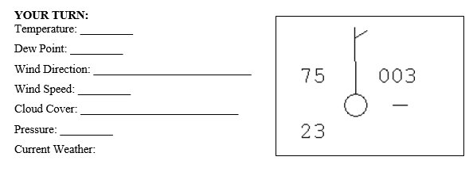
PRACTICE

Slide 14
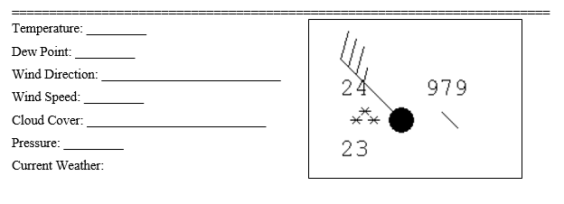
PRACTICE

Slide 15
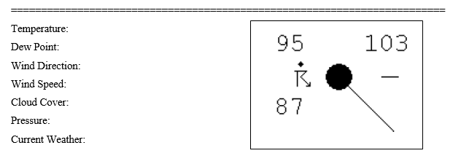
PRACTICE

Slide 16
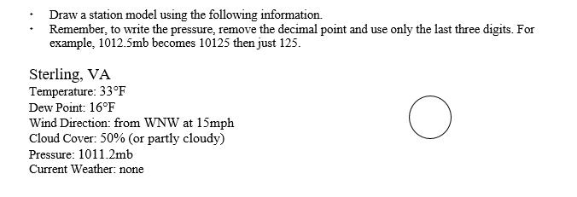
PRACTICE

Slide 17
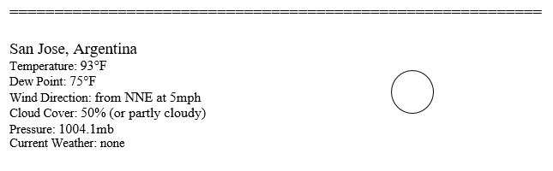
PRACTICE

Slide 18
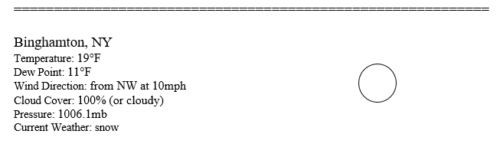
PRACTICE

Slide 19
WEATHER MAPS LAB
Purpose:
Weather maps are created to provide information about current weather conditions. In this activity you will create a station- model map using real-time data.

Slide 20
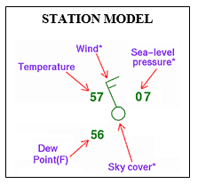
WEATHER MAPS LAB
Procedure:
Go to http://www.intellicast.com/Local/.
In the top right hand corner search box, Type in Nicholson, GA.
Look at the current conditions for Nicholson. Create a station model for Nicholson and nine other cities around the United States – no two can be in the same state.
Create a station model for each city and place it on the map below in the correct state.
When doing the pressure, you will need to convert the inches reading the millibars. Remember to drop the “10” or “9” at the beginning of the air pressure reading.

Slide 21

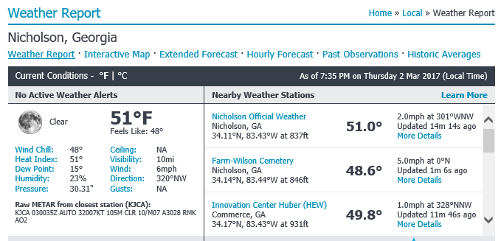
WEATHER MAPS LAB

Slide 22
TO DO

