Slide 1
DO NOW
Pick up notes.
Get out Weather Stations lab from yesterday.

Slide 2
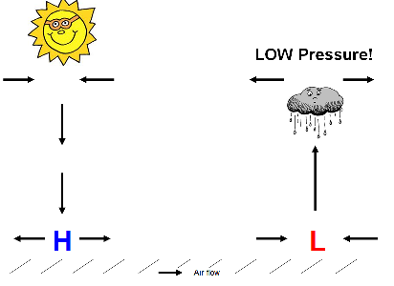
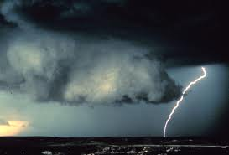
REVIEW
What type of pressure system is associated with stormy weather?

Slide 3
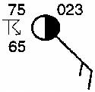
WHAT HAPPENS WHEN A FRONT PASSES THROUGH?
SES5. Students will investigate the interaction of insolation and Earth systems to produce weather and climate.

Slide 4
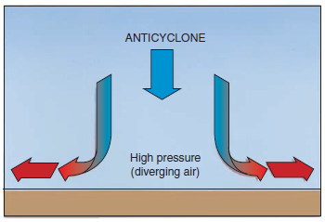
REVIEW: PRESSURE SYSTEMS
HIGH PRESSURE
Air is dry, moves out at the surface, spins clockwise due to Coriolis, brings cool, clear, dry weather at surface.

Slide 5
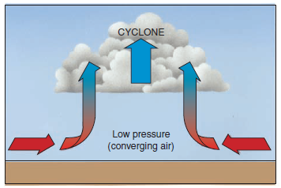
REVIEW: PRESSURE SYSTEMS
LOW PRESSURE
Air is warm, pulls air in at the surface, spins counterclockwise due to Coriolis, brings warm, cloudy, moist weather.

Slide 6
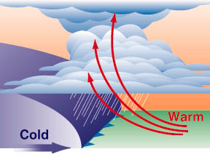
REVIEW: FRONTS – WHERE AIR MASSES MEET
Cold air: Moves faster than warm air and is denser and moves under warm air.
The greater the temperature/moisture differences between two air masses the greater the turbulence and instability, and the worse the weather can become.

Slide 7
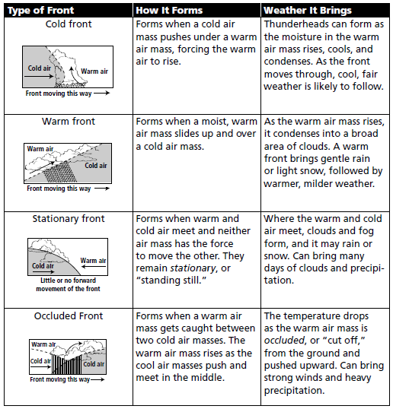
REVIEW: FRONTS – WHERE AIR MASSES MEET

Slide 8
WEATHER STATION DATA
Temperature:
Thermometer
Dew Point:
Psychrometer
Air Pressure:
Barometer

Slide 9
WEATHER STATION DATA
Wind Direction:
Wind Vane
Precipitation: Rain Gauge
Wind Speed:
Anemometer

Slide 10
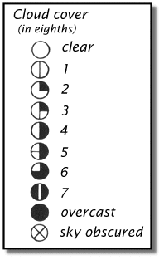
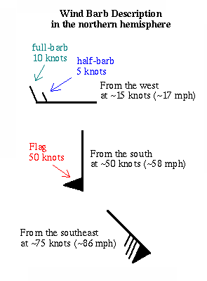
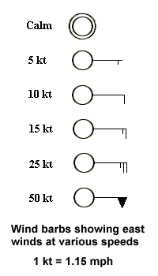
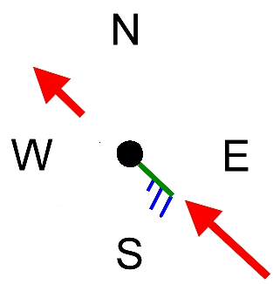
WEATHER STATION DATA: CLOUDS AND WINDS
Flags tell Wind Speed
Barbs tell wind direction

Slide 11
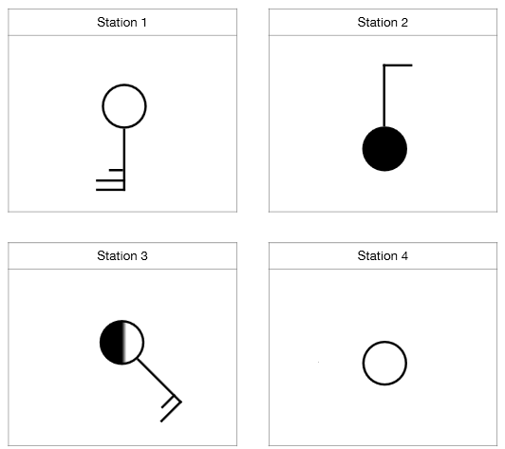
WEATHER STATION DATA: CLOUDS AND WINDS

Slide 12
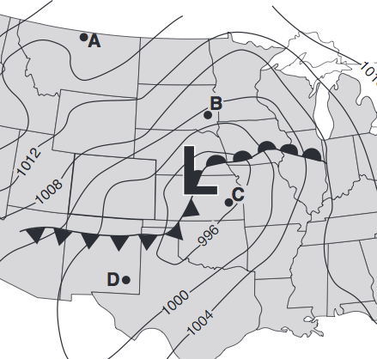
REVIEW
Looking at the diagram, how will the weather in City C change as the cold front passes through?
  Temperature?
  Wind direction?
  Skies?
  Air pressure?

Slide 13
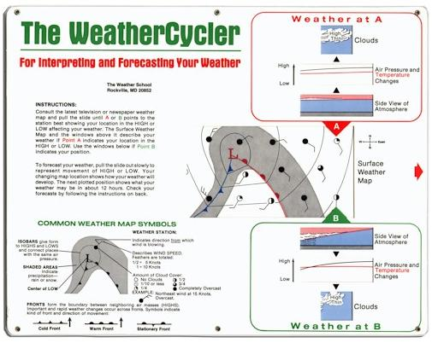
LAB
Purpose:
To find out how weather changes when a cold front passes through.
You may work in pairs ONLY if you work collaboratively - the activities are designed to be done sequentially – do NOT trade off sections or your paper will be discarded and you will start over

Slide 14
LAB
Work through all six sections:
Weather Maps
Weather in Highs
Weather Fronts
Weather in Lows
Forecasting Weather
Interpreting Weather
Write all answers on the answer document.
Please do not write in the booklet.

Slide 15
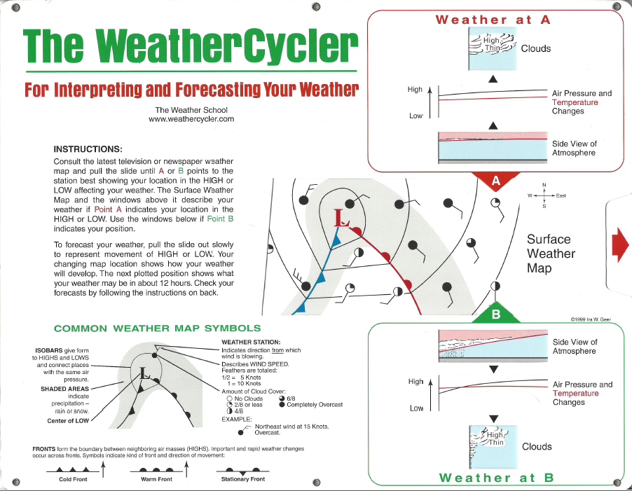
LAB

Slide 16
LAB
We will work on this today and tomorrow.
You may move and sit at the lab desk, or move desks together.
Work collaboratively.
Finish the weather station lab from yesterday first.

Slide 17
DO NOW
Get out Weather Cycler lab from yesterday.
Get a Weather Cycler card and get busy.
Weather Cycler is due at the end of the period today.

