Slide 1
DO NOW
Pick up notes and Review #27.
Do you have any labs to turn in?

Slide 2
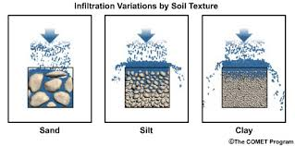
REVIEW
How does the porosity of sand, silt and clay differ?
Sand is the most porous with the biggest pores. Clay is the least porous with the smallest pore space. Silt is somewhere in between.

Slide 3
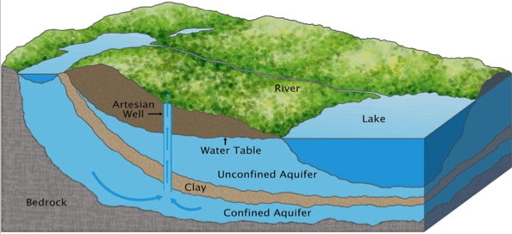
AQUIFERS and GROUNDWATER
SES1e: Identify the transformations and major reservoirs that make up the hydrologic cycle
SES3a: Describe how surface water and groundwater act as the major agents of physical and chemical weathering.

Slide 4
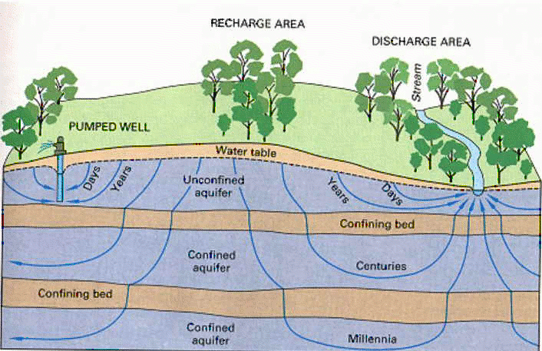
UNDERGROUND WATER
Groundwater: water beneath Earth’s surface - infiltrates surface then percolates through spaces in rock and sediment.
Aquifers: body of rock that stores underground water and allows it to flow.

Slide 5
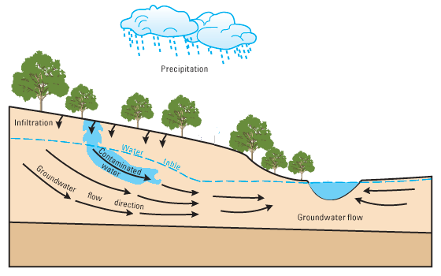
GROUNDWATER MOVES
Gravity pulls water down – fills pores in rock - until it hits impermeable rock.
Flow rate depends on
  Steepness of slope – like streams.
  Permeability: the ability of rock to let water pass through its pores.

Slide 6
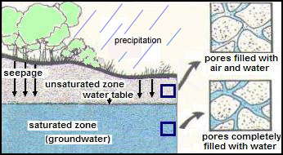
GROUNDWATER ZONES
Zone of saturation
  Level where pore space is completely filled with water.
  Upper surface is the water table.

Slide 7
GROUNDWATER ZONES
Unsaturated Zone
  Zone between water table and surface.
  Zone of Aeration
Water Table
  Upper boundary of the zone of saturation.
  It is the level below which the ground is saturated with water.

Slide 8
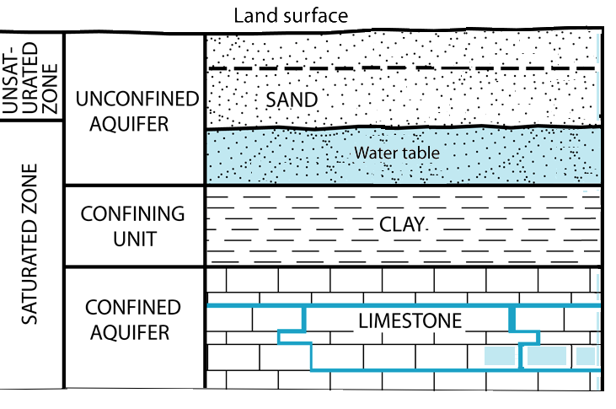
CONFINED VERSUS UNCONFINED AQUIFERS
Unconfined aquifers water infiltrates easily from surface.
Confined aquifers – water trapped by impermeable rock or clay –between layers of rock.

Slide 9
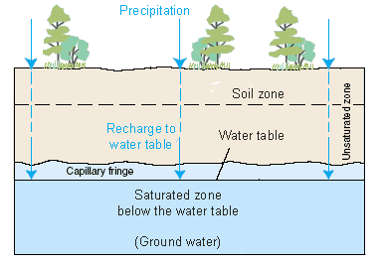
AQUIFERS STORE GROUNDWATER
Aquifers:
  Underground layers of rock that are saturated with water.
  Can be brought to the surface through natural springs or by pumping.
50% of all drinking water comes from aquifers.

Slide 10
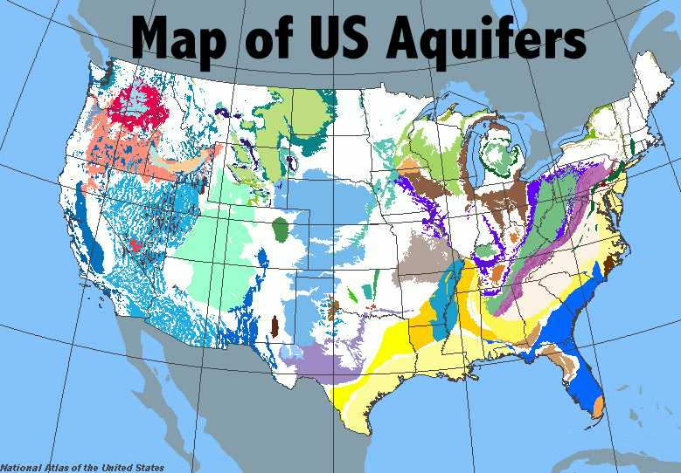
AQUIFERS STORE GROUNDWATER
The different colors indicate what the aquifer is stored in.

Slide 11
OUR AQUIFER: PIEDMONT AQUIFER
Piedmont and Blue Ridge aquifers :
Bedrock covered with regolith.
Soil at top.
Saprolite - chemically weathered bedrock
Porosity and permeability of bedrock is very low due to extreme heat AND pressure.
Groundwater obtained from (1) regolith and (2) fractures in the rock.

Slide 12
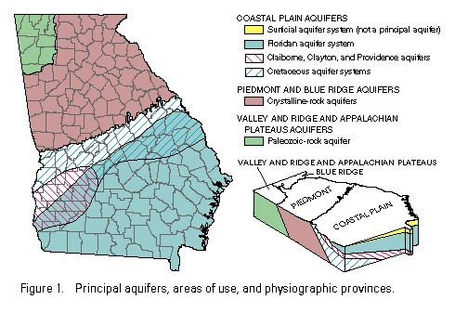
OUR AQUIFER: PIEDMONT AQUIFER

Slide 13
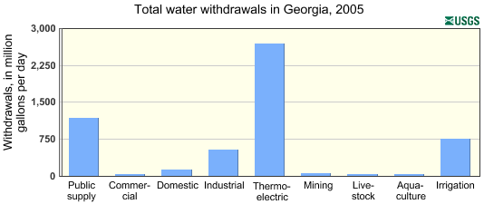
AQUIFER DRAWDOWN
Provides water for:
Human Uses: drinking, cooking, cleaning
Agriculture
Industrial Uses
Withdrawing water can deplete aquifers.

Slide 14
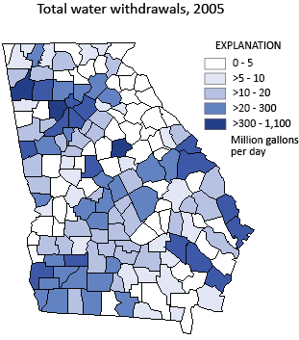
AQUIFER DRAWDOWN

Slide 15
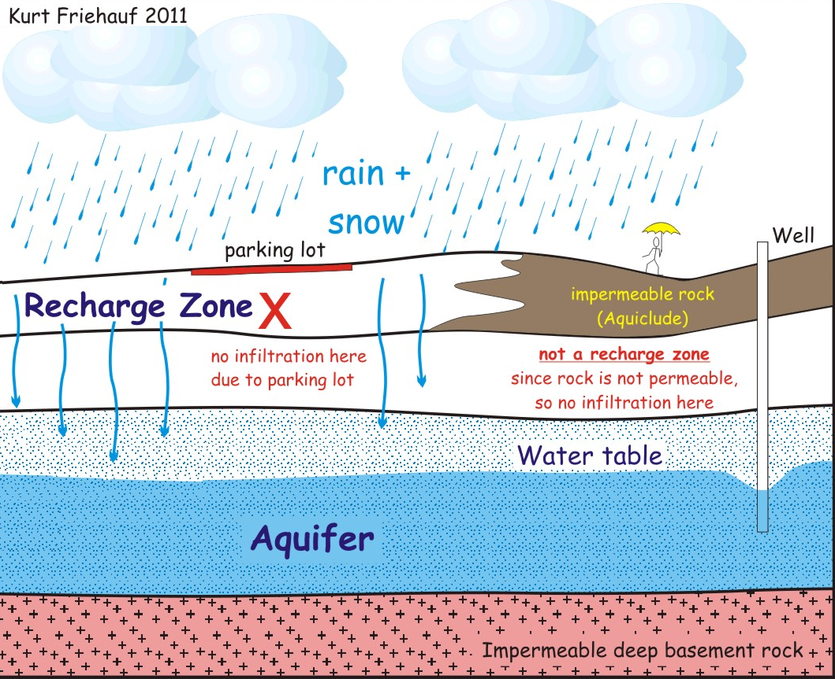
RECHARGING AQUIFERS
Recharged by infiltration of precipitation.
Recharge Zone: the area where water from the surface can move through permeable rock to reach an aquifer.
Recharge zones can be blocked by impermeable rock and man-made features.

Slide 16
RISK: GROUNDWATER DEPLETION
Groundwater depletion: long-term water-level declines caused by sustained pumping.
Leads to:
Lowered water tables (harder to get to).
Increased cost for consumers.
Reduced water in streams and lakes.
Land subsidence – loses support sinks.
Deterioration of water quality.
Saltwater intrusion near coasts.

Slide 17
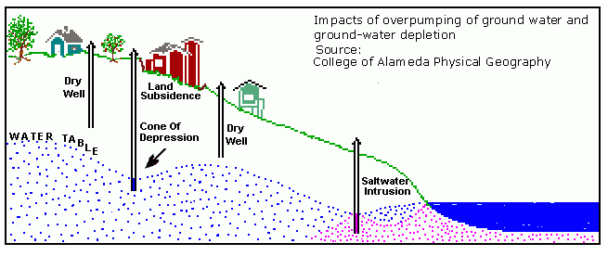
RISK: GROUNDWATER DEPLETION

Slide 18
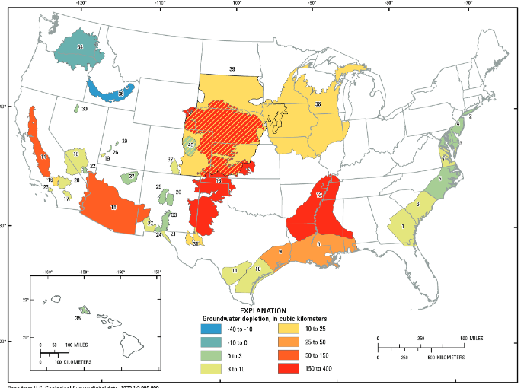
RISK: GROUNDWATER DEPLETION

Slide 19
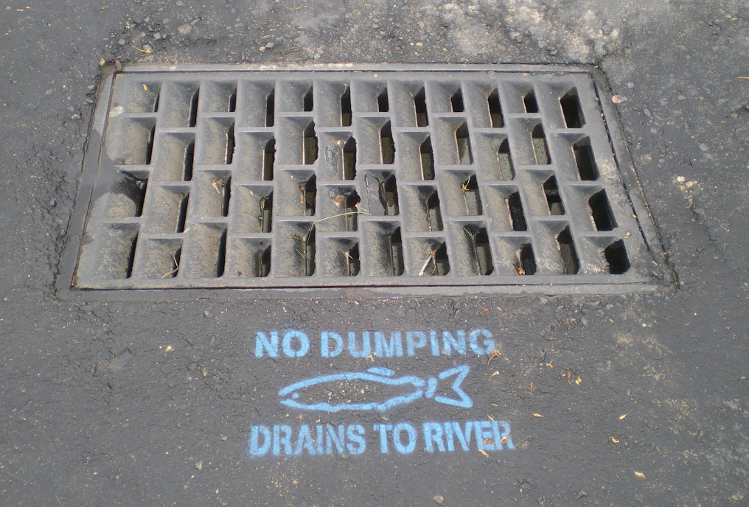
RISK: GROUNDWATER CONTAMINATION
Groundwater contamination is when man-made products (gasoline, oil, road salts, chemicals, etc.) get into the groundwater and cause it to become unsafe for human use.
Sources include:
Storage tanks
Septic tanks
Landfills
Hazardous waste
Industrial discharge
Some areas more environmentally sensitive than others.

Slide 20
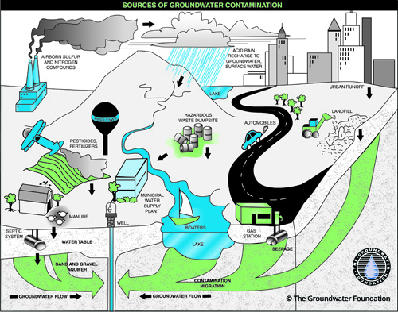
RISK: GROUNDWATER CONTAMINATION

Slide 21
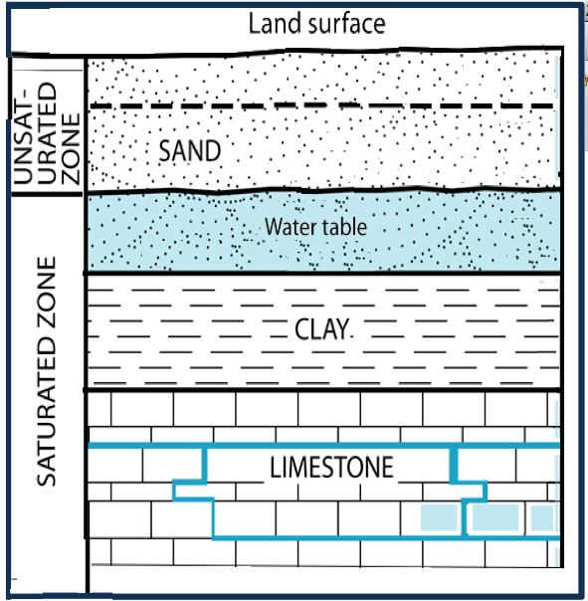
REVIEW
Which layer holds the confined aquifer?
Unsaturated Zone
Sand
Clay
Limestone

Slide 22
TO DO
Work on Review #27.
Work on missing labs and other missing work.

Slide 23
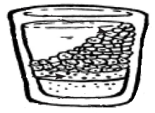
Lab: Aquifer in a Cube
In this lab you will create a model to illustrate:
How water is stored in an aquifer
How groundwater can become contaminated
How this contamination ends up in a drinking water source

