Slide 1
DO NOW
Pick up review.
Get out The Nature of Chemical Reactions handout from Friday.
Turn in Types of Reactions lab – data sheet only – is your name and your partner’s name on it?

Slide 2
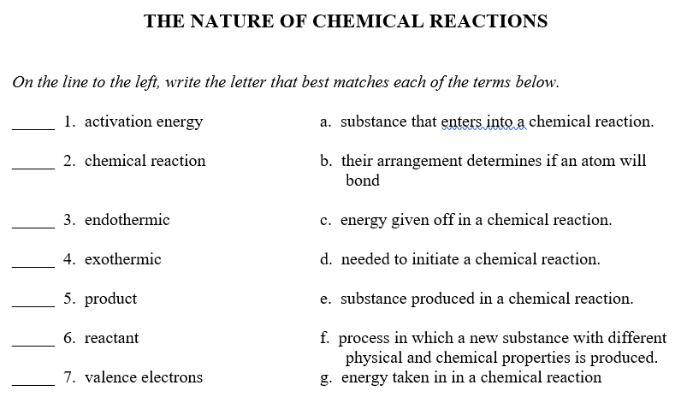
The Nature of Chemical Reactions
D
F
G
C
E
A
B

Slide 3
The Nature of Chemical Reactions
In chemistry lab, Ramon adds several granules of zinc to a beaker containing concentrated hydrochloric acid. Bubbles begin to form in the beaker and the zinc begins to disappear. Has a chemical reaction occurred? Explain your answer.
Yes, it is a chemical reaction; a new substance was formed.
9. Shelley discovers that the celery in her refrigerator has wilted. She cuts the celery at the base and places the stalks in a tall glass of water overnight. The next morning, the celery stalks are firm again. Has a chemical reaction occurred? Explain your answer.
No, it is a physical reaction; it is still celery – nothing new was formed.

Slide 4
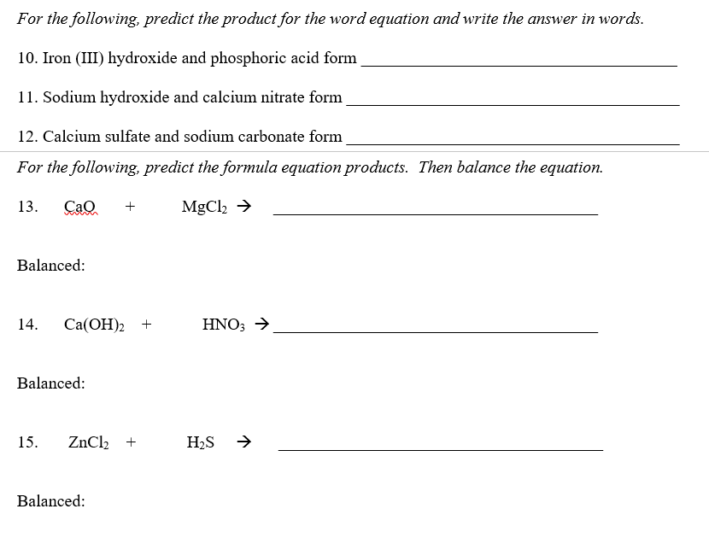
The Nature of Chemical Reactions
Iron (III) phosphate and water
Sodium nitrate and calcium hydroxide
Calcium carbonate and sodium sulfate
CaCl₂ + MgO
balanced
Ca(NO₃)₂ + H₂O
Ca(OH)₂ + 2HNO₃ → Ca(NO₃)₂ + 2H₂O
ZnS + HCl
ZnCl₂ + H₂S → ZnS + 2HCl

Slide 5
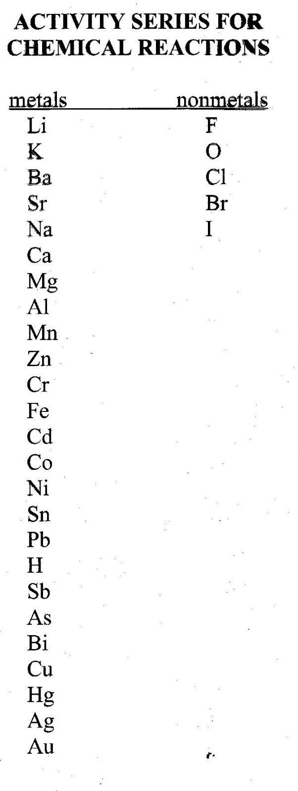
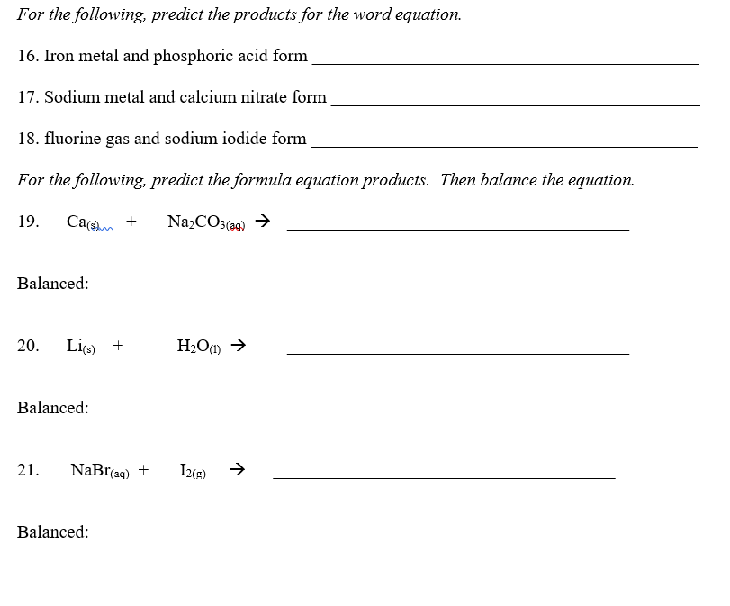
The Nature of Chemical Reactions
Iron (III) phosphate and hydrogen gas
Sodium nitrate and calcium
Sodium fluoride and chlorine gas
No Reaction, NR
LiOH + H₂
2Li + 2H₂O → 2LiOH + H₂
No Reaction, NR

Slide 6
TEST REVIEW
Identify the reactants and the products in a chemical reaction.
Reactants → Products

Slide 7
TEST REVIEW
Know the five characteristics of a chemical reaction.
A. There are always two kinds of substances
B. There is always a change in energy in a chemical reaction.
C. There is always activation energy
D. Bonding Capacity
E. Conservation of Mass

Slide 8
TEST REVIEW
3. Use appropriate symbols when writing an equation to accurately describe the chemical reaction.
(s) Solid
(l) liquid
(g) Gas
(aq) aqueous

Slide 9
TEST REVIEW
4. Balance a chemical equation.
1. Write the chemical equation for the reaction.
2. Count the number of atoms of each element on both sides of the arrow.
3. Balance the equation using coefficients.
Balance metals, then nonmetals,
then hydrogen, then oxygen
4. Check your work by recounting the number of atoms on each side of the arrow.

Slide 10
TEST REVIEW
4. Balance a chemical equation.
RULES TO FOLLOW
Change coefficients only.
Never change a symbol, formula, or subscript.
Place coefficients in front of the entire chemical formula.

Slide 11
TEST REVIEW
5. Given a written description of a chemical reaction, write a balanced chemical equation using the appropriate symbols and formulas.
Write the correct formulas for each of the chemicals named. Determine which are the reactant(s) and which are the product(s).
Write out the chemical equation for the reaction.
Count the number of atoms of each element on both sides of the arrow.
Balance the equation using coefficients
Check your work by recounting the number of atoms on each side of the arrow.

Slide 12
TEST REVIEW
6. Classify a reaction as synthesis, decomposition, single replacement, double replacement, or combustion.
1. SYNTHESIS Reaction
What to look for: ONE PRODUCT
2Mg_{(s)} + O_{2(g)} → 2MgO_{(s)}
2. DECOMPOSITION Reaction
What to look for: ONE REACTANT
H₂CO_{3(aq)} → H₂O_{(l)} + CO_{2(g)}
3. COMBUSTION
What to look for: REACTANT of HYDROCARBON
and OXYGEN and PRODUCTS OF CO₂ and H₂O
CH_{4(g)} + 2O_{2(g)} → CO_{2(g)} + 2H₂O_{(g)}

Slide 13
TEST REVIEW
6. Classify a reaction as synthesis, decomposition, single replacement, double replacement, or combustion.
4. SINGLE REPLACEMENT Reaction
What to look for: UNCOMBINED ELEMENT ON EACH SIDE
Mg_{(s)} + 2HCl_{(aq)} → MgCl_{2(aq)} + H₂
Cl_{2(g)} + 2 NaBr_{(aq)} → 2NaCl_{(aq)} + Br_{2(g)}
5. DOUBLE REPLACEMENT Reaction (or double displacement reaction)
What to look for: TWO COMPOUNDS ON BOTH SIDES
HCl_{(aq)} + NaOH_{(aq)} → NaCl_{(aq)} + H₂O_{(l)}

Slide 14
TEST REVIEW
7. Use the activity series of metals to predict the products of single replacement reactions.
8. Write the products of double-replacement reaction between two ionic compounds.

Slide 15
SCHEDULE
TUESDAY:
Chemical Reactions Test
Chemical Reactions Review is due for test redo points.

Slide 16
SCHEDULE
WEDNESDAY - MONDAY:
We will start reviewing for your midterm.
  Wednesday – Matter and Measurement
  Thursday – Atom and Periodicity
  Friday – Bonding and Nomenclature
  Monday – Chemical Reactions and final questions

Slide 17
SCHEDULE
TUESDAY, December 13:
7th Period: midterm exam
1st, 6th periods: vote on the elements for the periodic table
WEDNESDAY, December 14:
1st Period: midterm exam
6th Period: work on your own
7th Period: short answer part of exam.

Slide 18
SCHEDULE
THURSDAY:
1st Period: short answer part of exam
6th Period: short answer part of exam
7th Period: vote on the elements for the periodic table
FRIDAY:
1st Period: work on your own
6th Period: midterm exam
7th Period: work on your own.

Slide 19
TEST REDOS and COUPONS
Test Redo Coupons can be used any time between now and Friday, May 12.
Homework or Lab coupons MUST be used before the END of THIS semester. I must receive them by the end of the day, Wednesday, December 14. A listing of labs and homeworks is posted by the class calendar. Please put the HW # or the Lab # on the blank provided on the coupon.

Slide 20
TO DO
Work on Chemical Reactions Test Review – due tomorrow for test redo points

Slide 21
DO NOW
Prepare for test
Turn in your Chemical Reactions Review sheet if complete.
We will start reviewing for your midterm tomorrow.
NO ELECTRONIC DEVICES AT ALL (even music) during the testing time. I will take that device and give it back on Friday afternoon or to your parent, whichever comes first.

Slide 22
CHEMICAL REACTIONS
A Review

