Slide 1
DO NOW
Pick up notes and Review #8.

Slide 2
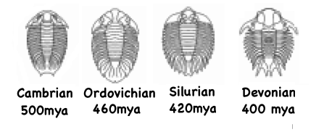
REVIEW
The image below shows drawings of one species of trilobite fossils that appeared in the fossil record from the early Cambrian through the Devonian periods. Think about:
What changes can you observe?
How long did the changes take?
Why do you think these changes happened?
What conclusions can you make based on the changes?

Slide 3
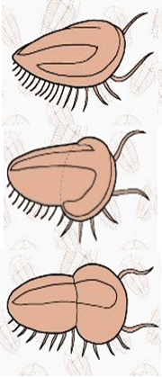
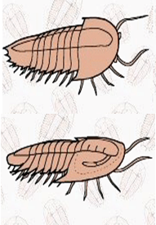
FOSSILS AND NATURAL SELECTION
SES6e: Describe how fossils provide a record of shared ancestry, evolution, and extinction that is best explained by the mechanism of natural selection.

Slide 4
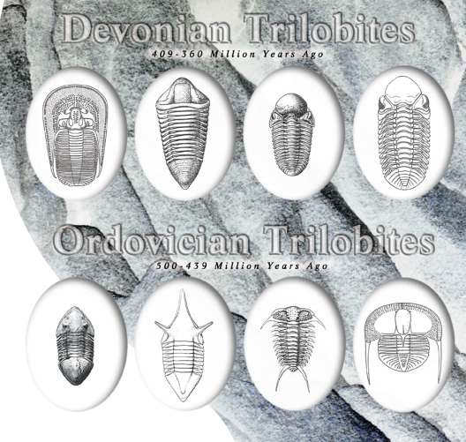
FOSSIL RECORD SHOWS CHANGE
Ordovician trilobites differ from Devonian trilobites.
Silurian and Devonian fish differ from Jurassic and Cretaceous fish.
Mesozoic mammals differ from Cenozoic mammals.
Whole groups of organisms that were once abundant and diverse, such as trilobites, have become extinct.

Slide 5
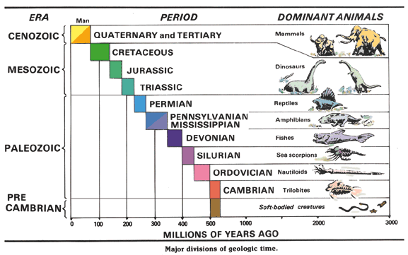
GRADUAL CHANGE
Fossil evidence shows life becomes more complex over time.
Gradual change occurs in most species.
Some organisms go extinct.
Changes explained by Natural Selection.
Natural Selection first proposed by Charles Darwin based on data.

Slide 6
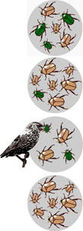
WHAT IS NATURAL SELECTION?
Gradual process.
Organisms that are best suited to the environment most likely to live and pass on their genes (traits).
Organisms with less suitable traits fail to survive and/or pass on their genes.
Biological traits become either more or less common in a population.
Result of inherited traits and interactions with the environment.

Slide 7
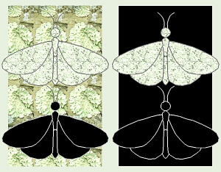
LIFE RESPONDS TO ENVIRONMENTAL CHANGES
Environmental change is any change in an environment to which an organism must adapt.
  Can be gradual, ex: mountains form
  Can be quick, ex: floods volcanoes

Slide 8
LIFE RESPONDS TO ENVIRONMENTAL CHANGES
Environmental change forces the organism to adapt.
  Genetic variations best suited to the environment thrive.
  Traits least suited to the environment die off.
  Small changes occur across multiple generations.
  Some changes are more rapid – ex: antibiotic resistant strains of bacteria.
  Changes don’t occur at the individual level – but rather across multiple generations.

Slide 9
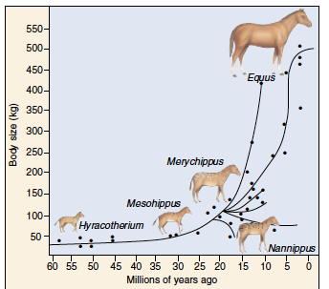
FOSSIL EXAMPLE: HORSE
Fossil record spans over 60 million years.
Earliest ancestors small, lived in rainforests.
Early fossils show multi-toed feet, adapted for walking across the forest floor.
Single toe hooves are more suited for running over open country.

Slide 10
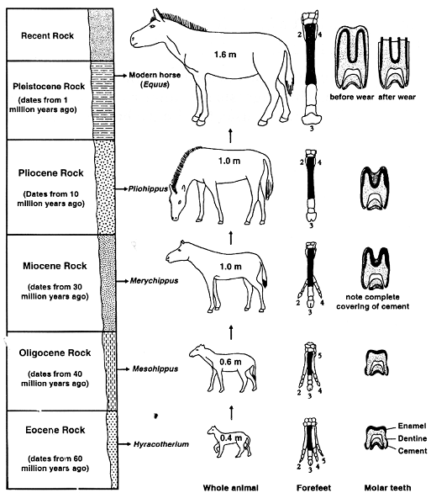
FOSSIL EXAMPLE: HORSE

Slide 11
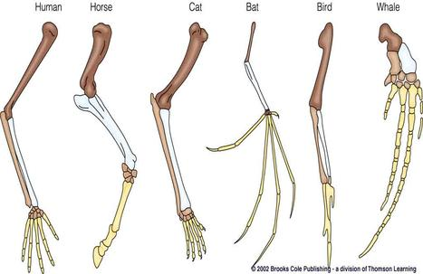
COMPARING ANATOMICAL DIFFERENCES
Clues to changes in organisms over time can be found in structural anatomy.

Slide 12
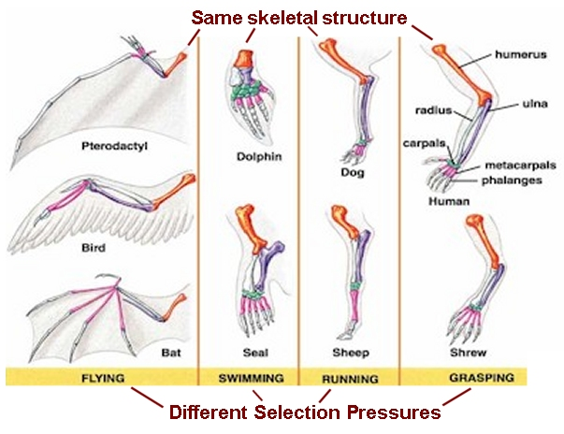
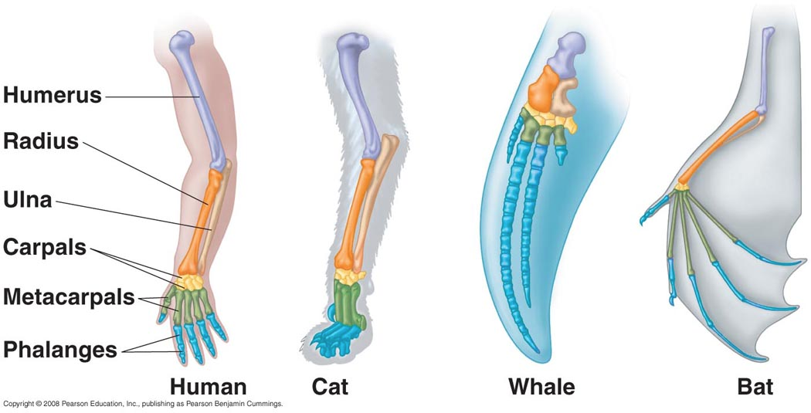
HOMOLOGOUS FEATURES
Similar STRUCTURE
  Often different functions
COMMON ancestor
  Divergent evolution
The structural similarities between the flippers of whales and the arms of humans suggests that the human species and whales have a common ancestry.

Slide 13
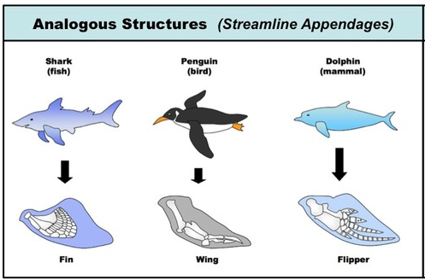
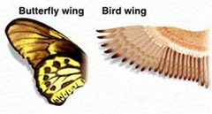
ANALOGOUS FEATURES
Similar FUNCTION.
Different structures
  Different solutions to same problem.
Evolved independently.
NOT RELATED – not from common descent.

Slide 14
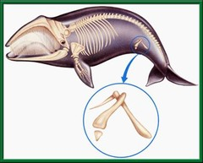
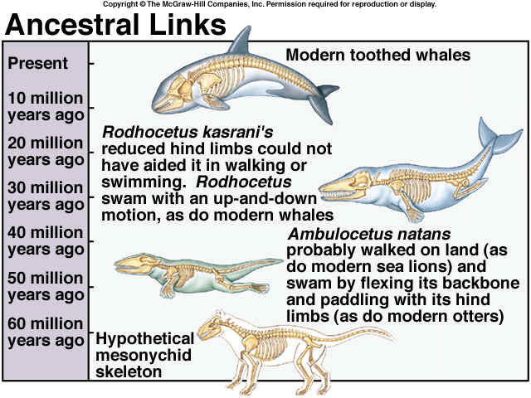
VESTIGIAL STRUCTURES
Features that serve no apparent purpose.
Serve a function in a related species.
Likely served purpose in ancestors.
Provide clues to ancestry.
Ex: Whale pelvis
  Pelvis transfers weight to hind legs.

Slide 15
FOSSIL RECORD
Fossilization is rare – most organisms extinct.
Millions of fossils exist.
Shows a succession of incremental development from one species to another.
Characteristics of newer organisms often appear to be modified forms of characteristics of older organisms.

Slide 16
FOSSIL RECORD
Same patterns appear everywhere.
Forms complete picture of change over time.
Much of the evidence for the evolution of life-forms on Earth has been obtained by examining fossils preserved in rock layers.
Changes in fossil record provide evidence for Evolution and are best explained by Natural Selection.

Slide 17
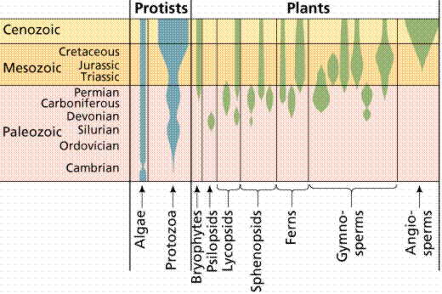
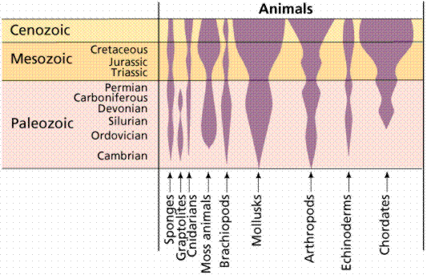
FOSSIL RECORD

Slide 18
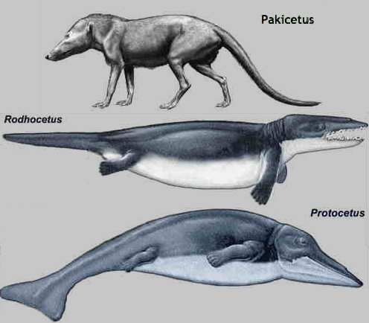
EXAMPLE: WHALE EVOLUTION
Philip Gingerich, paleontologist
Pakicetus (pack-eh-SEA-tus)
  About 48.5 mya – Pakistan.
  Resembles large land mammals.
  Wolf-like skull, whale-like ear bones.
Rodhocetus (row-deh-SEA-tus)
  “Barely walking whale”.
  About 46.5 million years ago – Pakistan.
  Features of aquatic whale and hoofed mammal - all in the same skeleton.

Slide 19
EXAMPLE: WHALE EVOLUTION
Protocetus (pro-toe-SEE-tuss)
  “First whale”.
  About 45 million years ago – Egypt.
  Classification as whale based on:
  General shape of the skull.
  Position of the nose/ blowhole.
  Position of the ears.

Slide 20
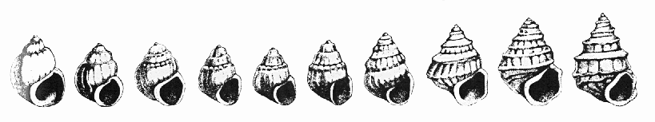
REVIEW
The image below shows 10 fossils of a species of snails from a sequence of snail shells, oldest on the left, youngest on the right.
These were discovered in a freshwater deposit in Yugoslavia and laid down from 10 million years ago to 3 million years ago.
A comparison of these fossils provides evidence that these species may have:
Undergone metamorphism
Experienced weathering and erosion
Evolved
Had identical lifespans

Slide 21
TO DO
Review #8 due tomorrow.
Work on missing labs.

