Slide 1
GAS LAWS
A REVIEW

Slide 2
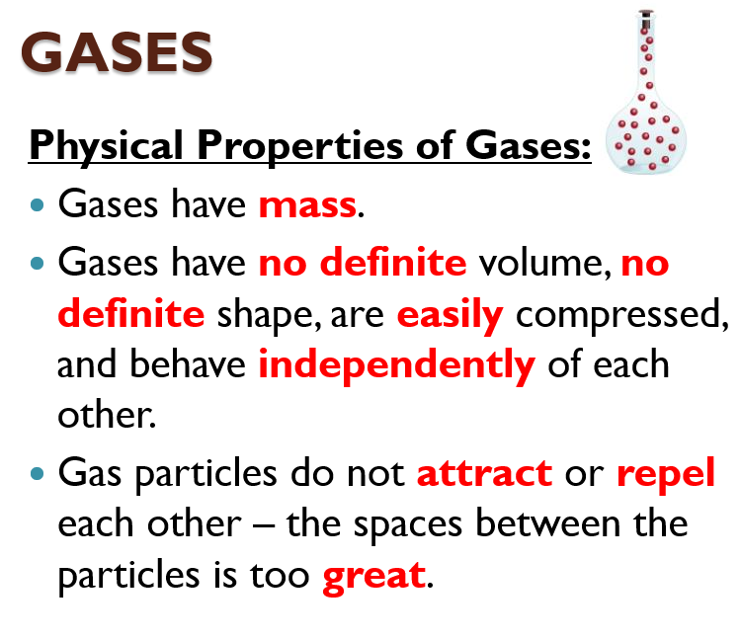
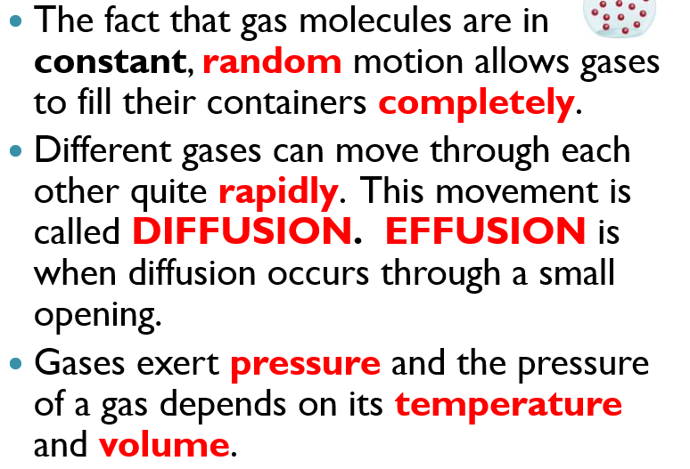
REVIEW OBJECTIVES
1. Describe the effect on a gas by a change in the amount of gas (moles), the pressure of gas, the volume of gas, and the temperature of gas.
Be sure you can talk about gases in general – give general characteristics.

Slide 3
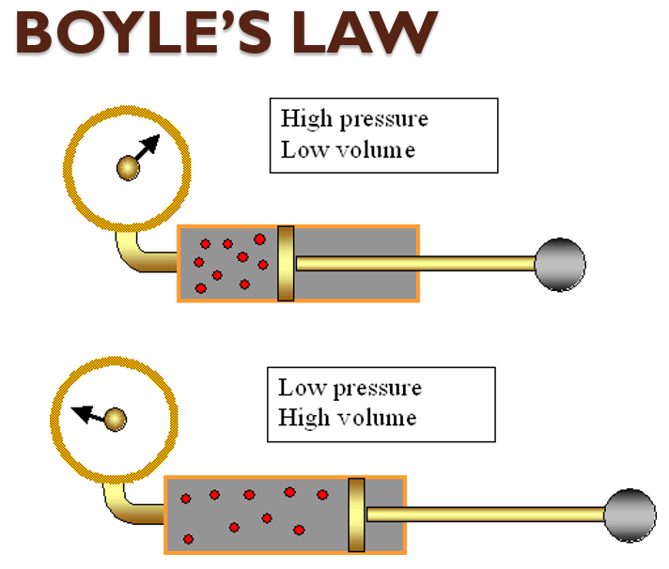
REVIEW OBJECTIVES
2. Be able to perform calculations using Boyle’s Law, Charles’ Law, and Gay-Lussac’s Law.
Know the relationship of the variables and the name of each one. Example: Boyle’s shows an inverse relationship between P and V.
THE LAW: For a given mass of gas, at a constant temperature, the volume varies inversely with the pressure:
P₁V₁ = P₂V₂

Slide 4
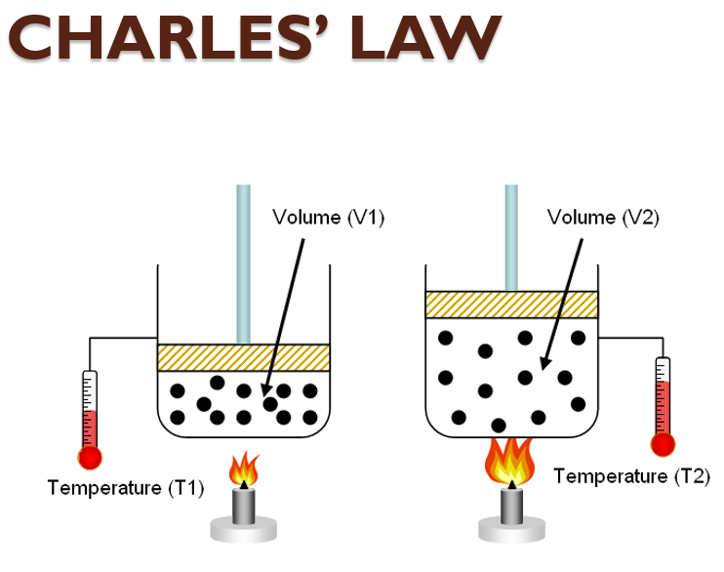
REVIEW OBJECTIVES
2. Be able to perform calculations using Boyle’s Law, Charles’ Law, and Gay-Lussac’s Law.
Know the relationship of the variables and the name of each one. Example: Boyle’s shows an inverse relationship between P and V.
THE LAW: The volume of a fixed mass of a gas is directly proportional to its KELVIN temperature if the pressure is constant.
V₁T₂ = V₂ T₁
You must use the Kelvin temperature scale!

Slide 5
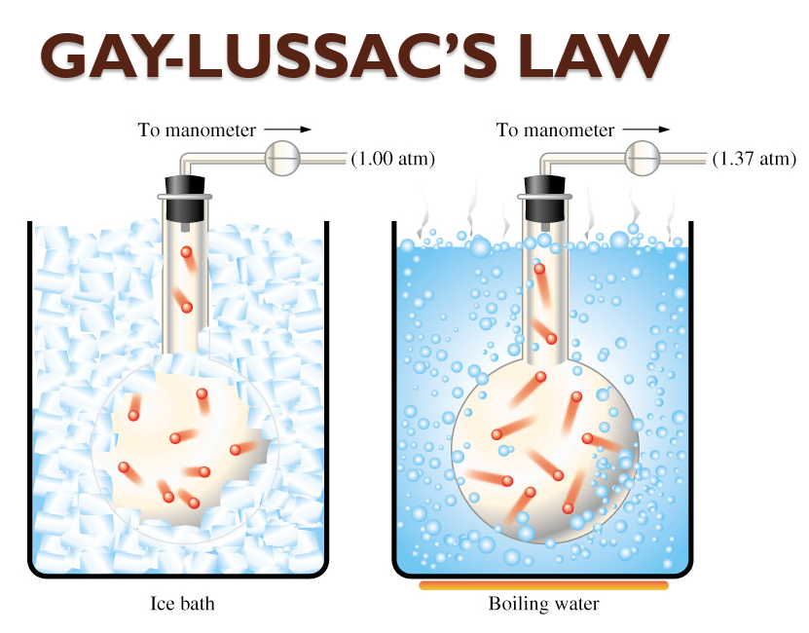
REVIEW OBJECTIVES
2. Be able to perform calculations using Boyle’s Law, Charles’ Law, and Gay-Lussac’s Law.
Know the relationship of the variables and the name of each one. Example: Boyle’s shows an inverse relationship between P and V.
THE LAW: An increase in temperature increases the frequency of collisions between gas particles.
P₁ T₂= P₂ T₁
You must use Kelvin temperature scale!

Slide 6
REMINDER
EVERY TIME you do a gas laws problem:
Write what you know and what you are trying to find.
Write the formula.
Plug in the numbers with units and solve with the correct number of sig figs.
Points will be given for this information.

Slide 7
REVIEW
PTV

Slide 8
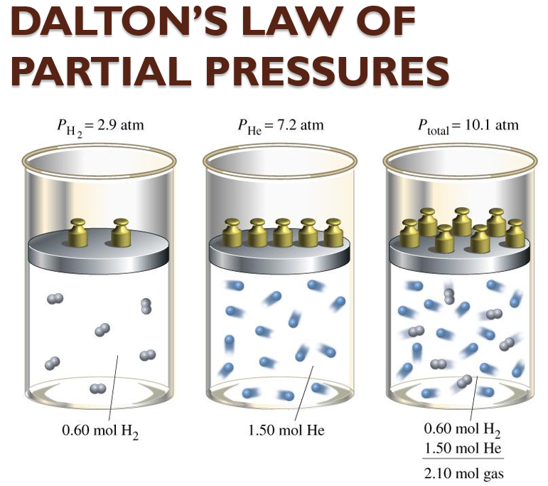
REVIEW OBJECTIVES
3. Be able to use Dalton’s Law of Partial Pressures in a calculation.
Remember that you only correct P₁ – subtract the water vapor pressure from the total P₁ pressure.
THE LAW: The sum of the partial pressures of all components of a gas mixture is equal to the total pressure of the gas mixture.
P_{total} = P₁ + P₂ + P₃ +.....

Slide 9
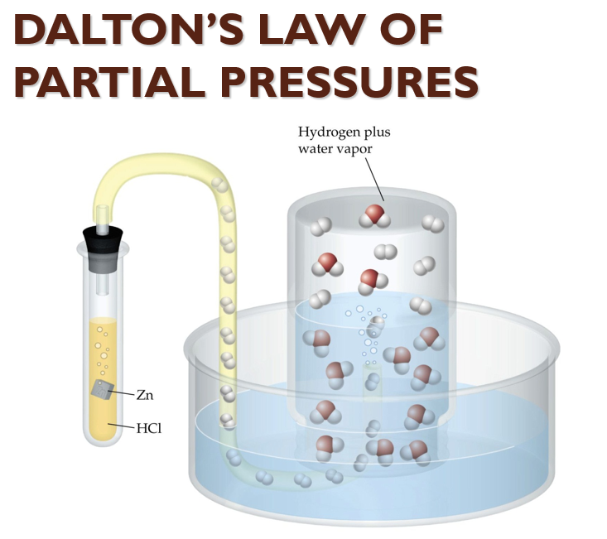
REVIEW OBJECTIVES
3. Be able to use Dalton’s Law of Partial Pressures in a calculation.
Remember that you only correct P₁ – subtract the water vapor pressure from the total P₁ pressure.
A quantity of oxygen gas is collected over water at 8°C in a 0.353L vessel. The pressure is 84.5kPa. What volume would the DRY oxygen gas occupy at standard atmospheric pressure (101.3kPa) and 8°C. (The dry gas pressure of water at 8°C is 1.1kPa)
P₁ = 84.5 kPa – 1.1 kPa = 83.4 kPa
You must correct the pressure so that you can have the DRY gas without the water pressure added in.

Slide 10
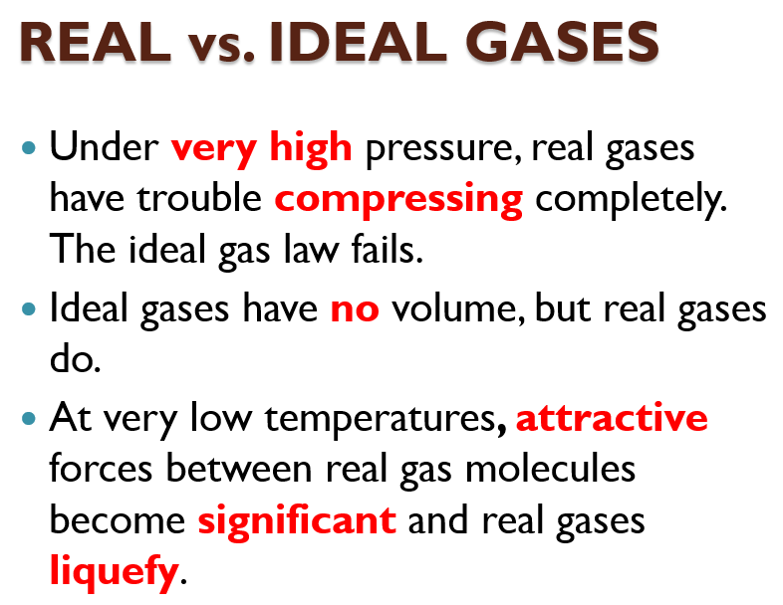
REVIEW OBJECTIVES
4. Distinguish between real and ideal gases. Be able to tell how real gases differ from ideal gases.
Remember the two conditions where ideal gases do not behave like real gases.

Slide 11
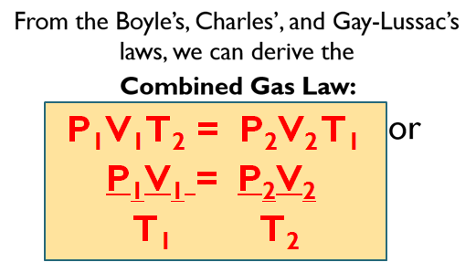
REVIEW OBJECTIVES
5. Perform calculations using the ideal gas law and the combined gas law.
You must memorize the formulas:
PV = nRT P₁V₁T₂ ₌ P₂V₂T₁

Slide 12
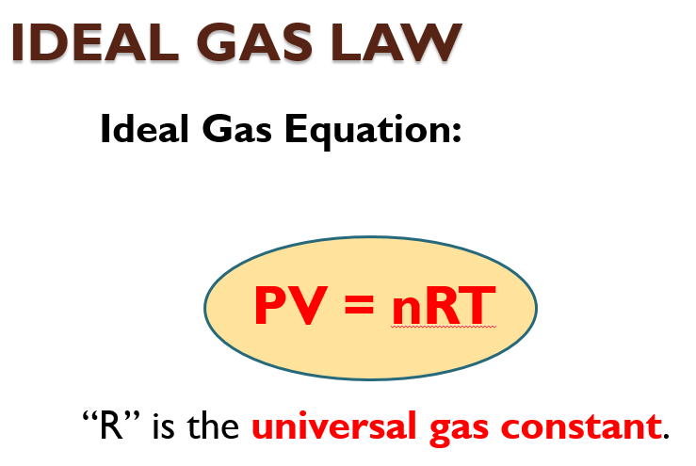
REVIEW OBJECTIVES
5. Perform calculations using the ideal gas law and the combined gas law.
You must memorize the formulas:
PV = nRT P₁V₁T₂ ₌ P₂V₂T₁

Slide 13
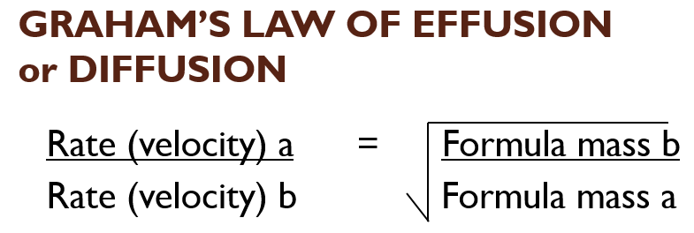
REVIEW OBJECTIVES
6. State and use Graham’s Law of Diffusion.
The lighter you are, the faster you travel.

Slide 14
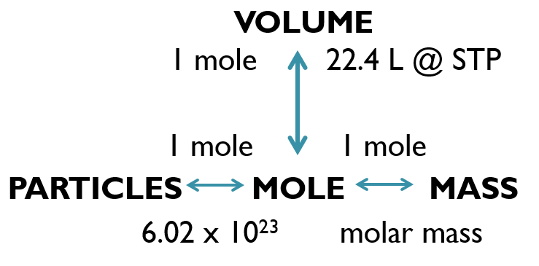
REVIEW OBJECTIVES
7. Be able to calculate gas stoichiometry problems (volume – volume, mass – volume, volume – mass).
Be sure to write what you know and where you are going as well as the balanced equation before starting.

Slide 15
REVIEW OBJECTIVES
7. Be able to calculate gas stoichiometry problems (volume – volume, mass – volume, volume – mass).
Be sure to write what you know and where you are going as well as the balanced equation before starting.
GAS STOICHIOMETRY
Convert to moles
Do the mole ratio using the balanced equation
Convert to what is asked for, if necessary.

Slide 16
REVIEW OBJECTIVES
8. Be able to calculate molecular mass using the ideal gas law formula.
We can use the ideal gas equation to calculate the molar mass of a gas from laboratory measurements.
To solve these problems, we:
  Calculate moles using the ideal gas law equation and then divide the moles into the number of grams (the mass) given.

Slide 17
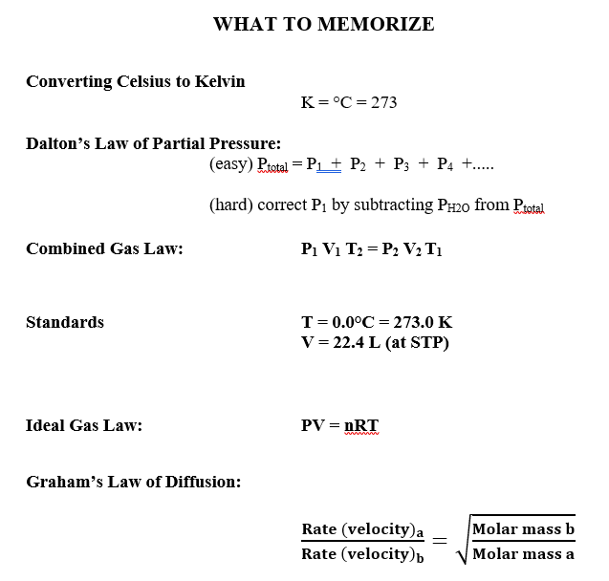
REVIEW

Slide 18
REVIEW
Remember the following:
ALWAYS convert to KELVIN temperature.
Convert to LITERs for the ideal gas law.
Correct P₁ only for dry gas pressure when using Dalton’s law.

