Slide 1
DO NOW
Pick up review.
Get out Hydrate lab from yesterday.
Get out green periodic table and a calculator.
Hydrate lab is due Monday.

Slide 2
LAB DATA

Slide 3
THE MOLE
REVIEW

Slide 4
REVIEW FOR TEST
Know the MOLE as the basic SI unit for measuring the amount of a substance.
Know Avogadro’s number (6.02 x 10²³) as it is related to a mole of any substance.
Calculate the molar mass from the periodic table for any substance.

Slide 5
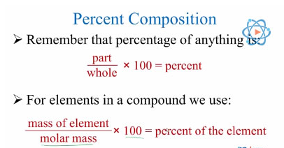
REVIEW FOR TEST
4. Be able to calculate percent composition using masses.

Slide 6
REVIEW FOR TEST
54. What is the percent composition of H₃PO₄?
H 3 x 1.01 = 3.03 %comp = part x 100
P 1 x 30.97 = 30.97 whole
O 4 x 16.00 = 64.00
98.00

Slide 7
REVIEW FOR TEST
5. Calculate the mole-mole, mole-mass, mass-mole, mole-particle, and particle-mole problems.
How many moles of oxygen atoms are present in 5.00 mol P₂O₅?
5.00 mol P₂O₅ 5 mol O = 25.0 mol O
1 mol P₂O₅

Slide 8
REVIEW FOR TEST
5. Calculate the mole-mole, mole-mass, mass-mole, mole-particle, and particle-mole problems.
Calculate the number of molecules in 11.5 moles of H₂O.
11.5 mol H₂O 6.02 x 10²³ molecules H₂O 1 mole H₂O
= 6.923 x 10²⁴ = 6.92 x 10²⁴ molecules H₂O
Calculate the number of moles in 25.5g Ag.
25.5g Al 1 mol Al = 0.2363956
107.87g Ag = 0.236 mol Ag

Slide 9
REVIEW FOR TEST
6. Use the mole to convert between mass and number of particles.
Calculate the number of atoms in 55.2g Li.
55.2g Li 1 mol Li 6.02 x 10²³ atoms Li
6.94g Li 1 mol Li
= 4.78824 x 10²⁴ = 4.79 x 10²⁴ atom Li
Calculate the mass in grams of 6.02 x 10²⁴ atoms Bi.
6.02 x 10²⁴atoms Bi 1mol Bi 208.98g
6.02 x 10²³ atoms Bi 1 mol Bi
= 2089.8 = 2090g Bi

Slide 10
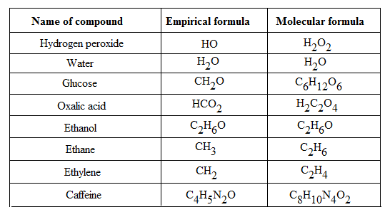
REVIEW FOR TEST
7. Distinguish between empirical and molecular formulas.

Slide 11
REVIEW FOR TEST
8. Calculate empirical formulas, molecular formulas, and hydrate formulas from appropriate data.

Slide 12
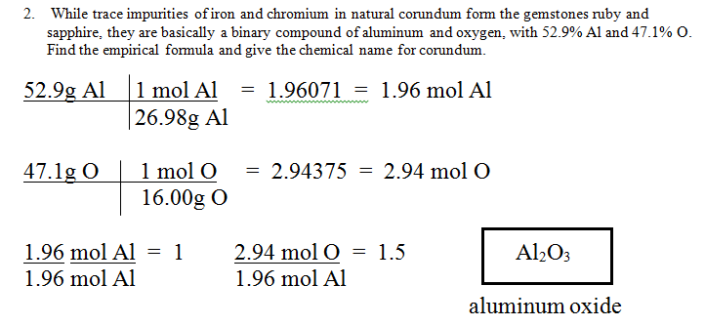
REVIEW FOR TEST

Slide 13
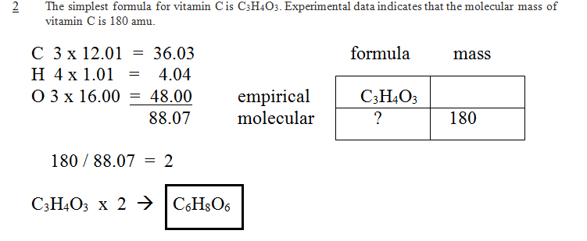
REVIEW FOR TEST

Slide 14
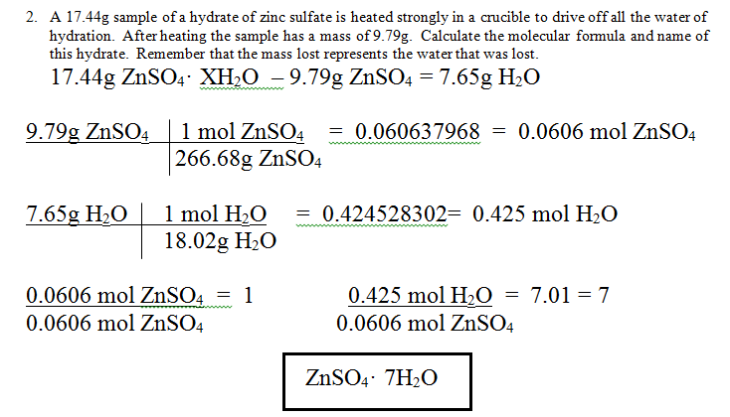
REVIEW FOR TEST

Slide 15
WHAT I WILL LOOK FOR
Be sure to show all your work.
Be sure to use the correct number of significant digits.
Be sure to show all units and substances.
Place all final answers on the line provided in the top right of the box.
Remember the more you show me, the more credit I can give.

Slide 16
WHAT’S ON THE TEST
10 problems
Mole to mole
Mole → mass; mass → mole
Mole → particles; particles → mole
Particles → mass; mass → particles
Percent composition
Empirical formula
Molecular formula
Hydrate formula

Slide 17
TO DO
Complete the Review. Pretend like it is your test and do EVERYTHING! Do not take short cuts.
I am happy to check any of the ones you want.
Due tomorrow.

Slide 18
DO NOW
Prepare for test – calculator and something to write with.
Turn in your review sheet for test redo points.
NO ELECTRONIC DEVICES AT ALL (even music) during the testing time. I will take that device and give it back NEXT Friday afternoon or to your parent, whichever comes first.

