Slide 1
TEST REVIEW
Earthquakes and Volcanoes

Slide 2
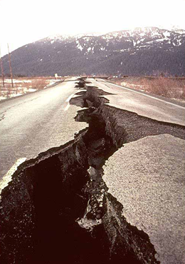
REVIEW
EARTHQUAKES – What are they?
Destructive natural disaster
Movement of the ground
Usually along a fault line
Caused by a sudden release of energy
Rocks under stress suddenly shift.

Slide 3
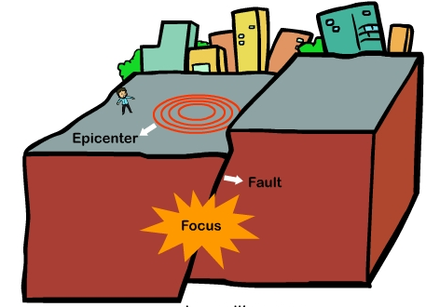
REVIEW
EARTHQUAKES – What are they?
Earthquakes occur in the Earth’s CRUST.
Focus: location along a fault where the first motion occurs.
Epicenter: point on Earth’s surface directly above focus.

Slide 4
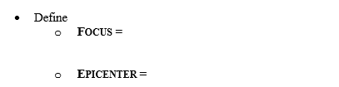
REVIEW
EARTHQUAKES – review sheet

Slide 5
REVIEW
EARTHQUAKES – How it happens
Rocks along fault are locked by friction.
The lock prevents rocks from moving past each other.
The stress in locked rock increases.
When stress goes past where rocks can maintain their integrity, they fracture.
Stress increases, rocks along the fault move, trembling and vibrations result = earthquake!
When rocks slip into new positions, energy is released.

Slide 6
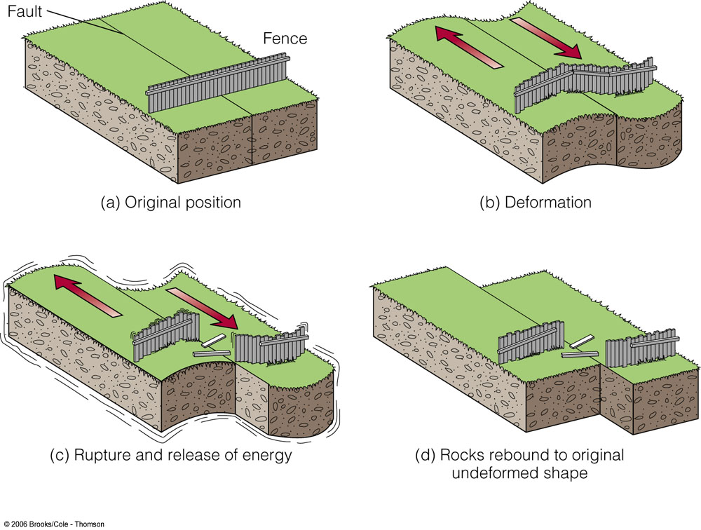
REVIEW
EARTHQUAKES – Elastic Rebound
Energy is stored in the form of Potential Energy.
This is the sudden return of rock to undeformed shape.
The pieces separate at weakest point, then rebound.
Rebound results in earthquake as rock fractures, then rebounds and springs back to original shape.

Slide 7
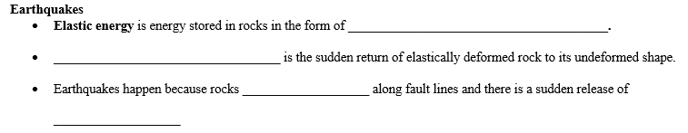
REVIEW
EARTHQUAKES – review sheet

Slide 8
REVIEW
EARTHQUAKES – Seismic Waves
Seismic waves: When rocks along a fault slip into new positions – energy is released.
Waves transfer energy.
Waves travel outward in all directions from the focus.
The composition of the material the waves pass through affects the speed and direction of the waves.

Slide 9
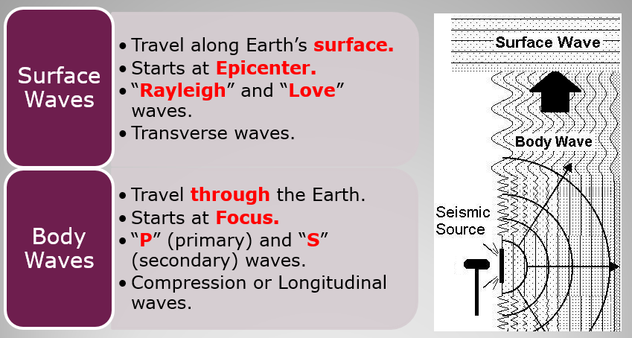
REVIEW
EARTHQUAKES – Seismic Waves

Slide 10
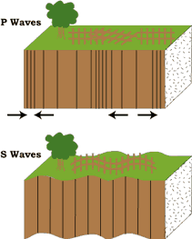
REVIEW
EARTHQUAKES – Seismic Waves
Primary (P) waves
Compression (longitudinal)
Fastest waves - Arrive first.
Travel through solids, liquids and gases.
Travel faster in more rigid material.

Slide 11
REVIEW
EARTHQUAKES – Seismic Waves
Secondary (S) waves
Transverse waves
Arrive second.
Travel through solids only – can’t go through liquids.

Slide 12
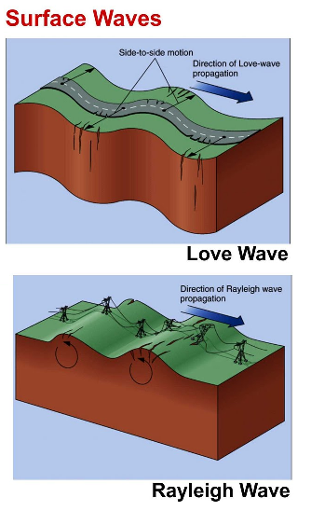
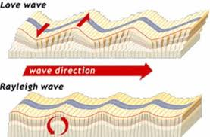
REVIEW
EARTHQUAKES – Seismic Waves
MOST DESTRUCTIVE
Move along surface.
Slowest moving; Greatest damage
Love waves
  Side-to-side - not vertical
  Ground twists
Rayleigh waves
  Rolling motion

Slide 13
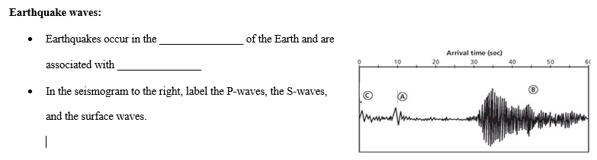
REVIEW
EARTHQUAKES – Review sheet

Slide 14
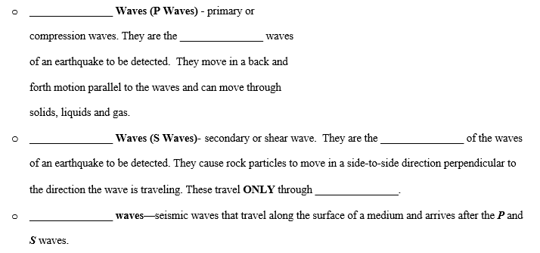
REVIEW
EARTHQUAKES – review sheet

Slide 15
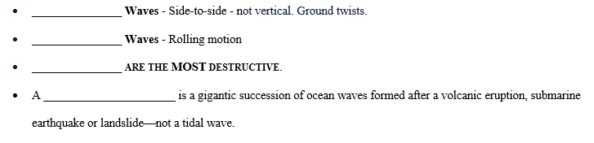
REVIEW
EARTHQUAKES – review sheet

Slide 16
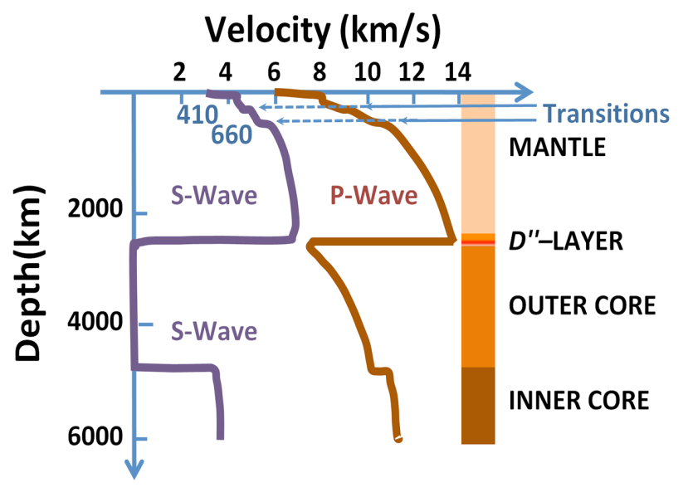
REVIEW
EARTHQUAKES – Seismic Waves
The speed of seismic waves depends on the composition of the material (density and elastic properties of the rocks and soil).
P-waves travel faster through rigid or denser material.
S-waves do not travel through liquid outer core.
Differences helped explain layers of Earth.

Slide 17
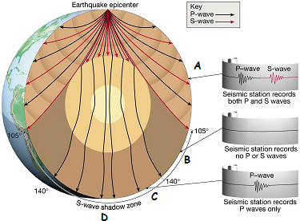
REVIEW
EARTHQUAKES – Seismic Waves
Location A:
P and S waves
Location B:
NO waves felt of any kind
P wave Shadow Zone
P waves deflected by liquid core
S waves stopped by liquid core
Location C:
S wave shadow zone
Only P waves felt
P waves bent in liquid core
S waves stopped by liquid core
Earthquake waves are not felt or recorded everywhere, every time.
What type of waves are received at location “D”?

Slide 18
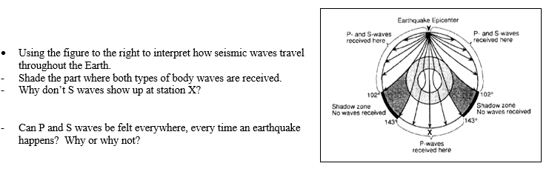
REVIEW
EARTHQUAKES – review sheet

Slide 19
REVIEW
EARTHQUAKES - Measuring
Magnitude measures the strength of an earthquake. It is related to energy released in the earthquake and is determined from measurements on seismographs.
Intensity measures the strength of shaking produced by the earthquake at a certain location. Intensity is determined from effects on people, human structures, and the natural environment.

Slide 20

REVIEW
EARTHQUAKES – Review sheet

Slide 21
REVIEW
EARTHQUAKES – Measuring Magnitude
Magnitude:
Measures the strength of an earthquake.
Related to energy released in the earthquake.
Richter Scale:
Older system.
Used in 20th century.
Based on ground motion.
Moment Magnitude Scale
New system
More accurate
Based on:
  size of the area of the fault that moves.
  average distance that the fault block moves.
  rigidity of the rocks in the fault zone.

Slide 22
REVIEW
EARTHQUAKES – Measuring Intensity
Intensity: the amount of damage caused by an earthquake. Depends on Magnitude, Distance from epicenter, Local geology, Infrastructure, Local geology
Mercalli Scale:
Measurement system
Describes the effects of the earthquake.
Expresses intensity in Roman numerals.

Slide 23
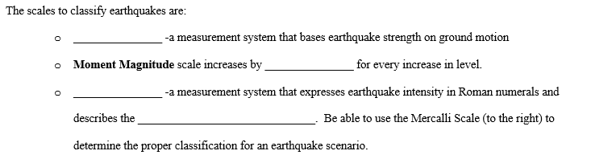
REVIEW
EARTHQUAKES – Review sheet

Slide 24
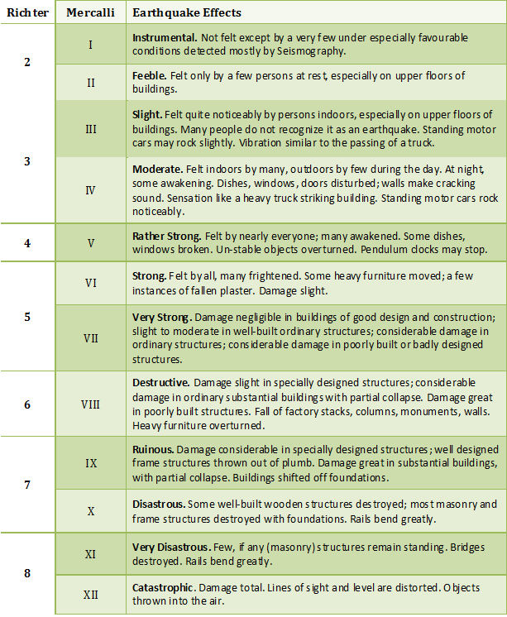
REVIEW
EARTHQUAKES – review sheet

Slide 25
REVIEW
EARTHQUAKES – Depth
SHALLOW:
less than 70 km of surface – more common; Most damage; Closest to the surface; Occur at all boundaries.
INTERMEDIATE:
70 – 300 km deep; Occur at convergent boundaries.
DEEP:
Over 300 km; usually at subduction zones (convergent boundaries).

Slide 26
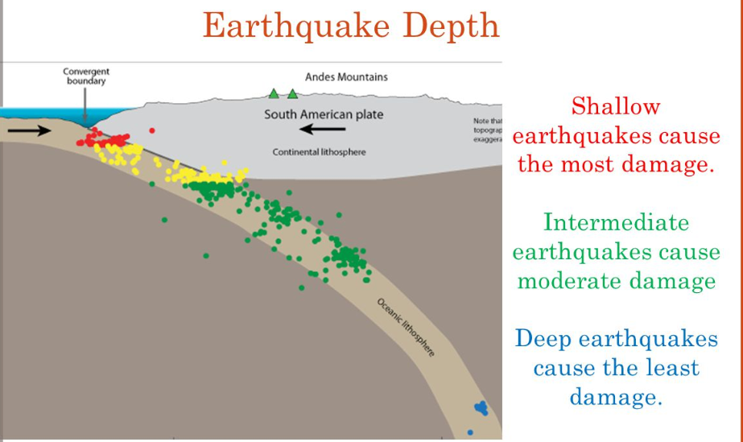
REVIEW
EARTHQUAKES – Depth

Slide 27
REVIEW
EARTHQUAKES – Epicenter
Energy released (elastic potential) as fault blocks move.
Energy moves in vibrations called seismic waves.
Body waves:
P waves
  Arrive first; Compression waves
S waves
  Arrive second; Transverse waves
Surface waves:
Most damaging; Rayleigh and Love waves

Slide 28
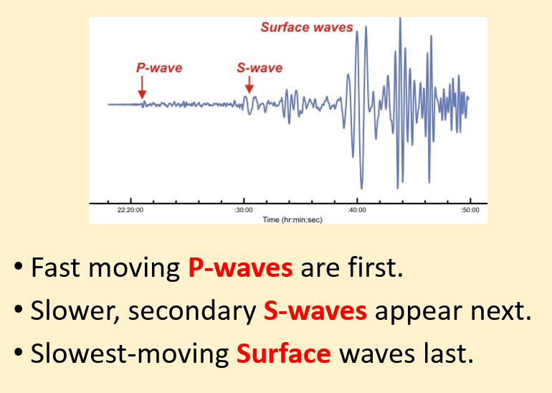
REVIEW
EARTHQUAKES – Epicenter

Slide 29
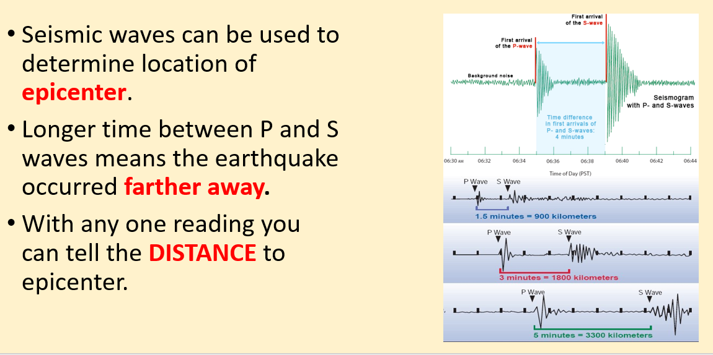
REVIEW
EARTHQUAKES – Epicenter

Slide 30
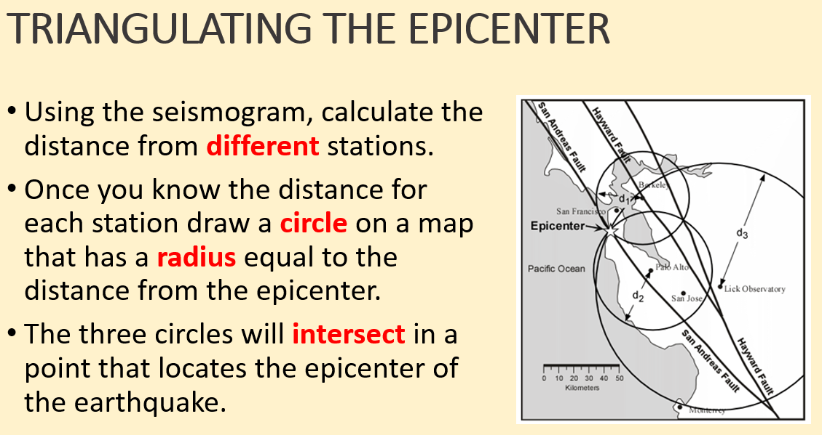
REVIEW
EARTHQUAKES – Epicenter

Slide 31
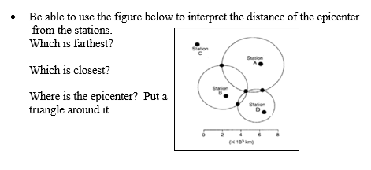
REVIEW
EARTHQUAKES – review sheet

Slide 32
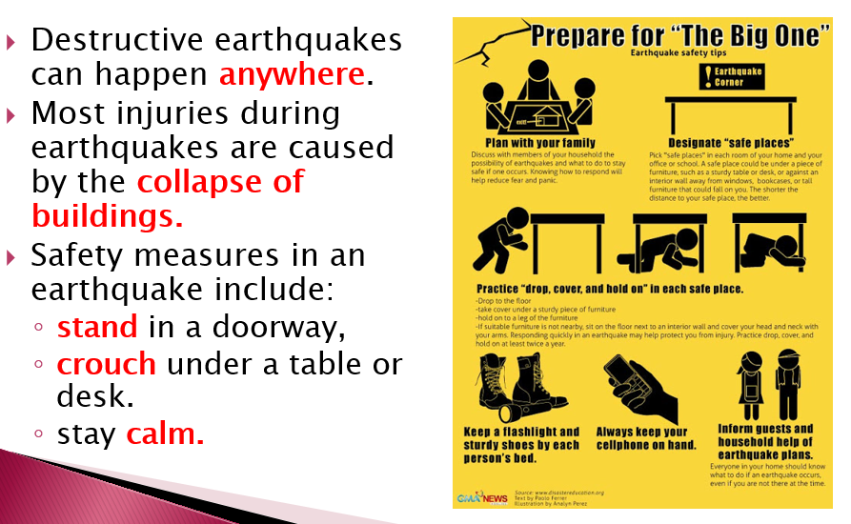
REVIEW
EARTHQUAKES – Hazards

Slide 33
REVIEW
EARTHQUAKES – HAZARDS
TSUNAMI
Gigantic ocean waves
Severe ground shaking may cause tsunamis.
When the waves enter shallow water, they may rise to several feet or, in rare cases, tens of feet, striking the coast with devastating force.
Formed after:
  volcanic eruption
  submarine earthquake
  landslide

Slide 34
REVIEW
EARTHQUAKES – HAZARDS
LANDSLIDE
Seismic waves destabilize cliffs and steep slopes.
Can cause landslides and rockfalls.

Slide 35
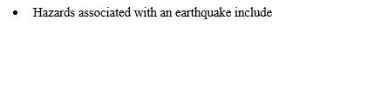
REVIEW
EARTHQUAKES – review sheet

Slide 36
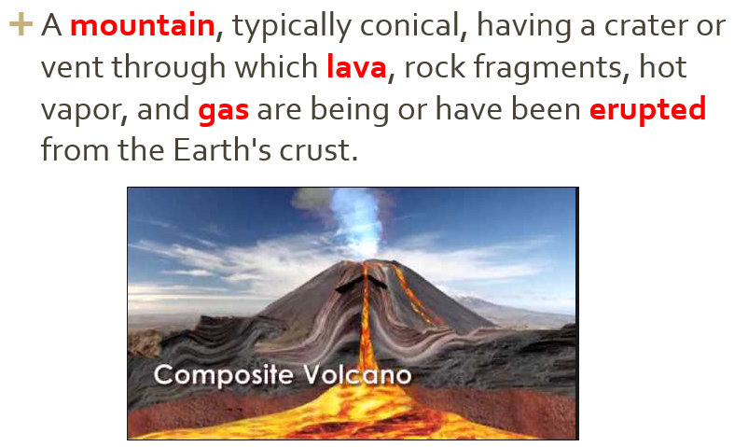
REVIEW
VOLCANOES - Define

Slide 37
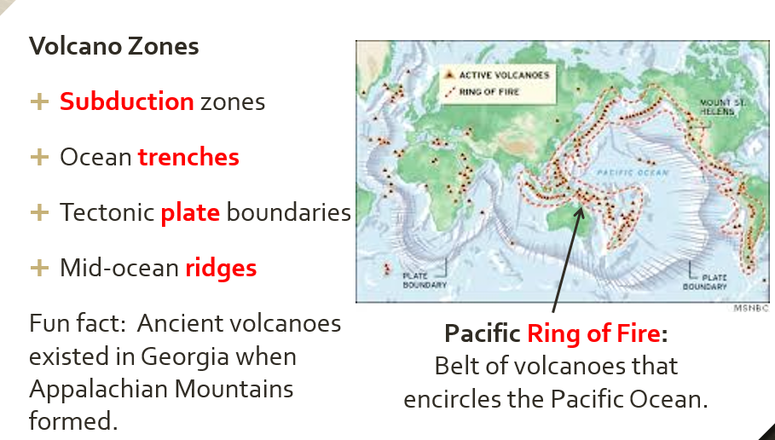
REVIEW
VOLCANOES – Where do they form?

Slide 38
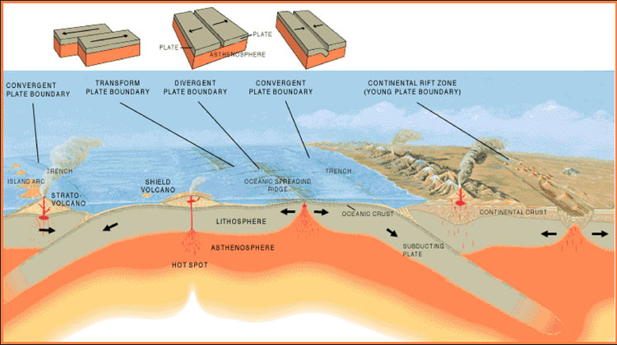
REVIEW
VOLCANOES – Where do they form?

Slide 39
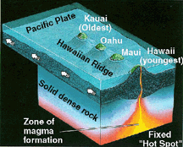
REVIEW
VOLCANOES – Where do they form?
Hot Spots
Areas of volcanism within tectonic plates.
Mantle plumes develop and hot spots form above plumes.
Rock melts, lava forms.
Some not associated with plate boundaries.

Slide 40
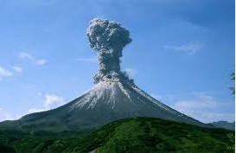
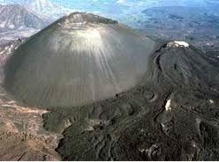
REVIEW
VOLCANOES - Types
Composite
Built with layers of lava flows.
Steep-sided and symmetrical cones
Alternates eruptive explosions and quieter lava flows.
Cinder Cone
From explosive eruptions.
Made of pyroclastic materials.
Steep sides and a bowl-shaped crater.
Most common type of volcano.

Slide 41
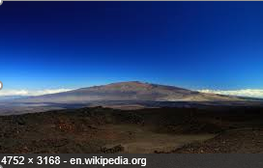
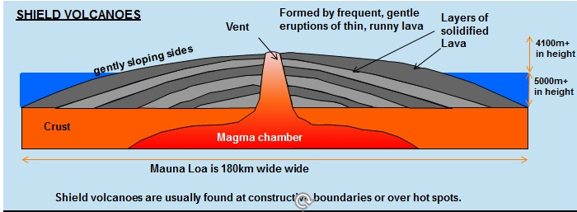
REVIEW
VOLCANOES - Types
Shield
Built from fluid lava flows.
Gently sloping sides.
Broad base.

Slide 42
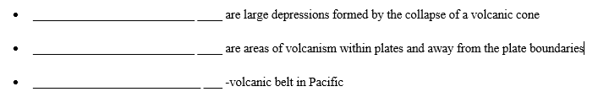
REVIEW
VOLCANOES – review sheet

Slide 43
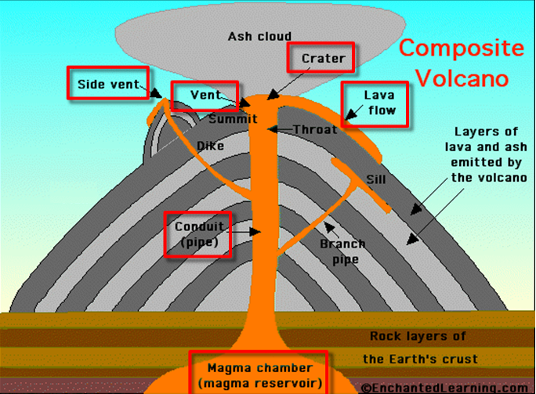
REVIEW
VOLCANOES - Terminology

Slide 44
REVIEW
VOLCANOES - Terminology
Vent – an opening in a volcano connecting the magma to the surface.
Side Vent - magma reaching the surface through another opening.
Magma Plume or Chamber - large underground pool of molten rock sitting underneath the Earth’s crust.
Crater – a bowl shaped area that forms around a volcano’s central opening.
Lava flow – magma that flows onto Earth’s surfaces.
Conduit or Pipe – the channel from the magma chamber to the vent to bring the magma to the surface.

Slide 45
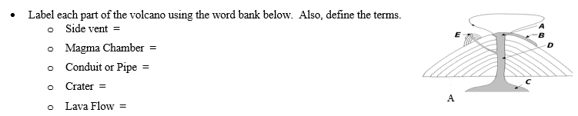
REVIEW
VOLCANOES – review sheet

Slide 46
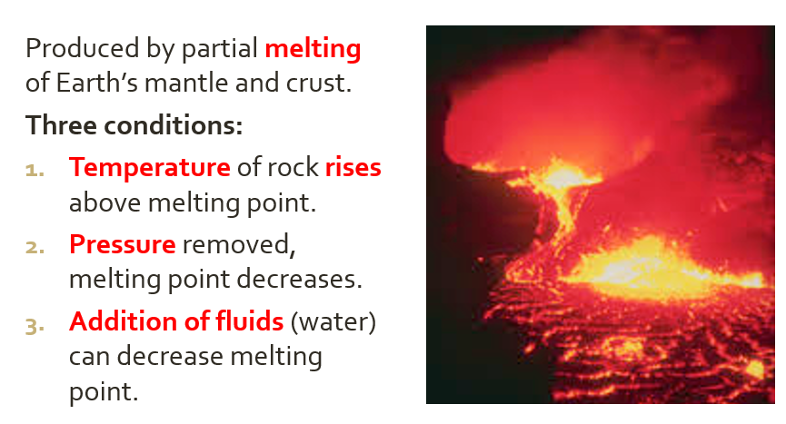
REVIEW
VOLCANOES – Formation of Magma

Slide 47
REVIEW
VOLCANOES – review sheet

Slide 48
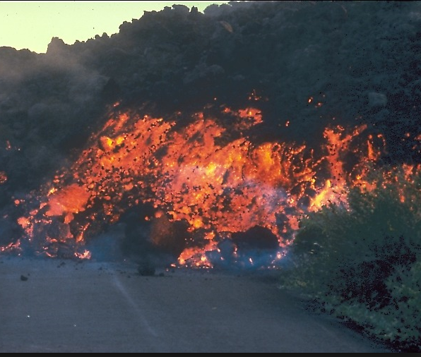
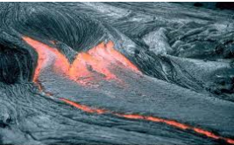
REVIEW
VOLCANOES – Formation of Magma
More viscous lavas:
Higher silica content.
More explosive eruptions.
Flow slower and thicker.
A’a lava
Felsic composition
Less viscous lavas:
Low silica content.
Lava tends to ooze out.
Flow faster and thinner.
Pahoehoe lava
Mafic composition

Slide 49
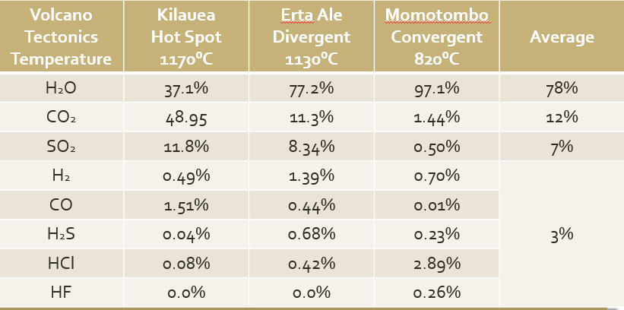
REVIEW
VOLCANOES – Formation of Magma
Volcanic Gases:
Water vapor and Carbon Dioxide are the most common.

Slide 50
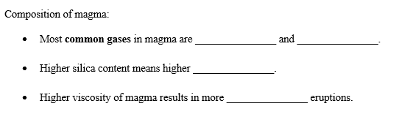
REVIEW
VOLCANOES – review sheet

Slide 51
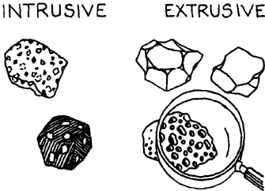
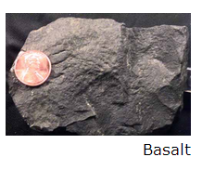
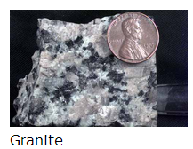
REVIEW
VOLCANOES – Rocks
Small crystals
  Quickly cools.
  Usually extrusive.
Large Crystals
  Cools slowly.
  Usually intrusive.

Slide 52
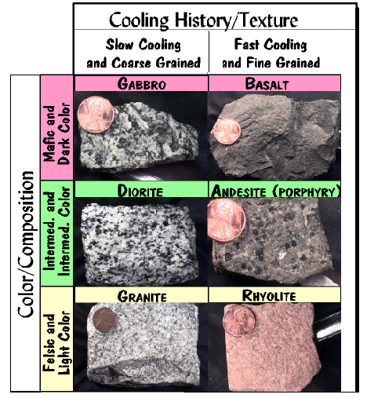
REVIEW
VOLCANOES – Rocks
Mafic
High amounts of iron (Fe) and magnesium (Mg).
High melting point.
Intermediate
Mixed Composition.
Unusual process of formation.
Felsic
High amounts of silicon (Si), sodium (Na), aluminum (Al), and potassium, (K).
Low melting point.

Slide 53
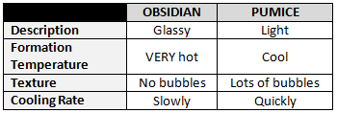
REVIEW
VOLCANOES – Rocks
Mafic:
  Scoria – darker color, gassy with lots of air bubbles – cooler formation temperature – cools quickly
Felsic:
  Pumice – light, gassy with lots of air bubbles – cooler formation temperature – cools quickly
  Obsidian – dark, no gas bubbles – hotter formation temperature – cools slowly

Slide 54
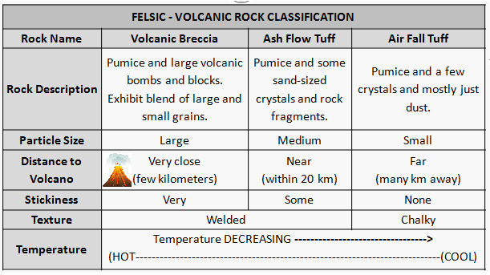
REVIEW
VOLCANOES – Rocks

Slide 55
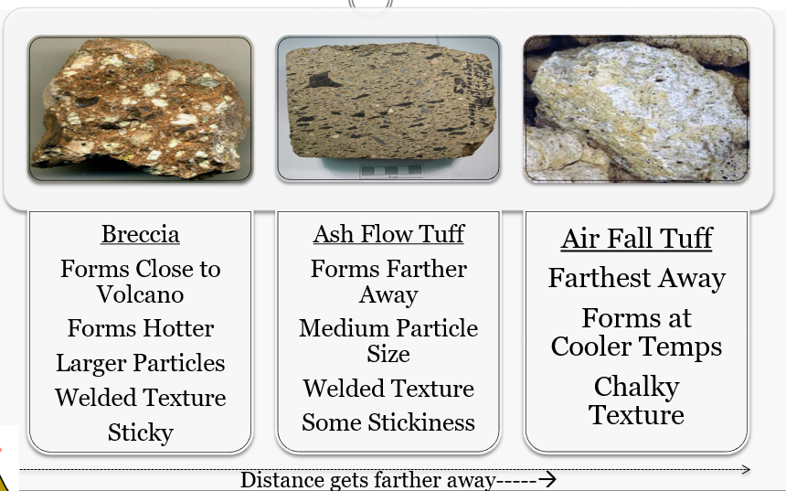
REVIEW
VOLCANOES – Rocks

Slide 56
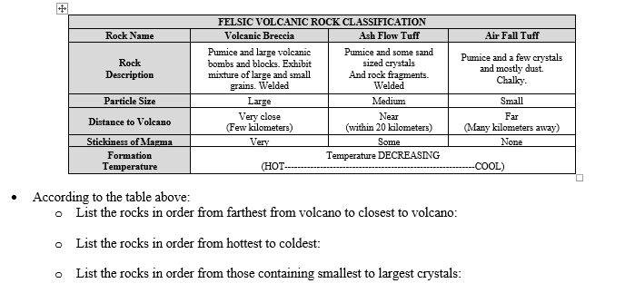
REVIEW
VOLCANOES – review sheet

Slide 57
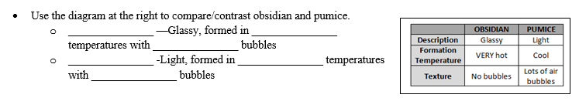
REVIEW
VOLCANOES – review sheet

Slide 58
REVIEW
Test is 40 multiple choice questions – you will be bubbling in an answer sheet just like before.
There is some extra credit on the back.
QUIZLET test review:
https://quizlet.com/_2nbqb4

