Slide 1
DO NOW
Pick up vocabulary sheet if you did not get one yesterday.

Slide 2
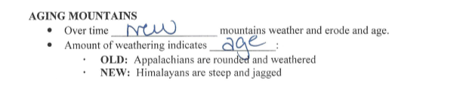
REVIEW #13
The shape and appearance of mountains are clues to their _______________
  Appalachian Mountains
    Rounded and weathered peaks indicate _______________ age
    They formed around 480 million years ago when ancient plates collided
  Rocky Mountains
    High, jagged peaks indicate _______________ mountains
    Formed between 55-80 million years ago at divergent boundary
  Himalayan Mountains
    _______________ mountain range on planet—still forming
    Result of collision of Eurasian Plate and Indo-Australian Plate

Slide 3
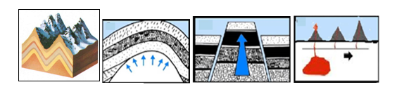
REVIEW #13
Be able to identify the four types of mountains in the illustrations below—label (A) dome, (B) fault block, (C) folded, (D) volcano

Slide 4
REVIEW: VOCABULARY
Match the vocabulary words to the definitions.
Fix the sheet by making #8 part of #7:
Once you finish the sheet, you can do the quizlet on a laptop: https://quizlet.com/152373203/. There is also a quizlet for the test: https://quizlet.com/_2jxrc5
7. a region where one plates moves beneath another plate; associated with
8. oceanic crust sliding under continental crust

Slide 5
ROCK IDENTIFICATION LAB
Once you have completed six, get a large folded piece of drawing paper
On the cover, write, in order:
a. Write the name of the Lab
b. Write the name of both lab partners
c. Write the period for your class
d. Draw and label the rock cycle

Slide 6
ROCK IDENTIFICATION LAB
On the left inside panel, write the words and definitions for:
a. Igneous
b. Metamorphic
c. Sedimentary
d. Extrusive (igneous rock)
e. Intrusive (igneous rock)
f. Clastic (sedimentary rock)
g. Foliation
On the inside right panel, staple your rock lab sheets.

Slide 7
ROCK IDENTIFICATION LAB
On the back cover answer these questions:
1 - How many rocks were you correctly able to identify?
2 - What were the clues that helped you the most?
3 - What rocks were the easiest to identify? Why?
4 - What is the difference between a rock and a mineral?
5 - Do you think if you were to find one of these rocks outside you would be able to identify it now? Why or why not?

Slide 8
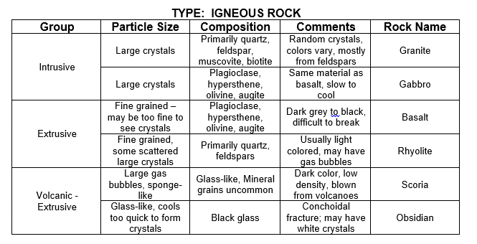
ROCK IDENTIFICATION LAB

Slide 9
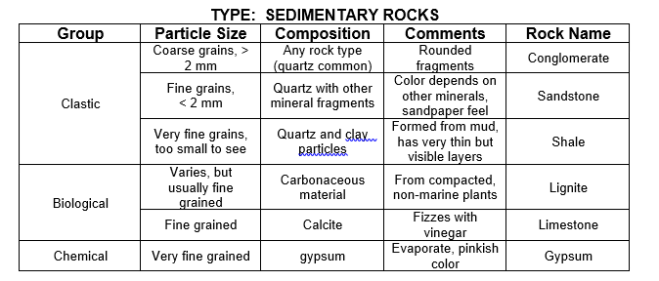
ROCK IDENTIFICATION LAB

Slide 10
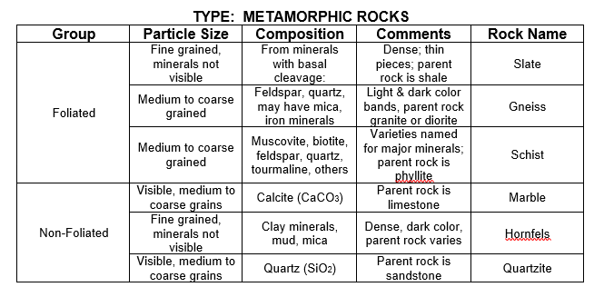
ROCK IDENTIFICATION LAB

Slide 11
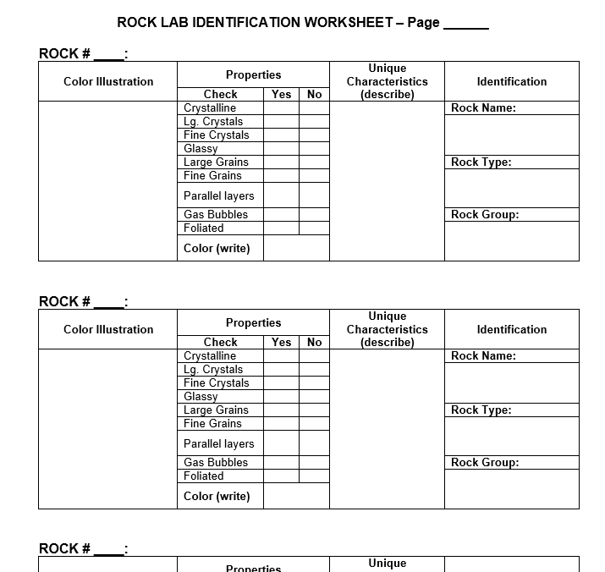

Slide 12
ROCK CATEGORIES
Igneous Rocks
#1, 4, 7, 10, 13, 16
Sedimentary Rocks
#2, 5, 8, 11, 14
Metamorphic Rocks
#3, 6, 9, 12, 15, 18

