Slide 1

Unit 4 Review
What to expect, what to know…

Slide 2
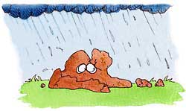
STANDARDS
SES3: Students will explore the actions of water, wind, ice, and gravity that create landforms and systems of landforms (landscapes).

Slide 3
REVIEW
HYDROLOGIC CYCLE: SES1e: Identify the transformations and major reservoirs that make up the hydrologic cycle.
Earth’s Water Supply:
About 70 percent of the Earth's surface is water-covered
The oceans hold about 97% of the planet’s water.
Freshwater is 3%.

Slide 4
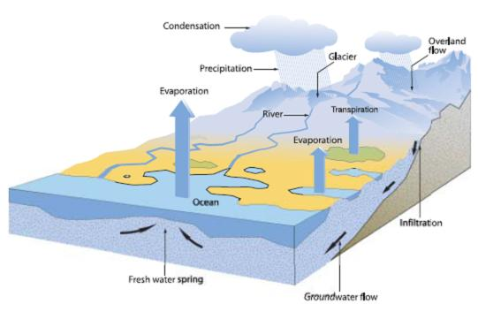
REVIEW
Cycle that transports water through Earth’s systems
The Sun: Source of energy
Gravity:
  Major force acting on water.
  Moves all transformations except evaporation.

Slide 5
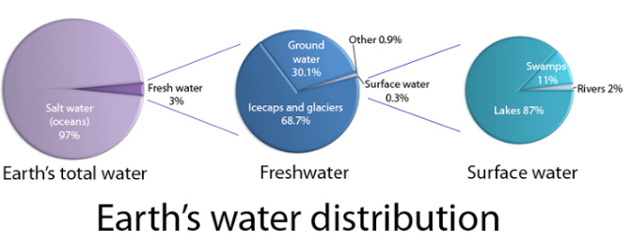
REVIEW
Reservoirs:
Ocean water
Glaciers and Ice caps
Groundwater
Surface water
Water in the Atmosphere

Slide 6
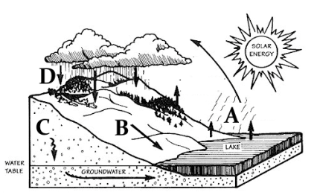
REVIEW
Transformations:
Evaporation
Transpiration
Condensation
Precipitation
Surface runoff
Groundwater

Slide 7
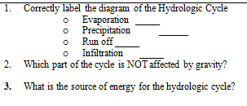
REVIEW

Slide 8
REVIEW
SES3a. Describe how surface water and groundwater act as the major agents of physical and chemical weathering.
The breaking down of rock by physical processes.
Does not change the rock chemically.
When chemical reactions in the environment react with minerals in the rock to break it down.
Does change the rock chemically.
MECHANICAL
CHEMICAL

Slide 9
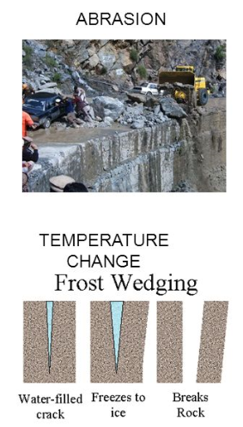
REVIEW
Mechanical Weathering
Wind
Waves and Water
Gravity
Ice Wedging
Organic Activity
  Animal burrowing
  Root wedging

Slide 10
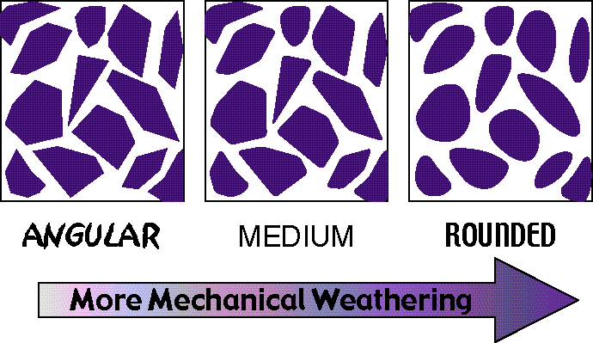
REVIEW

Slide 11
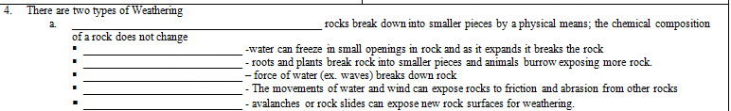
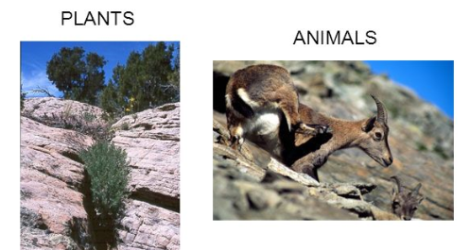
REVIEW

Slide 12
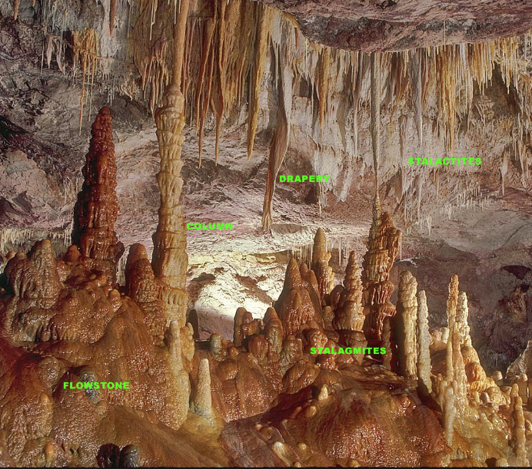
REVIEW
Chemical Weathering
Hydrolysis
  Minerals dissolve in water.
Oxidation
  Turns iron minerals a brown-red color because the minerals react with oxygen in the air.
Carbonation
  Carbonic acid breaks down compounds chemically.
Acid Precipitation

Slide 13

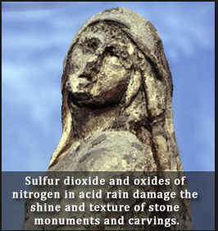
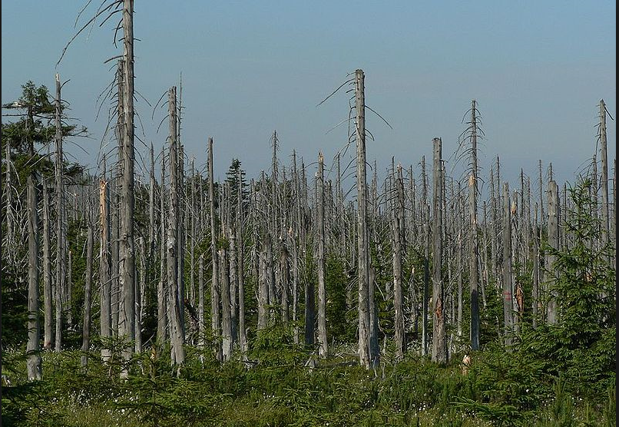
REVIEW
Iron Oxide is the cause of the __________________________________of Georgia clay.

Slide 14
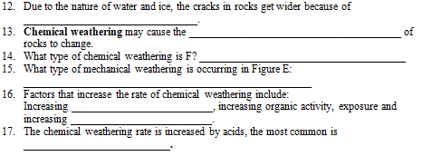
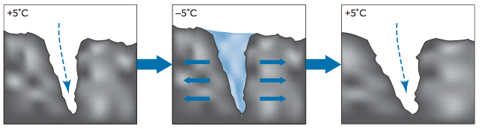
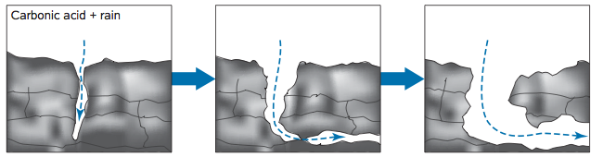
REVIEW
E
F

Slide 15
REVIEW
Factors that Affect the Rate of Weathering
Rock Composition
  Differential Weathering: Softer, less resistant rocks wear away at a faster rate than more weather resistant rocks.
Climate
  Most rapid in hot, wet climates and slowest weathering occurs in cold, dry climates.
Exposure
  More Surface area = more exposure and greater rate of weathering.
  Mechanical weathering makes chemical weathering faster by breaking rock into smaller pieces and exposing more surface area.

Slide 16

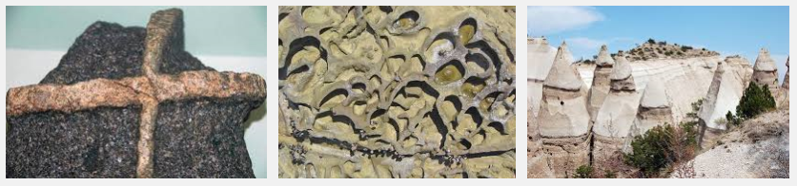

REVIEW

Slide 17
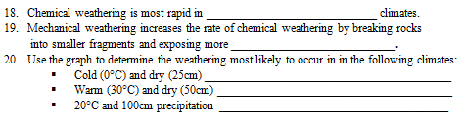
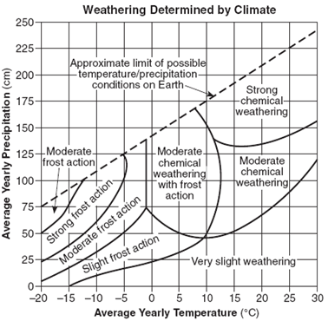
REVIEW

Slide 18
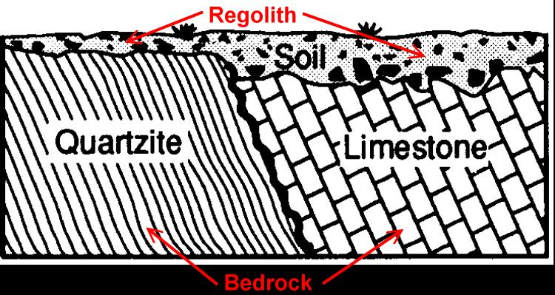
REVIEW
SES3b. Explain how soil results from weathering and biological processes acting on parent rock.

Slide 19
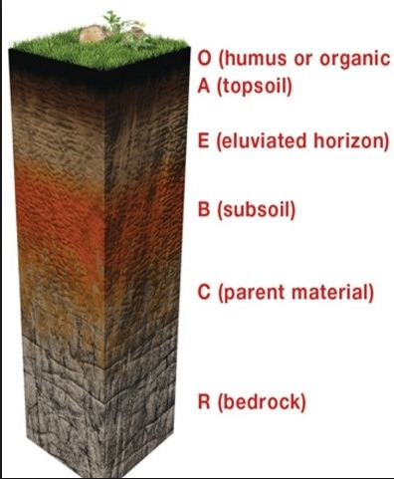
REVIEW
Soil Profile
O Horizon - humus
A Horizon - topsoil
B Horizon - subsoil
C Horizon - regolith
D Horizon - bedrock
  Parent rock has greatest impact on soil composition.

Slide 20
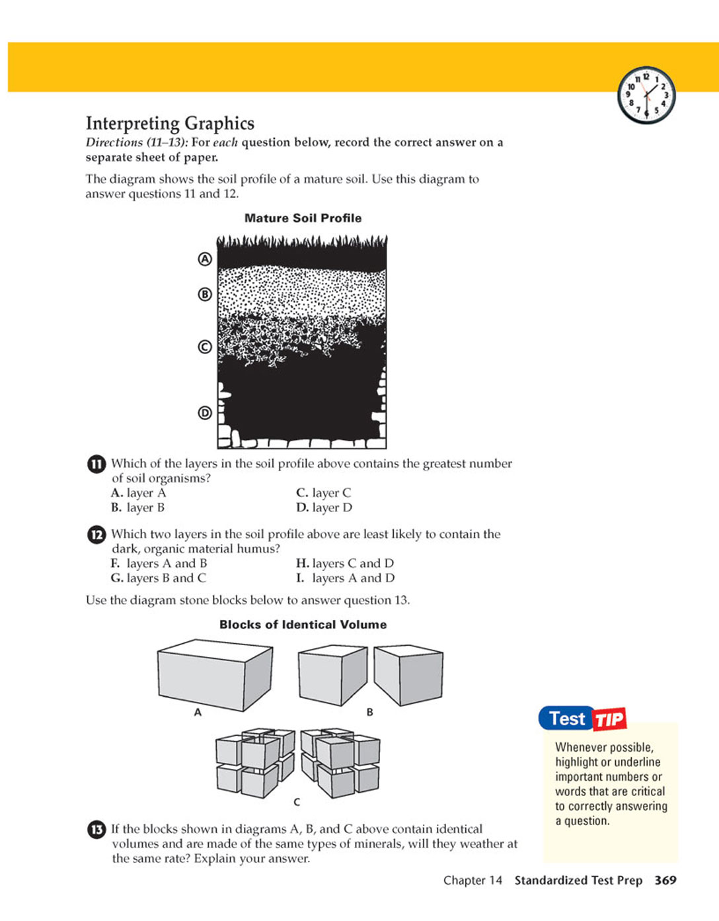
REVIEW
22. Using the figure, be able to label the layers properly.
A Horizon - ______________—organic matter and living organisms
B Horizon – _______________- Zone of leaching-dissolved are
pulled down by gravity
C Horizon – ________________
D _________________-solid rock layer at the bottom
Characteristics of ____________________________have the greatest impact on soil composition.

Slide 21
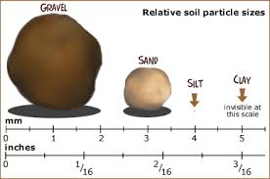
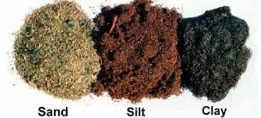
REVIEW
Soil Type and Texture
Loam – equal parts of all
Sand – largest, most porous
Silt – medium size, medium porosity
Clay – smallest – poor porosity

Slide 22
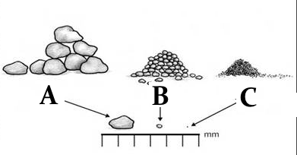
REVIEW
23. Using the figure to the right, determine which of the samples (A, B, or C) is
  ______________________– largest particles - porous
  ______________________– medium size
  ______________________– smallest particles – retains water well
24. Which particle was at the bottom of the soil test tube?

Slide 23
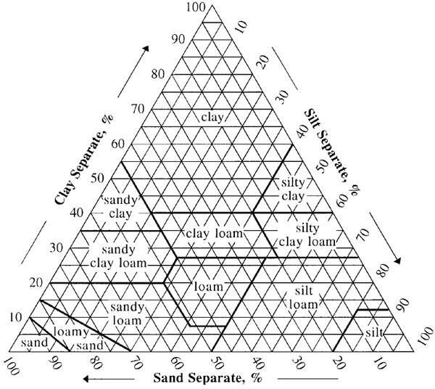
REVIEW
Soil Triangle
21. Use the triangle graph to determine types of soil described based on percentages of sand, silt and clay.
20% sand and10% silt and 70% clay
60% sand and10% silt and 30% clay
10% sand and70% silt and 20% clay

Slide 24
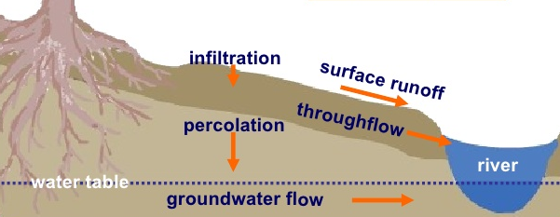
REVIEW
Infiltration – when the water enters the soil surface after falling from the atmosphere.
Percolation – the downward movement of water from the land surface into soil or porous rock.

Slide 25
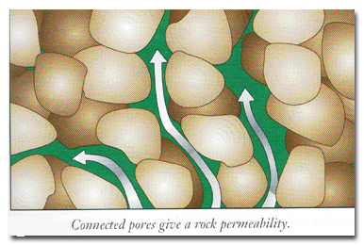
REVIEW
POROSITY: The percent of rock or sediment that consists of open space.
  Groundwater moves through the spaces called pores between soil particles.
PERMEABILITY: The ease with which water passes through a porous material.
  Is affected by how large the pores in the substance are and how well the particles fit together.

Slide 26
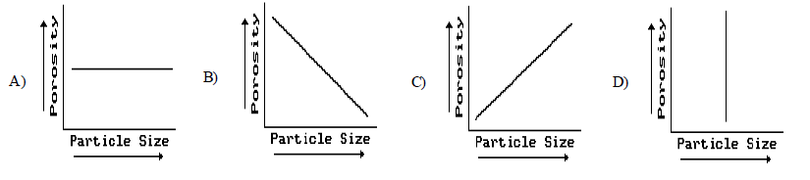
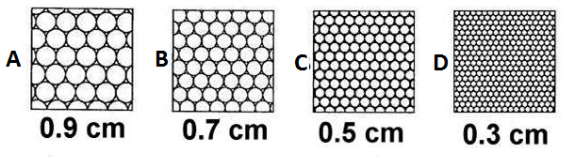
REVIEW
Relationship between porosity and particle size?
Greatest and least porosity?

Slide 27
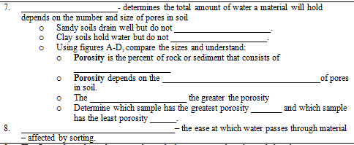
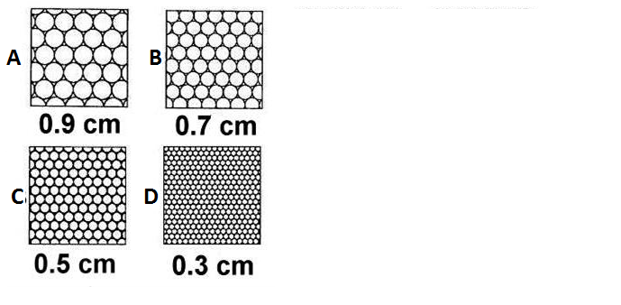
REVIEW

Slide 28
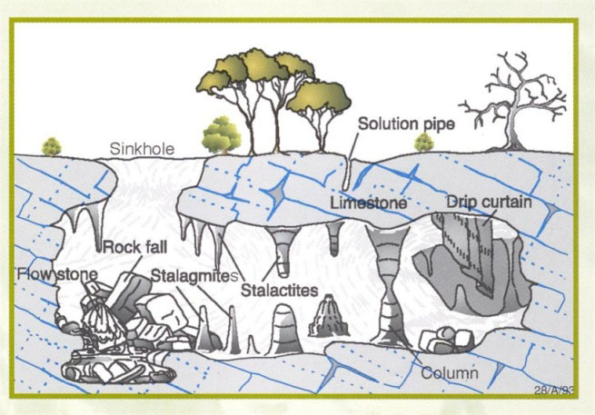
REVIEW
SES3d. Relate the past and present actions of ice, wind, and water to landform distribution and landscape evolution.
Chemical Weathering landforms:
Cave and Caverns – caused by carbonation of limestone rock
Sinkhole - caused by carbonation of limestone rock
Karst Topography - landscape characterized by the above landforms

Slide 29
REVIEW
Mechanical Weathering landforms
Coastal weathering – caused by waves and water; differential weathering
  Sea cliffs
  Sea arches
  Stacks

Slide 30
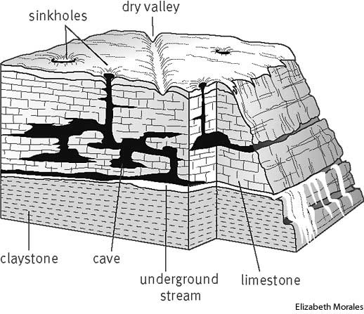
REVIEW
29. What is Karst Topography?
Why does it form?
List some evidence of it from Figure L.
27. Caves are most often formed in ______________________ rock.
L.

Slide 31
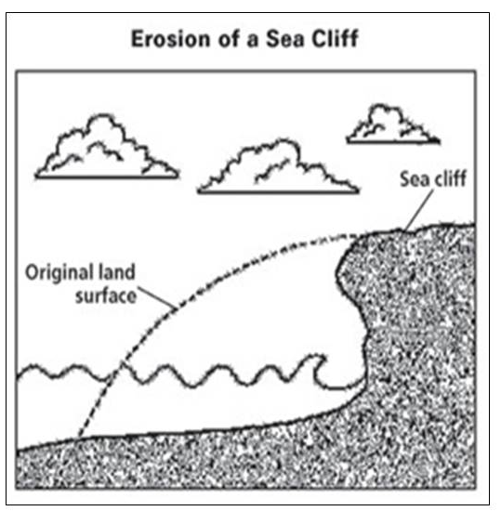
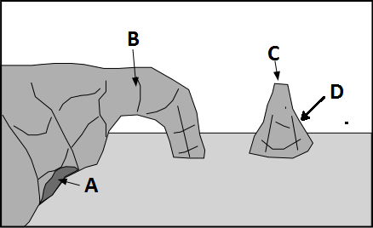
REVIEW
28. Understand in Figure K the most probable reason for the sea cliff erosion is weathering by __________________________________.
30. Use Figure M to explain what type of mechanical weathering took place to form the features present in the illustration: _____________________
31. Label: Sea Arch ______ Sea Cave ______ Headland ______ Sea Stack ______
K.
M.

Slide 32
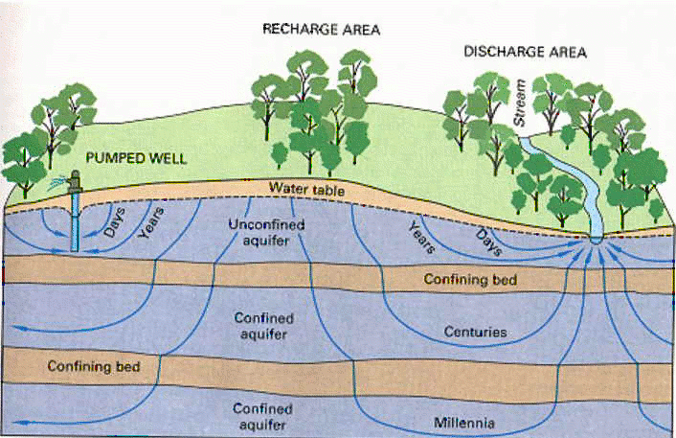
REVIEW
Groundwater: water beneath Earth’s surface
  infiltrates surface then percolates through spaces in rock and sediment.
Aquifers: body of rock that stores underground water and allows it to flow.

Slide 33
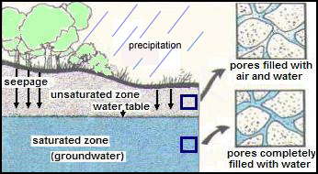
REVIEW
Zone of Saturation
  Level where pore space is completely filled with water.
Water Table
  Upper boundary of the zone of saturation.
Unsaturated Zone
  Zone between water table and surface.

Slide 34
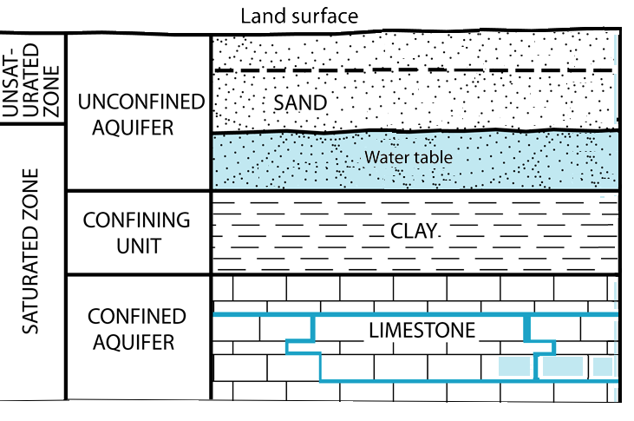
REVIEW
Unconfined aquifers water infiltrates easily from surface.
Confined aquifers – water trapped by impermeable rock like granite or clay –between layers of rock.

Slide 35
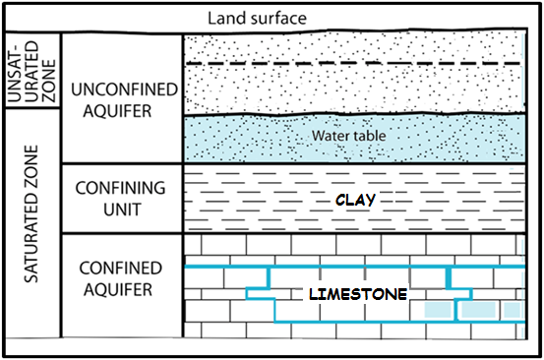
REVIEW
Groundwater Layers
Confining layer is most likely clay – keeps water from seeping deeper
Water trapped table above confining layer cannot seep below
Layers of rock under confining layer can be anything
Porous rocks like Limestone will have water fill the spaces throughout the layer
Water in confined aquifer comes from elsewhere – not above

Slide 36
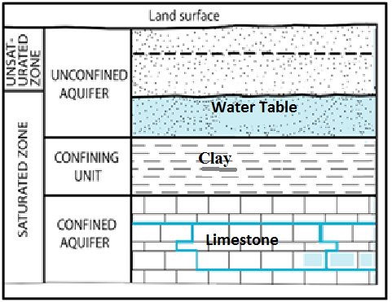
REVIEW
6. Using the figure, understand Confined vs. Unconfined Aquifers
  _________________________-water infiltrates easily from surface
  _________________________– water trapped by impermeable rock or clay– between layers of rock

Slide 37

How to Study?
KNOW the study guide
Review the online Quizlet
Look over your notes and individual reviews
BE SURE TO STUDY!
Quizlet for test: https://quizlet.com/_2qd9m5
Four complete, on time study guides required to retake a test!

