Slide 1
DO NOW
Pick up Test Study Guide
Turn in your vocabulary if it is complete.

Slide 2
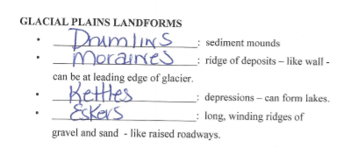
REVIEW #35
  Match the glacial features with their definitions below.
  ______ depressions – can form lakes.
  ______ long, winding ridges of gravel and sand - like raised roadways
  ______ ridge of deposits – like wall - can be at leading edge of glaciers.
  ______ sediment mounds
Drumlins
Eskers
Kettles
Moraines

Slide 3
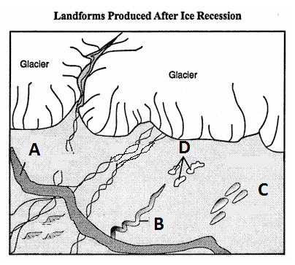
REVIEW #35
Now match the features above with the letters in the drawing above.
Drumlin ______
Esker ______
Kettles ______
Moraines _____

Slide 4
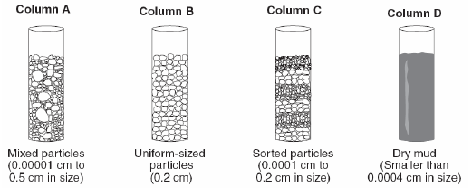
REVIEW #35
Using the figure to the right, identify which samples will create the following (you may not use all the letters):
shale _____ sandstone _____
breccia _____ conglomerate _____
Which would have been deposited by a glacier? __

Slide 5
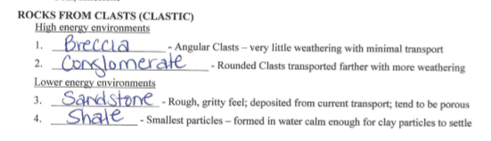

REVIEW #35

Slide 6

Unit 5 Review
What to expect, what to know…

Slide 7
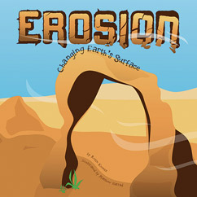
STANDARDS
SES3. Students will explore the actions of water, wind, ice, and gravity that create landforms and systems of landforms.
c. Describe the processes and hazards associated with both sudden and gradual mass wasting.
d. Relate the past and present actions of ice, wind, and water to landform distribution and landscape evolution.
e. Explain the processes that transport and deposit material in terrestrial and marine sedimentary basins, which result, over time, in sedimentary rock.

Slide 8
EROSION
REMEMBER
Erosion is the process that transports Earth’s weathered materials from one place to another by wind, water or ice.

Slide 9
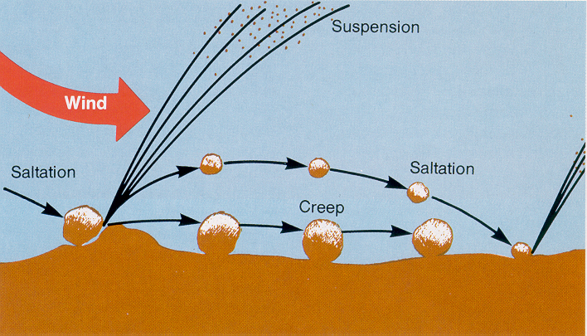
WIND EROSION
Creep- The largest particles which are too heavy to be lifted into the air are rolled along the surface.
Saltation - larger particles are pushed and bounced along the ground. This accounts for the most wind transport of sand.
Suspension- small particles become airborne for long distances.

Slide 10
WIND EROSION LANDFORMS
Obstacles slow wind
A dune is a pile of wind blown sand.
Formation:
  Wind meets obstacle.
  Obstacle causes wind to slow down.
  Sand (load) is dropped.
  Dune forms and grows.
  The more sand deposited, the bigger the obstacle, the more sand is dropped.

Slide 11
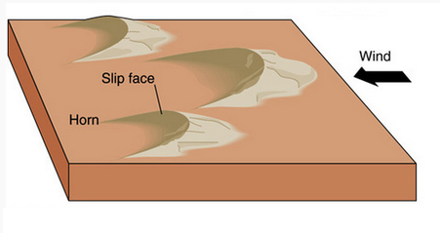
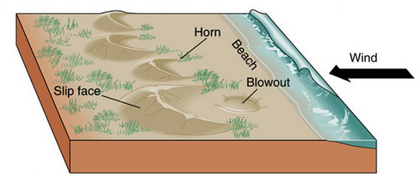
WIND EROSION LANDFORMS
Most common
Crescent shaped
Constant wind
Always in moist environment
Requires vegetation to anchor ends.
BARCHAN DUNE
PARABOLIC DUNE

Slide 12
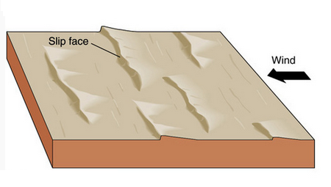
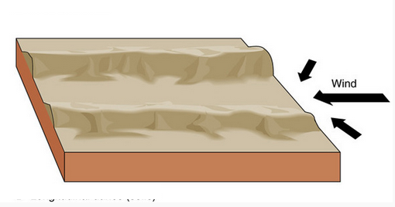
WIND EROSION LANDFORMS
Long, asymmetrical
Form at right angles to the wind direction.
Abundant supply of sand.
Abundant sand.
Strong cross winds from at least two directions.
Sand in long lines or ridges.
Straight / slightly wavy.
TRANSVERSE DUNE
LATERAL DUNE

Slide 13
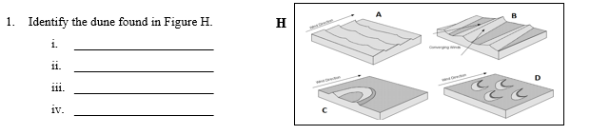
WIND EROSION LANDFORMS
A.
B.
C.
D.

Slide 14
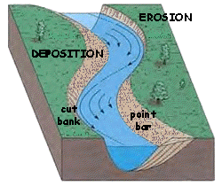
RIVERS AND EROSION
Water moves faster on the inside of outside curves – increases erosion.
Water moves slower on inside curves – greater deposition.

Slide 15
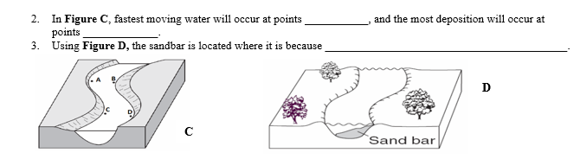
RIVERS AND EROSION

Slide 16
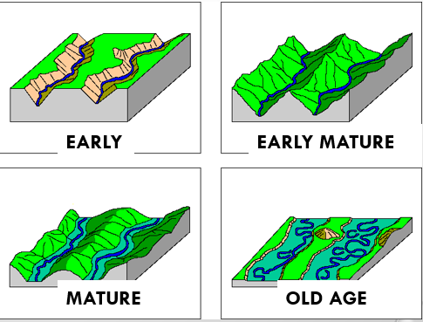
RIVERS AND EROSION
Over time, rivers become wider and deeper.

Slide 17
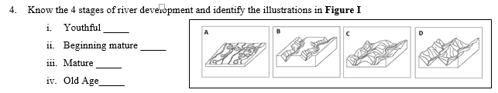
RIVERS AND EROSION

Slide 18
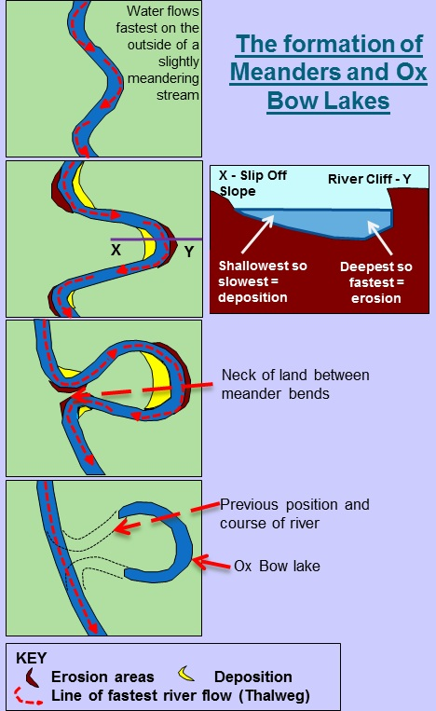
RIVERS AND EROSION
The wide curves of meanders cause the formation of oxbow lakes.
Differences in speed:
  Outside curve – faster speed – erosion.
  Inside curve– slower speed – deposition.

Slide 19
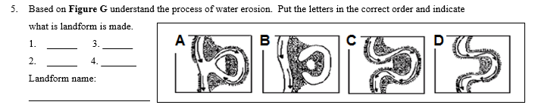
RIVERS AND EROSION

Slide 20
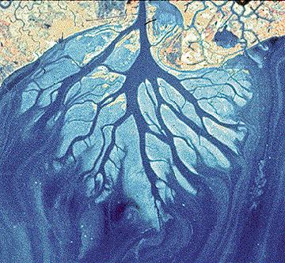
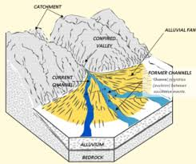
RIVERS AND EROSION
A DELTA is where stream empties into large body of water.
Alluvial Fan forms where streams descend steep slopes onto a flat plain (land).
RIVER DELTA
ALLUVIAL FAN

Slide 21

RIVERS AND EROSION

Slide 22
RIVERS AND EROSION
Stream flow velocity = how fast water is moving.
Sediment transport depends on velocity of the water in the stream.
  Slower moving water holds less and smaller sediments.
  Faster moving water transports more and bigger sediments and erodes the river channel more quickly.

Slide 23
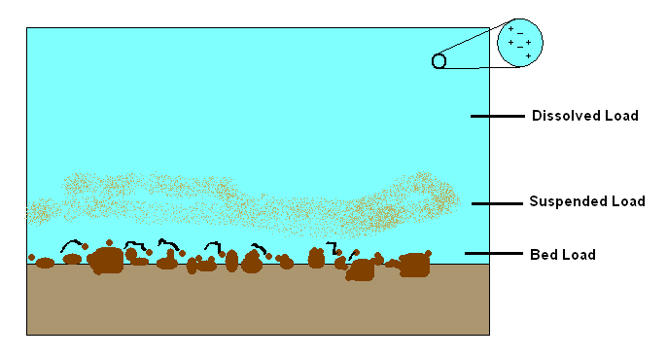
RIVERS AND EROSION
Stream Load is the materials carried by a stream.
Suspended load – particles of sand and silt – carried by velocity.
Bed load – larger sized sediment – gravel and pebbles – moves by sliding and jumping.
Dissolved load – transported in liquid solution.

Slide 24
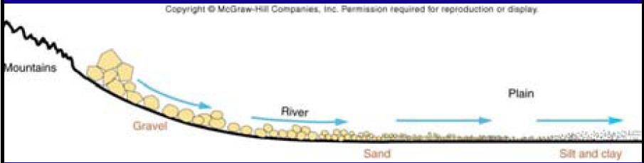
RIVERS AND EROSION
As water slows down, the largest particles or sediment is dropped first.
Sorting: the process by which particles of a particular size or characteristic are concentrated.
As energy is reduced (speed slower), particles begin to drop – big first, then smaller and smaller.
So the further away from the source, the smaller and more rounded the particles are.

Slide 25
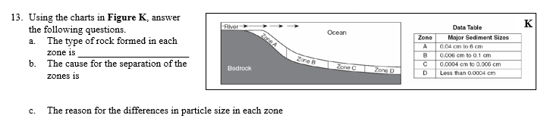
RIVERS AND EROSION
Skip to #13

Slide 26
MASS WASTING
Mass wasting is the movement of large amounts of material downhill under gravity.
Follows after weathering.
May be fast or slow.
Can occur on steep slopes or shallow dipping slopes.
Causes are GRAVITY, Friction, Slope.

Slide 27
MASS WASTING
Classified based on speed and the way they travel downslope.
  Rock fall is when a piece of rock on a steep slope becomes dislodged and falls down the slope. It is the fastest type.
  Creep is the slowest type of flow (cm or mm per year) and is too slow to observe; Dry conditions.
  Solifluction is soil flow – cold, wet, slow.
  A mud slide or land slide is the sliding down of a mass of earth or rock from a mountain or cliff; A fast, wet type of slide.
  A slump is a type of slide that forms crescent-shaped scar at the head where the material detached

Slide 28
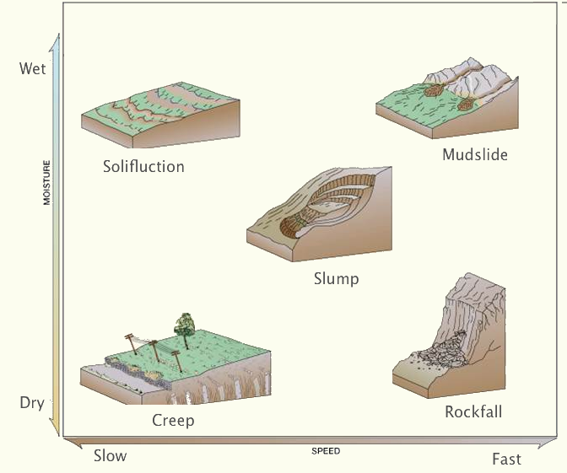
MASS WASTING

Slide 29
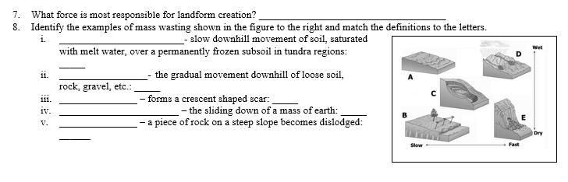
MASS WASTING

Slide 30
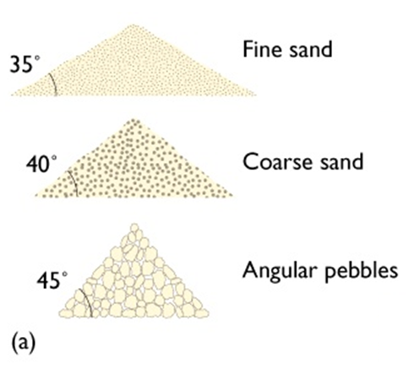
MASS WASTING
FACTORS
Angle of Repose
  The Angle of Repose is the steepest angle at which a pile of grains remains stable.
  It is controlled by the frictional contact between the grains.
  The larger the grain size, the greater the angle material will be stable.
  The smaller the grain size, the smaller the angle material will be stable.

Slide 31
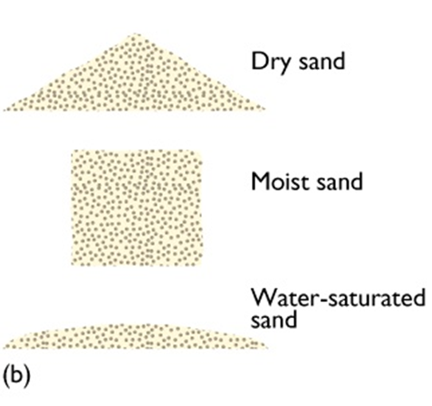
MASS WASTING
FACTORS
Water
  Can cause previously stable slopes to slide.
  SMALL amounts can increase stability.
  cohesiveness = increases surface tension.
  Excessive water leads to slope failure because friction and cohesion is reduced (lubricates the slope, promotes slippage).

Slide 32
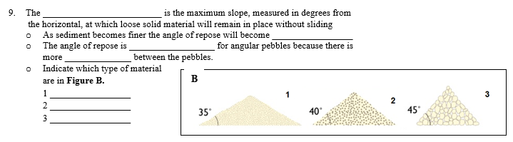
MASS WASTING

Slide 33
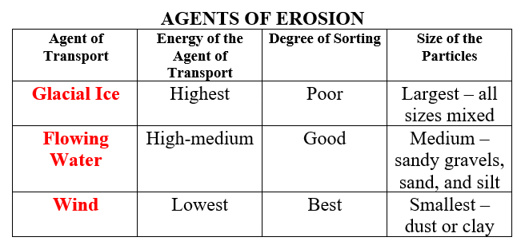
SEDIMENTATION
Sorting and size of particles provide clues to agent of transport.

Slide 34
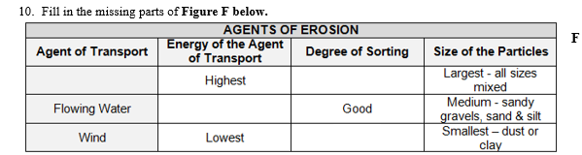
SEDIMENTATION

Slide 35
SEDIMENTATION
ROCKS FROM CLASTS (CLASTIC)
High energy environments
BRECCIA - Angular Clasts – very little weathering with minimal transport
CONGLOMERATE - Rounded Clasts transported farther with more weathering
Lower energy environments
3. SANDSTONE - Rough, gritty feel; deposited from current transport; tend to be porous
4. SHALE - Smallest particles – formed in water calm enough for clay particles to settle

Slide 36
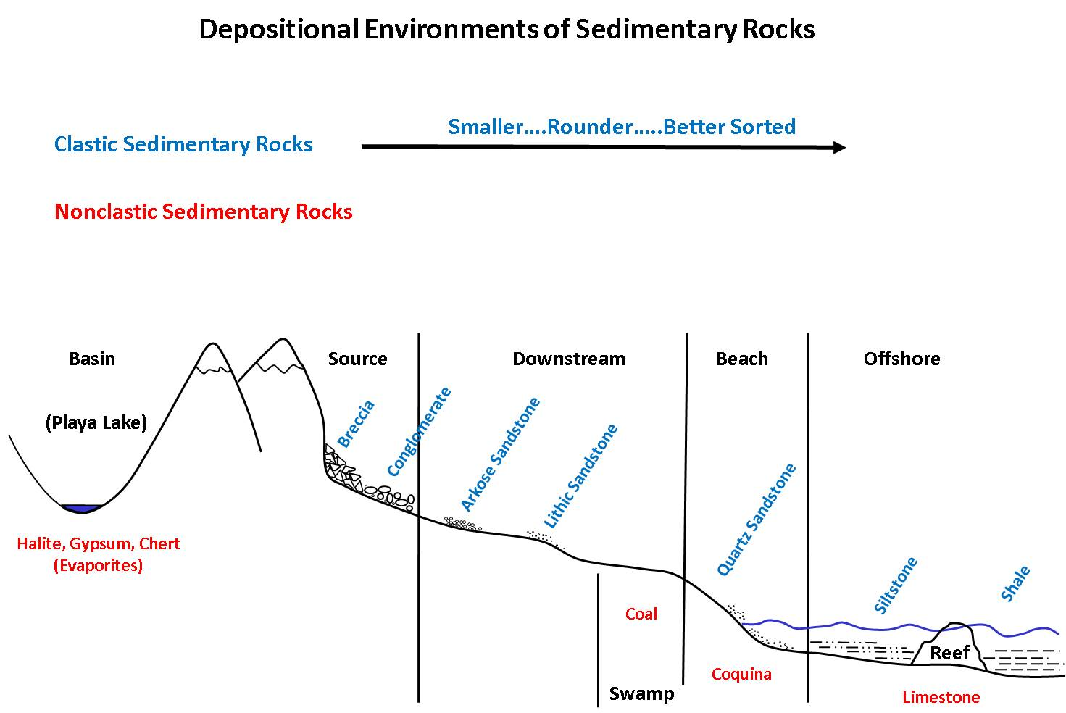
SEDIMENTATION

Slide 37
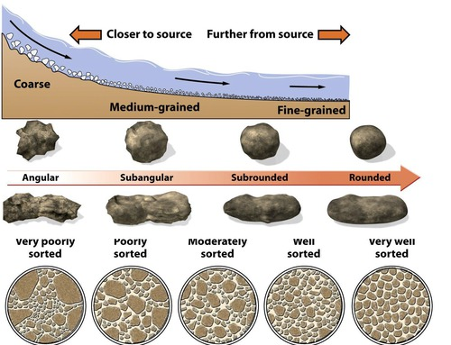
SEDIMENTATION
Degree of sorting and size of sediment tells about the environment rocks formed in.

Slide 38
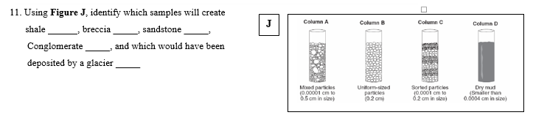
SEDIMENTATION

Slide 39
SEDIMENTATION
A. Clastic:
Accumulations of little pieces of broken up rock) which have piled up, compacted and cemented.
B. Chemical:
Forms when standing water evaporates, leaving dissolved minerals behind.
C. Organic:
An accumulation of sedimentary debris caused by organic processes; shells, bones, plant matter, etc.

Slide 40
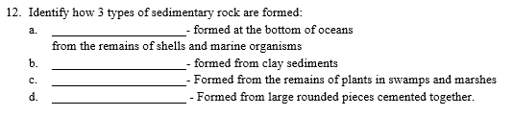
SEDIMENTATION

Slide 41
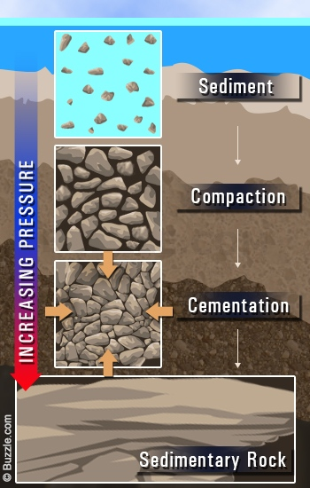
SEDIMENTATION
How Sedimentary Rocks form:
Weathering ✔
Erosion ✔
Deposition ✔
Lithification ✔
  Compaction
  Cementation

Slide 42
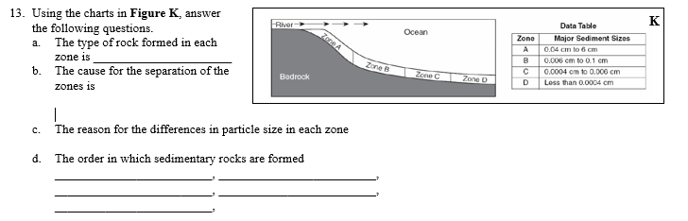
SEDIMENTATION
The rest of #13

Slide 43
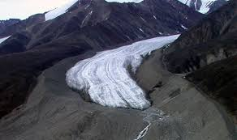
GLACIERS
Glaciers are a large mass of moving ice.
They are made up of fallen snow that, over many years, compresses into large, thickened, ice masses.
They flow like slow rivers (thanks gravity!) and shape the landscape.

Slide 44
GLACIERS
Cycles of partial melting and refreezing change snow and ice into FIRN.
Deep layers of snow and firn create pressure on underlying layers.
Continued buildup of firn and snow form a glacier.
It begins to move downslope and outward under its own weight.
Snow added greater than snow melted = glacier grows.
Snow added less than snow melted = glacier recedes.

Slide 45
GLACIERS
HIGH transport energy.
Glaciers pick up and carry sediment.
Rocks carried by glaciers cause abrasion.
Glacial Drift: Sediment carried and deposited by glaciers. Can be TILL (carried by ice) or OUTWASH (carried by water).

Slide 46
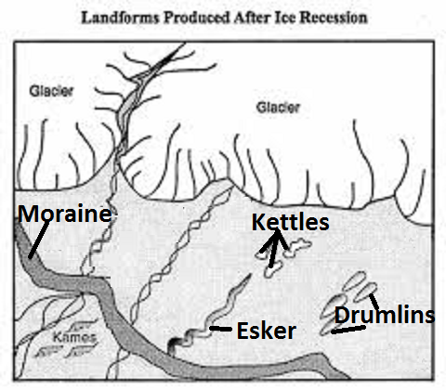
GLACIERS
GLACIAN LANDFORMS CAUSED BY EROSION AND DEPOSITION:
Drumlins: sediment mounds
Moraines: ridge of deposits – like wall - can be at leading edge of glacier.
Kettles: depressions – can form lakes.
Eskers: long, winding ridges of gravel and sand - like raised roadways.

Slide 47
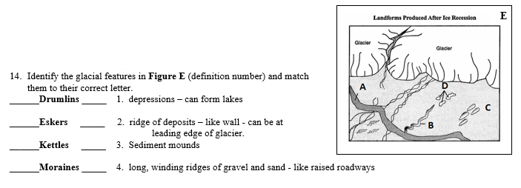
GLACIERS

Slide 48
QUIZLET
https://quizlet.com/_2urgu6

Slide 49

HOW TO STUDY?
KNOW the study guide.
Do the Quizlet.
Go through the Review powerpoint.
BE SURE TO STUDY!

Slide 50
DO NOW
Turn in the Unit 5 Test Study Guide if it is completed.
Prepare for your test.
We will work on missing work AFTER the test.
NO cell phones out during ANY PART of the test.

Slide 51
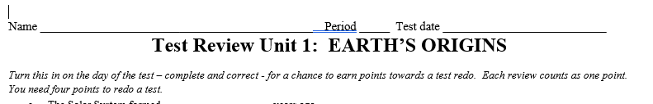
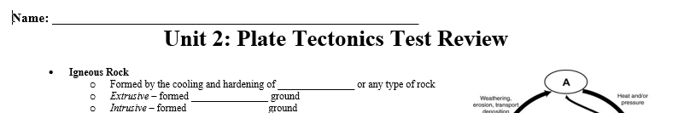
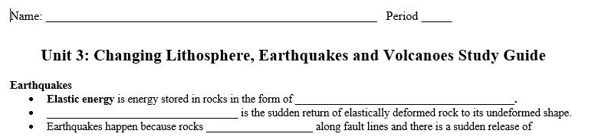
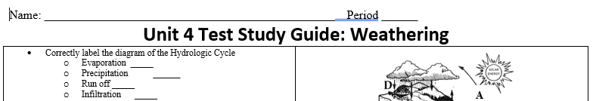
FIND THE FOLLOWING:

