Slide 1
DO NOW
Pick up review.
Turn in vocabulary.
Article Summaries are due on Friday.

Slide 2

Unit 6 Review
What to expect, what to know…

Slide 3
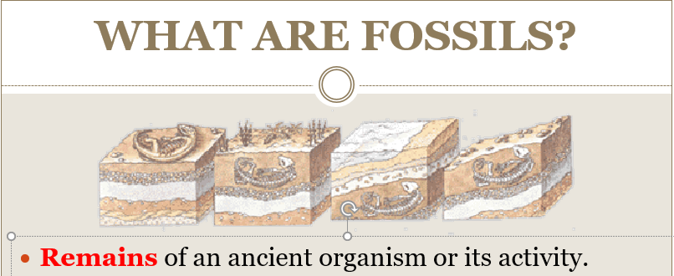
REVIEW
Fossils:
Help determine the absolute and relative ages of rocks.
Provide clues to past geologic events, climates, and evolution of living things.
Are an indicator of an area's ancient environmental conditions and climates.

Slide 4
REVIEW
Fossils are found in SEDIMENTARY ROCKS.
  Igneous rocks are too hot.
  Metamorphic rocks require too much heat and pressure to have fossils.
Fossils can tell us about the age of the ricks they are found in
  Absolute age is radiometric dating with radioactive isotopes – tells how many millions of years old something is.
  Relative dating tells the age by Location of fossils in layers of rock; the oldest layers are below newer layers. It tells which are older or younger without specific dates.

Slide 5
REVIEW

Slide 6
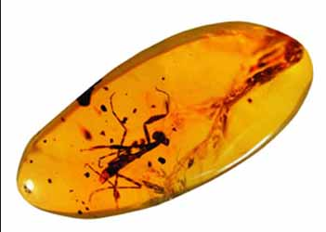
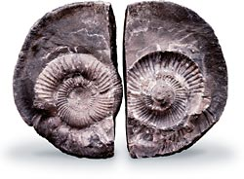
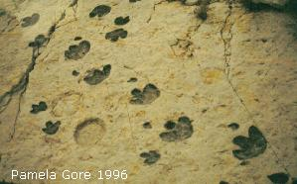
REVIEW
Types of Fossils:
Mineralized remains
Mummification
Amber
Casts and Molds
Imprints
Coprolites
Gastroliths
Trace Fossils

Slide 7
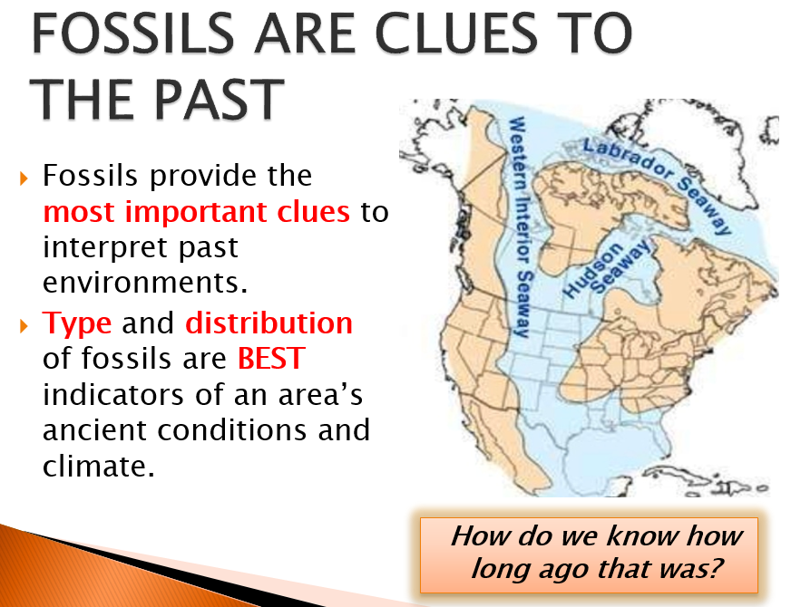
REVIEW

Slide 8
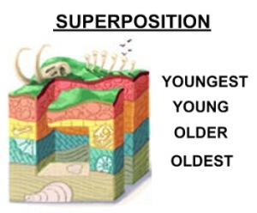
REVIEW
LAW OF SUPERPOSITION
In an undisturbed rock column, the oldest rocks will be on the bottom and the youngest ones on top.
Oldest fossils are on the bottom.
Newest fossils are on the top.
Relative age is a comparison (ex: one fossil is older than another).

Slide 9
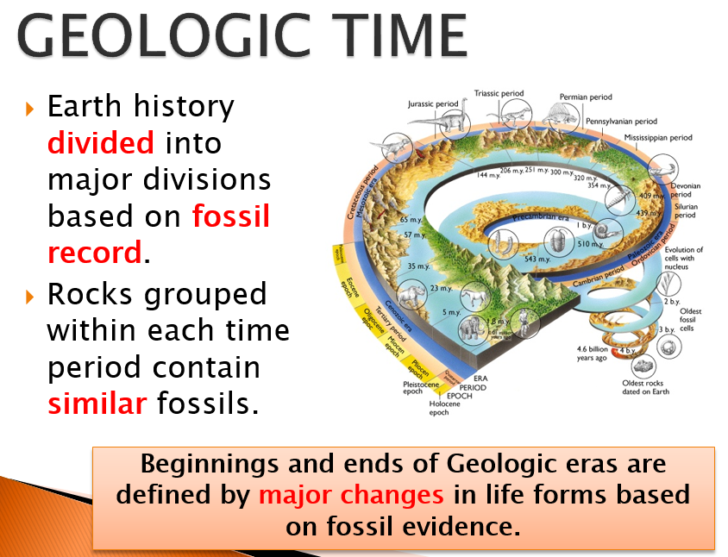
REVIEW

Slide 10
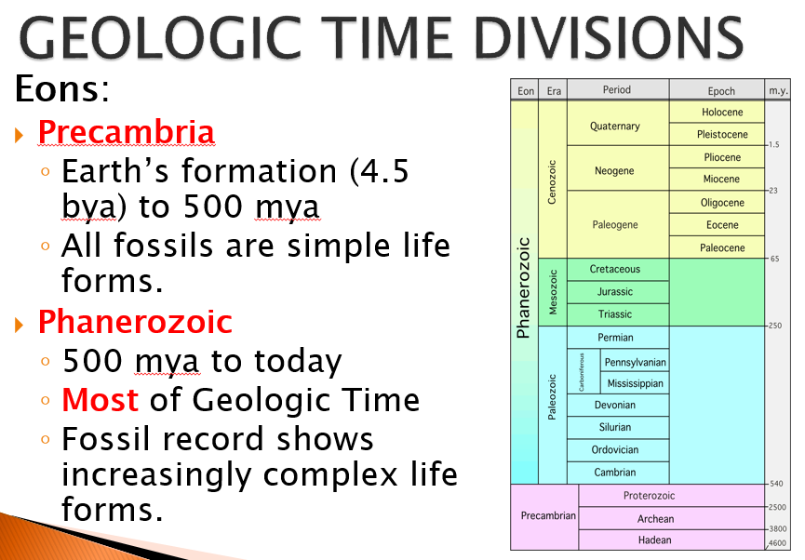
REVIEW

Slide 11
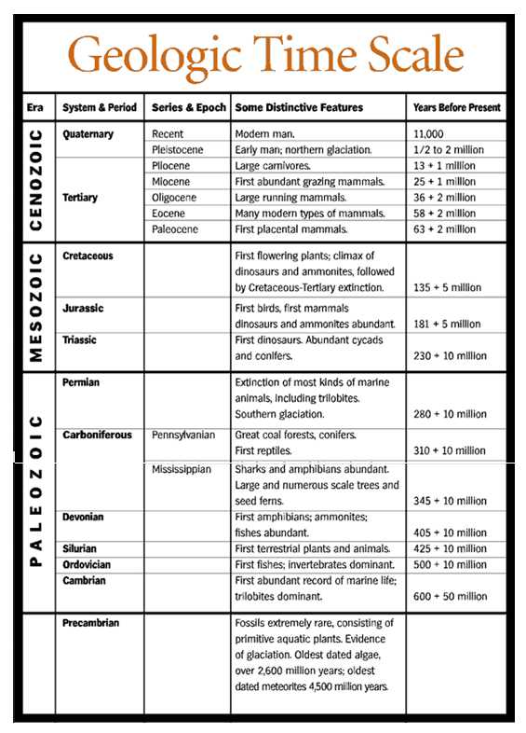
REVIEW

Slide 12
REVIEW
PALEOZOIC ERA: LIFE FLOURISHES
AGE OF FISH
Cambrian Period: Cambrian Explosion - most life in ocean.
First Mass Extinction in Ordovician Period.
First Forests
Second Mass Extinction in Devonian Period.
Pangaea and Appalachian Mountains formed during Permian Period (end of Paleozoic Era).
Third Mass Extinction at end of Permian Period – GREAT DYING – biggest mass extinction event.

Slide 13
REVIEW
MESOZOIC ERA
AGE OF REPTILES
Pangaea begins to break up.
Divided into three periods.
Early mammals but NO humans!
Dinosaurs dominant life form during Jurassic.
Different dinosaurs during different periods.
First flowers in Cretaceous.
Mass Extinction Events at end of Triassic and Cretaceous. Dinosaurs die out at the end of the Cretaceous Period.

Slide 14
REVIEW
CENOZOIC ERA:
AGE OF MAMMALS
Most known about this Era.
First primates.
Himalayan Mountains 15MYA.
First Humans – Pleistocene Epoch.
Human History – Holocene Epoch.
More divisions because more is known.

Slide 15
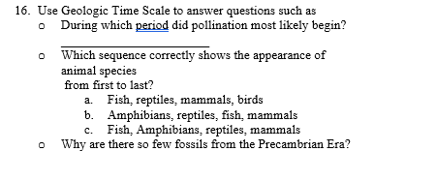
REVIEW

Slide 16
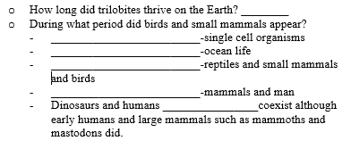
REVIEW

Slide 17

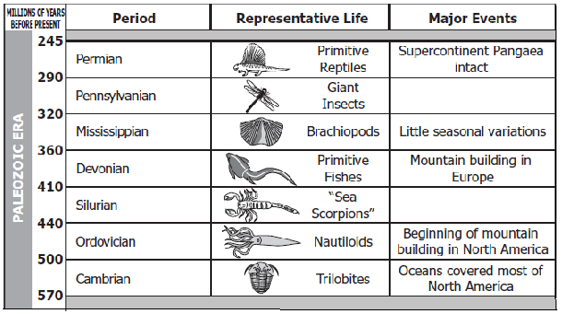
REVIEW

Slide 18
REVIEW
INDEX FOSSIL
A fossil that scientists use to date rocks; they are found widely scattered in rocks over a large region existed for a geologically short time.
Every fossil tells us something about the age of the rock it's found in.
Some fossils that tell us more because they are found exclusively in rock layers of a specific geologic age.

Slide 19
REVIEW
CHARACTERISTICS OF AN INDEX FOSSIL
Abundant - distributed over a wide area.
Common - large numbers within a rock layer.
Distinctive - easy to recognize.
Limited – from a short, specific geologic time span.
Index fossils are used to establish the relative and absolute ages of the rock layers in which the fossils are found.

Slide 20
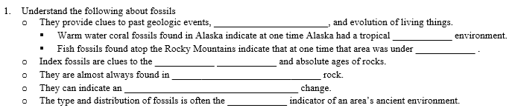


REVIEW

Slide 21
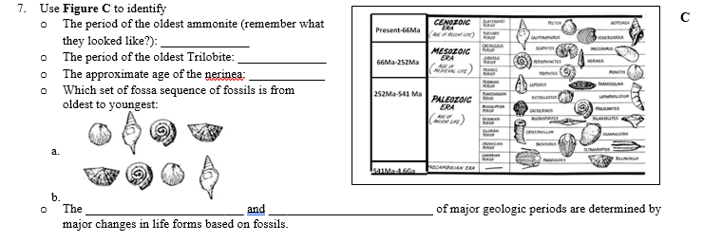
REVIEW

Slide 22
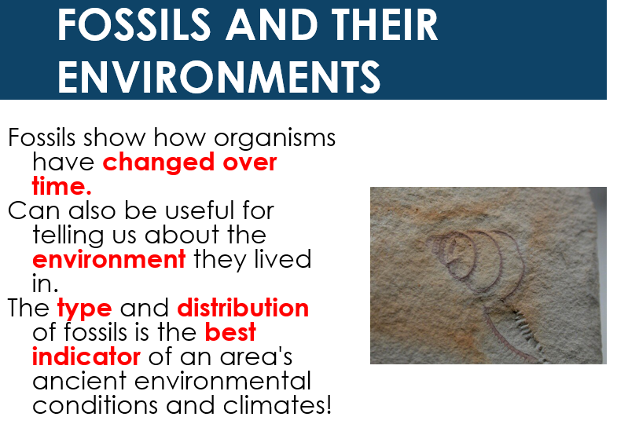
REVIEW

Slide 23
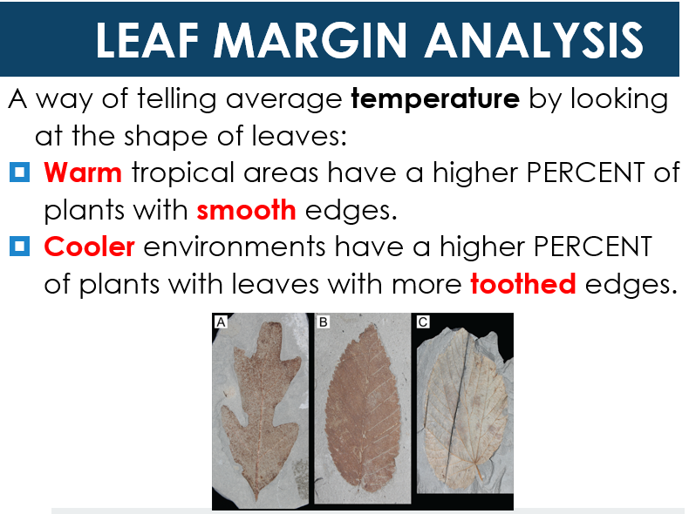
REVIEW

Slide 24
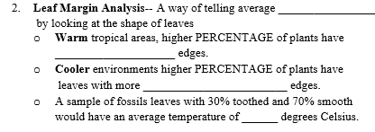
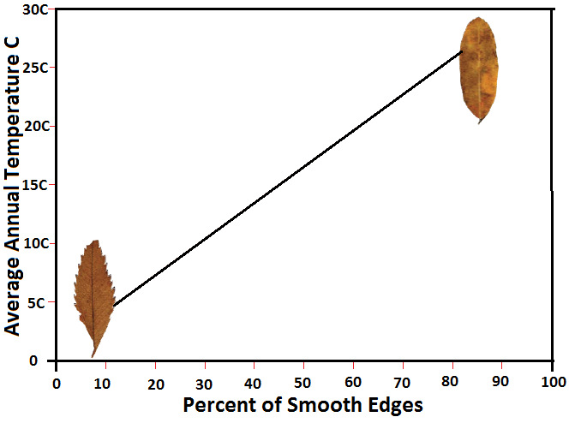
REVIEW

Slide 25
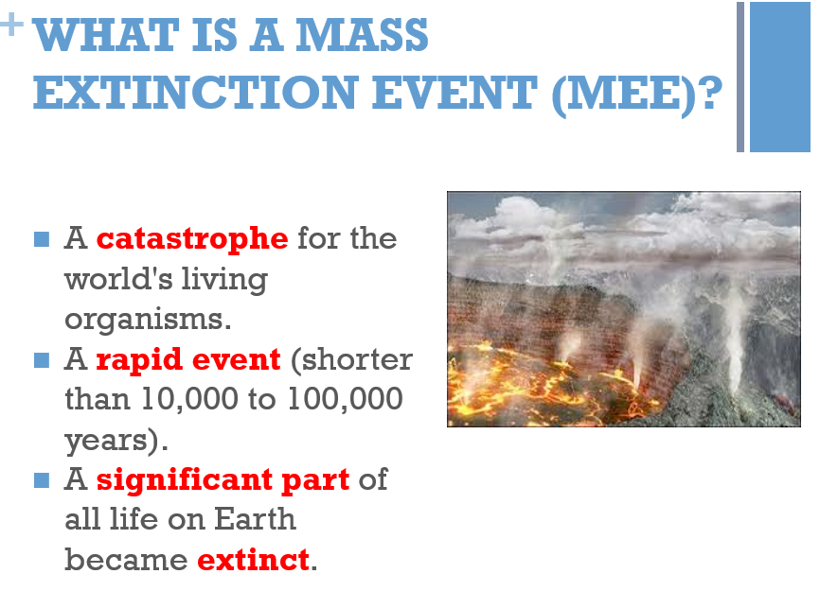
REVIEW

Slide 26
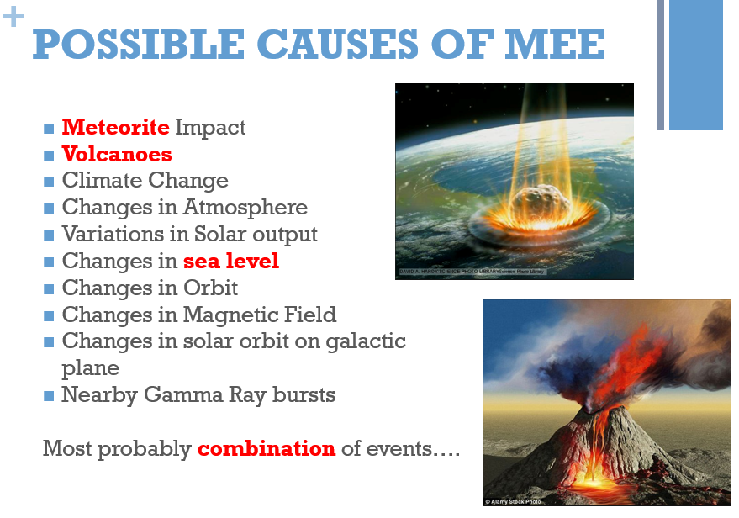
REVIEW

Slide 27
REVIEW
FIRST MASS EXTINCTION EVENT
End of Ordovician Period
57-65% of all species exterminated.
SECOND MASS EXTINCTION EVENT
Late Devonian period
57-72% of all species disappeared.
Shallow seas and coral reefs most affected.

Slide 28
REVIEW
THIRD MASS EXTINCTION EVENT
Most devastating of mass extinctions.
‘The Great Dying’
End of Permian Period, Paleozoic Era.
Approximately 96% species go extinct.
FOURTH MASS EXTINCTION EVENT
End of the Triassic period.
52-65% of all marine species vanished; not sure about land species.

Slide 29
REVIEW
FIFTH MASS EXTINCTION EVENT
Cretaceous-Tertiary mass extinction (K/T extinction).
End of Mesozoic Era.
76% species disappeared.
End of the Dinosaurs.
AFTER A MASS EXTINCTION
Surviving Species take over vacant habitats and resources.
New species develop.

Slide 30
REVIEW
SIXTH MASS EXTINCTION EVENT
Holocene Extinction – Human caused.
Phase One began when the first modern humans began to disperse to different parts of the world about 100,000 years ago. Extinction follows path of human migration.
Phase Two began about 10,000 years ago when humans turned to agriculture.

Slide 31
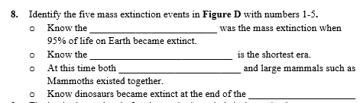
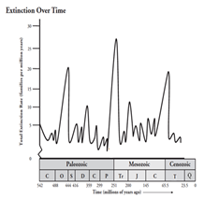
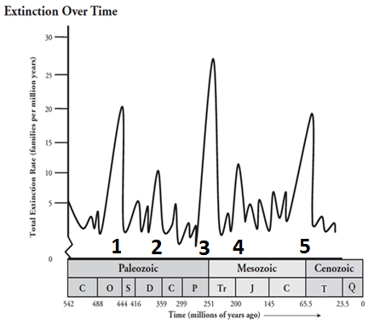
REVIEW

Slide 32
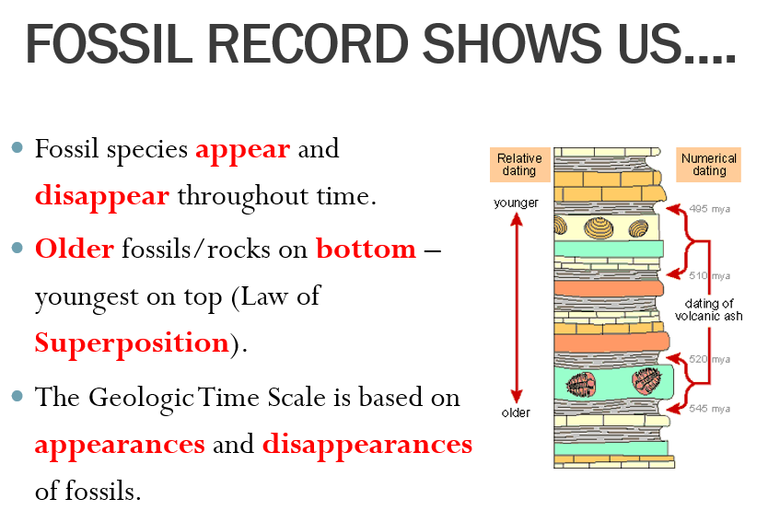
REVIEW

Slide 33
REVIEW
FOSSIL RECORD SHOW US:
Fossil species appear and disappear throughout time.
Older fossils/rocks on bottom – youngest on top (Law of Superposition).
The Geologic Time Scale is based on appearances and disappearances of fossils.
Geologic eras and periods determined by appearance and extinction of species.
Extinction events are followed by appearances of new species.
Sequence of fossils help provide clues to Earth’s history and dating of rocks.

Slide 34
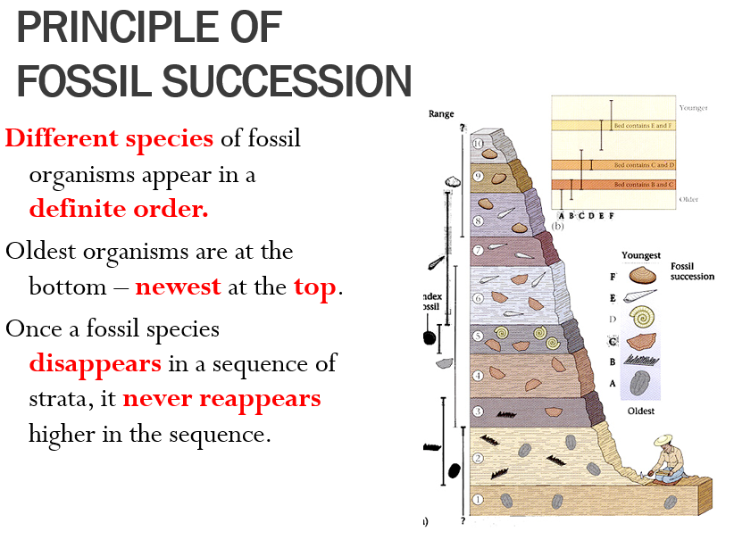
REVIEW

Slide 35

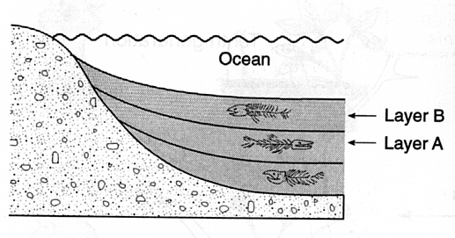
REVIEW

Slide 36
REVIEW
WHAT FOSSILS TELL US
Fossil evidence shows life becomes more complex over time.
Gradual change occurs in most species.
Some organisms go extinct.
Changes explained by Natural Selection.
Natural Selection first proposed by Charles Darwin based on data.

Slide 37
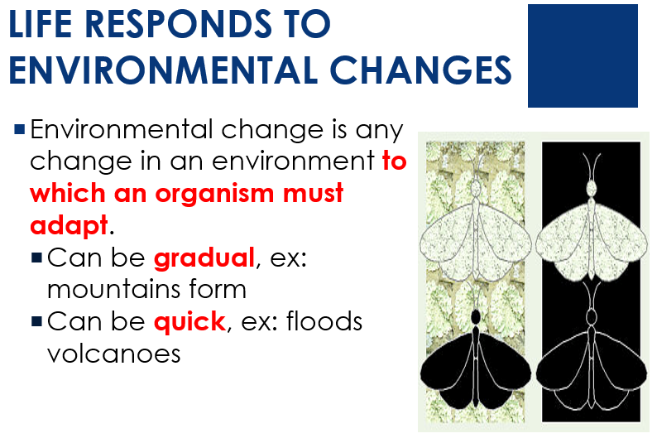
REVIEW

Slide 38
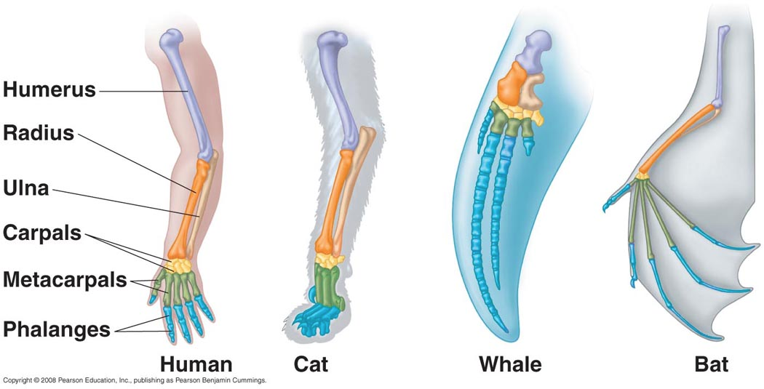
REVIEW
HOMOLOGOUS FEATURES
Similar STRUCTURE but often different functions.
COMMON ancestor
  Divergent evolution

Slide 39
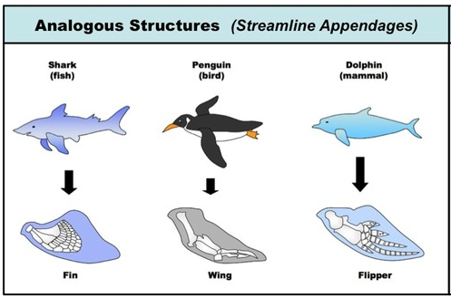
REVIEW
ANALOGOUS FEATURES
Similar FUNCTION but with different structures
  Different solutions to same problem.
Evolved independently.
NOT RELATED – not from common descent.

Slide 40
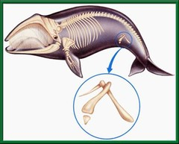
REVIEW
VESTIGIAL STRUCTURES
Features that serve no apparent purpose.
Serve a function in a related species and likely served purpose in ancestors.
Ex: Whale pelvis
  Pelvis transfers weight to hind legs.

Slide 41
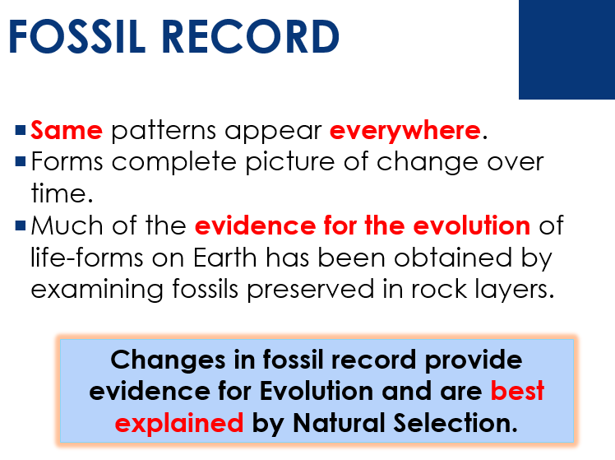
REVIEW

Slide 42
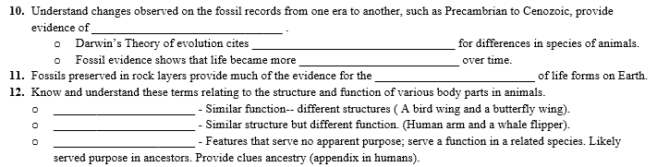
REVIEW

Slide 43
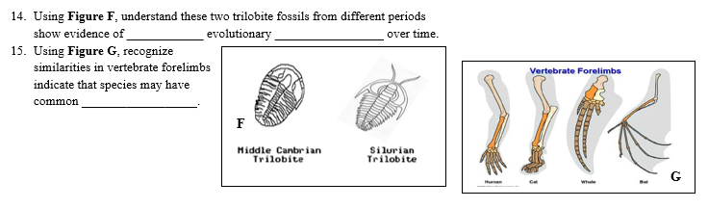
REVIEW

Slide 44
ILLUSTRATIONS IN THE TEST
Fossils and Climate:
Leaf Margin Analysis: What does the ratio of smooth to rough edges tell you?
  Can you interpret the graph?

Slide 45
ILLUSTRATIONS IN THE TEST
What can you tell about ancient environments based on these fossils?

Slide 46

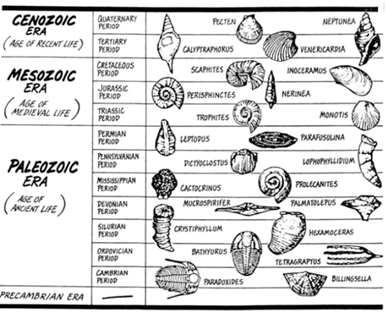
ILLUSTRATIONS IN THE TEST
How old the the rock each of these fossils found in?
What is the correct sequence in the fossils?

Slide 47
ILLUSTRATIONS IN THE TEST
What do you know about each of these Mass Extinction events?
Can you interpret the chart?

Slide 48
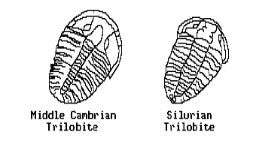
ILLUSTRATIONS IN THE TEST
What do these images suggest about fossil succession?
Evolution?

Slide 49
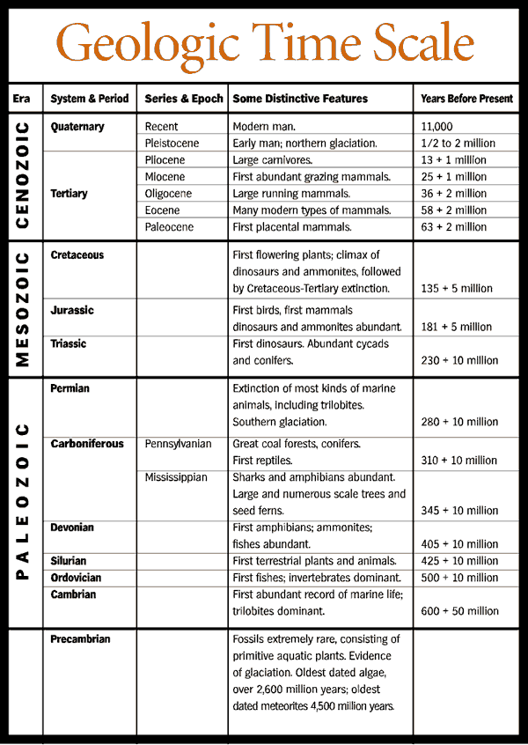
ILLUSTRATIONS IN THE TEST
Answer questions about events and life forms that appeared in different geologic periods.

Slide 50
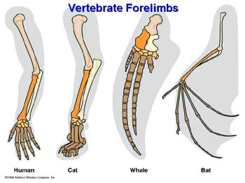
CHARTS IN THE TEST
What is the difference between features that are:
Homologous?
Analogous?
Vestigial?
What does the image represent?

Slide 51
QUIZLET
https://quizlet.com/_2zv0ql

Slide 52

HOW TO STUDY?
KNOW the study guide.
Do the Quizlet.
Go through the Review PowerPoint.
BE SURE TO STUDY!

