Slide 1
DO NOW
Pick up notes sheet.
Get out half sheet review.

Slide 2
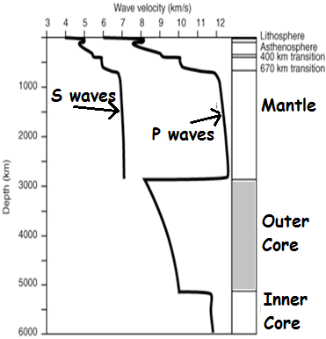
LOOKING BACK….
How do Earthquake tell us about Earth’s layers?
Remembering that the outer core is molten metal:
What do “S” waves do in liquids?
What do “P” waves do in liquids?

Slide 3
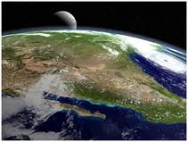
Composition of Earth’s Crust
SES2b. Explain how the composition of the Earth’s crust, mantle and core is determined.

Slide 4
ELEMENTS IN EARTH’S CRUST
Earth’s Crust is made up of:
47% Oxygen
28% Silicon
8% Aluminum
5% Iron
4% Calcium
3% Sodium
2% Potassium
2% Magnesium
1% Other

Slide 5
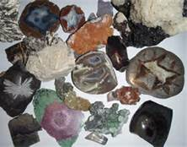
WHAT ARE MINERALS?
Minerals are the building blocks of rocks
Naturally occurring,
Inorganic,
Solid chemical compound,
Orderly internal structure - crystalline (Atoms arranged in a regular, repeating pattern),
Consistent chemical composition – homogenous.

Slide 6
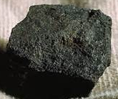
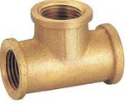
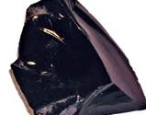
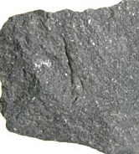
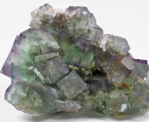
WHAT IS AND IS NOT A MINERAL:
Four Criteria for Minerals
 | Coal | Brass | Obsidian | Basalt | Fluorite
Inorganic | No | Yes | Yes | Yes | Yes
Occurs naturally |  | No | Yes | Yes | Yes
Crystalline solid |  |  | No | Yes | Yes
Consistent chemical composition |  |  |  | No | Yes

Slide 7
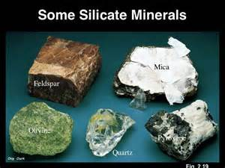
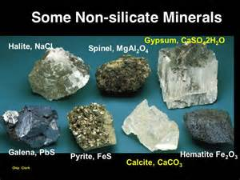
MINERAL GROUPS
Grouped according to chemical composition
Silicates
Nonsilicates

Slide 8
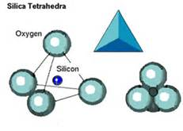
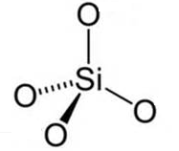
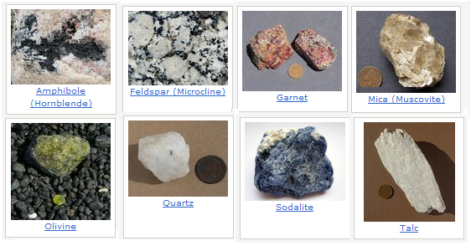
SILICATES
Has BOTH Silicon and Oxygen.
Make up 96% of Earth’s crust.
Crystalline Structure:
Silicon-Oxygen Tetrahedron
  4 oxygen atoms in pyramid with one silicon atom in the center
Quartz = SiO2
May contain other elements:
  Olivine (Mg,Fe)₂SiO₄
  Orthoclase KAlSi₃O₈
  Muscovite KAl₃Si₃O₁₀(OH)₂

Slide 9
NONSILICATES
Group | Description | Example
Carbonates | Contain carbonate group (CO3) | Dolomite (CaMgCO3)2 Calcite (CaCO3)
Halides | Contain chlorine or fluorine with potassium, sodium or calcium (salts) | Halite (NaCl) Fluorite (CaF2)
Native elements | Pure elements | Silver (Ag) Copper (Cu)
Oxides | Contain oxygen AND an element other than silicon | Corundum (Al2O3) Hematite (Fe2O3)
Sulfates | Contain a sulfate group (SO4) | Gypsum (CaSO4) Anhydrite (CaSO4)
Sulfides | Contain one or more elements combined with sulfur | Galena (PbS) Pyrite (FeS2)

Slide 10
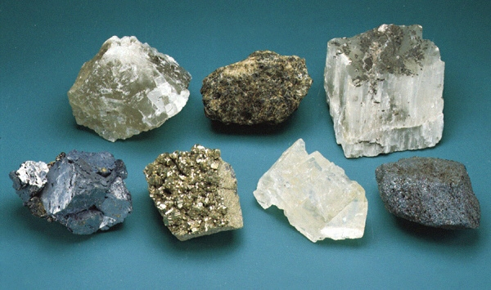
NONSILICATES
Do NOT contain BOTH silicon AND oxygen (they can have one, the other or neither).
4% of Earth’s crust.
Crystalline structure: no silicon-oxygen tetrahedron.
Crystalline structure includes:
  Cubes
  Hexagonal prisms
  Irregular masses
Structure determines characteristics
  Native elements – closely packed, dense

Slide 11
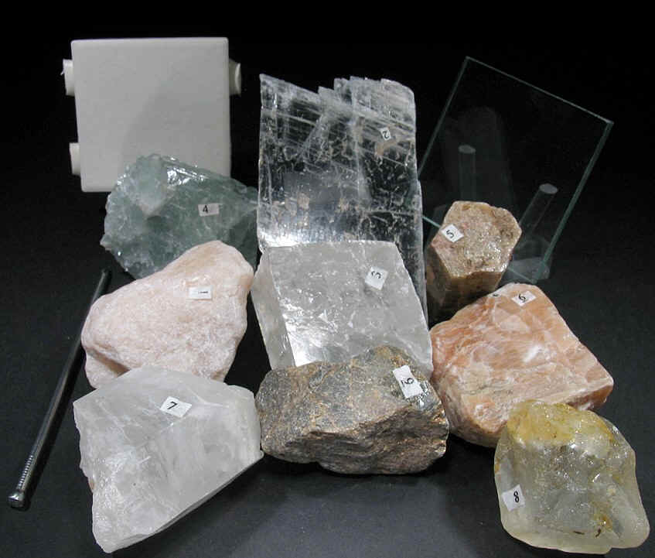
IDENTIFYING MINERALS
Examine the mineral collections.
  How are minerals alike? Different?
  What characteristics can be used to classify and identify minerals?

Slide 12
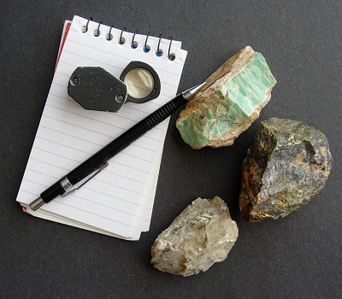
PROPERTIES OF MINERALS
Each mineral’s properties are a result of its unique chemical composition and crystalline structure.
Tests used to identify minerals include:
  Color
  Streak
  Luster
  Cleavage and Fracture
  Hardness
  Crystal Shape
  Density
  Special Properties

Slide 13
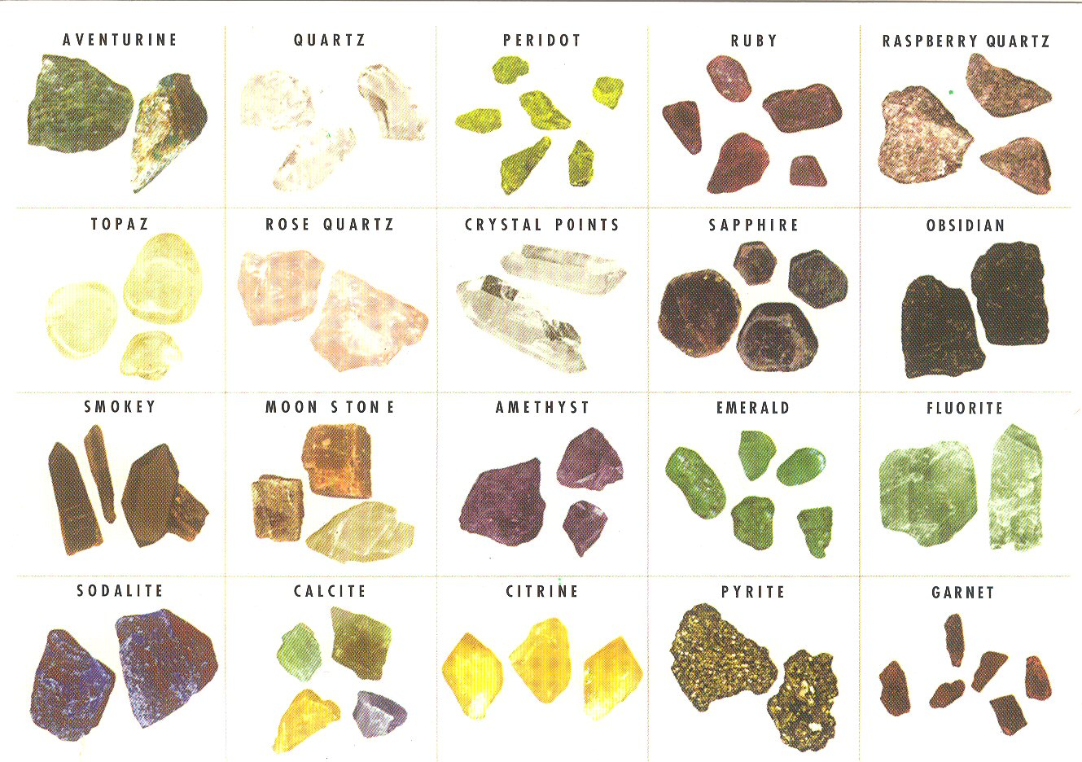
COLOR
Easy to observe.
Not reliable.
Some have distinct colors, others are similar in color.
Some minerals come in different colors.
Weathering can conceal true color.

Slide 14
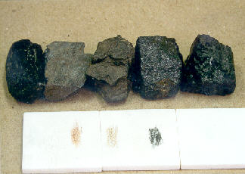
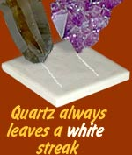
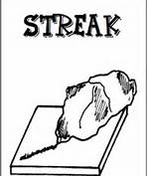
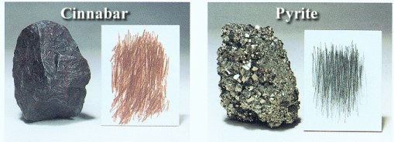
STREAK
Color left behind when rubbed on streak plate (unglazed ceramic tile).
Streak color may not match mineral color.
Metallic minerals – dark streak.

Slide 15
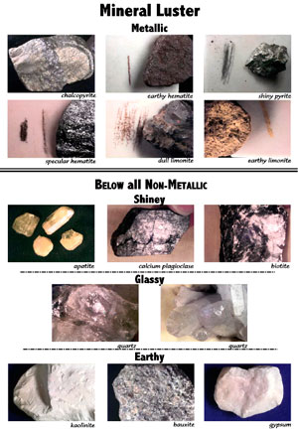
LUSTER
The way a mineral reflects light.
How shiny it is.
Types includes:
  Metallic
  Vitreous (glassy)
  Dull

Slide 16
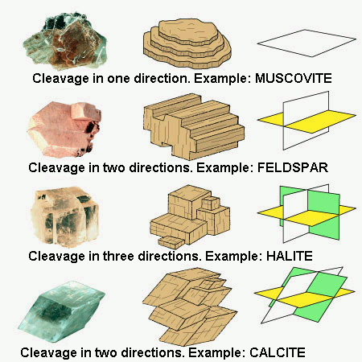
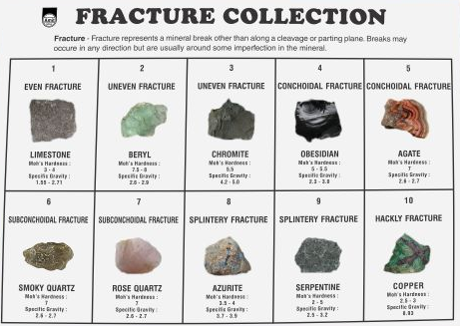
CLEAVAGE AND FRACTURE
Cleavage: tendency to split along specific planes to form smooth, flat surface.
Fracture: break unevenly
  Irregular or uneven
  Splintery or fibrous
  Conchoidal or curved

Slide 17
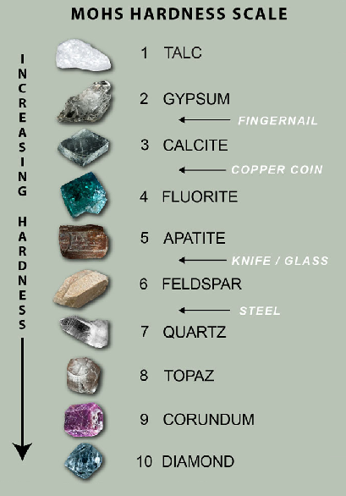
HARDNESS
Ability to resist scratching.
Based on strength of chemical bonds.

Slide 18
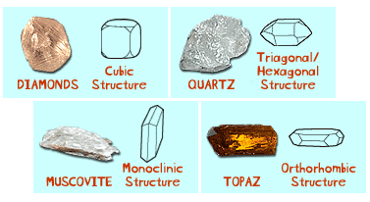
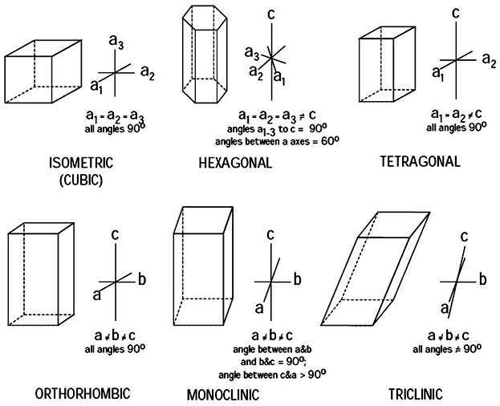
CRYSTAL SHAPE
Chemistry determines shape.
To form a crystal shape minerals need specific conditions:
  Lots of time (they form slowly).
  Room to “grow”.
Shapes defined by number and direction of axes.

Slide 19

DENSITY
Depends on type and arrangement of atoms.
Specific gravity is similar to density – but has no units.

Slide 20
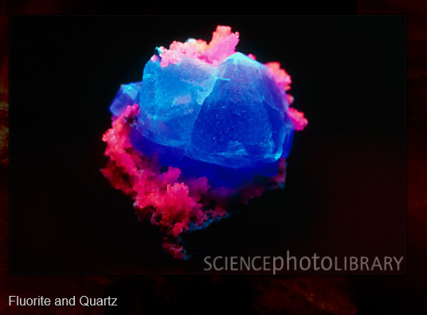
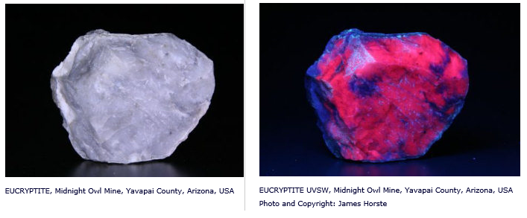
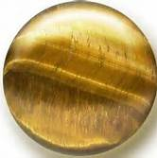
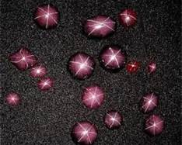
SPECIAL PROPERTIES
Fluorescence – ability to glow under UV light – fluorite.
Phosphorescence – continue to glow after UV light off – eucryptite.
Chatoyancy – “cat’s-eye effect – silky appearance – Tiger’s Eye.
Asterism – reflects six-sided star shape – star sapphire.

Slide 21
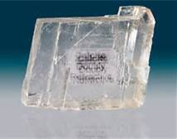
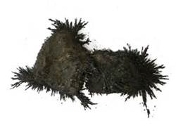
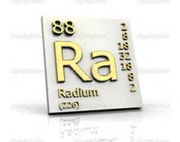
MORE SPECIAL PROPERTIES
Double Refraction – bending light – produces double image – calcite.
Magnetism – magnetic – lodestone .
Radioactivity – unstable atomic nuclei – radium.

Slide 22
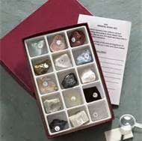
LAB: MINERAL IDENTIFICATION
Mineral Identification Lab
Consider Color, Streak, Luster, Cleavage or Fracture, Hardness and other properties.
Draw mineral.
Identify using chart.

Slide 23
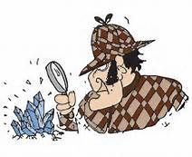
Something to think about:
Which mineral was the hardest to identify? Why?
Which mineral was the easiest to identify? Why?
Which physical property was the most useful in identifying your minerals? Why?
Which physical property was the least useful in identifying your minerals? Why?

