Slide 1
DO NOW
Pick up notes sheet.
Get out Review half sheet.

Slide 2
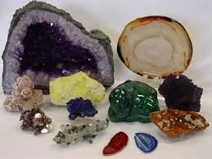
LOOKING BACK…
What are the two major groups of Earth’s minerals?
How are they different?

Slide 3
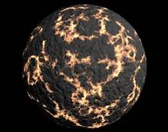
Earth’s Early Atmosphere
SES1d. Describe how the Earth acquired its initial oceans and atmosphere.

Slide 4
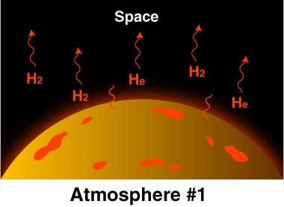
EARTH’S FIRST ATMOSPHERE
Early atmosphere came from comets and asteroids impact during the period of heavy bombardment.
Mostly hydrogen and helium
Very light gases – low mass.
Gravity too weak to hold light gases – escaped into space.
Blown away by the Solar Wind.

Slide 5
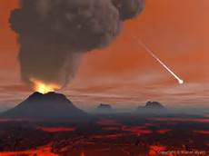
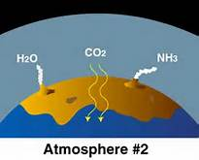
EARTH’S SECOND ATMOSPHERE
Out gassing from volcanic eruptions:
Water vapor
Carbon Dioxide (CO₂)
Nitrogen
Methane
Sulfur dioxide
Ammonia
Some gases broke down.
Ozone layer formed.
High amount of Carbon Dioxide!

Slide 6
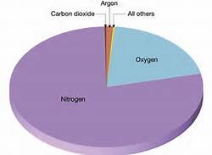
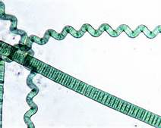
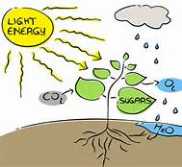
CURRENT ATMOSPHERE
Photosynthesis primarily responsible for the development of the present percentage of free oxygen.
Early plants, cyanobacteria used CO₂ and released O₂.
Buildup of Oxygen in the atmosphere.
Rapid O₂ build up 2 billion years ago.
Current atmosphere 78% Nitrogen, 21% Oxygen.

Slide 7
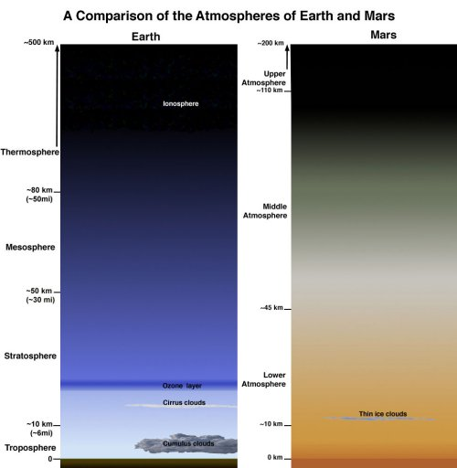
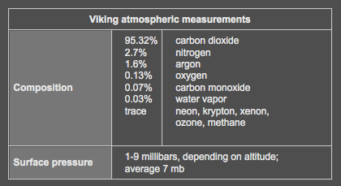
COMPARE: MARTIAN ATMOSPHERE
Thinner
Less gravity to hold it.
Not always like this….

Slide 8
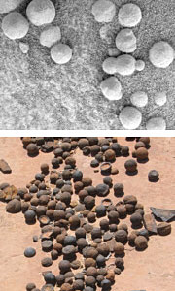
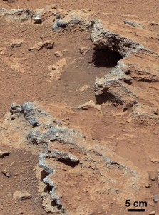
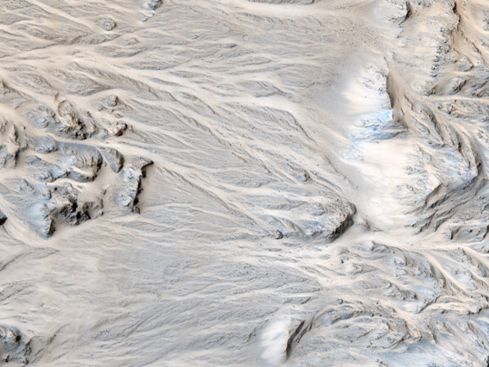
MARS’S INITIAL ATMOSPHERE
Evidence for water early in Martian history:
Water in Martian meteorites
Ancient streambeds
Rounded pebbles
Channels and alluvial fans
Sedimentary deposits
Evidence of past surface water means Mars once had thicker atmosphere!

Slide 9
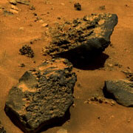
WHERE DID THE WATER GO?
Small planet cooled quickly.
Magnetosphere lost.
Solar wind blew away much of atmosphere.
Too little gravity to hold gases.
Possible collision could have blown away atmosphere.
Low atmospheric pressure means water boils at lower temperature.
Magnetic Martian Rocks

Slide 10
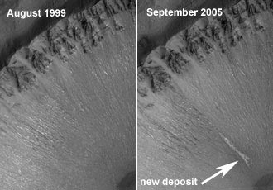
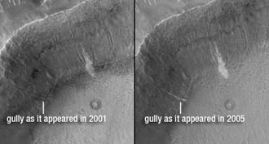
WATER ON THE MARTIAN SURFACE
Gully deposits in craters:
Centauri Montes Region
Terra Sirenum
Water that reaches the surface evaporates.
WHY?

Slide 11
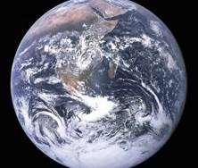
THINK ABOUT IT….
Water evaporates quickly at low pressures, like on the Martian surface.
Liquid water is a requirement for life as we know it.
Even though Mars is in the “Habitable Zone,” it can’t support liquid water on the surface.
How common or rare do you think planets are that are in a star’s Habitable Zone AND have liquid water?
How special does this make Earth?

Slide 12
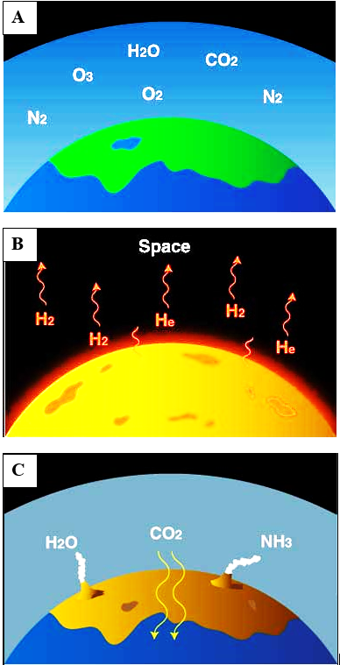
FLIP OVER TO THE BACKSIDE
Determine which of the pictures is
Earth’s first,
Earth’s second,
Earth’s current atmosphere.

Slide 13
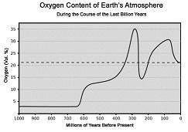

REVIEW…
Dinosaurs appeared on Earth approximately 230 million years ago. What was the oxygen content of Earth’s Atmosphere at that time?
A. 10%
B. 15%
C. 20%
D. 35%

