Slide 1
DO NOW
Pick up notes.
Get out review half sheet.

Slide 2
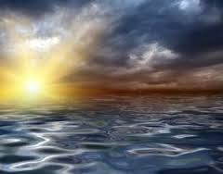
EARTH’S OCEANS
SES1d: Describe how the Earth acquired its initial oceans and atmosphere.

Slide 3
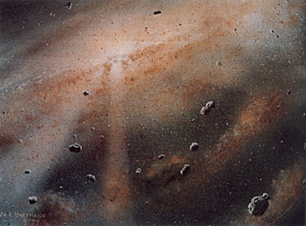
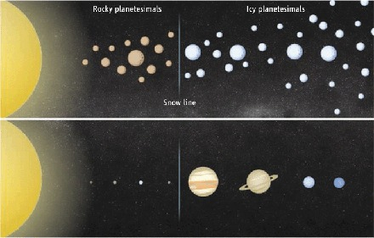
REVIEW:
SOLAR SYSTEM FORMATION
4.5 Billion Years Old
Interstellar Cloud (Nebula)
Flatten to create accretion disk.
Planet formation:
  Warmer near central star, rocky materials condensed and formed
  Lighter materials blown farther out, colder temperatures, gas/ice giants condensed and formed

Slide 4
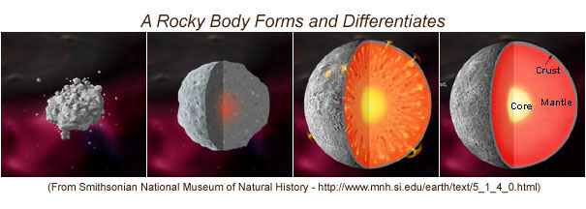
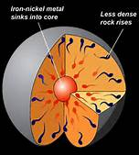
TERRESTRIAL WORLDS
Differentiation: outer layers compress inner layers – produce heat.
Dense metals sink to core - iron density 7.86 g/cm³
Lighter rock material rises to form crust - average rock density 3.5 g/cm³

Slide 5
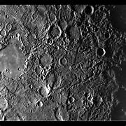
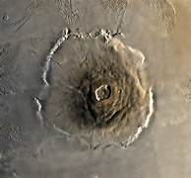
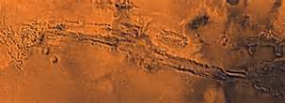
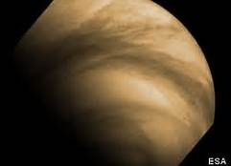
SURFACES OF TERRESTRIAL PLANETS
Impact Cratering
Heavy bombardment period ended 3.8 billion years ago.
Older surfaces have more craters.
Newer surfaces “erased”.
Volcanism
Earth has side to side plate movement.
Mars has largest volcano in solar system.

Slide 6
SURFACES OF TERRESTRIAL PLANETS
Tectonics
Earth is side to side.
Venus is up and down.
Erosion
Earth - wind and water.
Mars - wind, water in past.
Venus -wind and sulfuric acid rain.

Slide 7
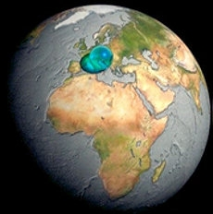
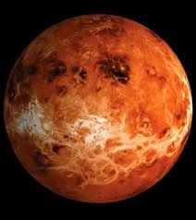
BLUE PLANET?
Early Earth:
Formed 4.5 Billion years ago.
Too hot for water to condense.
Molten surface.
Current Hydrosphere:
71% of the planet's surface is covered by ocean. Of that:
  97% of Earth’s water is found in the oceans.
  2% are Glaciers and Ice Sheets.
  1% is liquid Freshwater.
Where did all that water come from?

Slide 8
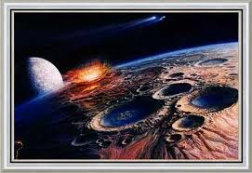
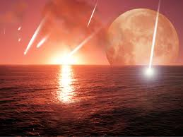
WHERE DID WATER COME FROM?
Oceans formed about 3.8 billion years ago.
Source of initial oceans:
Out gassing from volcanoes.
Water-heavy comets.
First oceans were FRESH water, NOT salty
Salt came later.
Video Link: Oceans

Slide 9
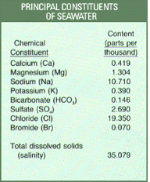
WHERE DID THE SALT COME FROM?
From rainwater that carried dissolved rock to the oceans!
Inorganic Sediments
Mineral salts from:
Weathering & erosion of rock
Dissolved minerals
Volcanic ash
Decayed biological matter
From marine plants and animals
Shells
Crustaceans
Foraminifera's (one cell animals)
Plankton
Diatoms

Slide 10
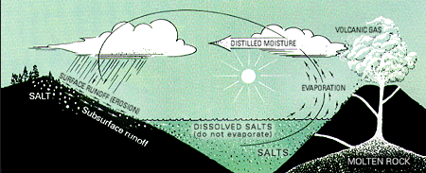
DEPOSITION AND EVAPORATION
INCREASES SALINITY OVER TIME
Deposition and evaporation increase salinity over time.

Slide 11
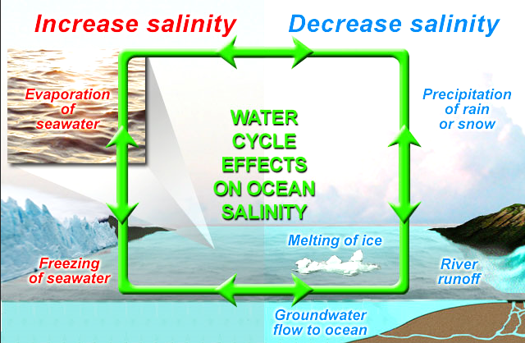
DEPOSITION AND EVAPORATION
SALINITY INCREASES OVER TIME

Slide 12

Current Composition of Oceans
Dissolved gases:
Nitrogen, N₂
Oxygen, O₂
Carbon Dioxide, CO₂
Dissolved solids (sea salts)
3.5% (35 ppt)
Cl, Mg, S, Ca, K, Na
Sources: volcanoes, erosion, weathering, chemical reactions between salt water and rock.

Slide 13
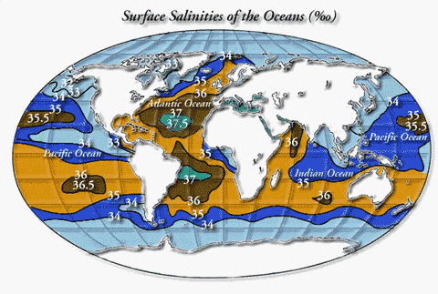
HOW MUCH SALT IS THERE?
Average salinity =
35 ppt (3.5%)
Saltiest – Sargasso Sea – WHY?
Least Salty – Arctic Ocean– WHY?
Spread evenly over the Earth's land surface it would form a layer more than 500 feet thick
Sargasso sea has no fresh water coming into it and it s water evaporates fast.
Arctic sea has slow evaporation.

Slide 14
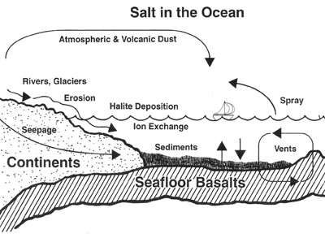
REVIEW…
Over time salinity in the oceans increases through deposition and evaporation.
How will life in the oceans need to adapt over the next million years?
  10 million?
  100 million?
By what process does life adapt to its environment?
Homeostasis

