Slide 1
DO NOW
Pick up notes.
Conservation of Mass lab is due Thursday.

Slide 2
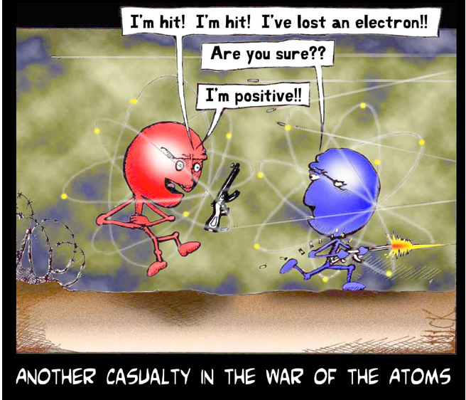
CHEMICAL REACTIONS

Slide 3
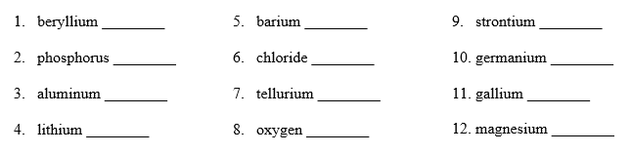
Write the ion formed for the following elements.

Slide 4
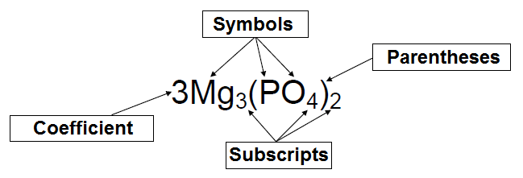
COUNTING ATOMS RULES
Rule One: SYMBOLS
Chemical symbols consist of either a capital letter or a capital letter and a lower-case letter. This means that as least ONE atom of this element is present in the compound.

Slide 5
COUNTING ATOMS RULES
Rule Two: SUBSCRIPTS
The subscript goes with the element it directly follows and indicates how many atoms of that element are present.

Slide 6
COUNTING ATOMS RULES
Rule Three: PARENTHESES
The elements in the ( ) go with the subscript that following it. Numbers inside the ( ) are multiplied by the subscripts outside the ( ).

Slide 7
COUNTING ATOMS RULES
Rule Four: COEFFICIENTS
The coefficient on a chemical compound tells how many molecules of that compound are present. The coefficient applies to every element in the compound and is multiplied with any subscripts present on an element.

Slide 8
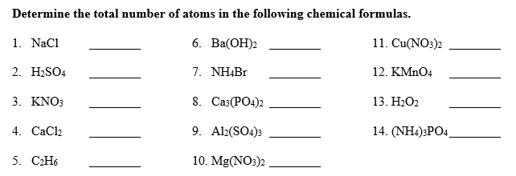
Determine the total number of atoms.

Slide 9
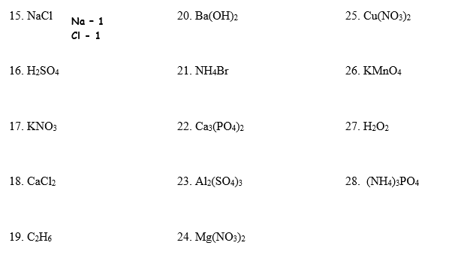
Determine the type of and number of each atom.

Slide 10
CHEMICAL REACTIONS
A chemical reaction is a process in which the physical and chemical properties of the original substances change as new substances with different chemical and physical properties are formed.
Remember: a new substance is always formed.
The properties and energies of the substances always change when a chemical reaction takes place.

Slide 11
CHARACTERISTICS
A. There are always two kinds of substances:
1. Reactant - substance that enters into a chemical reaction.
2. Product - substance produced by a chemical reaction.
Reactants → Products

Slide 12
CHARACTERISTICS
B. There is always a change in energy in a chemical reaction.
Exothermic - energy is given off. (Something that is burning or gives off light)
Endothermic - energy is absorbed. (Photosynthesis or test tube gets colder)

Slide 13
CHARACTERISTICS
C. There is always activation energy
Activation energy is the energy needed to form short-lived, highly energetic, extremely unstable, intermediate molecules that are rearranged to form products in the chemical rxn.

Slide 14
CHARACTERISTICS
D. Bonding Capacity
In order for a chemical reaction to occur, the reactants must have the ability to combine with substances to form products. Must follow the rules for bonding. Remember: An atom bonds with another atom to complete its outermost energy level.

Slide 15
CHARACTERISTICS
E. Conservation of Mass
Atoms can be neither created nor destroyed.
The number of reactant atoms must equal the number of product atoms.
This is important when balancing chemical equations.

Slide 16
BALANCING CHEMICAL EQUATIONS
Chemical reactions involve a rearrangement of atoms.
Chemical equations are expressions in symbols and formulas that represent a chemical reaction.
Example:
Magnesium + Oxygen yields Magnesium Oxide + energy
word equation

Slide 17
BALANCING CHEMICAL EQUATIONS
Magnesium + Oxygen yields Magnesium Oxide + energy
Mg + O₂ → MgO + heat
(skeleton equation)
2 Mg + O₂ → 2 MgO + heat
(balanced equation)
A balanced chemical equation has the same number of atoms of each element on both sides of the equation.

Slide 18
RULES TO FOLLOW
Change coefficients only.
Never change a symbol, formula, or subscript.
Place coefficients in front of the entire chemical formula.

Slide 19
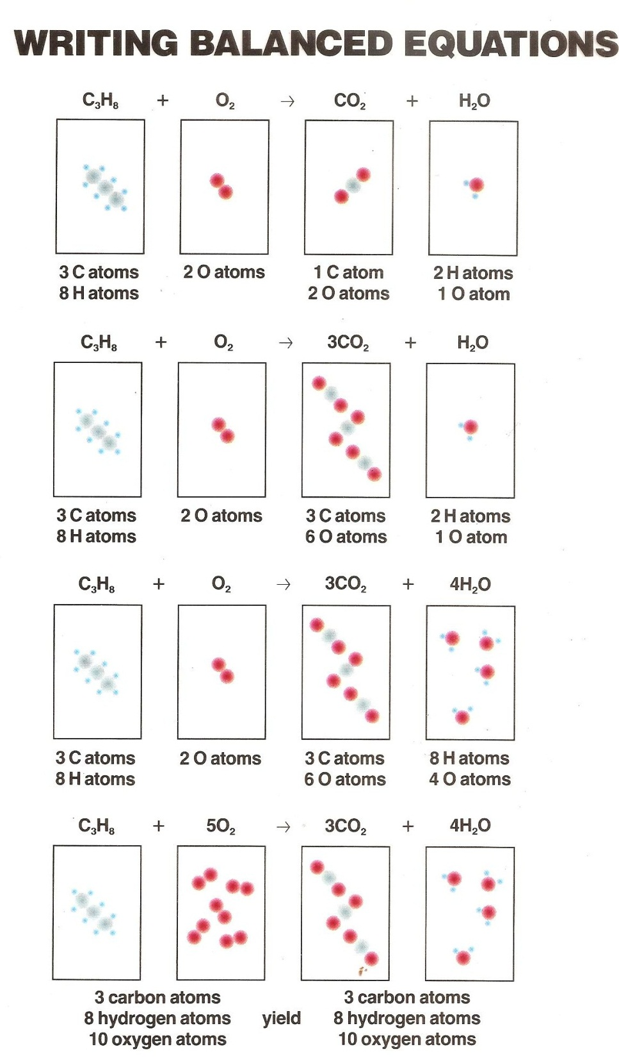

Slide 20
STEPS TO BALANCING
AN EQUATION
1. Write the chemical equation for the reaction.
Verify that the chemical symbols and formulas are correct.
2. Count the number of atoms of each element on both sides of the arrow.
If the atom numbers are equal, then the equation is balanced.

Slide 21
STEPS TO BALANCING
AN EQUATION
3. Balance the equation using coefficients.
Look for the least common multiple (LCM).
Balance metals, then nonmetals,
then hydrogen, then oxygen
4. Check your work by recounting the number of atoms on each side of the arrow.

Slide 22
BALANCING EQUATIONS (Part One)
1. ______ Al + ______ O₂ → ______Al₂O₃
Al - O - Al - O -
2. ______ Fe + ______ CuCl₂ → ______FeCl₂ + ______ Cu
Fe - Cl - Fe - Cl -
Cu - Cu -

Slide 23
BALANCING EQUATIONS (Part One)
3. ______ Al + ______F₂ → AlF₃
Al - Al -
F - F -
4. ______ H₂CO₃ → ______ H₂O + ______ CO₂
H - O - H - O -
C - O - C -

Slide 24
BALANCING EQUATIONS (Part One)
5. ______ H₂ + ______ N₂ → ______ NH₂
H - N - N -
H -
6. ______ KClO₃ → _______KCl + ______ O₂
K - O - K - O -
Cl - Cl -

Slide 25
BALANCING EQUATIONS (Part One)
7. NaCl + _____ AgNO₃ → _____ NaNO₃ + ____ AgCl
Na - Ag - Na - Ag -
Cl - N - Cl - N -
O - O -

Slide 26
TO DO
The Balancing Equations II handout is homework. Due tomorrow.
You are not required to show your work of counting atoms, but if you get the problem wrong and have not shown your work, I cannot give partial credit.

