Slide 1
DO NOW
Turn in National Chemical Week Extra Credit.
Pick up notes.
Get out Ionic Compounds handout from yesterday.

Slide 2
IONIC BONDING

Slide 3
COVALENT BONDING
Atoms with similar electronegativities tend to SHARE electrons.
There are not enough electrons for each individual atom to have a full octet.
Neither atom wants to lose electrons; both want to gain them.
Usually forms between nonmetals.

Slide 4
COVALENT BONDING
The positively charged nucleus of both atoms attracts the negative electrons to be shared.
Covalent bonds form a unit called a MOLECULE.
A molecule is the smallest particle of a covalent bond that has all the properties of that substance.

Slide 5
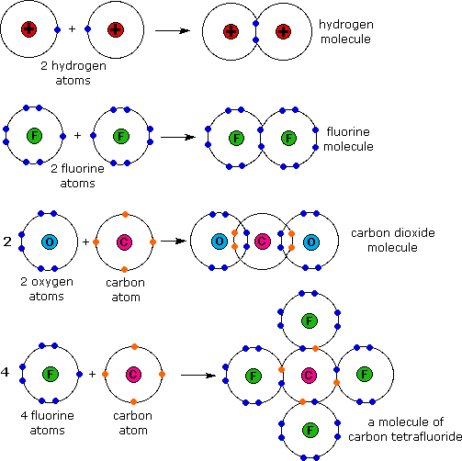
COVALENT BONDING

Slide 6
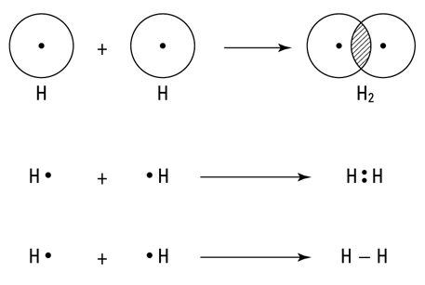
COVALENT BONDING
They share electrons and now have a full outer energy level.

Slide 7
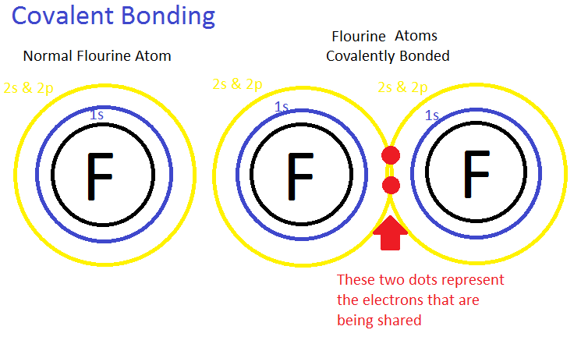
COVALENT BONDING
low melting points compared to ionic bonded compounds.
many exist as gases or vaporize easily at room temperature
relatively soft, brittle

Slide 8
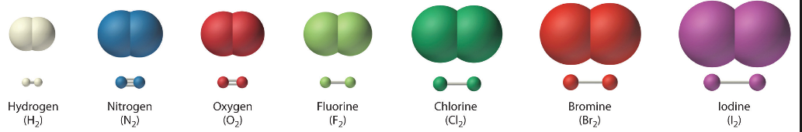
COVALENT BONDING
do not conduct electricity
solids do form a crystal but the attraction between atoms is not as strong as ionic
H₂, N₂, O₂, F₂, Cl₂, Br₂, I₂ - These are called diatomic atoms

Slide 9
TYPES OF COVALENT BONDS
Single
When a single pair of electrons is shared
Multiple
When more than one pair of electrons are shared. Triple bonds are stronger than double bonds which are stronger than single bonds.

Slide 10
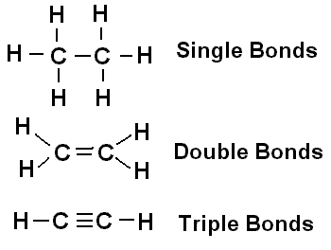
Types of Covalent Bonds

Slide 11
TO DO
Do the table on the back of your notes.
Then work on Bonding handout.

