Slide 1
DO NOW
Pick up notes and Review #14.

Slide 2
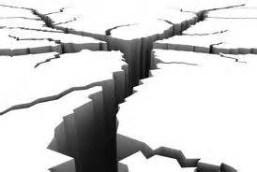
Earthquakes!
What causes Earthquakes?

Slide 3
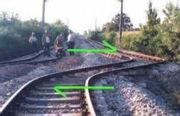
Review: Faults
They are breaks in rock.
They cause stresses – forces that act on rock.
Slow movement causes deformations in Earth’s crust.
Rocks along both sides of a fault are usually tightly pressed together.
Earthquakes are common along faults.

Slide 4
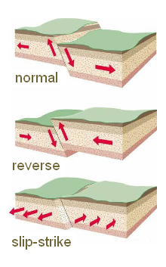
Review: Faults
Three Types:
  Normal
  Reverse
  Slip-strike
  Label the ones in your notes.

Slide 5
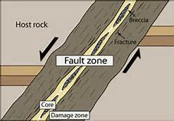
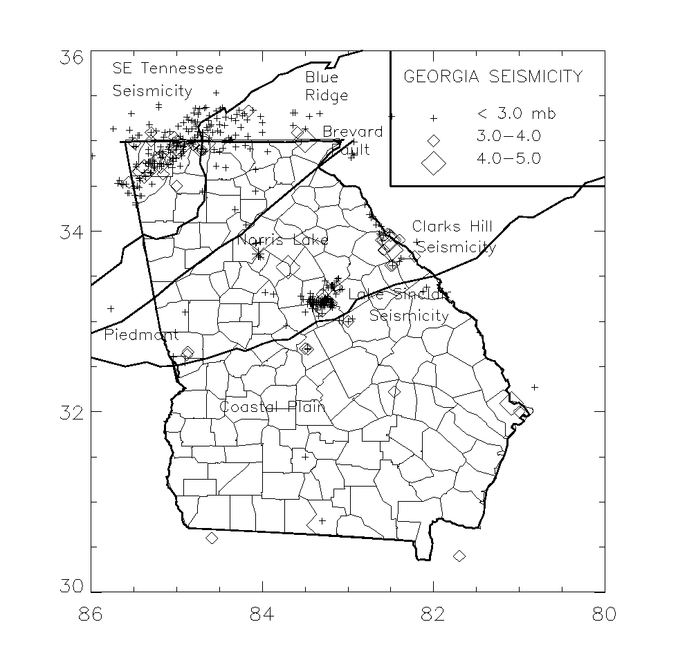
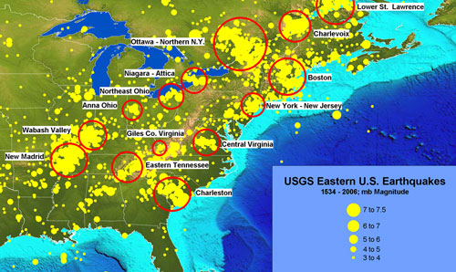
Fault Zones
These are regions of numerous, closely spaced faults.
Some fault zones are ancient so there is less stress and they are less active.
There are ancient faults in Georgia - we average one, magnitude 4+ quake every 10 years.
Georgia Earthquakes

Slide 6
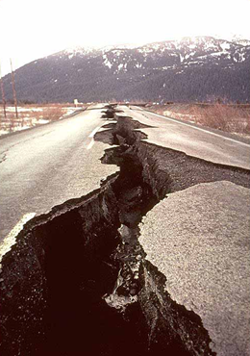
What are Earthquakes?
Destructive natural disaster
Movement of the ground
Usually along a fault line
Caused by a sudden release of energy
Rocks under stress suddenly shift.

Slide 7
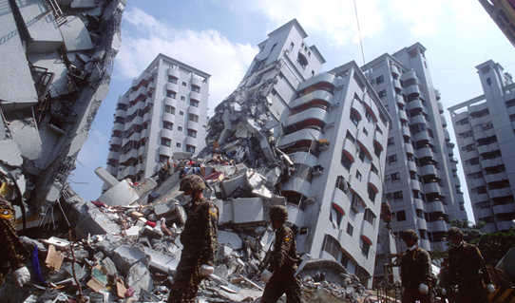
What are Earthquakes?
Blocks of Earth move in an earthquake along faults.
Seismic Gap: an area along a fault where there has not been any earthquake activity for a long period of time.

Slide 8
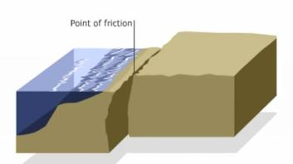
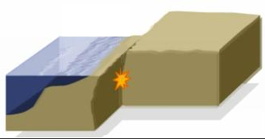
Locked Rocks
Rocks along fault are locked by friction.
The lock prevents rocks from moving past each other.
The stress in locked rock increases.
When stress goes past where rocks can maintain their integrity, they fracture.

Slide 9
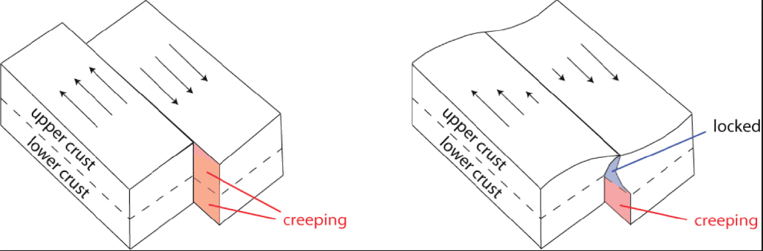
Locked Rocks
Stress increases, rocks along the fault move, trembling and vibrations result = earthquake!
When rocks slip into new positions, energy is released.

Slide 10
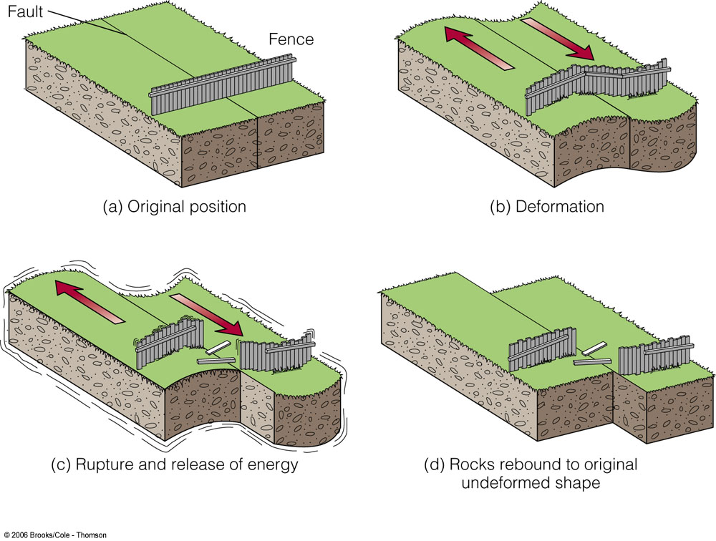
Elastic Rebound
This is the sudden return of rock to undeformed shape.
The rock under stress deforms and fractures.
The pieces separate at weakest point, then rebound.
Rebound results in earthquake as rock fractures, then rebounds and springs back to original shape.
ANIMATION LINK

Slide 11
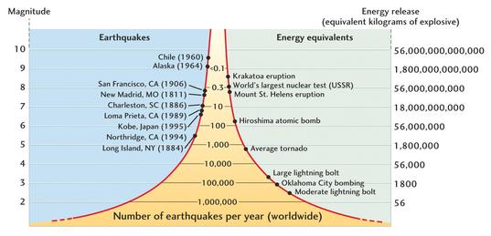
Earthquake Magnitude
Magnitude:
Measures the strength of an earthquake.
Related to energy released in the earthquake.
Richter Scale:
Older system.
Used in 20th century.
Based on ground motion.

Slide 12
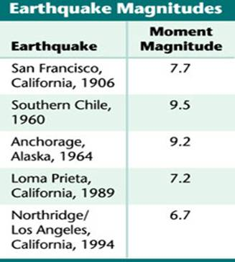
Earthquake Magnitude
Moment Magnitude Scale
New system
More accurate
Based on:
  size of the area of the fault that moves.
  average distance that the fault block moves.
  rigidity of the rocks in the fault zone.
Energy increases by factor of 30 for each increment on scale

Slide 13
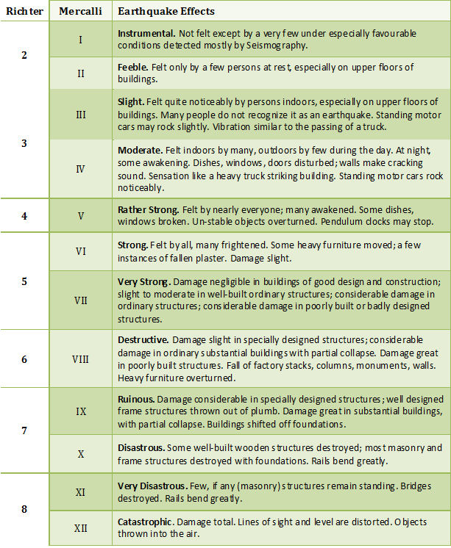
Earthquake intensity
Intensity: the amount of damage caused by an earthquake.
Depends on:
Magnitude
Distance from epicenter
Local geology
Infrastructure
Local geology

Slide 14
Earthquake intensity
Mercalli Scale:
Measurement system
Describes the effects of the earthquake.
Expresses intensity in Roman numerals.

Slide 15
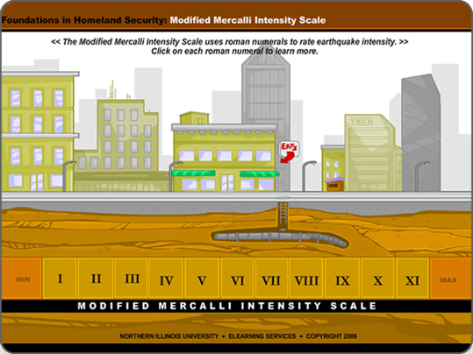
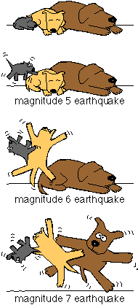
INTENSITY ANIMATION
Modified Mercalli Intensity Scale

Slide 16
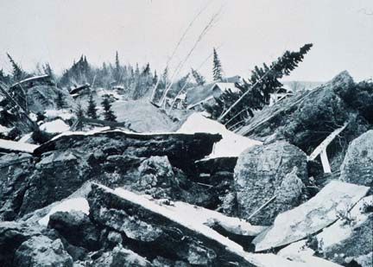
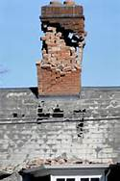
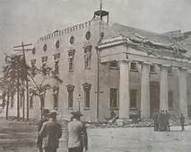
Activity: what does an Earthquake feel like?
August 10, 1884
An earthquake hits northeastern United States.
This is before seismographs.
How could newspaper stories be used to provide information about the magnitude and epicenter of the earthquake?
What evidence is provided in newspaper accounts?

Slide 17
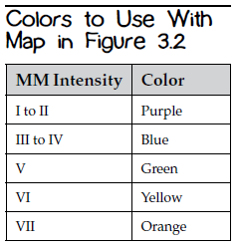
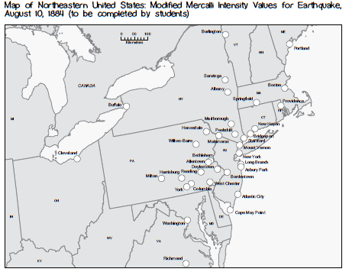
Task
Read the articles with partners.
Identify evidence
  Note what is NOT in articles.
Complete Data Table.
Determine Modified Mercalli (MM) intensity
  Use evidence from articles to determine
  Come to group consensus
  Be prepared to defend!
Mark map with MM Intensity & color using code

Slide 18
MODIFIED MERCALLI SCALE
MM I. Not felt, or rarely under especially favorable circumstances.
MM II. Felt indoors, especially on upper floors. Sometimes hanging objects may swing, especially when delicately suspended. Sometimes doors may swing very slowly. Sometimes dizziness or nausea is experienced.
MM III. Felt indoors by several people. Sometimes not recognized to be an earthquake at first. Duration estimated in some cases. Motion usually consists of rapid vibration, similar to the vibration of passing of light trucks. Hanging objects may swing slightly. Movement may be appreciable on upper levels of tall structures.
MM IV. Felt indoors by many, outdoors by few. Awakened some, especially light sleepers. Frightened those apprehensive from previous experience. Vibration like that due to passing of heavily loaded trucks. Rattling of dishes, windows, doors; glassware and crockery clink and clash. Creaking of walls. In numerous instances, hanging objects swing. Liquids in open vessels disturbed slightly.
MM V. Felt indoors by practically everyone, outdoors by many or most. Awakened most. Frightened few—a few ran outdoors. Buildings trembled throughout. Broke some dishes, glassware. Cracked windows (in some cases, but not generally). Overturned small or unstable objects. Hanging objects and doors swing generally or considerably. Knocked pictures against walls, or swung them out of place. Opened or closed doors and shutters abruptly. Moved small objects and furniture (the latter to slight extent). Spilled liquids in small amounts from well-filled open containers.
MM VI. Felt by all, indoors and outdoors. Frightened many, excitement general, some alarm, many ran outdoors. Awakened all sleepers. Liquid set in strong motion. Small bells rang, for example, in church, chapel, or school. Damage slight in poorly built buildings. Fall of plaster in small amount. Plaster cracked somewhat, especially fine cracks in chimneys. Broke dishes and glassware in considerable quantity; also some windows. Fall of knickknacks, books, and pictures. Overturned furniture in many instances. Moved moderately heavy furniture.
MM VII. Frightened all. General alarm; all ran outdoors. Some found it difficult to stand. Waves occurred on ponds, lakes, and running water. Damage slight to moderate in well-built ordinary buildings. Cracked chimneys to considerable extent, walls to some extent. Fall of plaster in considerable to large amounts; also some stucco. Broke numerous windows. Broke weak chimneys at the roofline. Dislodged bricks and stones. Overturned heavy furniture, with damage to furniture.
MM VIII. Fright general. Alarm approaches panic. Trees shaken strongly— branches and trunks broken off. Damage slight in structures built especially to withstand earthquakes. Considerable damage in ordinary substantial buildings. Fall of walls. Twisting and fall of chimneys, columns, and monuments. Very heavy furniture overturned.
MM IX to X. Panic general. Cracked ground up to widths of several inches; fissures up to a yard in width run parallel to canal and stream banks. Landslides considerable from river banks and steep coasts. Damage serious to dams, dikes, and embankments. Severe damage to well-built wooden structures and bridges: some collapse in large part; frame buildings completely shifted off foundations; dangerous cracks in excellent brick walls. Serious damage to reservoirs; underground pipes sometimes broken.
MM XI to XII. Damage total. Practically all works of construction damaged greatly or destroyed. Broad fissures, earth slumps, and landslides; fall of rocks of significant character; slumping of river banks, numerous and extensive. Fault slips in firm rock, with notable horizontal and vertical offset displacements.

Slide 19
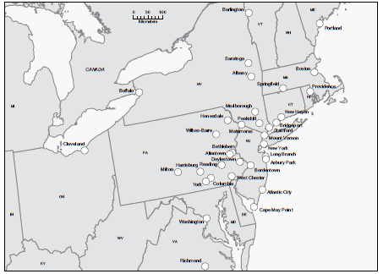
Sharing Group Results
As a class decide on each location’s intensity & find the epicenter!

Slide 20
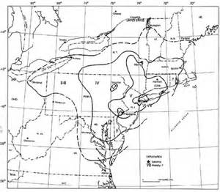
Debriefing….
What evidence was most helpful in determining intensity?
How did development of an intensity scale help geologists learn more about earthquakes?
Why did some locations close together seem to experience effects differently?
The map to the right is from a professional paper about this earthquake. How does it compare to ours?
How are magnitude and intensity different?

Slide 21
TO DO
Review #14 due tomorrow.

