Slide 1
DO NOW
Pick up notes and review #13.
Did you turn in your article summary #7 by Friday?

Slide 2
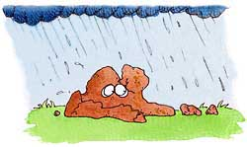
REVIEW
What process causes rocks to break down into sediment?
WEATHERING!

Slide 3
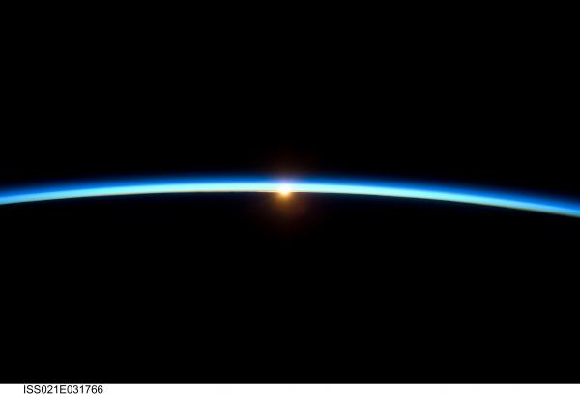
EARTH’S ATMOSPHERE
SES5. Students will investigate the interaction of insolation and Earth systems to produce weather and climate.

Slide 4
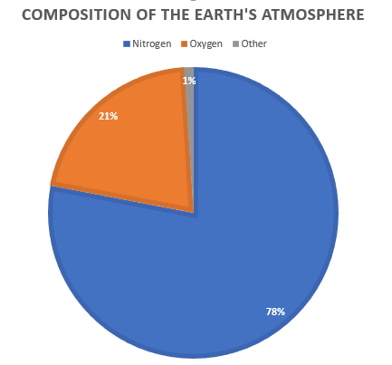
CHEMICAL COMPOSITION OF ATMOSPHERE
A solution (homogenous mixture) of different gases.
80% nitrogen
20% oxygen
traces of other gases.

Slide 5
CHEMICAL COMPOSITION OF ATMOSPHERE
More Specifics:
  Nitrogen: 78%
  Oxygen: 21%
  Argon: 0.9%
  Carbon Dioxide: 0.03%
  Hydrogen, ozone, methane, carbon monoxide, helium, neon, krypton, xenon, and water vapor: less than 0.1% in total

Slide 6
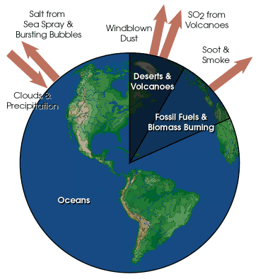
PARTICULATES IN THE ATMOSPHERE
Particulates scatter and absorb light.
They are natural and manmade.
Sources of particulates:
  Volcanic dust
  Sea salt particles
  Chlorofluorocarbons, CFCs

Slide 7
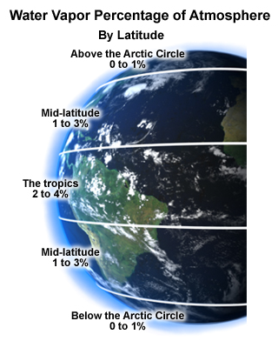
WATER VAPOR IN THE ATMOSPHERE
Sources of water vapor:
  Evaporation
  Transpiration
  Respiration
Part of water cycle.
Varies by latitude.
Warmer air holds more water vapor.
Considered a greenhouse gas.

Slide 8
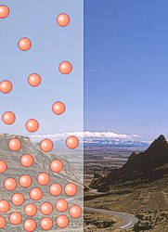
DENSITY OF ATMOSPHERE
Atmosphere has layers based on different characteristics.
  Density
  Pressure
  Temperature

Slide 9
DENSITY OF ATMOSPHERE
Atmosphere is 480 km thick.
Gravity holds onto air molecules.
Most air molecules (about 80%) are within 16 km of Earth’s surface.
  Air near the surface has greater density.
  Air thins out farther from the surface, is less dense.

Slide 10
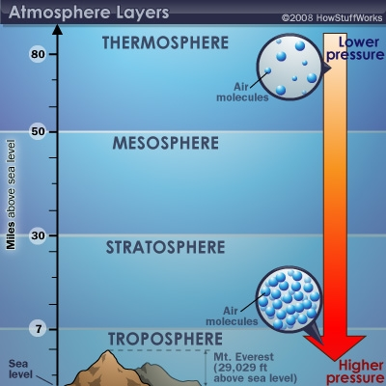
AIR PRESSURE
Denser air has greater air pressure.
Air near the Earth’s surface is denser and has greater air pressure.
Atmospheric pressure is measured with a barometer.

Slide 11
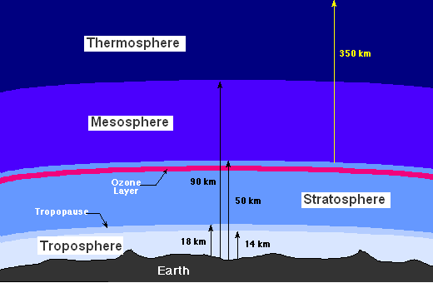
LAYERS OF EARTH’S ATMOSPHERE
The atmosphere of the Earth is divided into several distinct layers.

Slide 12
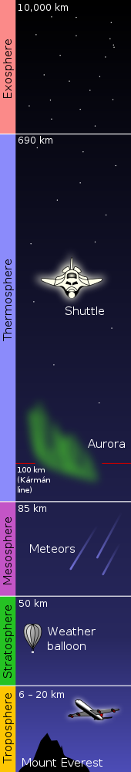
TROPOSPHERE:
BOTTOM LAYER:
Starts at the Earth's surface.
Extends 15 km (9 miles) high.
Most dense.
The temperature drops from about 17 to -52 degrees Celsius.
Where weather occurs.
Tropopause separates the troposphere from the next layer – temperature remains steady.

Slide 13
STRATOSPHERE
Starts above the troposphere.
Extends to 50 km (31 miles) .
Dry and less dense air.
Includes the ozone layer.
  Ozone absorbs and scatters solar ultraviolet radiation.
  Causes increase in temperature.

Slide 14
STRATOSPHERE
Ninety-nine percent of atmospheric air is located in the troposphere and stratosphere.
Stratopause separates the Stratosphere from the next layer.

Slide 15
MESOSPHERE
Starts just above the stratosphere.
Extends to 85 km (53 miles) high.
Temperatures get colder again.
  As low as -93 degrees Celsius.
Mesopause separates the Mesosphere from the Thermosphere.

Slide 16
THERMOSPHERE
Starts just above the mesosphere.
Extends to 600 km (372 miles).
Lower part of the Thermosphere is the Ionosphere.
  Absorbs gamma radiation from Sun.
  Creates aurora (Northern Lights).
Temperatures increase.
  Can go as high as 2000°C.
Includes part of the Magnetosphere.

Slide 17
EXOSPHERE
Outermost layer of Earth's atmosphere.
Extends from the Thermosphere upward.
Composed mainly of hydrogen and helium.
Particles are so far apart that they can travel hundreds of kilometers without colliding with one another.

Slide 18
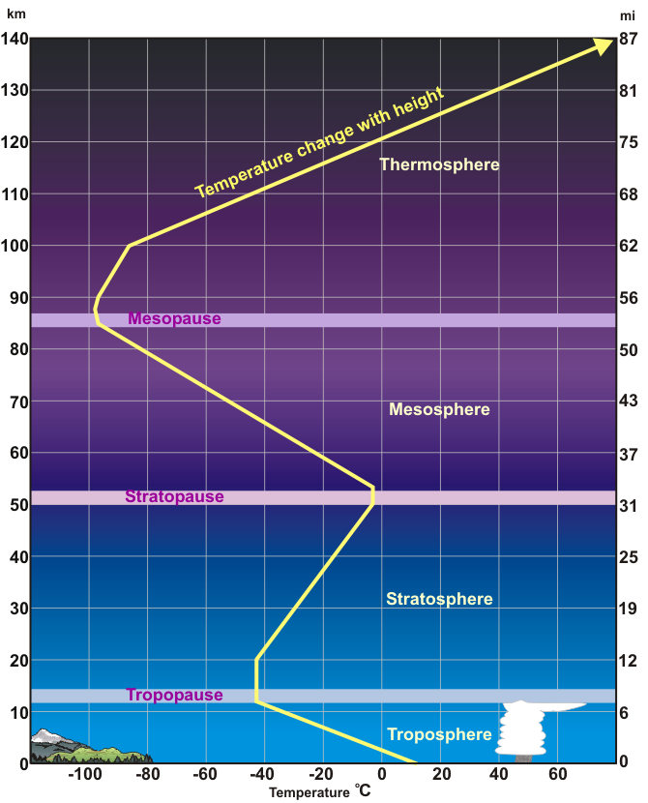
ATMOSPHERIC PROFILE
Stuve Diagrams are a type of diagram used to represent or plot atmospheric data as recorded by weather balloons as they rise in the atmosphere.

Slide 19
ATMOSPHERIC PROFILE
The data the balloons record are called soundings.
When the data is graphed we can see where each layer of the atmosphere begins and ends by seeing where the temperature changes.

Slide 20
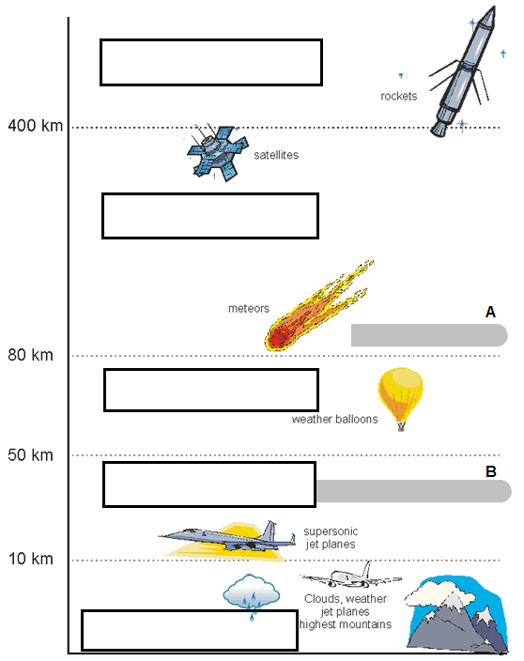
Exosphere
Thermosphere
A. Ionosphere
Mesosphere
Stratosphere
B. Ozone Layer
Troposphere

Slide 21
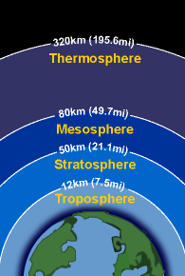
REVIEW
Which layer does all weather occur in?
Mesosphere
Stratosphere
Thermosphere
Troposphere

Slide 22
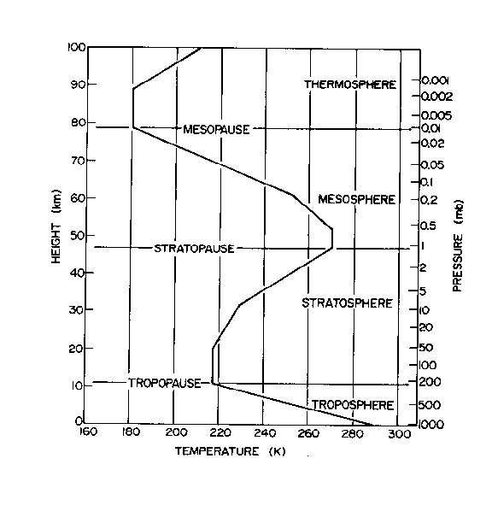
LAB: CREATING A STUVE CHART
Atmosphere Temperature Graphing Activity
Graph the temperature data.
Color each layer of the atmosphere.
Answer the questions.

Slide 23
TO DO
Stuve Diagram lab
Review #13

