Slide 1
DO NOW
Pick up notes
Gas Pressure lab is due Thursday
Big Chill project is due Friday.

Slide 2

GAS LAWS

Slide 3
VIDEO
Chapter 2 – Racing Hot Air Balloons

Slide 4

GASES (Chapter 12)
Physical Properties of Gases:
Gases have mass.
Gases have no definite volume, no definite shape, are easily compressed, and behave independently of each other.
Gas particles do not attract or repel each other – the spaces between the particles is too great.

Slide 5
GASES (Chapter 12)
The fact that gas molecules are in constant, random motion allows gases to fill their containers completely.
Different gases can move through each other quite rapidly. This movement is called DIFFUSION. EFFUSION is when diffusion occurs through a small opening.
Gases exert pressure and the pressure of a gas depends on its temperature and volume.

Slide 6
GASES
Remember that gases consist of very small particles, the particles have large distances between them, they are in constant, rapid, random motion and have elastic collisions.
Actual gases (in real life) do not obey all the suppositions stated in the kinetic-molecular theory.
In order to accurately measure a gas sample, you must know the quantity of particles (moles), pressure, temperature, and volume of a gas.

Slide 7
THE GAS LAWS
Boyle’s Law: between VOLUME and PRESSURE; inversely proportional.
Charles’ Law: betweenVOLUME TEMPERATURE ; directly proportional.
Gay-Lussac’s Law: between PRESSURE and TEMPERATURE; directly proportional.
Avogadro’ Principle: between numbers of particles – moles - and PRESSURE or VOLUME; directly proportional.

Slide 8
BOYLE’S LAW
DEMOS – Boyle’s Law
Chapter 7 – Breathing and Boyle’s Law
1. Why does the balloon expand?
2. What does this demo have to do with breathing?
3. Have you ever heard the phrase “nature abhors a vacuum?” What do you think it means?
Cartesian Diver
Artificial lung

Slide 9
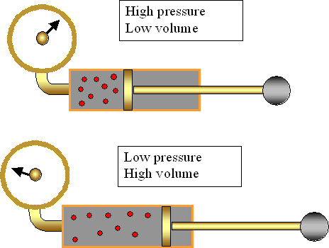
BOYLE’S LAW

Slide 10
BOYLE’S LAW
THE LAW: For a given mass of gas, at a constant temperature, the volume varies inversely with the pressure:
P₁V₁ = P₂V₂
PRACTICE:
The pressure in a 9.0 L balloon is 2.1 atm. If the volume is reduced to 5.0 L, what will the resulting pressure be? (Temperature does not change.)
V₁ = P₁V₁ = P₂V₂
P₁ =
V₂ =
P₂ =

Slide 11
REMINDER
EVERY TIME you do a gas laws problem:
Write what you know and what you are trying to find.
Write the formula.
Plug in the numbers with units and solve with the correct number of sig figs.
Points will be given for this information.

Slide 12
CHARLES’ LAW
DEMO
Balloon and temperature change

Slide 13
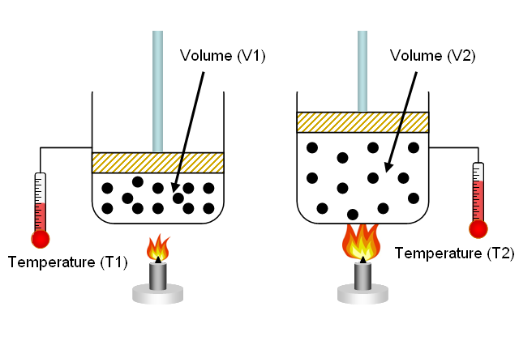
CHARLES’ LAW

Slide 14
CHARLES LAW
THE LAW: The volume of a fixed mass of a gas is directly proportional to its KELVIN temperature if the pressure is constant. If pressure is kept constant, then volume must change to keep temperature the same.
V₁T₂ = V₂ T₁
You must use the Kelvin temperature scale!

Slide 15
CHARLES LAW
You must use the Kelvin temperature scale!
PRACTICE:
The temperature of a sample of gas is 300.0 K. The gas’ volume is 25.0 L. What will be the new volume of the gas if the temperature is dropped to 125.0 K?
V₁ = V₂T₁ = T₂V₁
T₁ =
V₂ =
T₂ =

Slide 16
REMINDER
EVERY TIME you do a gas laws problem:
Write what you know and what you are trying to find.
Write the formula.
Plug in the numbers with units and solve with the correct number of sig figs.
Points will be given for this information.

Slide 17
GAY-LUSSAC’S LAW
Videodisc – Chapter 5 - Imploding Can
1. Why did the can implode?
2. How does the demonstration you just saw relate to a barometer?
3. How is a vacuum seal created on a jar of homemade preserves?
Egg in a bottle

Slide 18
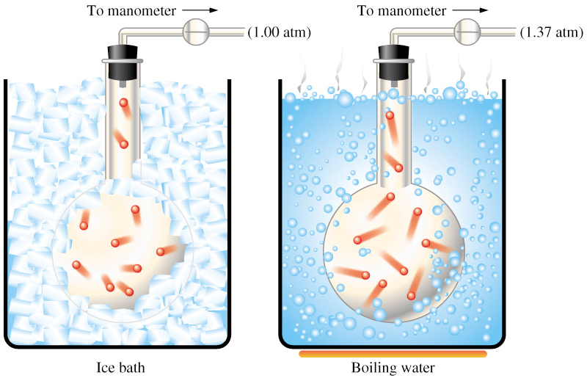
GAY-LUSSAC’S LAW

Slide 19
GAY-LUSSAC’S LAW
THE LAW: An increase in temperature increases the frequency of collisions between gas particles. In a given volume, raising the KELVIN temperature also raises the pressure.
P₁ T₂= P₂ T₁
You must use Kelvin temperature scale!

Slide 20
GAY-LUSSAC’S LAW
You must use Kelvin temperature scale!
PRACTICE:
The temperature of a sample of gas is 300.0 K. The gas’ pressure is 1.4 atm. What will be the new pressure of the gas be if the temperature is dropped to 125.0 K?
P₁ = P₂T₁ = T₂P₁
T₁ =
P₂ =
T₂ =

Slide 21
REMINDER
EVERY TIME you do a gas laws problem:
Write what you know and what you are trying to find.
Write the formula.
Plug in the numbers with units and solve with the correct number of sig figs.
Points will be given for this information.

Slide 22
HINT
PTV

Slide 23
PUTTING IT ALL TOGETHER
Simulation on gas laws:
Structure and Properties of Matter

Slide 24
TO DO
Handout on Boyle’s, Charles, and Gay-Lussac’s problems due Thursday.

