Slide 1
DO NOW
Turn in Review #1.
Pick up notes sheet and Review #2.

Slide 2
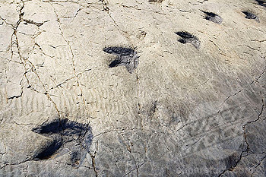
REVIEW
Fossils of footprints are examples of:
  A. Cast fossils
  B. Coprolites
  C. Gastroliths
  D. Trace fossils

Slide 3
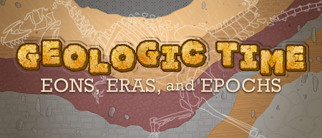
GEOLOGIC TIME
SES4. Students will understand how rock relationships and fossils are used to reconstruct the Earth’s past.
SES4d. Explain how sedimentary rock units are correlated within and across regions by a variety of methods including the principle of fossil succession.
SES4e. Use stratigraphic relationships to interpret major events in Earth history.

Slide 4
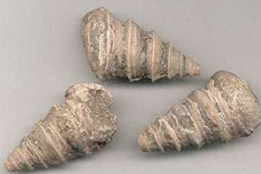
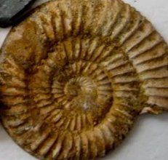
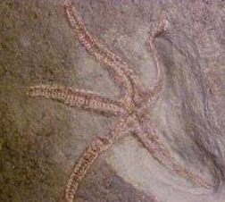
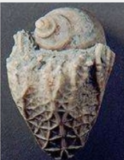
WHAT DO FOSSILS TELL US?
These fossils were found in Texas, Utah, and Colorado.
What conclusions can you make about their past environments?

Slide 5
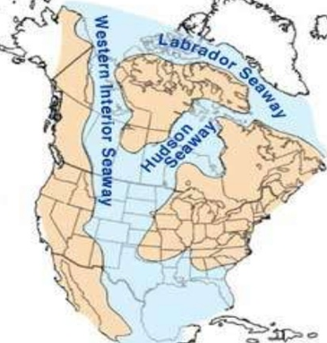
FOSSILS ARE CLUES TO THE PAST
Fossils provide the most important clues to interpret past environments.
Type and distribution of fossils are BEST indicators of an area’s ancient conditions and climate.
How do we know how long ago that was?

Slide 6
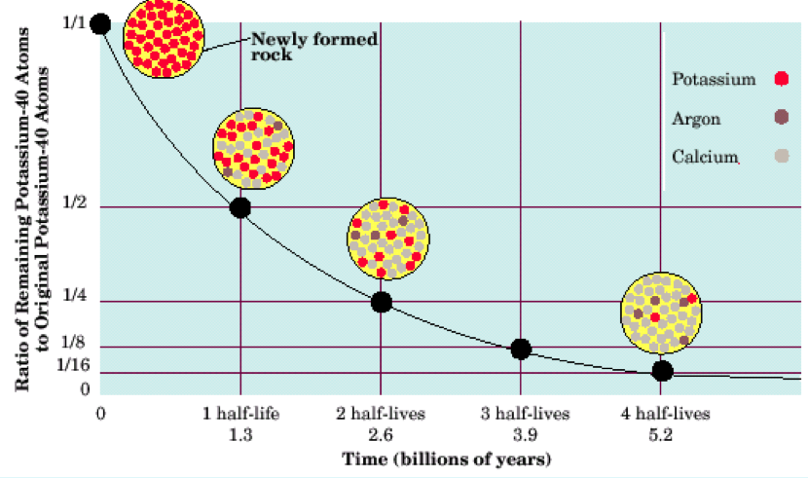
ABSOLUTE AGE: RADIOMETRIC DATING
Radioactive Decay of isotopes.
Absolute age tells how old something is (ex: 300 million years old).
Dating of sedimentary rocks provides information about age of fossils.
Radioactive substances are useful for measuring age because radioactive substances undergo decay at a predictable rate.

Slide 7
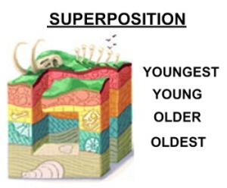
RELATIVE AGE: LAW OF SUPERPOSITION
In an undisturbed rock column, the oldest rocks will be on the bottom and the youngest ones on top.
Oldest fossils are on the bottom.
Newest fossils are on the top.
Relative age is a comparison (ex: one fossil is older than another).

Slide 8
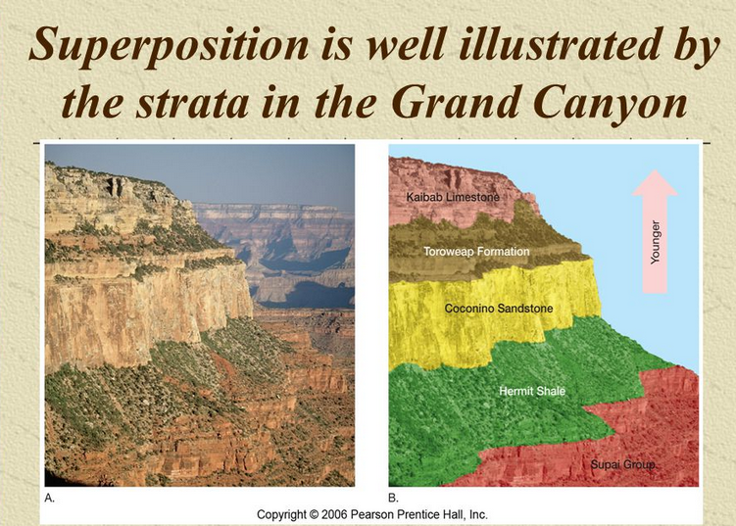

Slide 9
USING FOSSIL CLUES
Absolute and relative age of fossils help us construct history of Life on Earth.
Certain fossils only appear in rocks of specific ages.
Fossils provide important geologic information by revealing both the absolute and relative ages of rocks.

Slide 10
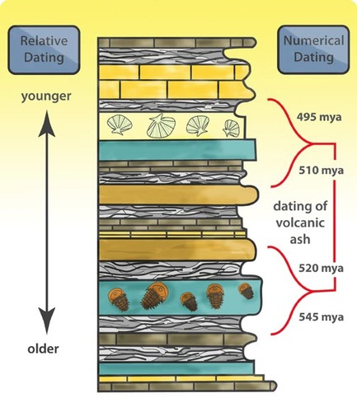
USING FOSSIL CLUES

Slide 11
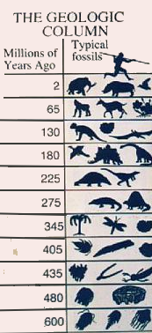
USING FOSSIL CLUES
Fossil record shows changes over time in organisms and their environments.
  Principal of Fossil Succession - more later.

Slide 12
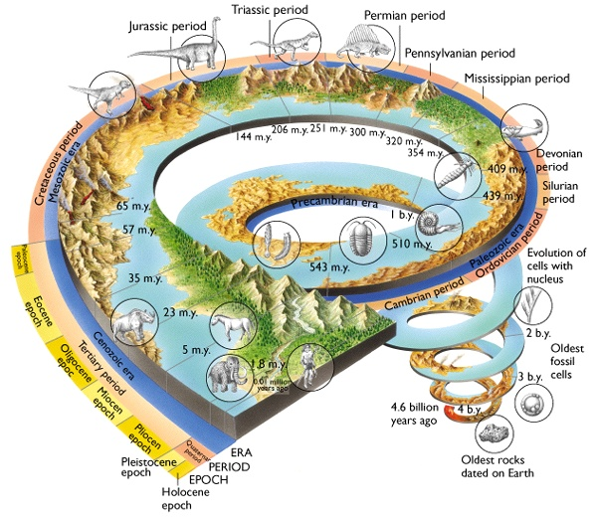
GEOLOGIC TIME
Earth history divided into major divisions based on fossil record.
Rocks grouped within each time period contain similar fossils.
Beginnings and ends of Geologic eras are defined by major changes in life forms based on fossil evidence.

Slide 13
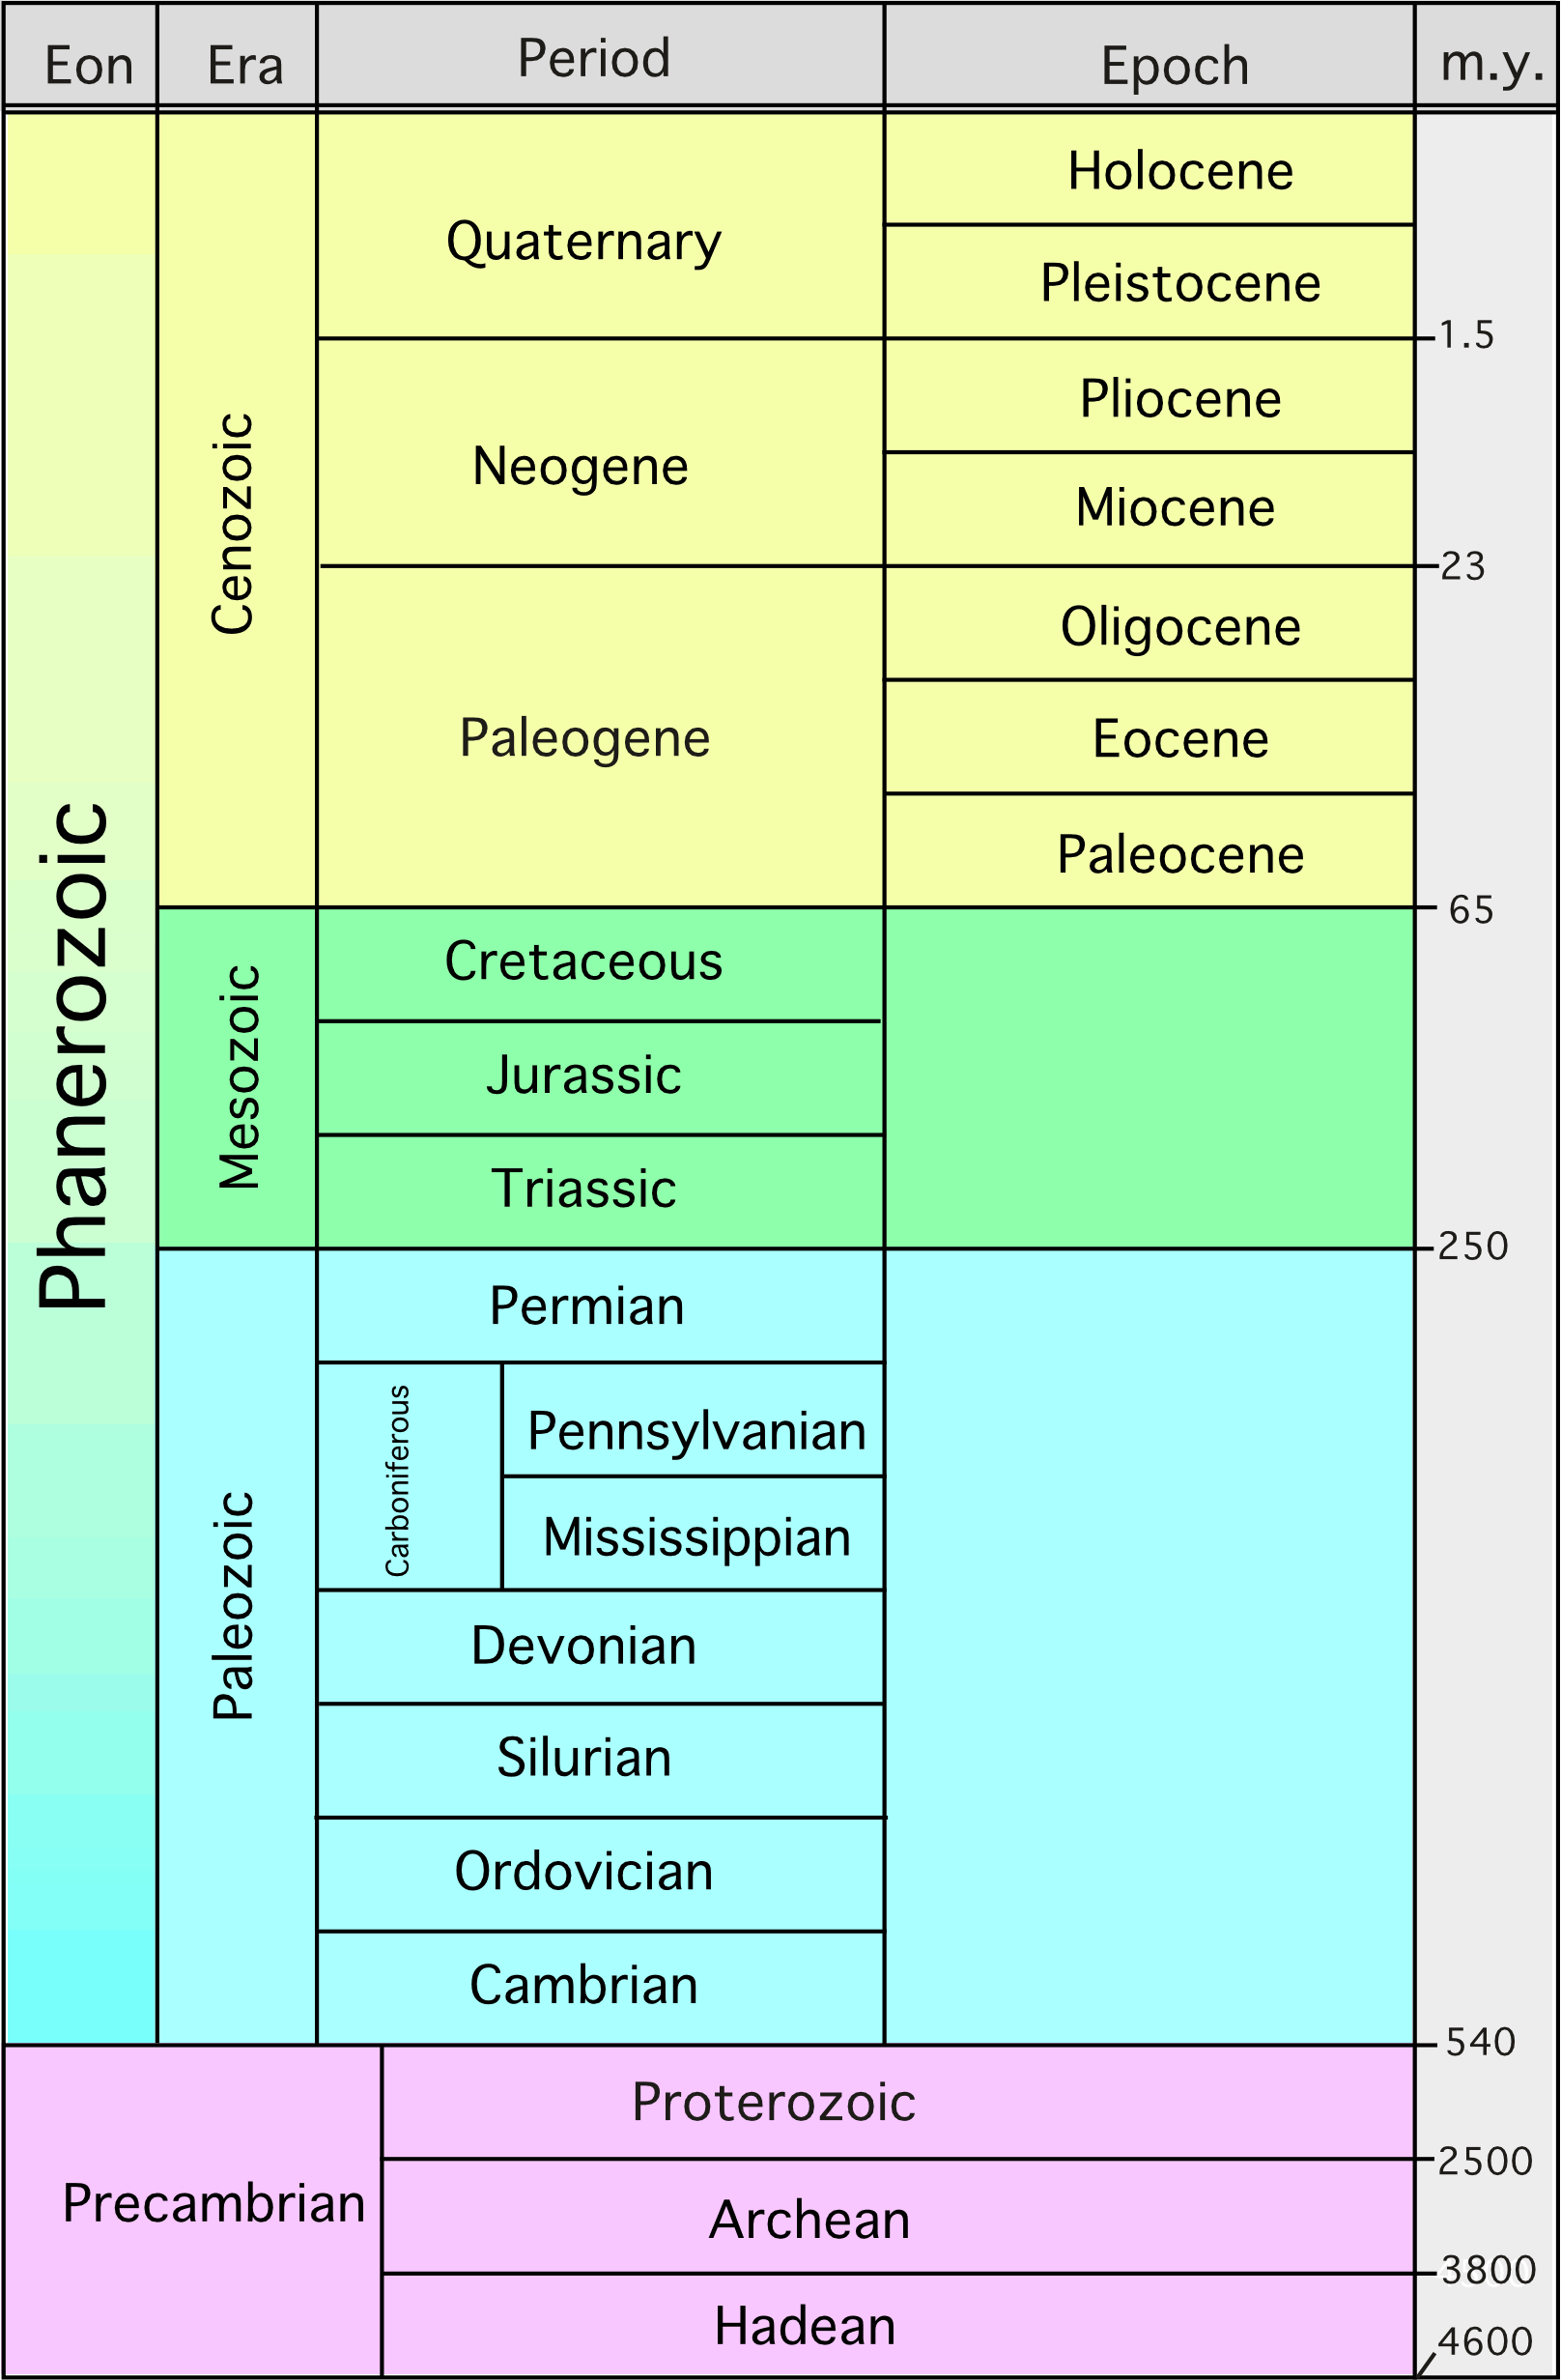
GEOLOGIC TIME DIVISIONS
Eons:
Precambria
  Earth’s formation (4.5 bya) to 500 mya
  All fossils are simple life forms.
Phanerozoic
  500 mya to today
  Most of Geologic Time
  Fossil record shows increasingly complex life forms.

Slide 14
GEOLOGIC TIME DIVISIONS
Eras:
In Precambria:
  Precambrian Era
In Phanerozoic:
  Paleozoic Era
  Mesozoic Era
  Cenozoic Era
Eras divided into Periods.
Periods in Cenozoic Era divided into Epochs.

Slide 15
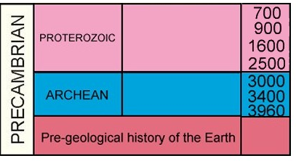
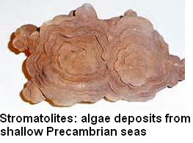
PRECAMBRIAN ERA
Three Divisions
Hadean Period
  4.5 to 3.8 Billion Years Ago
  Earth cooling
  Heavy bombardment
First 4 Billion Years of Earth’s History
Few fossils

Slide 16
PRECAMBRIAN ERA
Three Divisions
Archaean Period
  3.8 to 2.5 Billion Years Ago
  Continent building
  Early life – single cell prokaryotes.
First 4 Billion Years of Earth’s History
Few fossils

Slide 17
PRECAMBRIAN ERA
Three Divisions
Proterozoic Period
  2.5 Billion To 543 Million Years Ago
  Eukaryotic life appears.
  Multi-cellular life.
First 4 Billion Years of Earth’s History
Few fossils

Slide 18
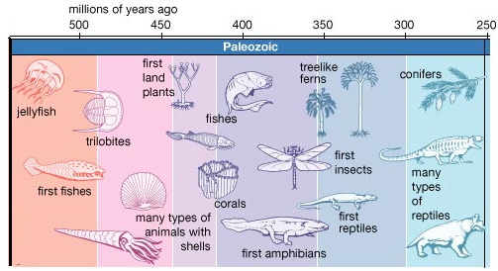
PALEOZOIC ERA: LIFE FLOURISHES
8 Periods named for the location in which the fossils were first discovered.
Age of fish
Cambrian Period: Cambrian Explosion - most life in ocean.
First Mass Extinction in Ordovician Period.

Slide 19
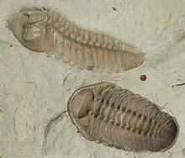
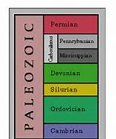
PALEOZOIC ERA: LIFE FLOURISHES
First Forests
Second Mass Extinction in Devonian Period.
Pangaea and Appalachian Mountains formed during Permian Period (end of Paleozoic Era).
Third Mass Extinction at end of Permian Period – GREAT DYING – biggest mass extinction event.

Slide 20
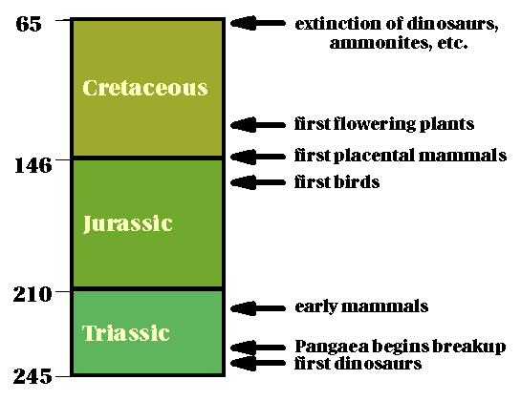
MESOZOIC ERA: AGE OF REPTILES
Pangaea begins to break up.
Divided into three periods.
Early mammals but NO humans!
Dinosaurs dominant life form during Jurassic.

Slide 21
MESOZOIC ERA: AGE OF REPTILES
Different dinosaurs during different periods.
First flowers in Cretaceous.
Mass Extinction Events at end of Triassic and Cretaceous. Dinosaurs die out at the end of the Cretaceous Period.

Slide 22
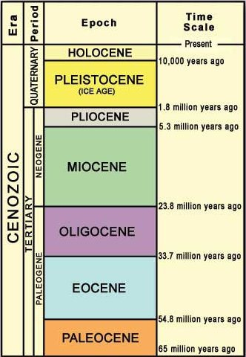
CENOZOIC ERA: AGE OF MAMMALS
Most known about this Era.
First primates.
Himalayan Mountains 15MYA.

Slide 23
CENOZOIC ERA: AGE OF MAMMALS
First Humans – Pleistocene Epoch.
Human History – Holocene Epoch.
More divisions because more is known.

Slide 24
TO DO
Work on your Fossil Lab
Review #2 is due tomorrow.

