Slide 1
DO NOW
Turn in Review #20.
Pick up notes.

Slide 2
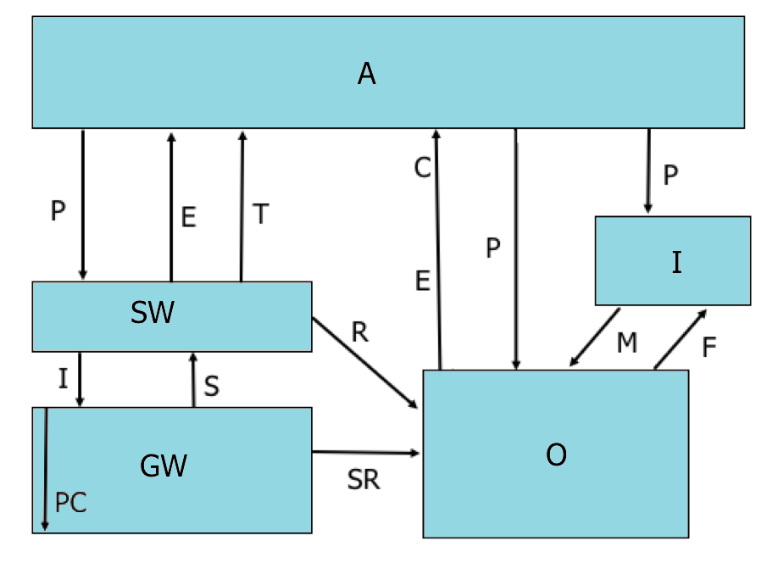
LOOKING BACK:
Hydrological Cycle: Reservoirs & Transformations
P = precipitation
E = evaporation
T = transpiration
What are the major reservoirs in the water cycle?
What are the major transformations in the water cycle?
Atmosphere
C = condensation
Ice
Surface Water
M = melting
F = freezing
Ground Water
Ocean Water
I – infiltration
S = springs
SR = subsurface runoff

Slide 3
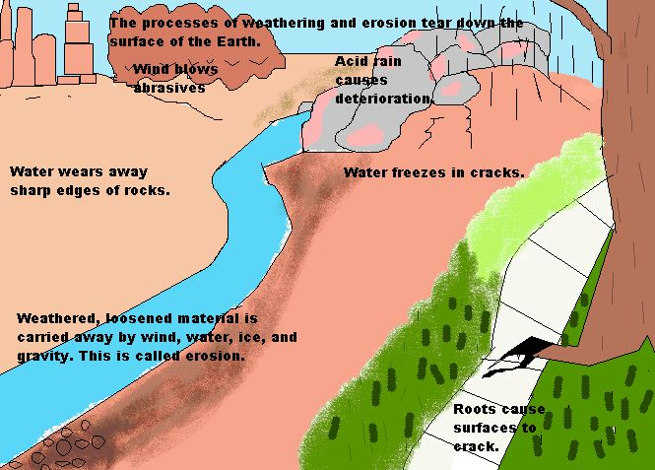
MECHANICAL WEATHERING
SES3: Students will explore the actions of water, wind, ice, and gravity that create landforms and systems of landforms (landscapes).

Slide 4
WEATHERING: BREAKING DOWN EARTH’S CRUST
Weathering is
Change in the physical form and chemical composition of rock.
Interaction between the tectonic and the hydrologic cycle causes recycling of the materials of the Earth's crust.
Part of the rock cycle – old rocks destroyed and can be recycled into new sedimentary rocks.

Slide 5
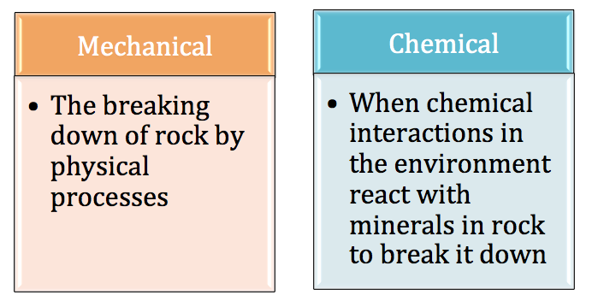
TYPES OF WEATHERING
Mechanical
Chemical
Does not change the rock chemically

Slide 6
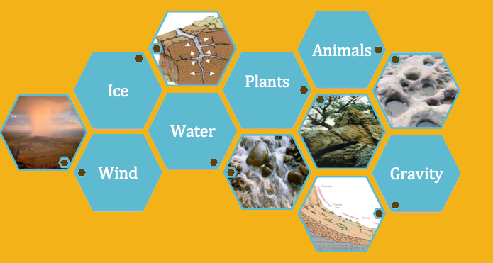
MECHANICAL WEATHERING
The breaking down of rock by
physical processes

Slide 7
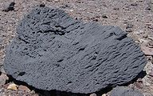
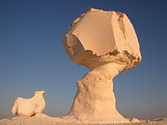
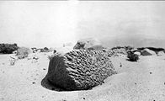
A. WIND
Wind blows sand and silt against exposed rock.
  Ventifacts: Rocks that have been pitted, etched, grooved or smoothed by wind abrasion.
  Formed in arid conditions.
  Shaped by wind.
  Appearance can show direction of prevailing wind.

Slide 8
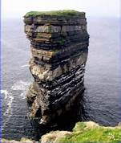
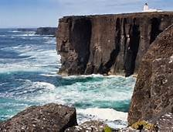
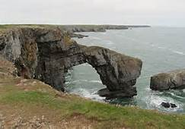
B. WAVES and WATER
Waves break and weather shorelines.
  Force of waves can break off pieces of rock.
  Storms release large amounts of energy and increase mechanical weathering.

Slide 9
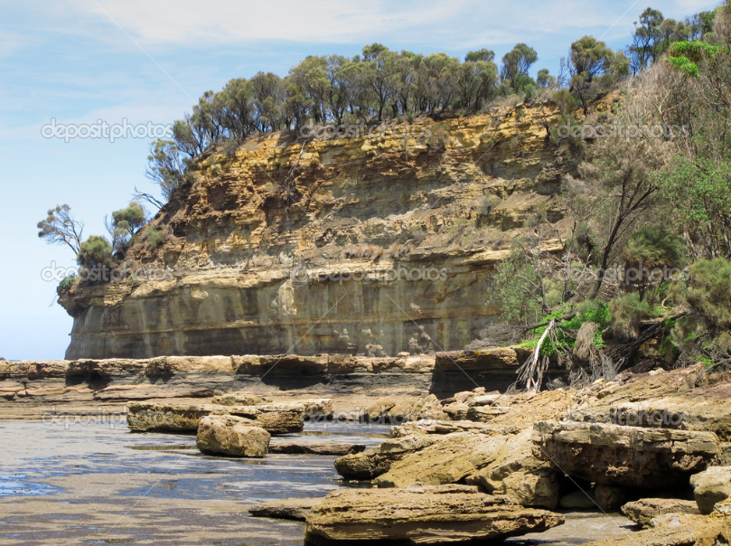
B. WAVES and WATER
Some features produced:
  Sea cliffs
  Sea arches
  Wave-cut terraces

Slide 10
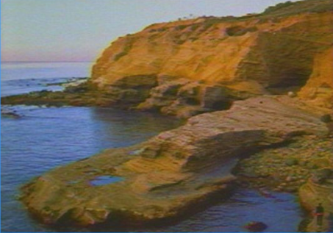
B. WAVES and WATER
Sea Cliffs – form when a rocky shore erodes at approximately the same rate throughout an area. This results in a steep walled structure.

Slide 11
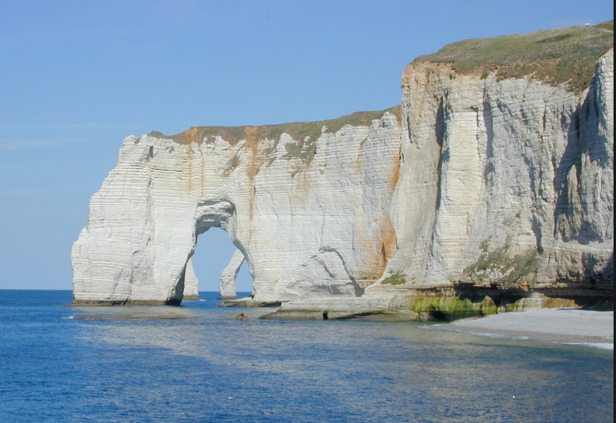
B. WAVES and WATER
Sea Arches - form when a rocky shore erodes at different rate in the middle. This results in a structure with a hole, or arch, in the middle.

Slide 12
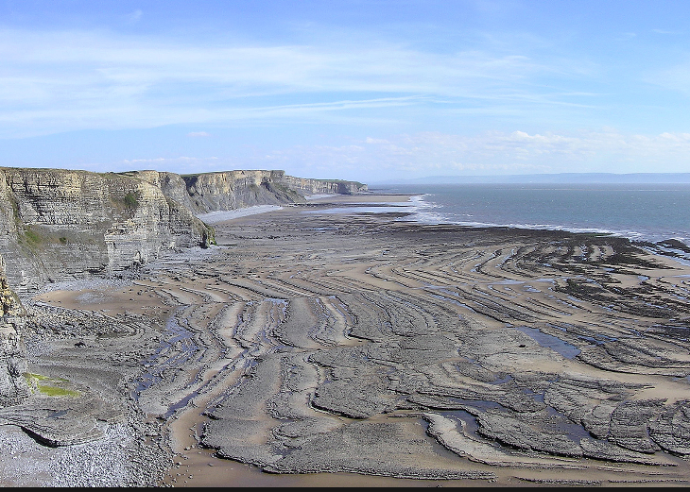
B. WAVES and WATER
Wave Cut terraces – forms a narrow flat area found at the base of a sea cliff or along the shoreline of a body of water created by the erosion of waves.

Slide 13
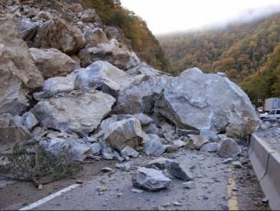
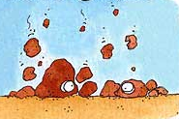
C. GRAVITY
Avalanche or rock slide
Exposes new surfaces for further weathering.
Falling rocks break up other rocks.

Slide 14
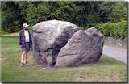
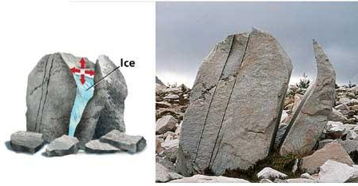
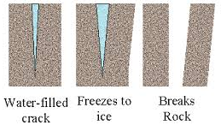
D. ICE WEDGING
  Rocks break because water expands when it freezes.

Slide 15
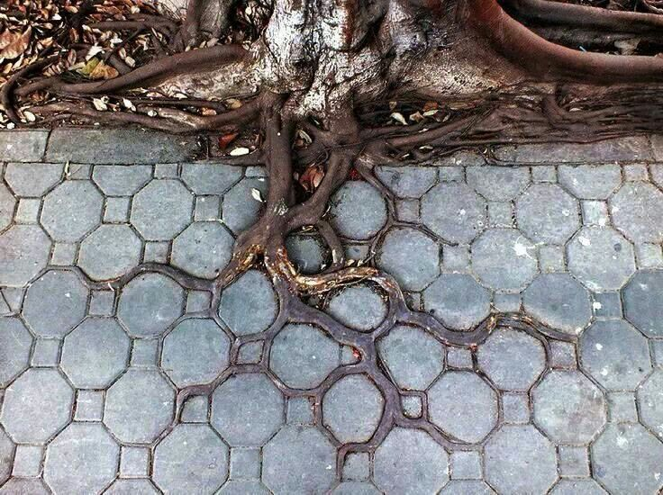
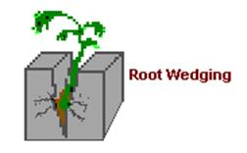
E. ORGANIC ACTIVITY
Root Wedging – plants send out roots for nutrients. These roots can move into smaller spaces and cracks. They eventually grow and can slit the rock apart.

Slide 16
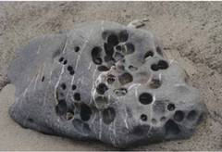
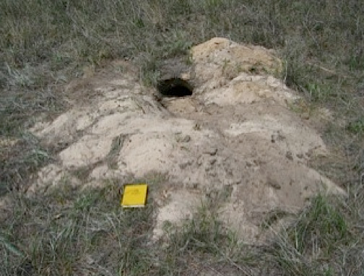
E. ORGANIC ACTIVITY
Animal Burrowing – dig holes and expose new rocks to the effects of weathering. The holes allow water and other weathering agents to reach the rock layer.

Slide 17
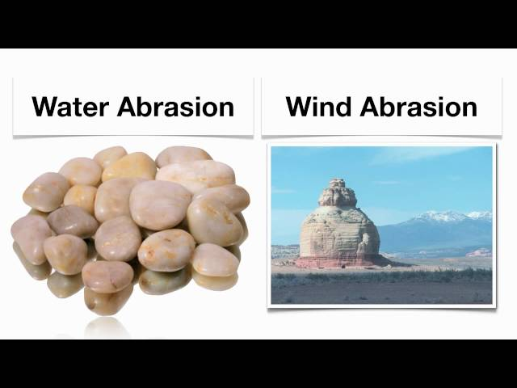
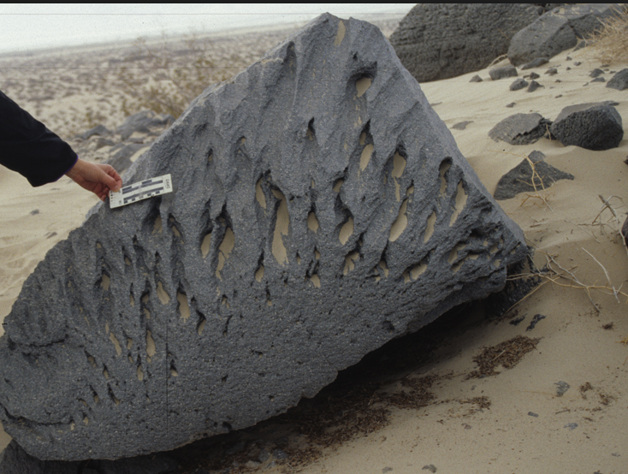
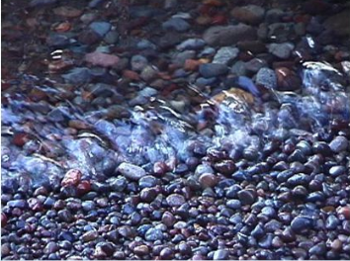
ABRASION and EXFOLIATION
Abrasion – collision of rocks results in breaking and weathering away of rock.
  Agents: running water and wind
  Makes rocks in river beds smooth and rounded.

Slide 18
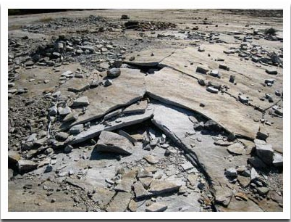
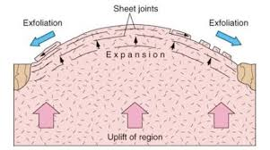
ABRASION and EXFOLIATION
  Exfoliation – rock breaks into curved sheets that peel away from underlying rock.
    Agents: pressure released, water

Slide 19
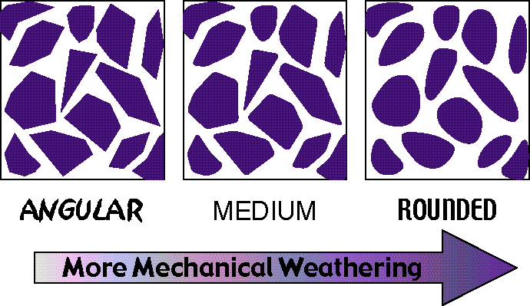
WEATHERING OVER TIME

Slide 20
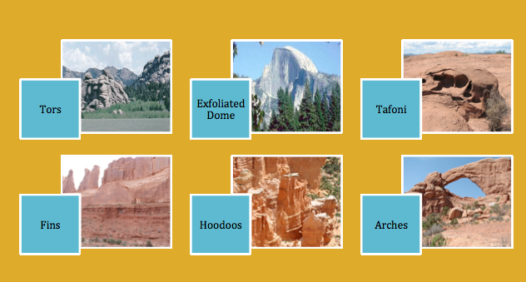
WEATHERING CREATES LANDFORMS
A landform is a natural feature of the Earth’s surface.

Slide 21
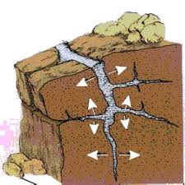
REVIEW
In ice wedging, why do the cracks in the rock get wider?
A. Plants get in with the ice and expand the rock.
B. Acids in the rainwater dissolve the rock when the water freezes.
C. Ice expands when it freezes.
D. Minerals in the rock react with the oxygen in the ice.

Slide 22

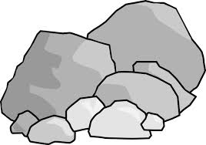
LAB
Mechanical Weathering:
Weathering and Wind Abrasion
Weathering & Abrasion Simulation
SES3. Students will explore the actions of water, wind, ice and gravity that create landforms and systems of landforms (landscapes).

Slide 23
LAB
Introduction: The force of the wind can change the surface of the Earth in a small way by removing materials and wearing down rock surfaces. Rocks that are made of soft minerals are broken down when they are hit by wind-blown pieces of sand or smaller particles of rock. Each impact can break off small pieces of the larger rock. In this activity you will explore how the size of rock carried by the wind affects the weathering of a larger rock.

Slide 24
LAB
Procedure:
Line the jar with a piece of the coarse sandpaper.
Measure the mass of one sugar cube on the electronic balance and record its mass in the data table. Draw what it looks like in your data table on the back side of this paper.
Start the stop watch and gently swirl the jar for one minute (enough so the cube inside gently hits the surface).
After one minute, open the jar and gently pour the sugar pieces onto the piece of paper.

Slide 25
LAB
Procedure
Measure the mass of the weathered cube (not the “dust” of sugar) and record this information in the data table. Draw what it looks like now in your data table on the back side of this paper.
Put the weathered sugar cube and the pieces on the paper into the waste cup.
Repeat steps 2 – 6 two more times for a total of three trials.
Remove the coarse sandpaper and replace it with fine-grained sandpaper.

Slide 26
LAB
Procedure
Repeat steps 2 – 6 with the fine-grained sandpaper for a total of three trials, recording the masses in the table each time.
For each trial calculate the amount of the cube that “weathered” by finding the difference between the un-weathered and weathered cubes.
Calculate the average amount of weathering for each type of sandpaper.

Slide 27
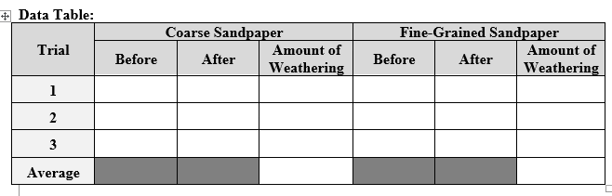
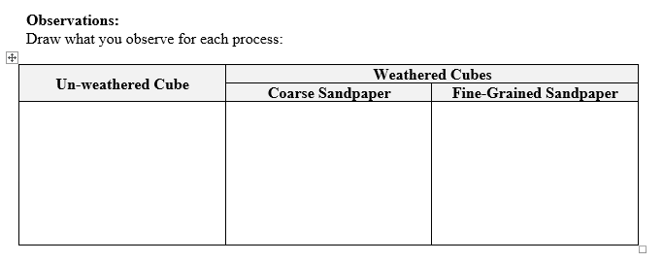
LAB

Slide 28
LAB
Calculating the Average:
Once you gather your data, calculate the averages. Remember to add up the three values and then divide by three.
Then answer the Analysis questions.

Slide 29
TO DO
Lab due Friday
Review #21 due tomorrow.

