Slide 1
DO NOW
Pick up notes
Get out homework handout

Slide 2
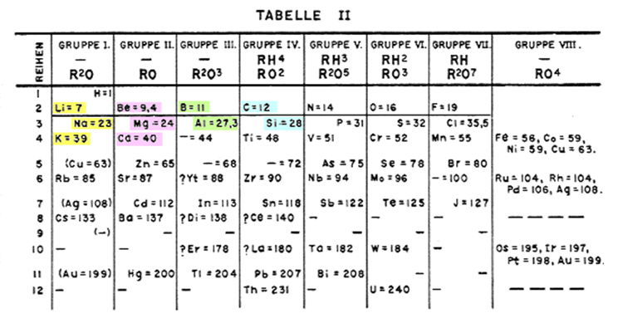
MENDELEEV’S PERIODIC TABLE

Slide 3
A REVIEW
Be sure that you can:
1. Describe the development of the modern periodic table (Mendeleev and Moseley only).
2. State the Periodic Law.
3. Be able to describe elements by their:
period
valence electrons
electron configuration
4. Recognize the divisions of the periodic table into an ‘s’ block, ‘p’ block, ‘d’ block, and ‘f’ block.
5. Be able to predict and write the electron configuration of an element using the periodic table as a guide.

Slide 4
THE PERIODIC LAW
The physical and chemical properties of the elements are periodic functions of their atomic numbers.
Memorize this!

Slide 5
ANOTHER WAY TO LOOK AT THE TABLE
All elements can be divided into three groups:
METALS
NONMETALS
METALLOIDS

Slide 6
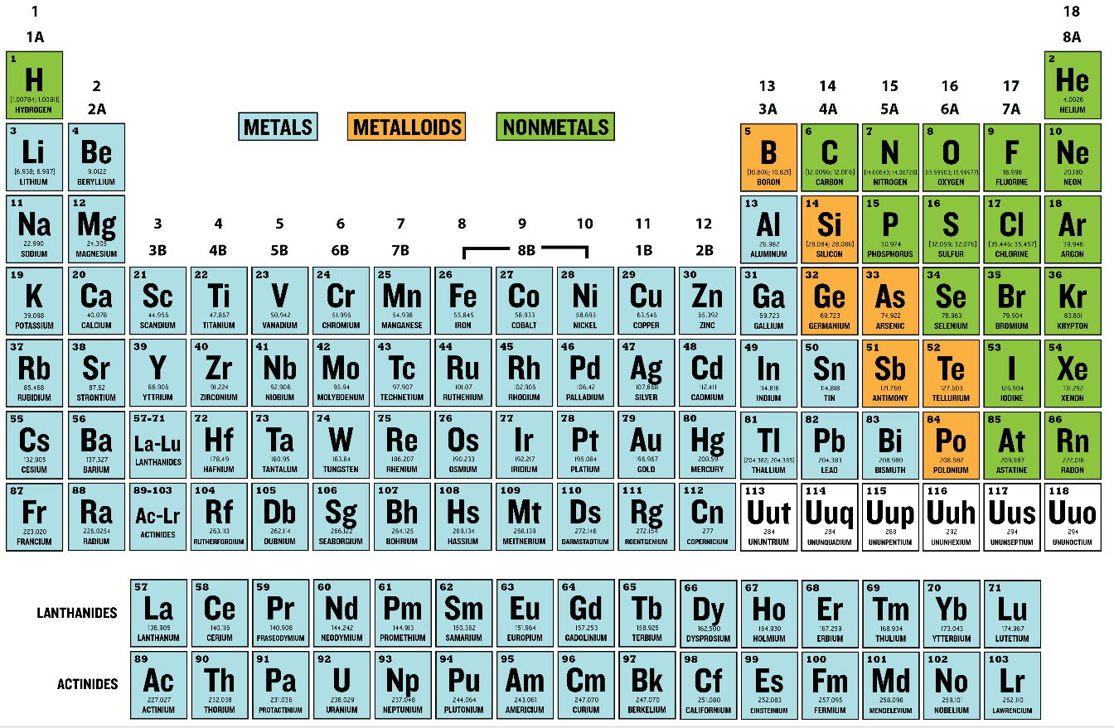
METALS

Slide 7
METALS
located on the left side.
good conductors of heat and electricity.
hard and shiny (not always silver)
can be pounded into different shapes – malleable.
can be drawn into a wire – ductile.
high density, high melting points
react with water and substances in the atmosphere (ex. rusting, tarnishing).

Slide 8
METALS
has only a few electrons in the outer level
most elements are metallic.
General rule:
3 or fewer electrons in outer level are considered to be metals.
Metals have a tendency to lose these electrons when forming compounds.

Slide 9
NONMETALS

Slide 10
NONMETALS
located on the right side (except hydrogen).
poor conductors of heat and electricity (solids are insulators).
brittle solids or gases; one liquid.
dull, shatter easily.
lower density, lower melting points.
not as easy to recognize as a group.

Slide 11
NONMETALS
has more than 4 electrons in the outer level.
General rule:
5 or more electrons in outer level are considered to be nonmetals.
Nonmetals have a tendency to gain electrons when forming compounds.

Slide 12
METALLOIDS
Debatable

Slide 13
METALLOIDS
have properties of metals and nonmetals.
metal-like
Sometimes called semi-metals.
located on either side of the staircase.
all are shiny, white-gray in color.
all are solids.
okay conductors (as in semi-conductors), ductile, malleable.

Slide 14
METALLOIDS
There are six:
Boron, Silicon, Germanium, Arsenic, Antimony, Tellurium
Aluminum, Polonium (debatable), and Astatine are NOT.

Slide 15
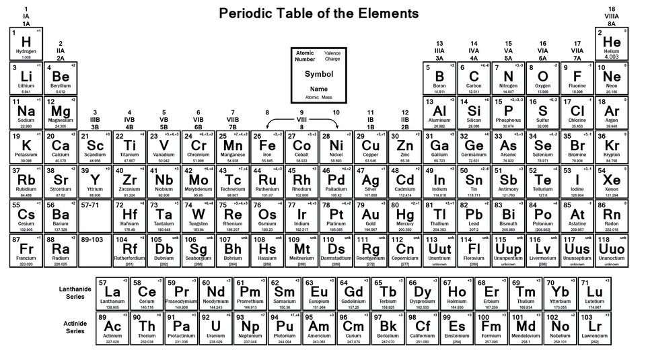
PERIODIC TABLE

Slide 16
WAYS TO DIVIDE UP THE PERIODIC TABLE
1. Period numbers
2. Group numbers
3. Family names
4. Metal, nonmetal, metalloids
5. Phases at room temperature (natural or standard state)
There are 2 liquids: mercury and bromine.
There are 11 gases.
The rest are solids.

Slide 17
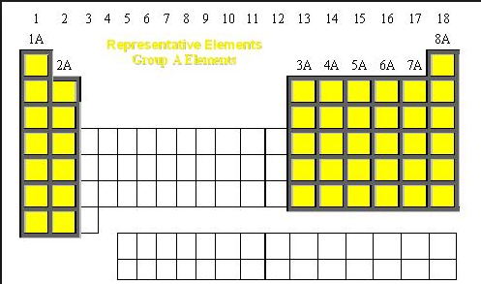
WAYS TO DIVIDE UP THE PERIODIC TABLE
6. Representative elements and Transition (inner) elements
They are called the representative elements because they display a wide range of physical and chemical properties.

Slide 18
A REVIEW
3. Be able to describe elements by their:
metal/nonmetal/metalloid

Slide 19
HOMEWORK
The Periodic Law is due tomorrow.
Lab tomorrow.

