Slide 1
DO NOW
Get out homework handout
Pick up notes.
Turn in Fizz, Fizz if you did not yesterday.

Slide 2
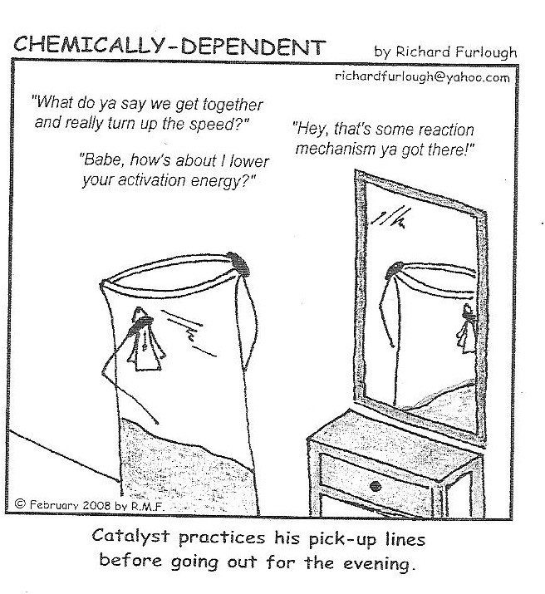

Slide 3
ENERGY IN CHEMICAL RXNS
Remember that particles must collide at a proper orientation in order to react and particles must collide with sufficient energy in order to react.
Energy is required to break the bonds that hold the reactants together. The energy must be present in the reacting particles before a collision.
Most collisions are elastic, but some collisions have enough energy to cause changes in the electron cloud of the colliding molecules.

Slide 4
ENERGY IN CHEMICAL RXNS
Particles of matter have both potential and kinetic energy.
  Potential energy is stored energy. It is present in an atom that is NOT bonded.
  Kinetic energy is the energy of motion. It is required to break the bonds of a molecule. The faster a molecule/atom moves, the more kinetic energy it has.

Slide 5
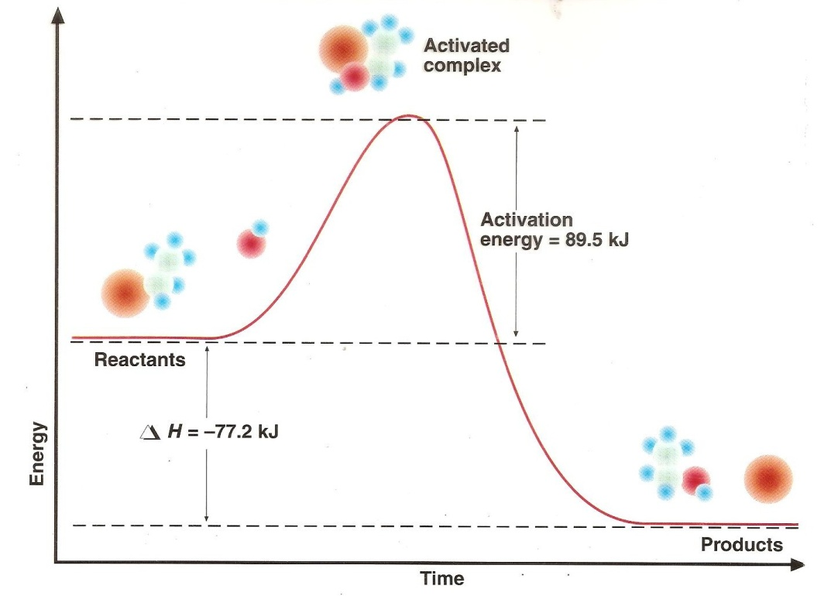
ENERGY IN CHEMICAL RXNS
1. ACTIVATION ENERGY, E_{a -} The energy required to form the activated complex is known as the activation energy.

Slide 6
ENERGY IN CHEMICAL RXNS
Particles must posses a certain minimum amount of energy in order to react.
Even though bonding is more stable in the products than the reactants, energy is required to force the reactants up and over an energy barrier .

Slide 7
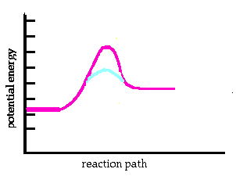
ENERGY IN CHEMICAL RXNS
2. TRANSITION STATE - The brief interval of bond disruption and bond formation once the reactants have enough activation energy and a place where the activated complex is formed.

Slide 8
ENERGY IN CHEMICAL RXNS
3. ACTIVATED COMPLEX: a short-lived structure formed by the colliding molecules. The activated complex exists along the reaction pathway at a point where the energy is the greatest - the transition state.

Slide 9

POTENTIAL ENERGY DIAGRAM

Slide 10
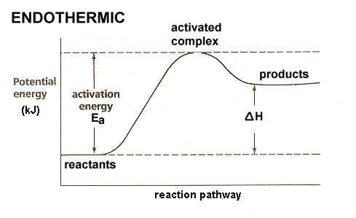
ENERGY IN CHEMICAL RXNS
4. HEAT OF REACTION (ΔH or ΔE) is the energy difference between the reactants and products.

Slide 11
ENERGY IN CHEMICAL RXNS
5. ENDOTHERMIC reactions - the energy of the products is more than the energy of the reactants

Slide 12
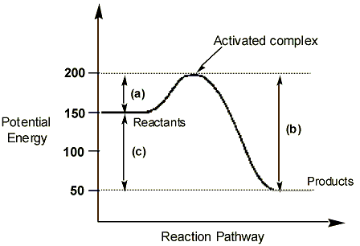
ENERGY IN CHEMICAL RXNS
6. EXOTHERMIC reactions - the energy of the products is less than the energy of the reactants.

Slide 13

ENERGY IN CHEMICAL RXNS

Slide 14
ENERGY IN CHEMICAL RXNS
7. CATALYST – a chemical compound that lowers the activation energy needed for the reaction by carrying the reaction along a different path.
Result of catalyst

Slide 15
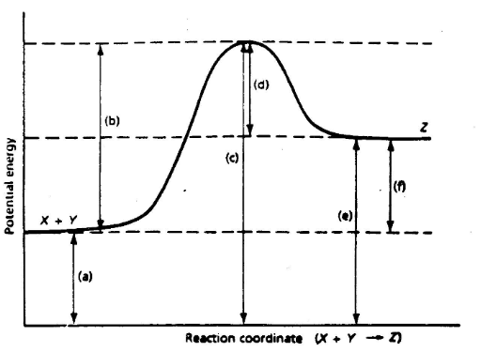
POTENTIAL ENERGY DIAGRAM

Slide 16
TO DO
Handout is due tomorrow

