Slide 1
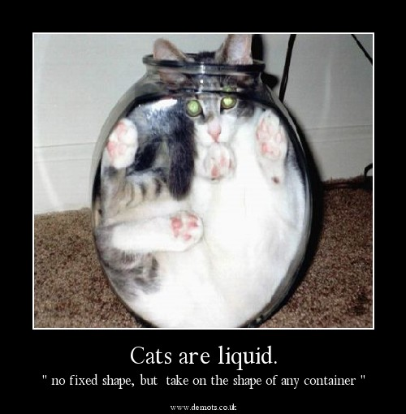
DO NOW
Pick up notes.
Get out yesterday’s notes.
Turn in “Turn up the Heat” if you did not do so yesterday.

Slide 2
KINETIC-MOLECULAR THEORY
State the three parts o the Kinetic-Molecular Theory.
How are temperature and heat different?
If temperature increases, what happens to the energy of the particles?
Define absolute zero.
What temperature is absolute zero? _________ K and ____________ °C

Slide 3
KINETIC-MOLECULAR THEORY
Convert the following temperatures using the formula K = °C + 273.
a. 247 K = _________ °C d. -173°C = ___________ K
b. 628 K = _________ °C e. 107°C = ___________ K
c. 125 K = _________ °C f. 273°C = ___________ K

Slide 4
Phases of matter
The phase of matter is determined by two things:
1. Temperature (kinetic energy) of the particles.
2. Intermolecular Force of Attraction (IMFs) – these are the forces between molecules.
a. Dispersion forces
b. Dipole-dipole forces
c. Hydrogen bonds

Slide 5
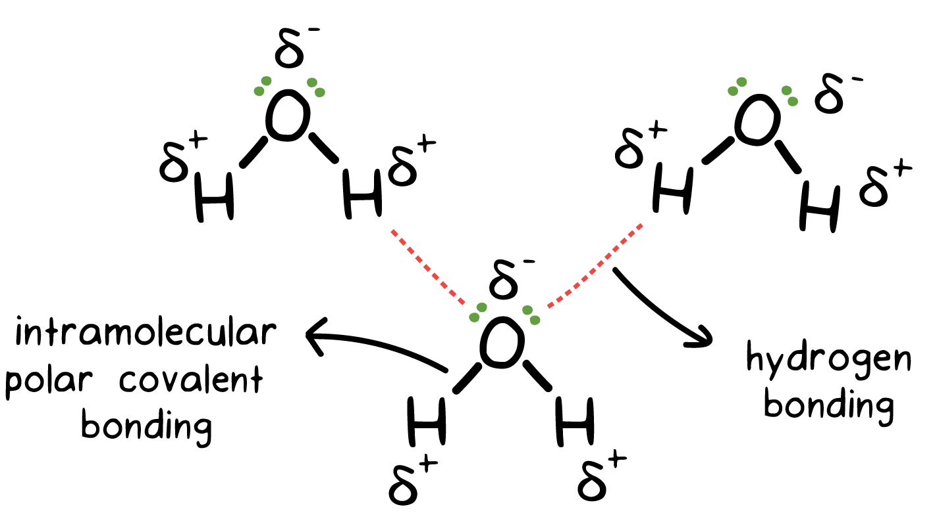
Phases of matter
All INTERmolecular forces are weaker than INTRAmolecular forces which are true bonds (ionic, covalent, metallic).

Slide 6
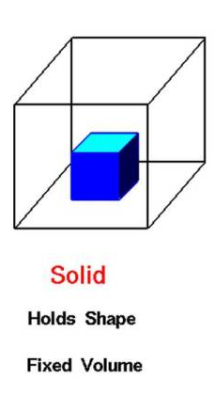
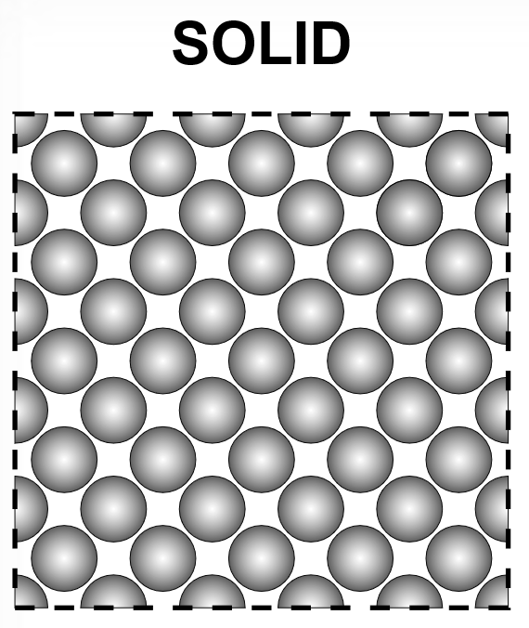
Phases of matter
Characteristics of the Phases of Matter - SOLID
definite rigid shape, definite volume, strong IMF, particles are in a fixed position, and vibrate around a fixed point.

Slide 7
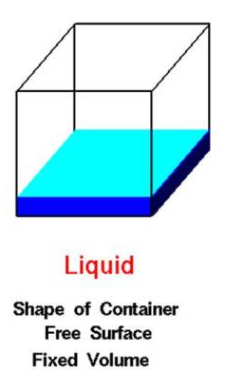
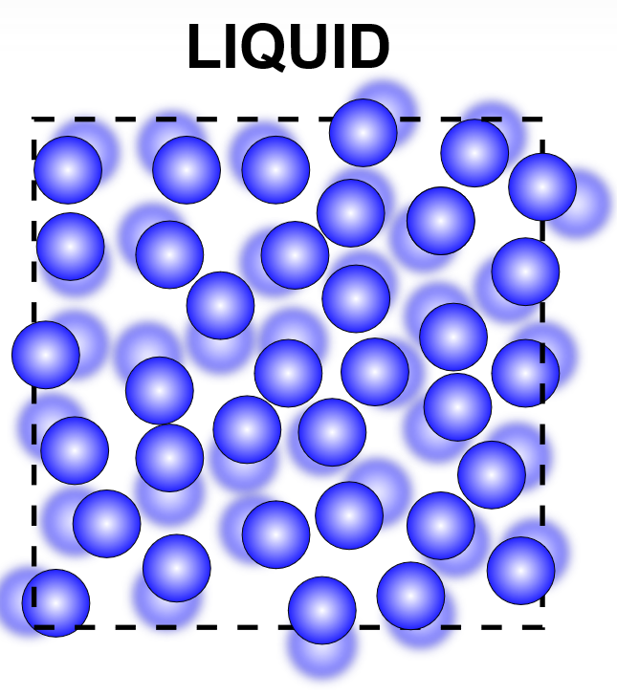
Phases of matter
Characteristics of the Phases of Matter - LIQUID
no definite shape, definite volume, strong IMF, particles can flow past each other but cannot break away completely.

Slide 8
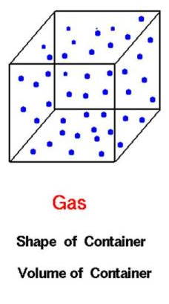
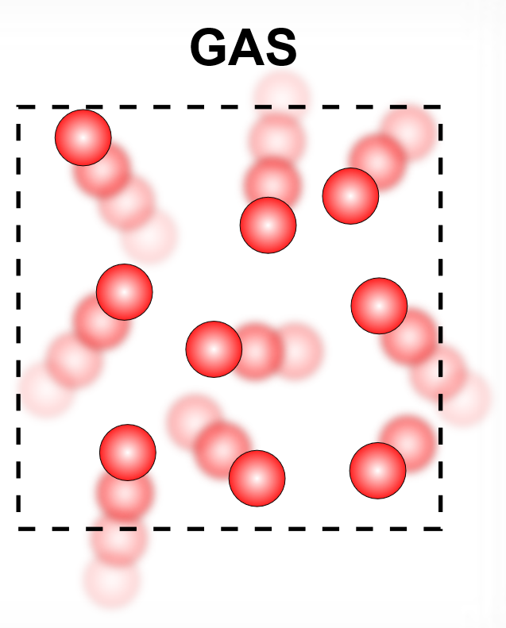
Phases of matter
Characteristics of the Phases of Matter - GAS
no definite shape, no definite volume, very weak IMF, particles are independent of each other and go wherever they want inside their container. Another word for gas is vapor.

Slide 9
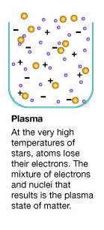
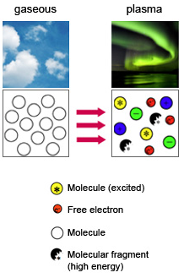
Phases of matter
Characteristics of the Phases of Matter - PLASMA
no definite shape, no definite volume, composed of electrons and positive ions. The electrons have been knocked away from the atoms due to the high temperatures. Most common state of matter in the universe.

Slide 10
Drawing matter
Looking at the boxes below and pretend that they are beakers sitting on a counter. Show what the atoms of a solid, liquid, and gas would look like in each.
SOLID LIQUID GAS

Slide 11
ACTUALLY SIX PHASES OF MATTER
Solid
Liquid
Gas
Plasma
Bose-Einstein Condensate
Fermionic Condensate

Slide 12
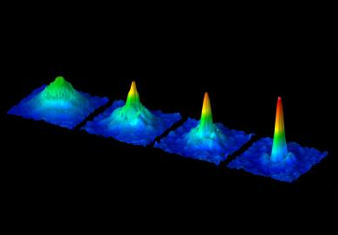
Bose-Einstein condensate
A Bose–Einstein condensate (BEC) is a state of matter of a dilute gas of bosons cooled to temperatures very close to absolute zero.

Slide 13
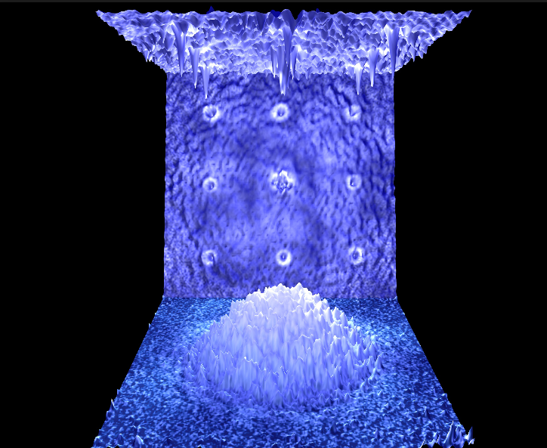
FERMIONIC CONDENSATE
A fermionic condensate is a superfluid phase formed by fermionic particles at low temperatures.

Slide 14
INTERMOLECULAR FORCES
Dispersion Forces – weakest
Dipole-Dipole Forces
Hydrogen Bonding - strongest

Slide 15
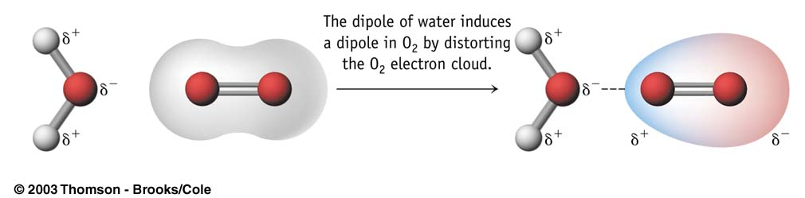
Dispersion Forces
a weak force that results in the attraction of normally non-polar particles;
the weakest intermolecular force;
when nonpolar molecules collide with each other, a temporary dipole is created; The more electrons in the electron cloud, the stronger the dispersion force.
Examples: H₂, Cl₂, I₂

Slide 16
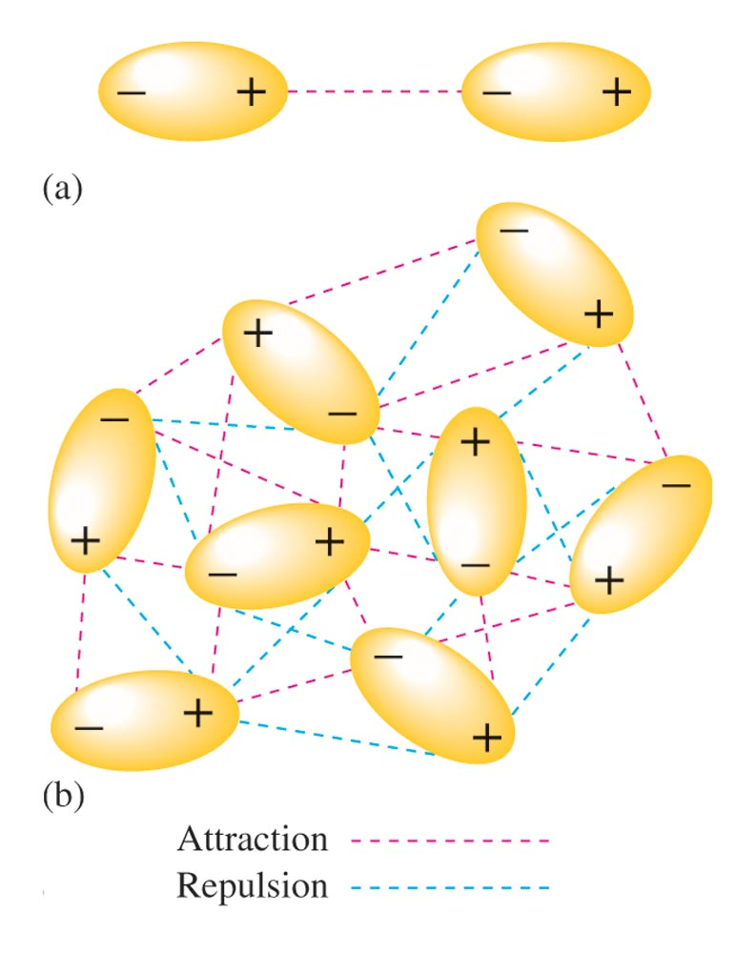
Dipole-dipole forces
attractions between oppositely charged regions of polar molecules;
polar molecules have permanent dipoles due to the fact that some regions are always positive and some regions are always negative;
these forces are stronger than dispersion forces if looking at particles of the same mass.
Examples: HCl, SO₂

Slide 17
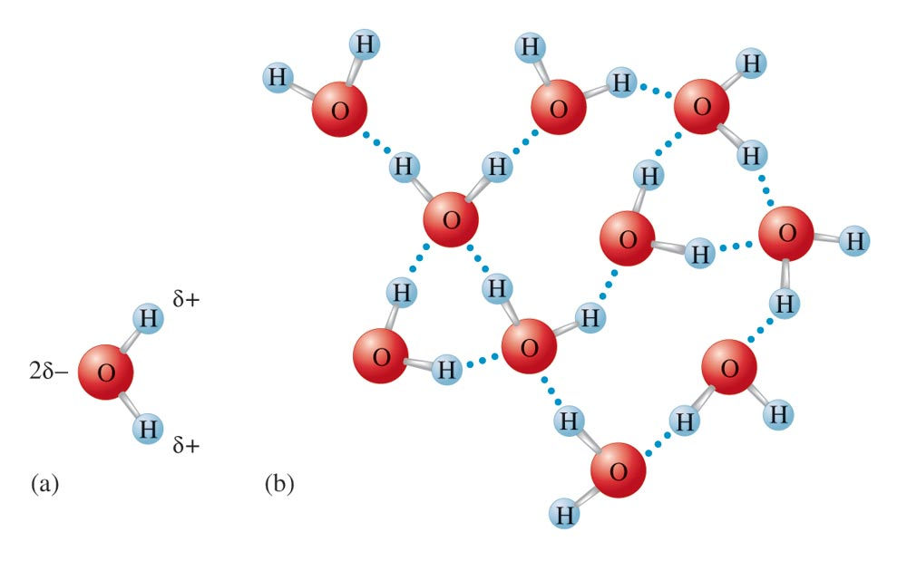
Hydrogen bonding
A special dipole-dipole attraction;
occurs when the molecule contains hydrogen and the hydrogen is covalently bonded to a highly electronegative atom (only F, O, N);
The molecule is highly polar;
Molecules have higher than expected boiling points (strong IMF).
Examples: water, H₂O, ammonia, NH₃

Slide 18
INTERMOLECULAR FORCES
Strongest – Hydrogen bonding
Weakest – dispersion forces
Permanent Dipoles: Dipole-dipole, hydrogen bonding
Temporary dipole: dispersion forces

Slide 19
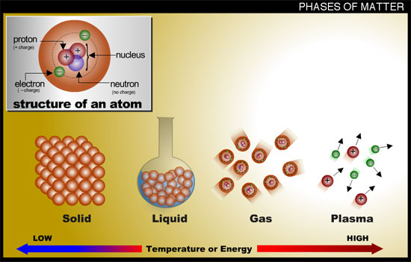
THREE PHASES
Syringes of:
Georgia red clay
Water
Air

Slide 20
MORE ON solids
Why is a Solid a Solid?

Slide 21
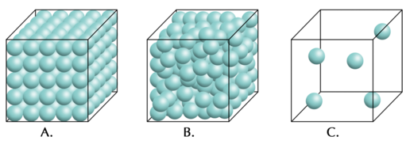
MORE ON SOLIDS
Density – more closely packed than a liquid, thus they are denser; Usually a 10% difference between the solid and liquid density of the same substance; Water is the exception.
Compression – not easily compressed.

Slide 22
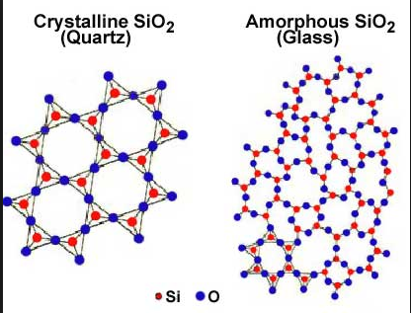
MORE ON SOLIDS
Amorphous solids – a solid where the particles are not arranged in a crystalline pattern; often forms when a molten (melted solid) cools too quickly to allow time for the crystals to grow; examples include glass, rubber, and many plastics.

Slide 23
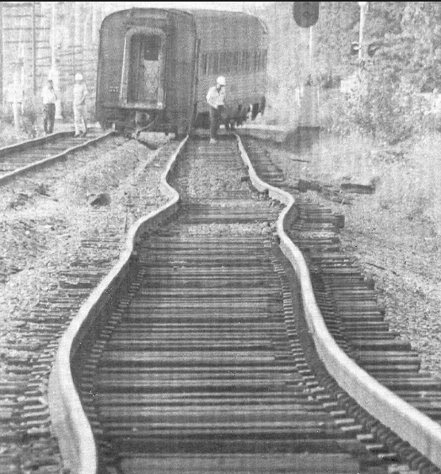
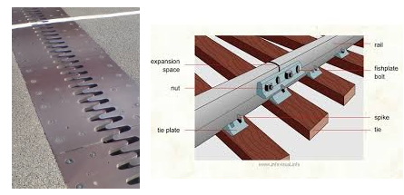
MORE ON SOLIDS
Thermal Expansion – most solids experience thermal expansion. Thermal Expansion is when objects are heated, they expand. When they are cooled, they contract. Example: joints in bridges, driveways, and roads.

Slide 24
More on LIQUIDS
Density – denser than gases.
Compression – enormous pressure can make liquids compress a small amount.

Slide 25
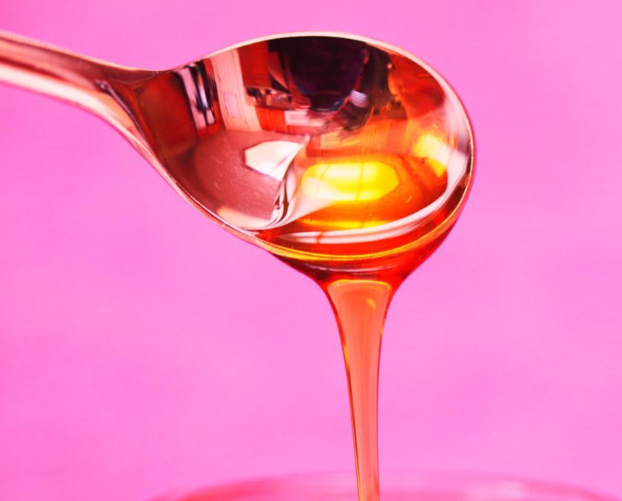
More on LIQUIDS
Fluidity – ability to flow; gases and liquids are fluids because they can flow through each other. Liquids are slower to diffuse than gases. Diffusion is the spreading of particles throughout a given volume until they are evenly distributed.

Slide 26
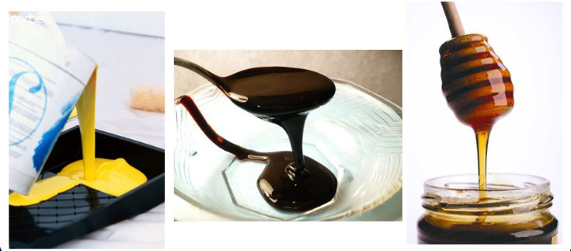
More on LIQUIDS
Viscosity Derby
Viscosity – a measure of the resistance of a liquid to flow; determined by the intermolecular forces, shape of particles, and temperature.

Slide 27
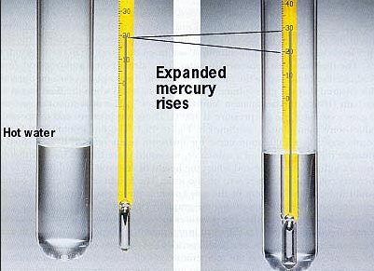
More on LIQUIDS
Thermal Expansion – liquids experience more thermal expansion than solids. Example: thermometers

Slide 28
MORE ON LIQUIDS
Surface tension – the energy required to increase the surface area of a liquid by a given amount;
It is a measure of the inward pull by particles in the interior;
The stronger the particle’s attraction for each other, the stronger the surface tension;
Water has a high surface tension due to the attractive forces of the water molecules;
Surfactants reduce surface tension.

Slide 29
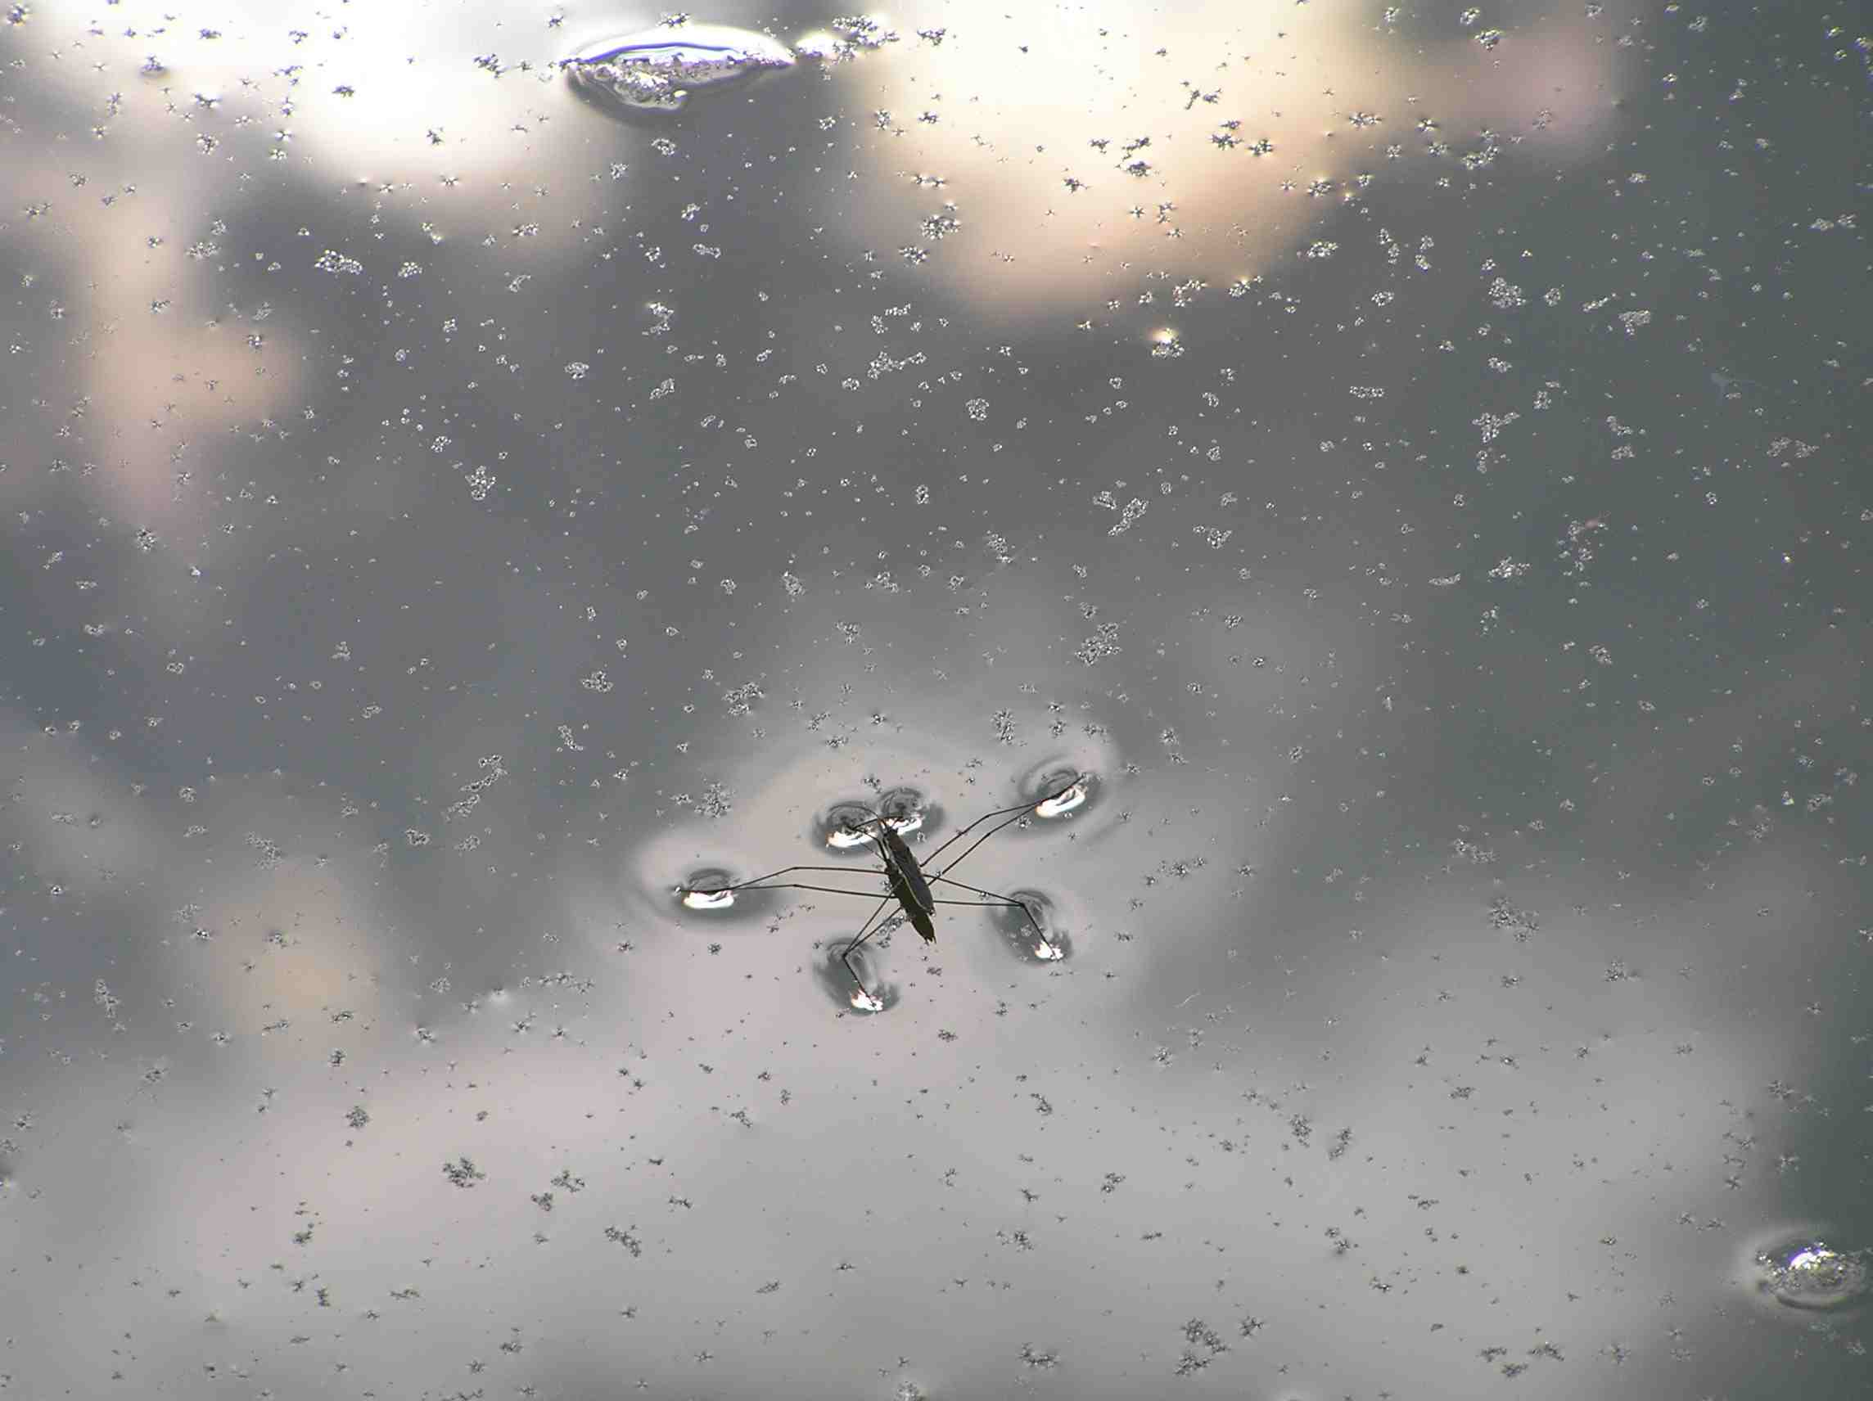
Surface tension

Slide 30
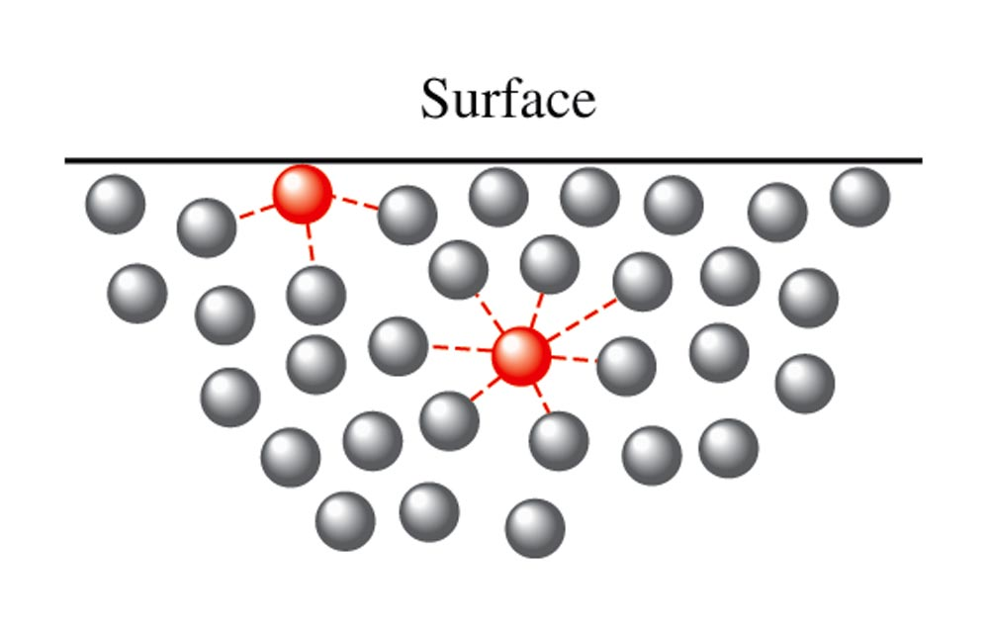
Surface tension

Slide 31
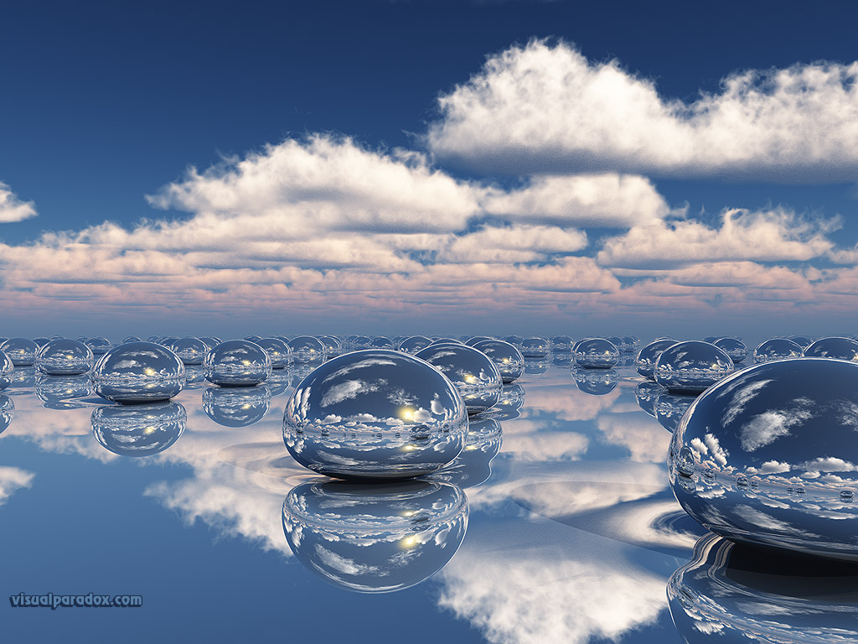
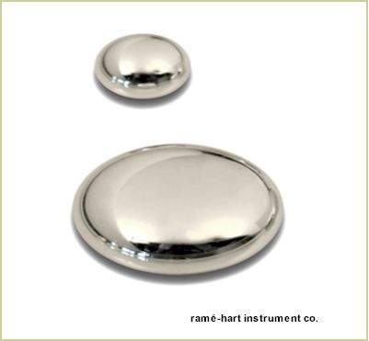
Mercury bead

Slide 32
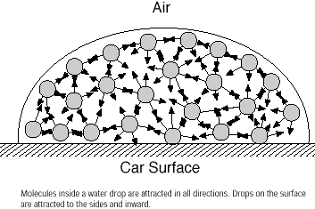
Water bead

Slide 33
MORE ON LIQUIDS
Capillary Action – the adhesion or attraction between molecules that are different;
Can cause the meniscus in the graduated cylinder or the wicking property of paper towels.
Cohesion = attraction to each other.
Adhesion = attraction to another.

Slide 34
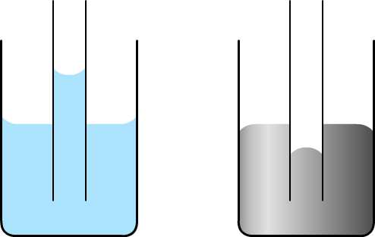
CAPILLARY ACTION
ADHESION
COHESION
WATER
MERCURY

Slide 35
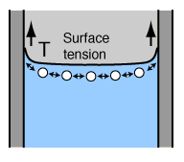
Capillary action

Slide 36
MORE ON GASES
Density – very low density.
Compression – gases are easy to compress. There are a lot of spaces between the particles.

Slide 37
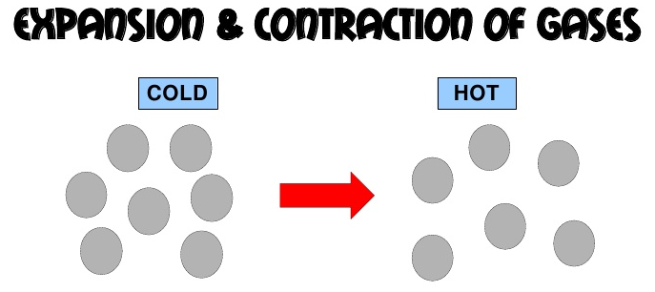
MORE ON GASES
Fluidity – ability to flow; gases and liquids are fluids because they can flow through each other. Gases diffuse faster than liquids.
Thermal Expansion – gases experience more thermal expansion than solids and liquids. Example: hot air balloons

Slide 38
TO DO
Do Review and Reinforcement: States of Matter – due Monday.

